Slide 1

The following resources are designed to complement the GCSE and A-Level curriculum in Geography regarding coastal landscapes and processes, with reference to biodiversity, changing weather and climate. They should also assist in the understanding of field work techniques, data analysis and enquiry. This PowerPoint and associated resources are intended to be used as a project spanning several lessons, with differentiation for different ability students. Further information for teacher planning is provided in an accompanying Word document.
These resources have been produced in association with the NERC-RESIST project by Clare Sydney.
Further information about the project can be found: https://www.nerc-resist.uk/ or via the videos https://www.youtube.com/watch?v=4ZoPBfm2aBY and https://www.youtube.com/watch?v=P9m7vAdqsWc
Please contact Clare via her LinkedIn profile to discuss teaching resource development: https://uk.linkedin.com/in/clare-sydney-96364b47

Slide 2

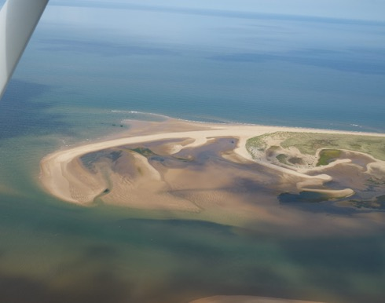
The RESIST Project and Salt Marshes
Do it now!
1. What is a coast?
2. Name the 2 main types of coast and give an example of each?
3. How are coasts changing and why?
Extension: why would it be important to manage and study coastal formations?
Aerial image of Scolt Head Island Norfolk: G. Fuller
Prepare for learning

Slide 3
Learning outcomes
Understand how coastal landscapes are influenced by geology interacting with physical processes: to form salt marshes/marshland with examples of these in the U.K
Understand how humans, weather and climate change are altering these environments
Understand how elements of the marshland ecosystem are dependent on each other
Discuss how fieldwork can help us to explore, understand and influence changes to coastal environments
Understand how physical processes work together with biological processes to produce and maintain coastal land forms
Agree learning outcomes
Notes:
How project/resource will relate to - Specification points

Slide 4
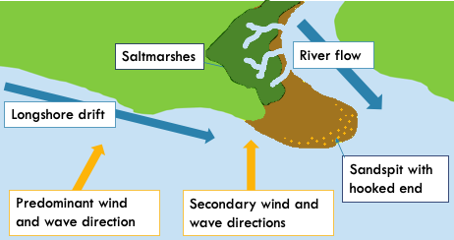
Look at the diagram below and copy the information in the red box.
A spit is a type of depositional landform which forms when there is a change in the shape of the landscape or there is a river mouth. This leads to an extended stretch of sand or shingle jutting out into the sea from the land.
Sketch out the diagram, and make notes as your teacher explains the process
Extension: Can you explain how the salt marsh forms?
Present new information

Slide 5
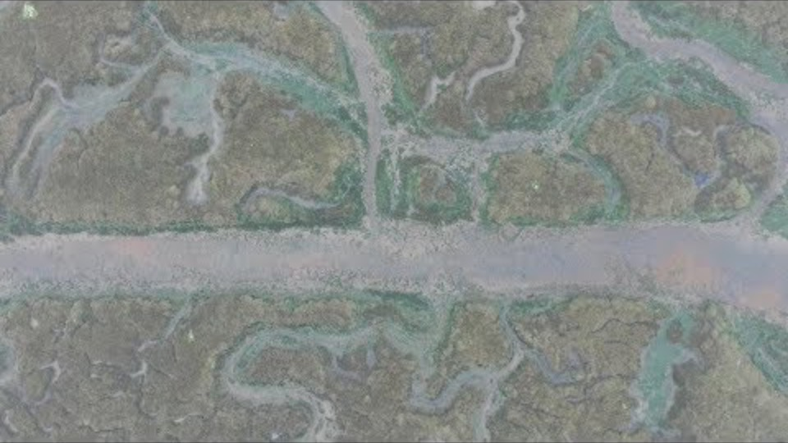
Watch the video and answer the questions below
What shapes our coastline?
What accumulates close to the shore in salt marsh formation?
Where are marshes likely to form?
What are 3 useful things these coastal zones do?
Why are coastal wetlands and salt marshes under threat?
Why is this a problem for UK coastlines?
What makes study of salt marshes difficult?
Extension: What links can you make between human activity and changing coastlines? Why is this a problem for biodiversity?
Construct meaning
Notes:
https://www.youtube.com/watch?v=4ZoPBfm2aBY

Slide 6
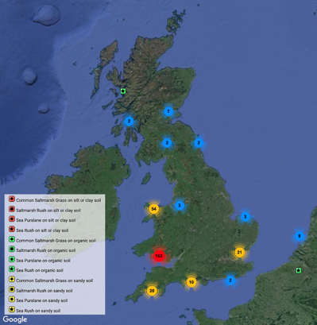
Salt Marshes
Salt marshes are formed on low-lying coastal areas as a result of deposition. These dynamic coastal ecosystems flood periodically with the tide and as more deposition occurs, their surface gains height. Most of the time, salt marshes represent low wave energy tidal environments which become areas of high biodiversity: animal and plant life.
The image opposite is taken from an app collecting information on salt marshes in the UK. What changes to our coasts mean is it important to monitor salt marshes? Why are they occurring?
What is meant by the term ‘dynamic’?
Image: https://www.saltmarshapp.com/
Present new information

Slide 7


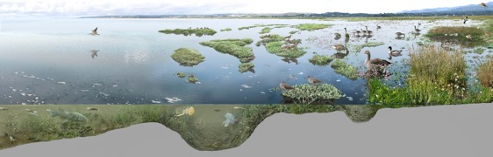
Formation of Salt Marshes
Salt marshes are complex in their formation, and are subject to many interacting factors including geology, biology and marine processes
Annotate your diagram as your teacher describes the processes of deposition, vegetation succession, and establishing and supporting wildlife
Points to discuss:
Why is the plant life important?
How can humans interact with coasts (both directly and indirectly) to contribute to their:
  Formation?
  Destruction?
  Protection?
Illustration by @tonixlobet
Construct meaning

Slide 8



Formation of Salt Marshes
vegetation succession (time)
submerged zone
tidal inlet mudflats
low marsh
high marsh
marsh uplands
sea rushes & reeds
sea lavenders
trees & shrubs
eel grass
cord grass
spring high tide
algae
mean high tide
decreasing salinity
greater soil fertility
reduced sea water flooding
low tide
Construct meaning
Notes:
https://www.lowermarshfarm.com/salt-marsh-important-habitat/
https://www.youtube.com/watch?v=NDT3osjum_I

Slide 9
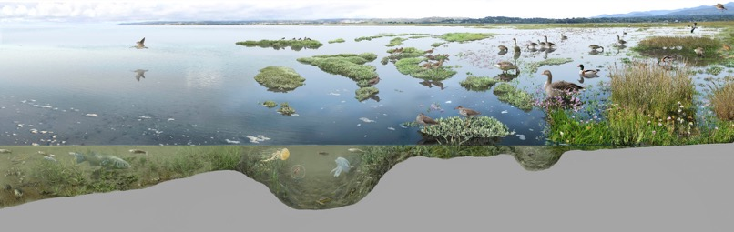
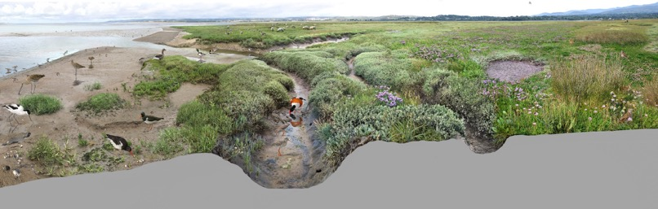
Illustration by @tonixlobet
Illustration by @tonixlobet

Slide 10
Watch the rest of the video from the RESIST project
What do you think of the ways the team addressed the challenges we discussed?
List the main findings from the project
What could be the next steps for the team?
Apply to demonstrate
Notes:
https://www.youtube.com/watch?v=4ZoPBfm2aBY

Slide 11
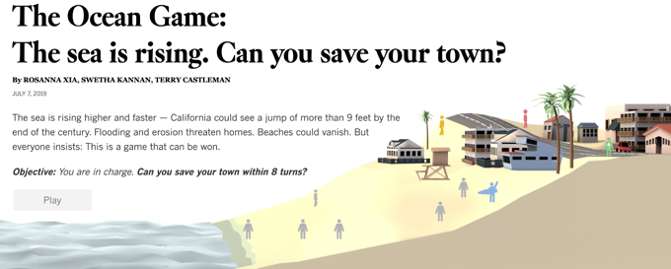
Community and Coasts: what are the challenges of adapting to change?
Many communities are facing the reality of having to adapt to sea level rise.
With your partner, discuss some ways we can preserve communities, and manage or protect our coasts?
As a class, play The Ocean Game developed with input from coastal scientists, planning departments, homeowners and environmentalists.
Present new information
Notes:
https://www.latimes.com/projects/la-me-climate-change-ocean-game/

Slide 12
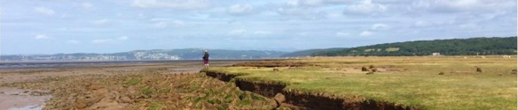
Managed Retreat
RESIST team at Warton Sands, Morecombe Bay
In the UK, this management method is used to improve coastal stability and adapt to changing coastal conditions. Managed retreat complements artificial coastal defences with natural coastal landforms, protecting the land.
Advantages
Cheaper than paying for sea defences as areas of low land value
Salt marshes are a natural defence against erosion and flooding
Salt marshes are diverse ecosystems with high biodiversity preserving habitats
Disadvantages
Land is lost to coastal marshes
Landowners need to be compensated
Sites need to be monitored to determine how effective MR is
Present new information

Slide 13
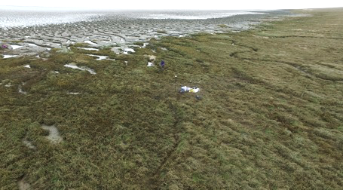
Fieldwork
Look at the statements. Discuss with your partner and make notes:
Why?
How could you address this?
2. “It is essential we understand the processes by which our salt marsh coastlines are under threat”
1. “Study of salt marshes is difficult”
3. “Tourism and industry are important but can be a big problem for marshland”
4. “As sea levels rise the marshes are being ‘squeezed’”
Aerial image of the RESIST team conducting fieldwork
Construct meaning

Slide 14
Studying Salt Marshes
There are lots of methods for studying coastal change. It is important to consider the most appropriate, accurate and reliable equipment and data collection methodology in each coastal change scenario.
Coasts are dynamic and constantly changing and evolving.
Monitoring the morphological, sedimentological and biological changes to our coasts is important for understanding how they can best be preserved, managed and protected, as well as how effective MR programmes are.
Discuss some options as a group. Can you list 3 examples for each of the below? Do you know how to collect data, review and use each method? Are they Quantitative or Qualitative?
Primary data collection
1.
2.
3.
Secondary data collection
1.
2.
3.
Equipment or resources required
1.
2.
3.
Construct meaning

Slide 15
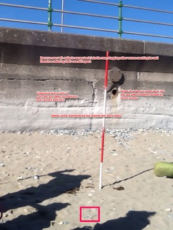
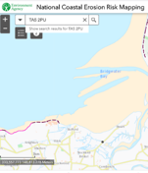
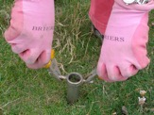
Coastal Fieldwork
Below are some images demonstrating methods for studying coastal change. Talk some methods through with your teacher: do you understand each method? What are the advantages/disadvantages?
Quantitative: Beach profiling with clinometer, measuring sediment size and roundness with calipers and index charts, recording location with GIS/GPS, sampling with corer or dibber
Qualitative: field sketching/photography to observe, describe, explain, link; bipolar studies, questionnaires
Images from Field Studies Council website, Environment agency and Saltmarsh App
Construct meaning
Notes:
https://www.geography-fieldwork.org/gcse/coasts/coastal-processes/fieldwork/

Slide 16

How would you research and monitor changes to our salt marshes?
Using the site information and planning sheets, construct a plan, including field sketch and a pitch, for your teacher to take the class to study a coastal salt marsh or coastal area. Consider the below questions in your plan, and the flow diagram for conducting fieldwork.
Hypothesis or Enquiry Question
The RESIST team have given us information on some sites of interest in the UK
Method
Data Collection
Which site have you chosen and why?
Secondary data and resources: What platforms and processes could you use to study the site and collect data remotely?
What risks are there?
Primary data: How will you conduct the fieldwork?
How will you present your findings?
How can you persuade your teacher to take you to this site? What are the main influences to consider?
Data presentation and analysis
Conclusion
Evaluation
Apply to demonstrate

Slide 17
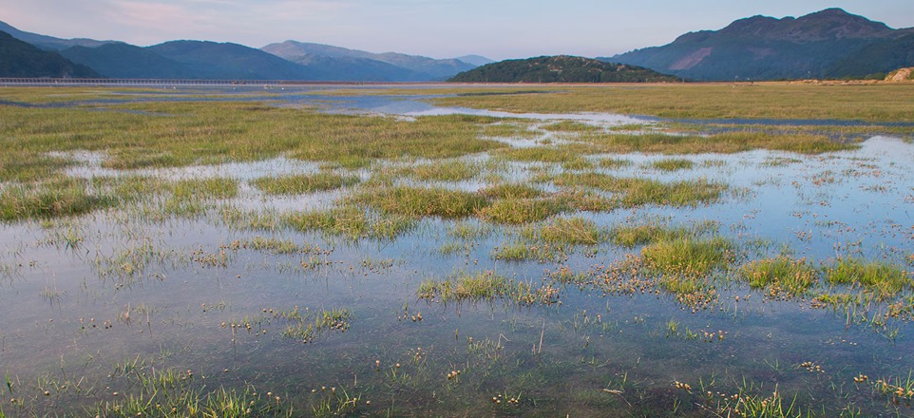

Presentations
As the other groups present on their chosen coast, listen carefully and write down:
Two things they did well
One way they could improve
One question you have about their pitch, the site they chose, or the data they are planning to collect
Points to consider:
Which site did they chose and why?
Secondary data and resources: What platforms and processes did they look at?
What risks have they considered?
Primary data: How will they conduct the fieldwork?
How are they going to present their findings?
How are they persuading you to go to this site?
Did they include all the points?
Did they consider the risks?
Did they choose suitable field work techniques?
Image from CoastWeb by Jordi Pagès Fauria
Apply to demonstrate

Slide 18
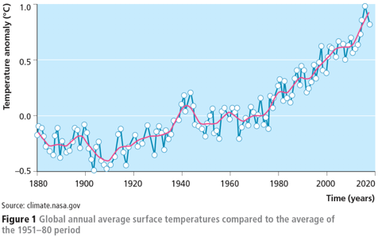
Case Study and Exam Practice
Watch the latest video of the research from the RESIST team.
In an exam, you may be asked to interpret and describe a data set. Use the RESIST teams work on salt marshes and the graph below and complete the exam style questions opposite.
Describe the trends shown in the data set [3 marks]
Suggest one reason for this [1 mark]
Explain what impact this will have on global sea levels [2 marks]
How will this effect coastal areas in the UK?
Apply to demonstrate
Notes:
https://www.youtube.com/watch?v=P9m7vAdqsWc

Slide 19
Case Study and Exam Practice
Watch the latest video of the research from the RESIST team.
1. Title of fieldwork enquiry: [1 mark]
Explain why the chosen location was suitable for the data collection. [2 marks]
In an exam, you may be asked to describe a fieldwork enquiry you conducted. Using the RESIST teams work on salt marshes as an example, complete the exam style questions opposite.
Justify one primary data collection method used in this fieldwork [3 marks]
Explain how data presentation helped interpret the results [3 marks]
Use the transcript from the video to help.
How could the team expand on their results and conclusions? [2 marks]
Apply to demonstrate
Notes:
https://www.youtube.com/watch?v=P9m7vAdqsWc

Slide 20
Exit ticket
Coastal marsh land is a type of …………. coast formation
Salt marshes trap and bury which element; that can lead to global warming?
What is one reason coastal marshes are difficult to study?
How did the RESIST team study the changes to marshes?
Name one primary data collection method and one secondary source
Review

