Slide 1

Writeup
Learning Goals
To reflect on the data collected in the field.
To present data in a different format.
To analyse the data being shown.

Slide 2
Reflection
Thinking about collecting the data for your fieldwork, use the sticky notes to write down:
  What worked well (WWW)
  Even better if (EBI)
  Next time (what you would do differently if you were to do the data collection again).

Slide 3
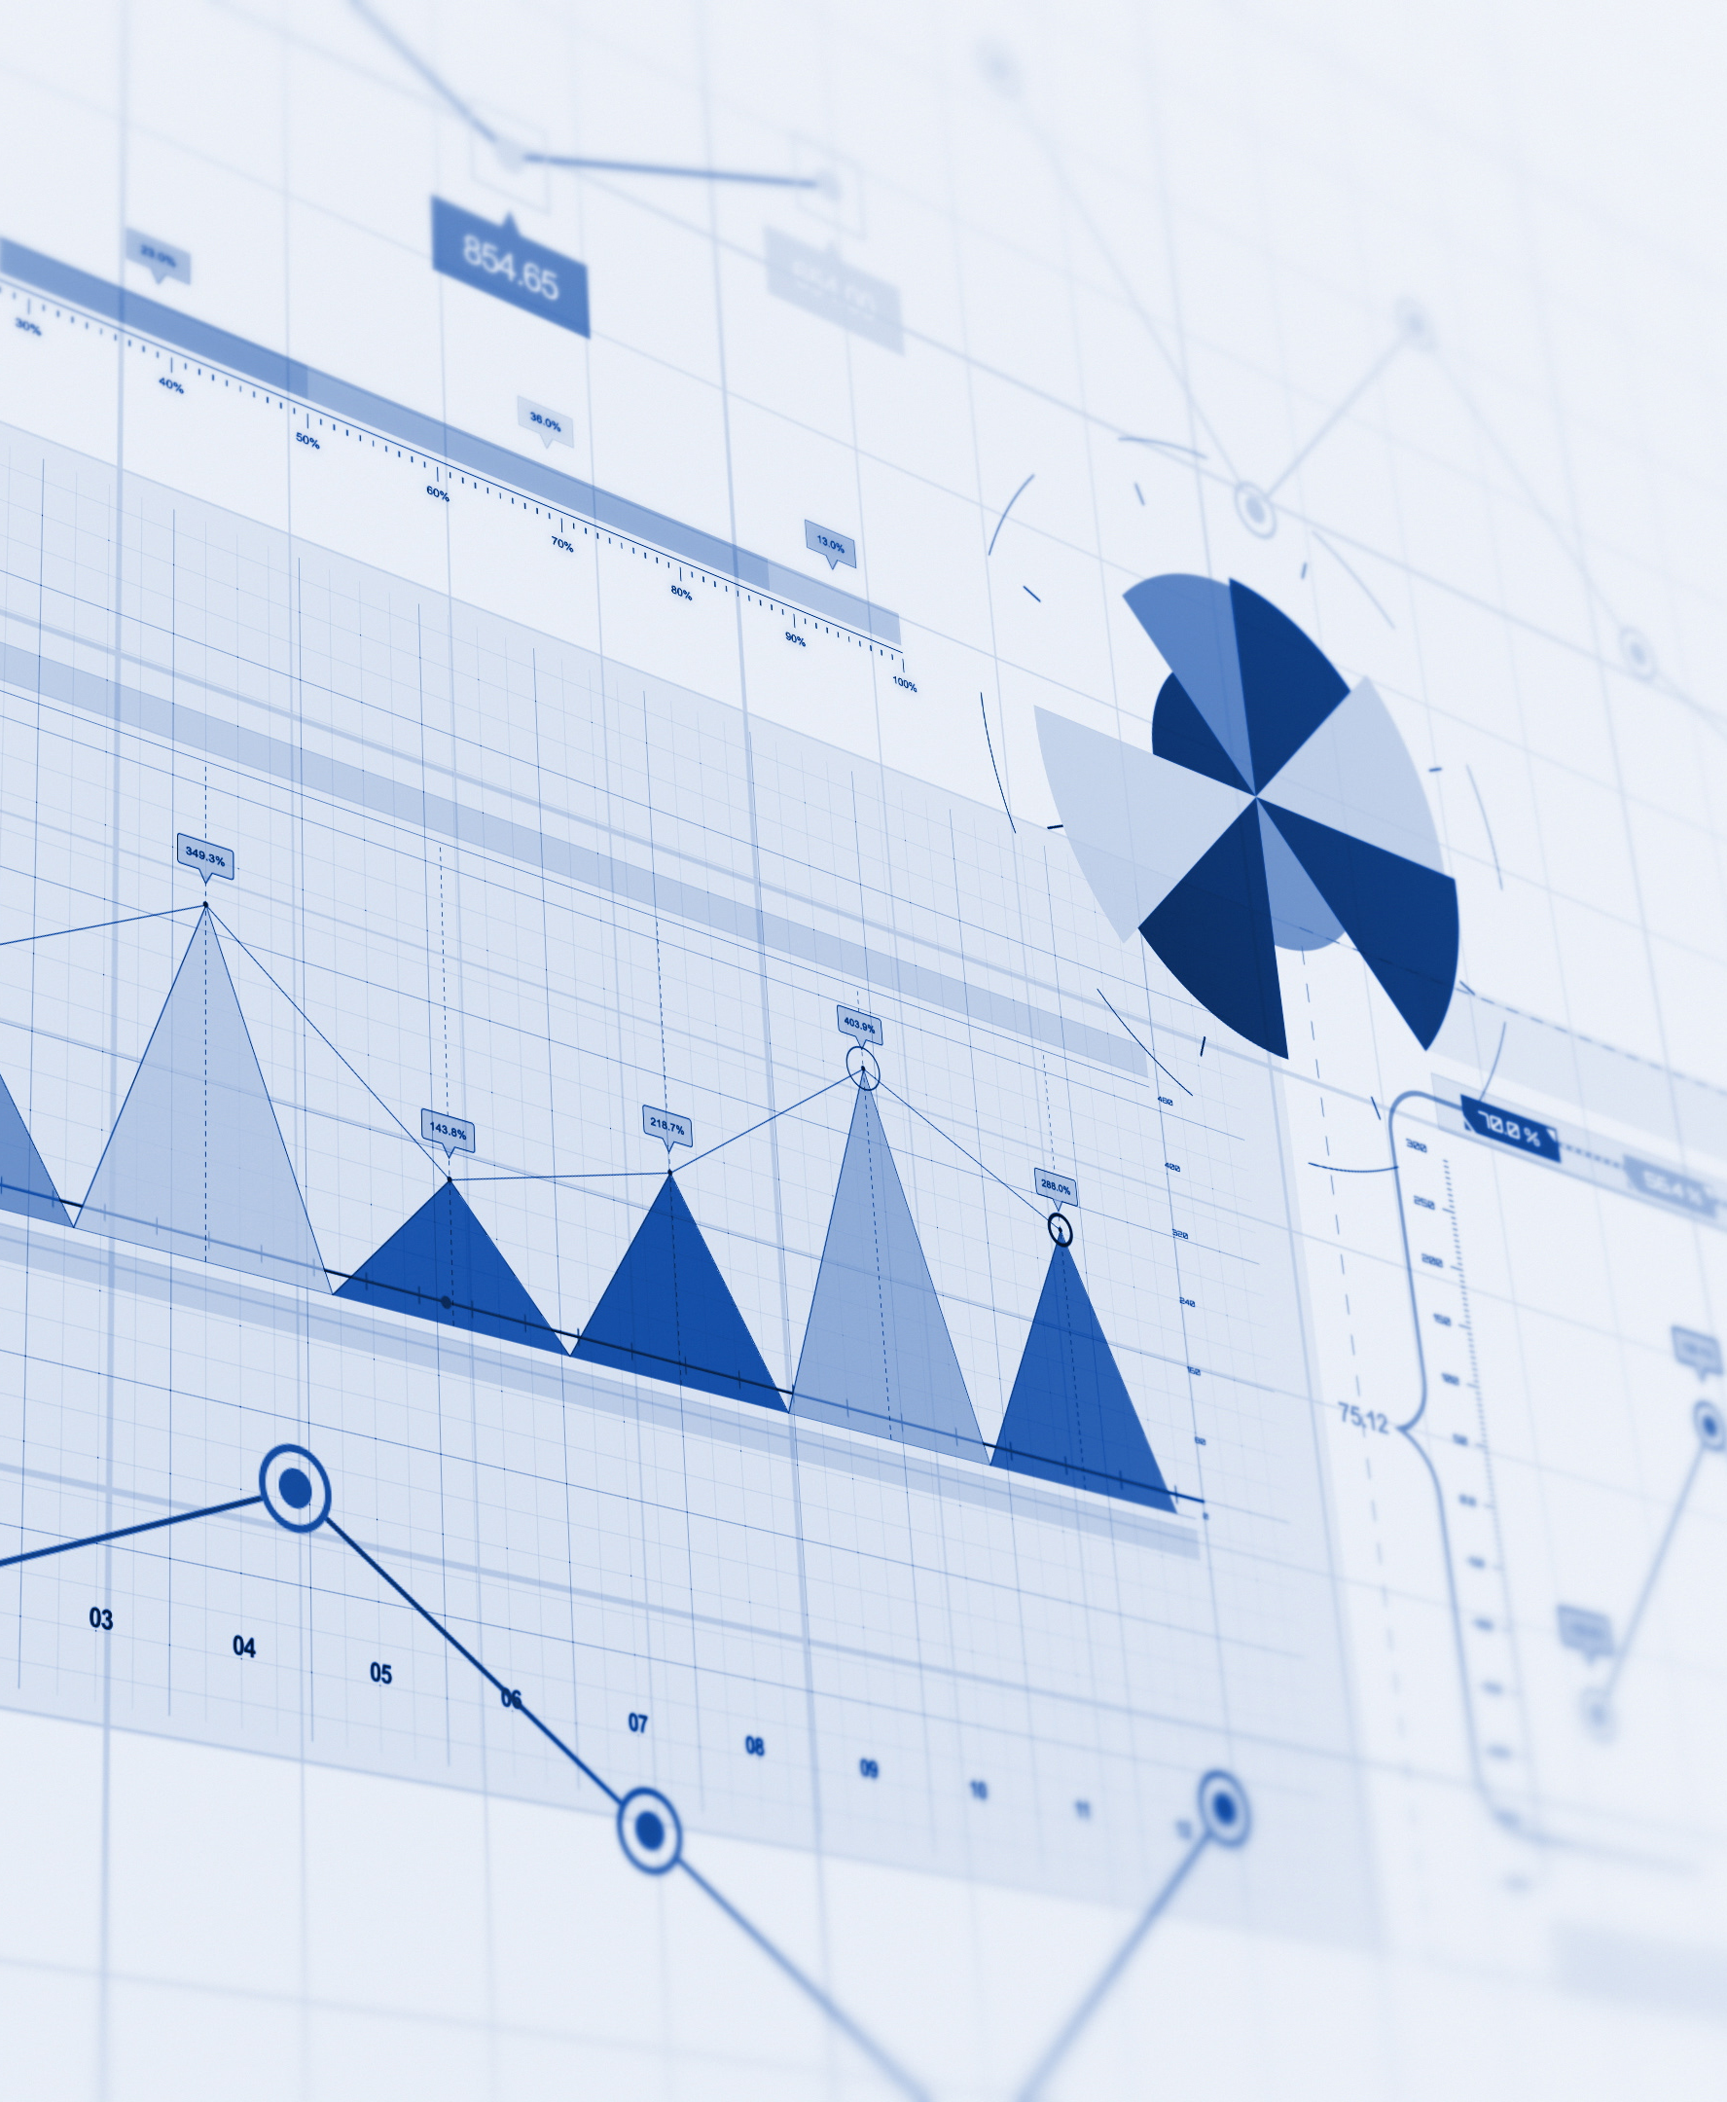
Data presentation and analysis
Why is data presentation and analysis important in Geography?
By putting data into graphs, maps, charts etc, it makes data easier to understand and see trends.
Analysing data shows why things happen in certain places and helps explain what is happening.
Data presentations can show differences between places like where there’s more traffic or higher temperatures.
Data analysis helps people make good decisions and use this information to solve problems or plan for the future. Data presentations help support these decisions.
Good presentation makes your work easy to read and understand and clearly communicates your findings.
Image credit: Microsoft creative content

Slide 4

Presenting your data
Working in your fieldwork groups, think about the following questions to help you decide how you are going to present your data.
  What are you trying to show with this data?
  How could this best be presented?
  What other data would be useful to support what yours is showing you?
  How does it answer (or not) your hypothesis?.
Now, use the raw data you have collected to create a graph/chart/map to best present your findings.

Slide 5

Checklist
Are all the axis labelled?
Does it have an appropriate title?
If a key is needed, is it added? Does it make sense (i.e. not ‘series x’)
Is it to scale?
Can you understand it?

Slide 6
Analysis
Looking at the data presentation from other groups. Use the sticky notes to identify one, some or all the following:
  What is the overall pattern/trend?
    Is it positive, negative, no pattern?
  Are there any relationships between the data and others you have seen?
  Is there any anomalies or outliers?

