Slide 1





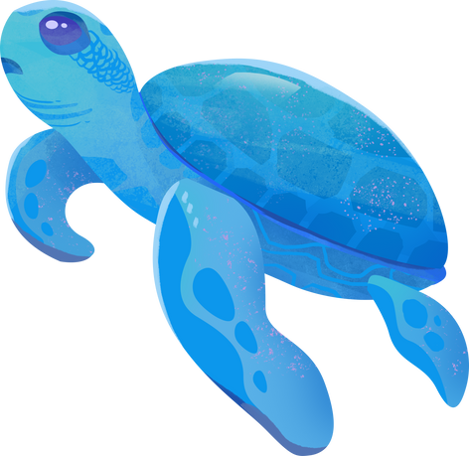
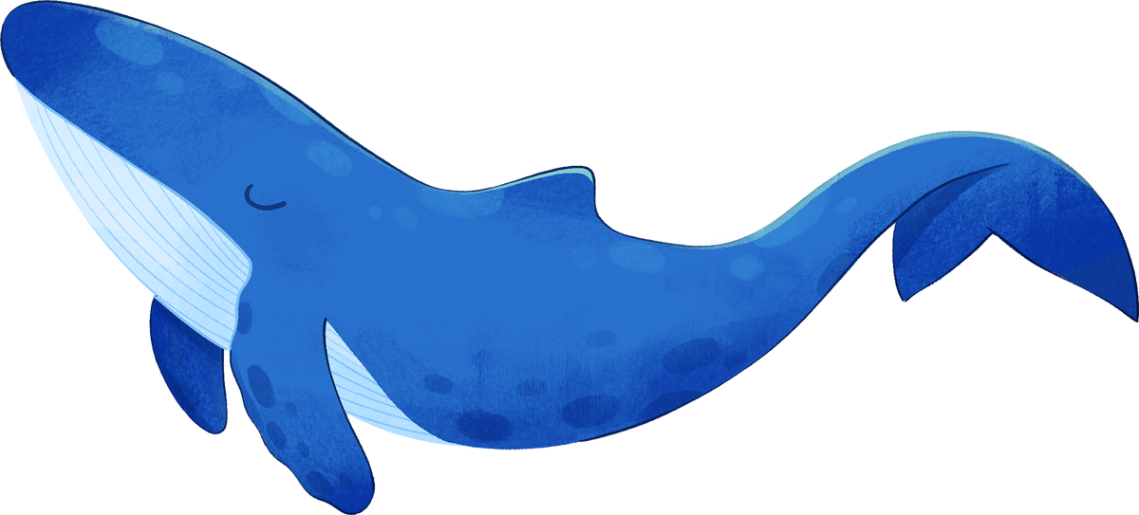


Starter: categorise the different ways humans can use the sea in the triple Venn Diagram. Are there any that do not fit in one place? Why do you think that is the case?
I CAN SEE THE SEA!
Ocean exploration
Notes:
Presentation adapted from the blue illustrative organic ocean habitat presentation © Olmos Carlos via Canva.com

Slide 2


Ocean exploration
Learning Goals
1
2
3
4
To identify different ways in which people use the sea.
Think about how people have used the oceans over time.
Look at notable people who have used the oceans in different ways.
Reflect on how we might use the oceans in the future.
Key Terms
Oceanographer ~ Discoveries ~ Stewardship
Notes:
Presentation adapted from the blue illustrative organic ocean habitat presentation © Olmos Carlos via Canva.com

Slide 3
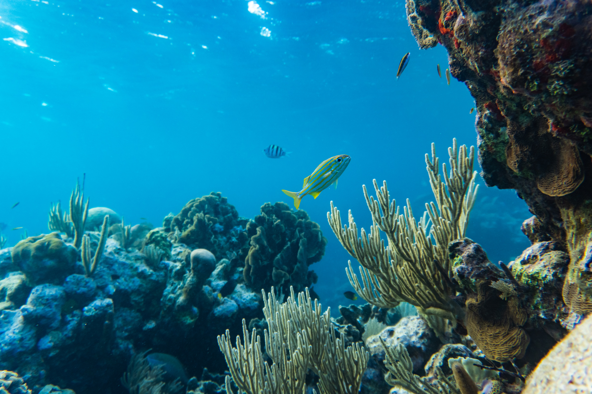
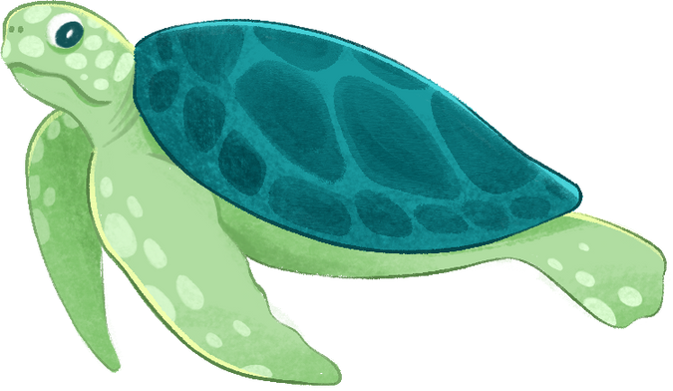

Using the ocean
Challenge: what patterns do you notice? Why do you think that is?
  Task 1
Complete the timeline using the information you have on how people have used the oceans.
  Task 2
Classify your timeline using coloured highlighters, pens or pencils to show the different uses humans have for the oceans.
Image credit: Samson Bush, Pexels
Notes:
Presentation adapted from the blue illustrative organic ocean habitat presentation © Olmos Carlos via Canva.com

Slide 4

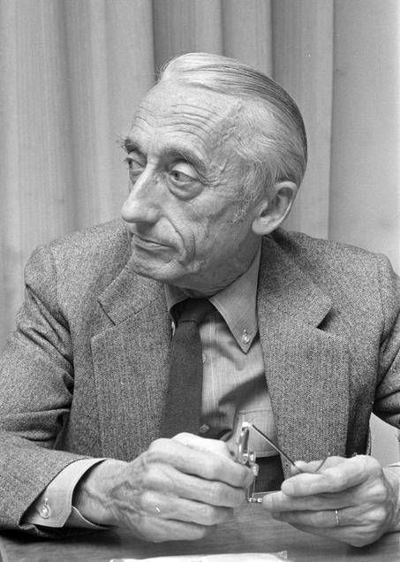
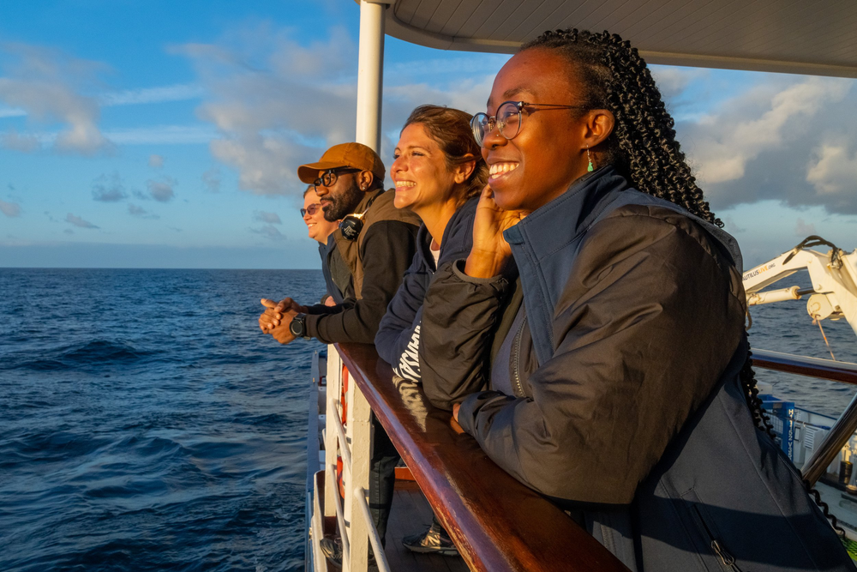

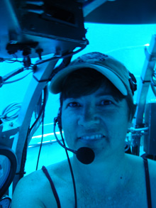


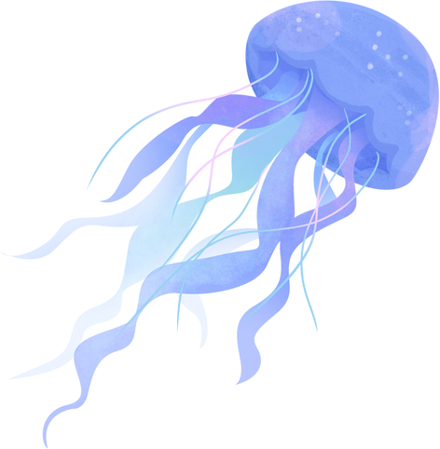
Humans that have been fascinated by the sea
Sylvia Earle
Jacques Cousteau
Edith Widder
Moronke Harris
Dominique Koné
Image credit:
Sylvia Earle, Kris Krug, Flickr
Jacques Cousteau, www.gahetna.nl, Wikimedia
Edit Widder, Dsmith6239, Wikimedia
Moronke Harris, Nova West and Ocean Exploration Trust
Dominique Koné, Dominique Koné
Notes:
Presentation adapted from the blue illustrative organic ocean habitat presentation © Olmos Carlos via Canva.com
Images:
Dominique Kone, emailed permission.
Edith Widde © Dsmith6293, Wikimedia
Jacques Cousteau 1972 © www.gahetna.nl, Wikimedia
Moronke Harris © Nova West and Ocean Exploration Trust, emailed permission
Sylvia Earle © TEDxOilSpill - Washington, DC by Kris Krug-1, Flickr

Slide 5

WHAT WOULD IT BE LIKE TO EXPLORE THE SEA?
Notes:
Presentation adapted from the blue illustrative organic ocean habitat presentation © Olmos Carlos via Canva.com

