Slide 1
5 Then and Now
Shackleton 100
Endurance 100
Geography History

Slide 2
The Story So Far…
In brief
The story so far in brief…
In 1914 the explorer Sir Ernest Shackleton set out on an ambitious expedition to cross the continent of Antarctica from one side to the other. He failed. However he achieved one of the greatest feats of turn of the century polar exploration; he returned with all his 27 men – alive, despite the loss of his ship. Shackleton’s ship, the Endurance, was crushed and sank in ice in the Weddell Sea, before his team could even begin that ill-fated attempt to cross the hostile continent of Antarctica.
Find out more here Royal Geographical Society - Geography resources for teachers (rgs.org)
In 2022, the Centenary of Shackleton’s death, Dan Snow travelled to Antarctica on board the S.A. Agulhas II, as part of the Endurance22 expedition, in a successful attempt to locate the missing wreck of Shackleton’s ship.
Find out more here Expedition Team - Endurance22

Slide 3
Sea Ice Facts: true or false?
The worldwide sea ice cover affects the global climate.
The worldwide sea ice cover acts as a large mirror for the sun, reflecting some energy back and preventing additional heating of the ocean.
Much sea ice is made up of ice piled up in ridges that can be 3 metres high.
Shackleton’s Endurance was crushed by sea ice.
Multi-year sea ice means that ice survives from one year to the next rather than melting each year.
The Weddell Sea ice is the only region where you have a large area of multi-year ice in Antarctica.
All statements are true and informed by the Endurance 22 website. Sea Ice Research - Endurance22

Slide 4
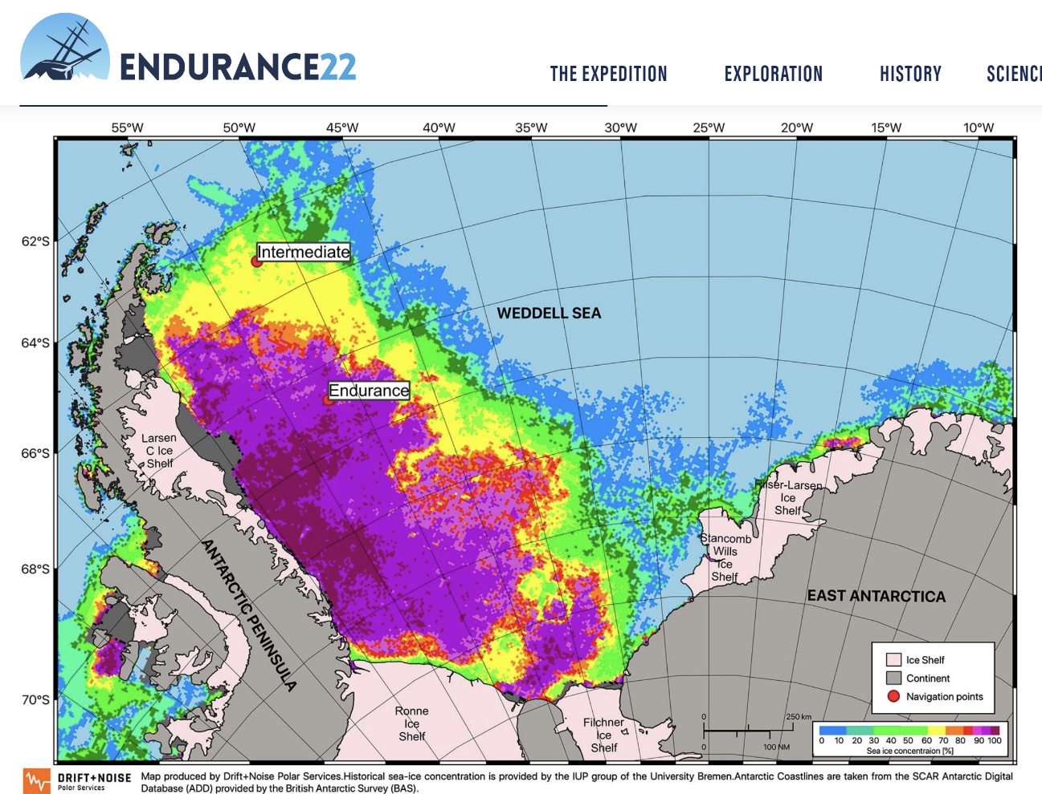
Average Sea Ice Concentration of February 15 (2017-2021)
Sea Ice Research - Endurance22
Where is the sea ice most concentrated?
Where did Endurance sink?
What is the difference between sea ice and ice shelf?

Slide 5
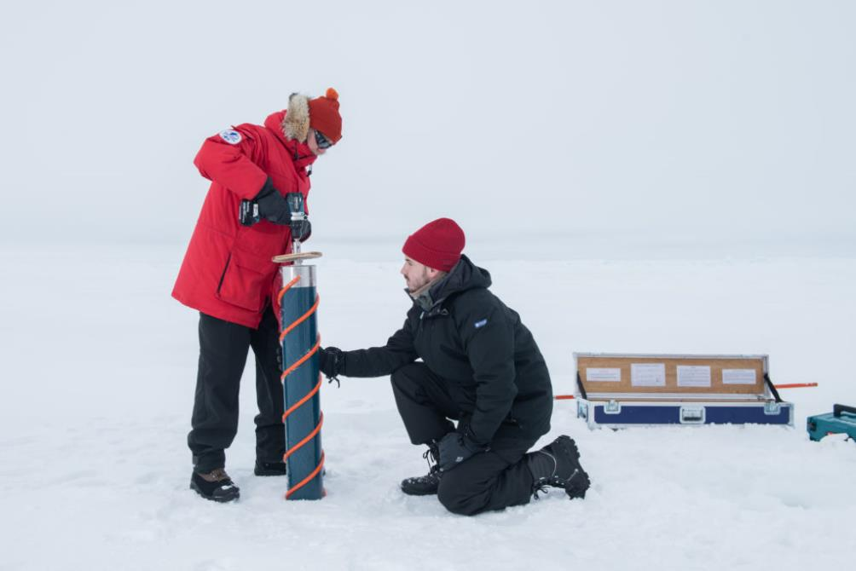
Then and Now:
Ice changes
What are these scientists doing?
What is an ice core? What does it tell us?
Scientists take ice cores in the ice floe next to S.A. Agulhas II for further analysis in the lab. Photo by Esther Horvath
Sea Ice Research - Endurance22

