Slide 1
MALI & Bamako
Mali is one of Africa’s widest countries, located in the South of the Sahara region, with a size of 1 241 238 km2, 60% of its area is a desert. The country is secluded inside 7 000 kms of borders with 7 neighbour states: Algeria, Niger, Burkina Faso, Côte d’Ivoire, Guinea, Senegal, and Mauritania.
The country’s hydrographical network is built around the drainage basins of the two main rivers: Senegal and Niger rivers and their tributaries.
The urban population’s growth has increased rapidly between 1987 and 1998: between + 4,6 and 5,1% per year.
According to statistics, the urbanization should increase swiftly and reach 47,5 % in 2024.
Images (except GapMinder images) are sourced from http://www.ateliers.org/en/sites/default/files/docschantiers/Topic_Atelier_Bamako_EN.pdf

Slide 2
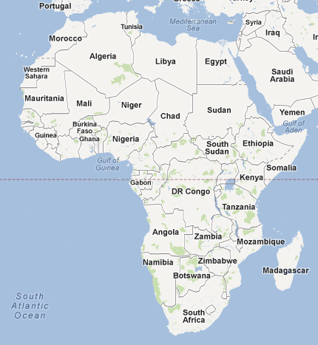

Slide 3
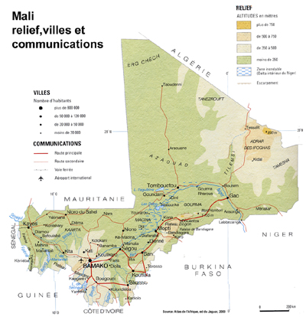

Slide 4
Bamako is located on both sides of the Niger river, which flows from West to East. The central business district and all centrality functions are gathered on the North bank, but the city is contained in the North by the Plateaus, therefore, the city has crossed the river and sprawls swiftly to the South bank.
Growing from a big village of a thousand people to a 2 million inhabitants agglomeration over one century, Mali’s capital city is now jutting out from everywhere.
Area: 267km2
District’s population: 1 809 106 (2009), 12,5% of the total population.
Density: 76 inhabitants/ha (2010)
Population Growth Rate: 5,4% (6th rank in the world)
Informal Employment Rate: 80%
Primary, Secondary and Tertiary Sectors Parts (2006): 6%, 20%, 80%.
80% of the Malian’s industry companies (2006)
75% of the country’s importations and 10% of its exportations.
The landscape of Bamako is characterized by three important geographic entities : the river Niger, the hills on the North (Point G-the hill of the hope and Koulouba-the hill of the power) and some reliefs on the South bank (Badalabougou-the hill of knowledge...).

Slide 5
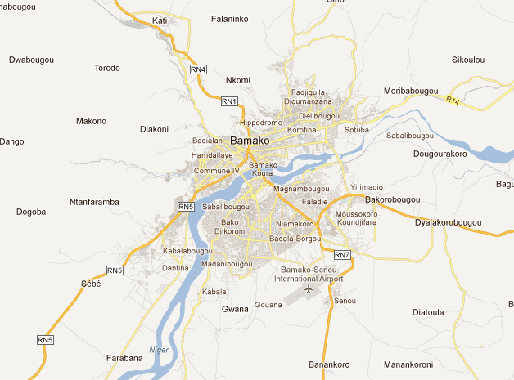

Slide 6
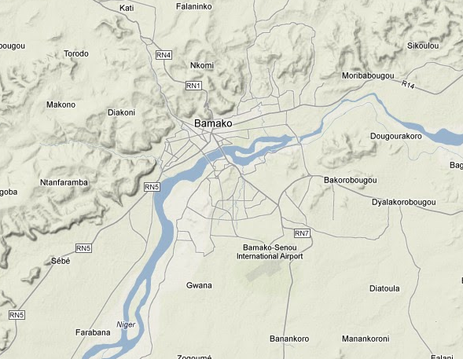
Bamako Terrain

Slide 7
Bamako growth since 1950

Slide 8
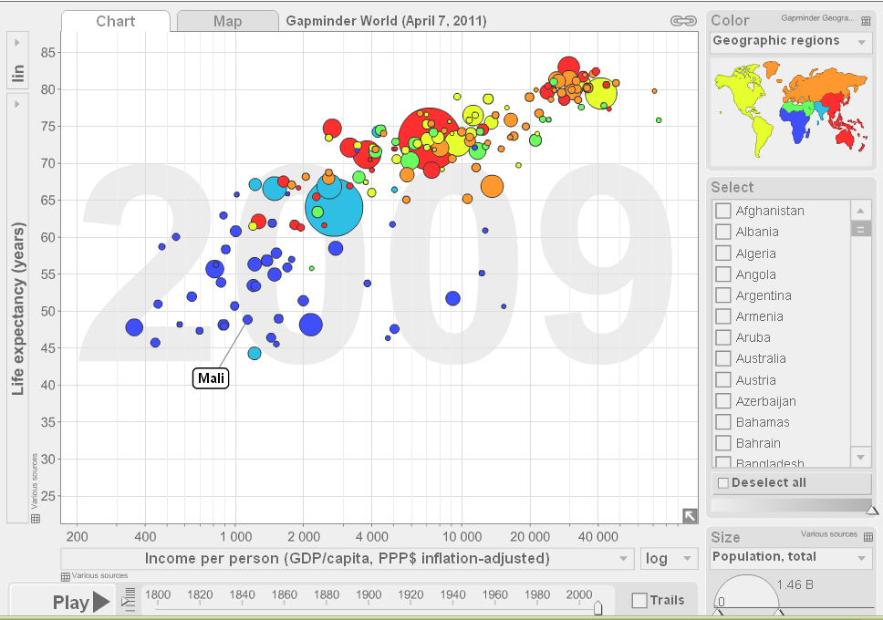
Gapminder graph displaying life expectancy, income (GDP), population of Mali

Slide 9
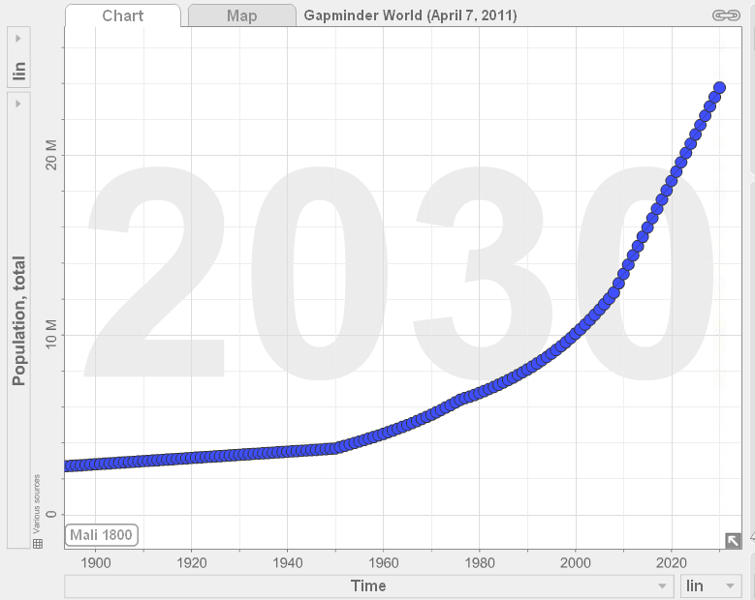
Gapminder graph showing Mali’s population growth

Slide 10
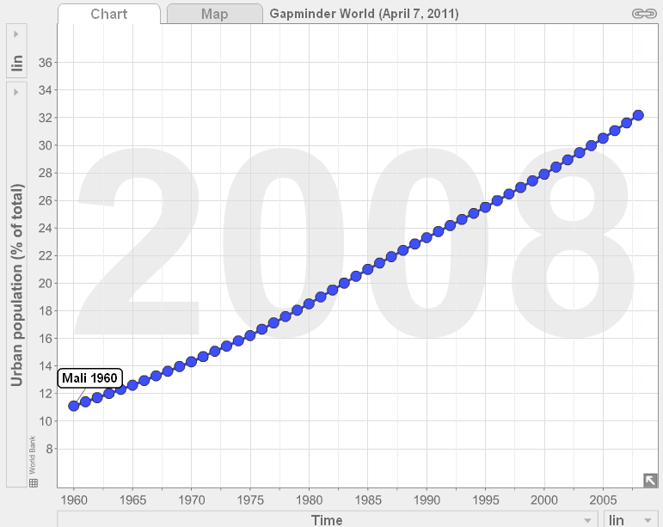
Gapminder graph showing urban population of Mali

Slide 11
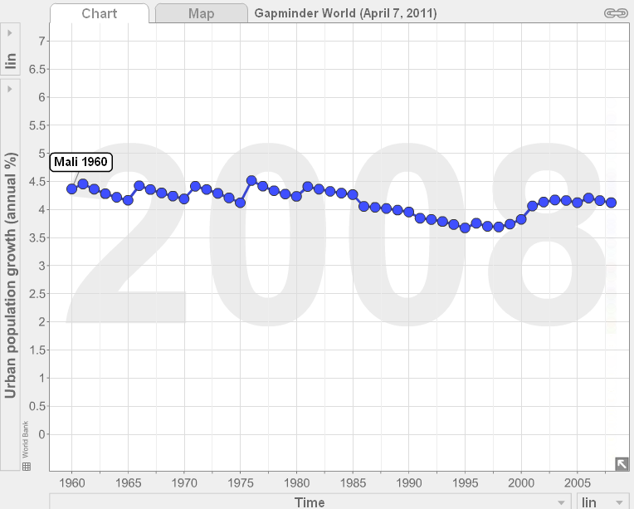
Mali annual urban population growth

Slide 12
