Slide 1

Water sources in Oman
What are the main sources of freshwater?
Learning Goals
Know what desalination is.
Describe the physical context of Oman, in particular the arid climate of the country.
Evaluate the policies and management strategies Oman employs to ensure reliable water supply.
Notes:
Oman is a hot, dry, country in the Middle East. Freshwater is limited to areas of high elevation, in the northern and southern extremities of the country.
Oman, therefore, relies on aquifers, in the Dhofar (Najd), Al Dahra (Al Massrat) and Sharqia (Rimal al Sharqia) regions, and the process of desalination.
Desalination makes an important contribution to Oman’s water resources, particularly in areas which lack reliable access to water. Desalinised water, as a share of the overall country’s water budget, is therefore increasing.

Slide 2
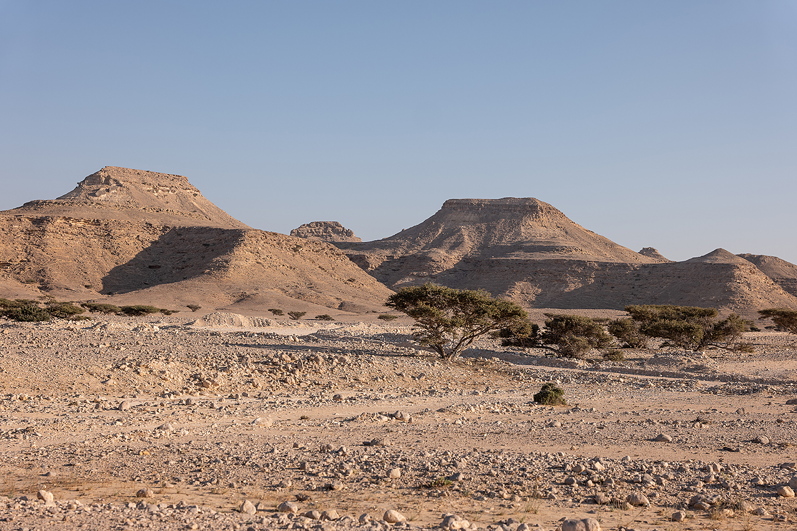

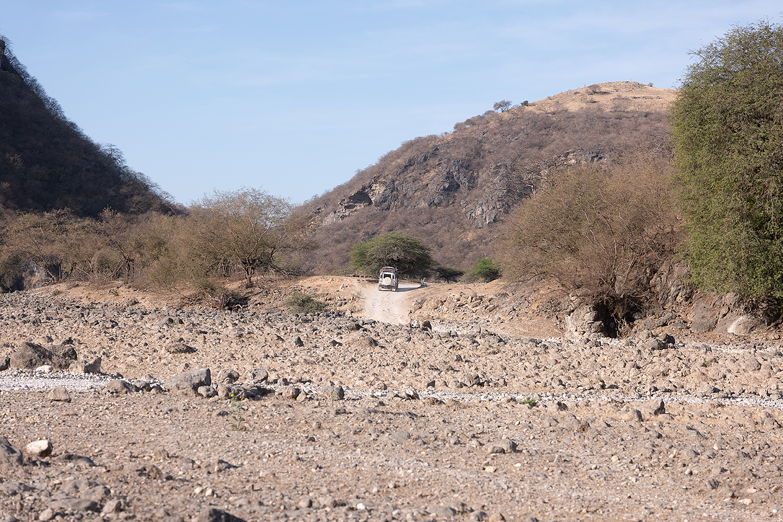
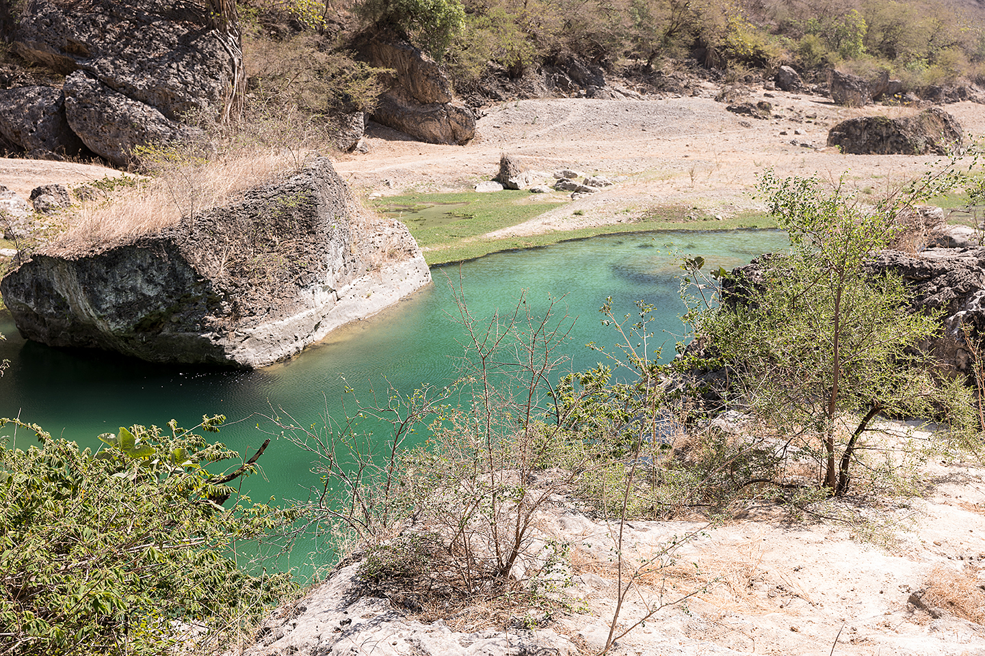
Oman’s landscape
Describe the geographical context of Oman, either by using a paper atlas or the ArcGIS Geography Visualiser.
Using the images below, describe the landscape in Oman.
Why is water scarcity a significant issue in some regions?
All images © Ana-Maria Pavalache

Slide 3
Data analysis
Population
Year | Population m | % change
2025 | ~5,500,000 proj | ~21.6 ↑
2020 | 4,522,497 | 8.0 ↑
2015 | 4,184,895 | 51.7 ↑
2010 | 2,757,446 | 12 ↑
2005 | 2,459,802 | 7.7 ↑
2000 | 2,282,131 | 7.6 ↑
1995 | 2,120,528 | 20.2 ↑
1990 | 1,763,954
Climate
Year | Average annual 5-year smooth °C | Average precipitation mm
2025 | ~29.0 | ~100 proj
2020 | 28.01 | 66
2015 | 27.92 | 27
2010 | 27.72 | 42
2005 | 27.76 | 44
2000 | 27.61 | 31
1995 | 27.2 | 92
1990 | 27.41 | 27.15
Freshwater
Year | Annual freshwater withdrawal bcm | % change
2025 | ~1.6 | 0
2020 | 1.6 | 0
2015 | 1.6 | 6.6 ↑
2010 | 1.5 | 15.3 ↑
2005 | 1.3 | 0
2000 | 1.3 | 8.3 ↑
1995 | 1.2 | 0
1990 | 1.2 | 0
Data source: Worldometer Population of Oman, proj = projected, World Bank Climate Change Knowledge Portal and Trading Economics Oman, World Bank Indicators Annual freshwater withdrawals, bcm = billion cubic metres
Is Oman's population increasing or decreasing?
What is the trend in annual average temperatures?
Which biome best describes Oman according to The Five Major Types of Biomes?
Why might the annual freshwater withdrawal data be concerning?

Slide 4
Water stress: precipitation
Oman is one of the most water stressed countries in the world, according to the IEA. Water supply is a problem because:
Oman has less than 1000m³ of freshwater per capita per year (world average 5500m³)
Decreasing annual rainfall - in 2022, annual average was just 76.4mm, 1/16 of the global average
Oman's aquifers are not replenishing at a rate that keeps up with the demand for water.
Variability in rainfall: is evident between regions (~20mm in the desert, and as high as 300mm across the mountains) and from one season to another. During Spring, from February to March, Oman receives 35% of its yearly rainfall. Precipitation levels in Oman are typically low. However, after storm events, Wadis experience a rapid rise, and subsequent fall, in surface runoff. Consequently, precipitation rates can vary considerably throughout the year.

Slide 5
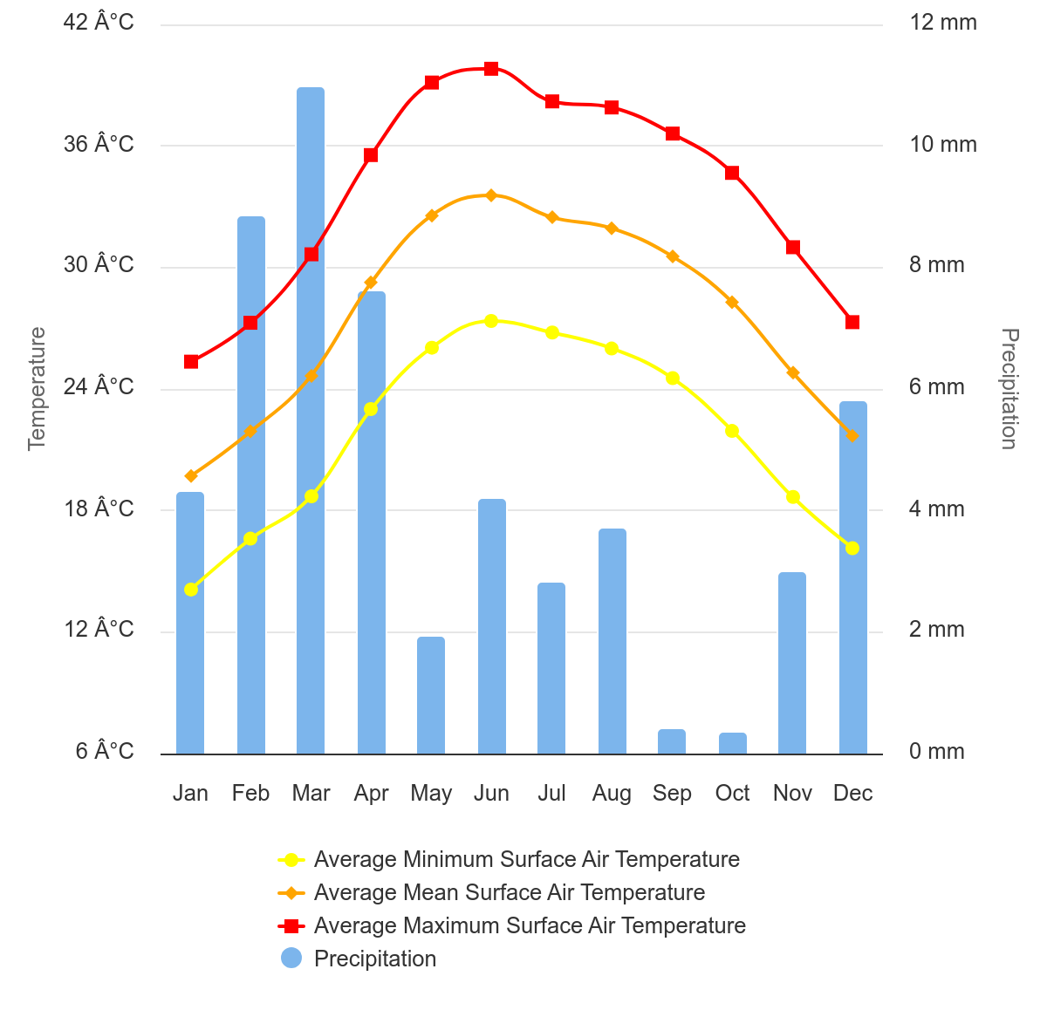
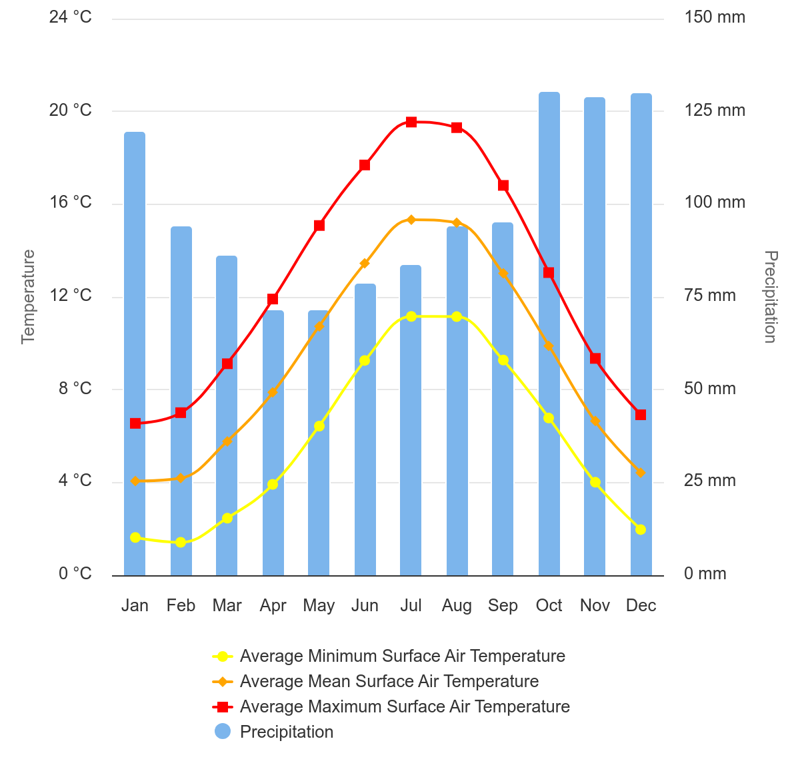
Water stress
Oman
United Kingdom
The climate graphs above show an average per month for mean surface air temperature (in orange points), and precipitation (in blue columns) between 1991 and 2020.
Source: World Bank Climate Knowledge Portal Oman and UK comparison

Slide 6
Water source data presentation
In 1970, the predominant sources of water supply were groundwater (70%), traditional irrigation systems known as Aflaj supported wells (29%), and surface water (1%).
By 1990, groundwater extraction increased (to 94%) whilst Aflaj supported wells declined (to 5%). At this point desalination began (1%).
In 2010, the three major annual sources of water were groundwater (78.3%), desalination (15.3%), and surface water from small wadis (6.3%).
By ~2030, it is predicted that groundwater use will remain static (78%), surface water will decline (to 1%), and desalination will continue to grow in importance (increasing to 20%).
Create a stacked column chart to represent the major annual sources of water in Oman for the years 1970, 1990, 2010, and 2030.
How have water sources in Oman changed over time?

Slide 7
Water source: geology
The geology of Oman varies widely. The Hajar Mountains, Huqf, and Dhofar Mountains are prominent geological features due to their complex rock formations.
Oman is famous for its large geological formation of Semail Ophiolite (orange on the geology map). These rocks are from the Cretaceous Period, approximately 95 million years ago. This is a section of the Earth’s oceanic crust which has been uplifted and exposed.
Water availability is determined by geology. The location of groundwater is controlled by the type of rocks in Oman. In mountainous areas in the northern and southern extremities, fractures in the rocky terrain allow rainfall to penetrate and recharge aquifers. Most of the water in other areas is brackish to saline and therefore has very limited use.

Slide 8
Water source: aquifers
Oman has large amounts of water in aquifers, replenished a long time ago during wet climatic conditions, but present recharge is very low.
These water resources are essential for the country. They are limited to the Dhofar (Najd), Al Dahra (Al Massrat) and Sharqia (Rimal al Sharqia) regions.
The Omani government has decided to use these aquifers to supply water for urban use and as a reserve for the future.

Slide 9
Water source: altitude
The elevation profile of Oman is a key influence on water availability in the country. The Hajar Mountains run parallel to the northern coast, creating a dramatic landscape with peaks reaching up to 3,000 meters.
The interior of Oman is dominated by the Rub' al Khali, also known as the Empty Quarter, which is one of the largest deserts in the world.
In the Dhofar region to the south, land is more fertile and supports agriculture. The Dhofar region benefits from the Khareef (southwest monsoon), which brings seasonal rains and creates a unique, green environment compared to the arid interior.

Slide 10
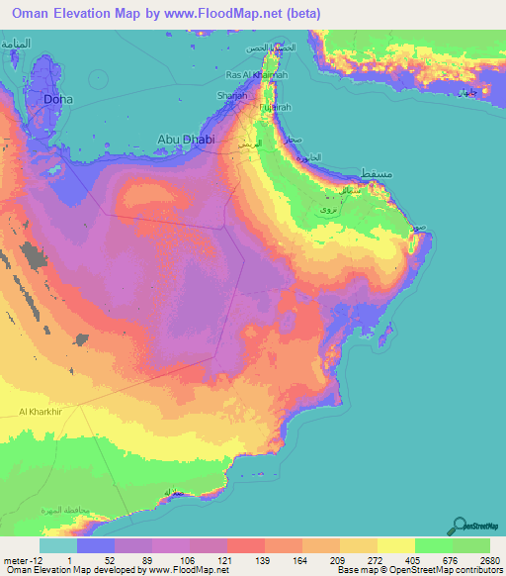
Water source: altitude
Elevation varies considerably across Oman. Use the map to answer the following:
What is the highest point in Oman, and what is its elevation?
Describe the variation in elevation across Oman, from its lowest to highest points.
How does the altitude of the Hajar Mountains influence the climate and vegetation in Oman?
Source: FloodMap Oman elevation map

Slide 11
Water source: desalination
Watch How desalination plants keep water flowing in Oman.
Answer the questions below.
What does the word desalination mean. Why does Oman rely on desalinated water?
How many desalination plants are there?
What are the costs?
On the next slide is a diagram illustrating how desalination plants in Oman use reverse osmosis (RO). There are 11 steps to the process. Annotate the diagram using the sentences provided.
Notes:
Desalination is the process of removing salt and other impurities from seawater to produce fresh water for human consumption, irrigation, and industrial use. This is particularly important in Oman where freshwater resources are scarce.

Slide 12
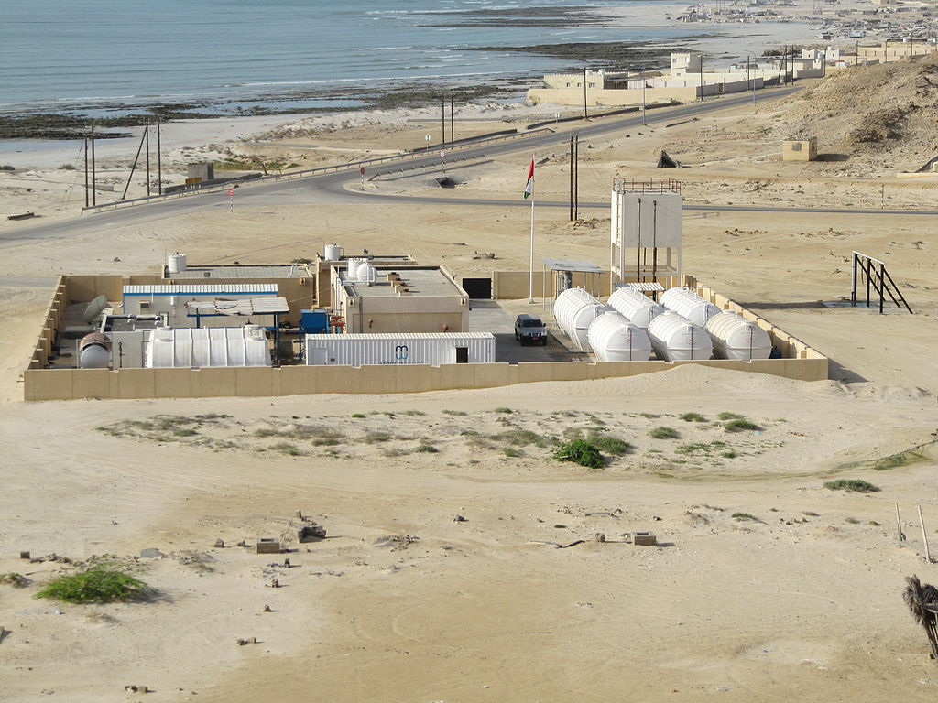
A desalination plant
Intake is directly from the sea
Pre-treatment to remove solids such as sand, silt, and any organic matter
Chemicals (coagulants) are added to aggregate fine particles together
Coagulants settle at the bottom of the tank (sedimentation) before removal
HPP (High Pressure Pumps) force water along pipelines, using 70% of total energy usage
Water either flows to a BP (Booster Pump) or a RO system (Reverse Osmosis)
In the RO system water is forced through a semipermeable membrane
Post-treatment involves adding chlorine (disinfectant) and remineralisation
Minerals like calcium and magnesium are added back into the water to stabilize its pH
ERD (Energy Recovery Device) captures the hydraulic energy from high-pressure brine
Captured energy is transferred to incoming seawater to lower operational costs
Notes:
Image source: Wikimedia CC BY-SA 4.0

Slide 13
Sharqiyah desalination plant
The Sharqiyah desalination plant is located on the north-east coast of Oman in the administrative governorate (muhafazah) of Sharqiyah.
The desalination plant first opened in 2007 and has produced over 200 million m³ of water. The water is primarily used to supply drinking water to more than 600,000 inhabitants across Sharqiyah. Desalination is important for this part of the country because 50% of the population live in the neighbouring Muscat region.
A crucial component is energy efficiency. The desalination plant incorporates advanced technology called ERDs (Energy Recovery Devices) to enhance efficiency and lower costs. An example of ERDs are devices which recover energy from the high-pressure reject brine water.
In 2022 Veolia and TotalEnergies announced an agreement to start the construction of a solar photovoltaic system for the desalination plant. It is the largest solar power plant in Oman, and started commercial operations in 2023, providing 100% of the desalination plant’s energy needs during daylight hours, significantly reducing CO₂ emission in the region.

Slide 14
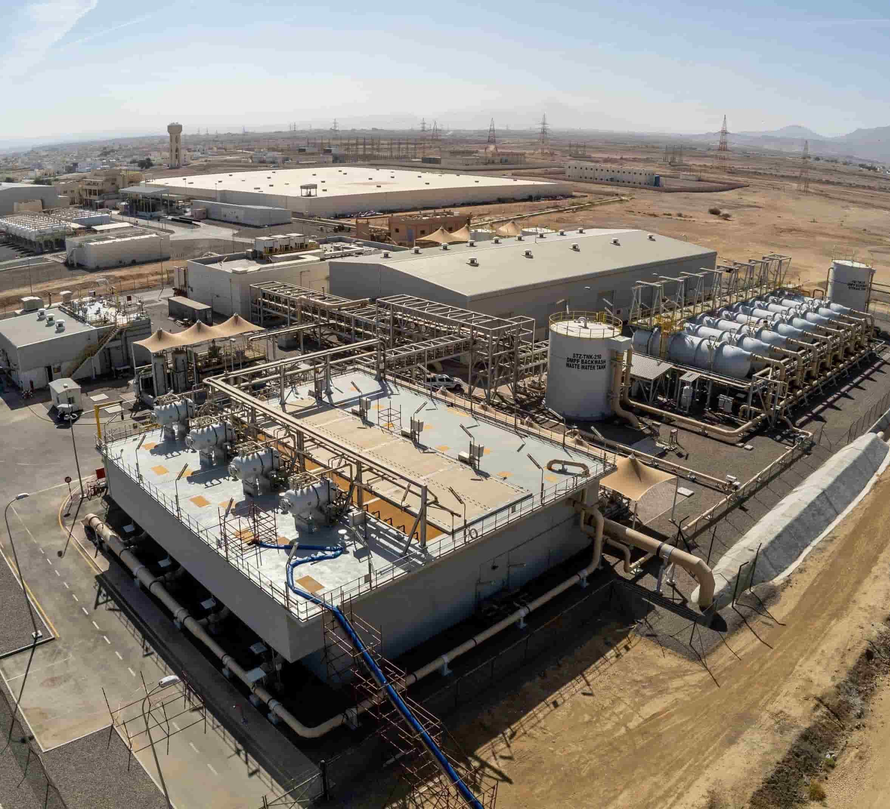
Sharqiyah desalination plant
Either:
Research the 5 major aquifer systems in Oman to explore how aquifers are an alternative water source.
and/or:
Plan the answer to the following examination style question ‘Evaluate the environmental, economic, and social impacts of desalination as a water supply solution in Oman’.
Source: Veolia and TotalEnergies press release

Slide 15
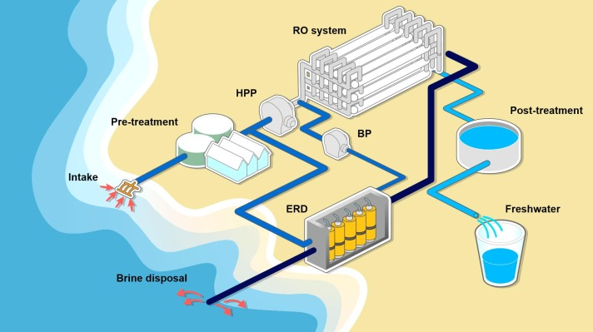
A desalination plant
Source: adapted from © Science Direct

