Slide 1



www.thewaterdiaries.com

Slide 2

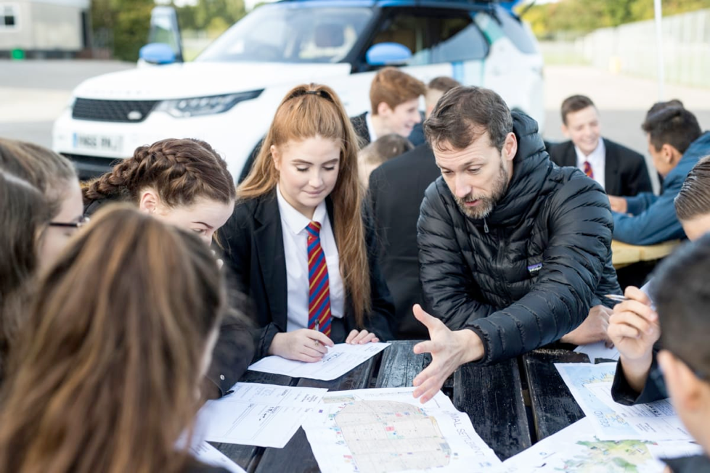
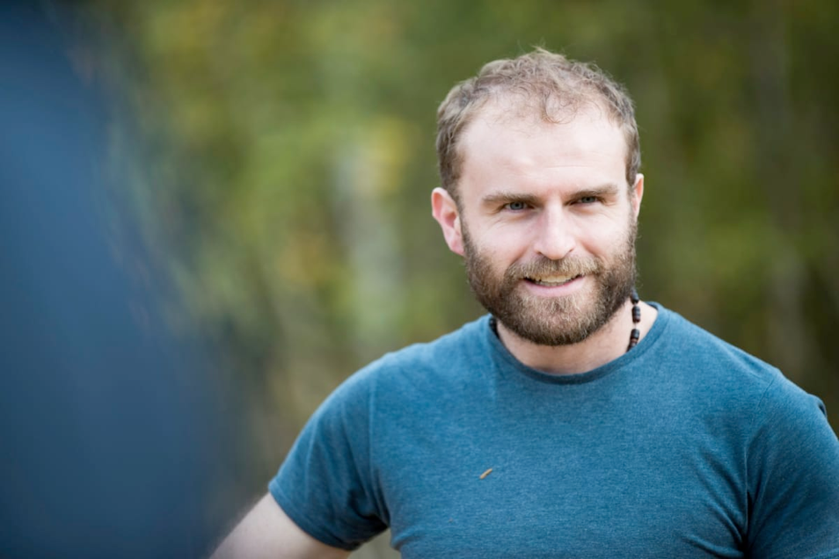
The water diaries team
Winners of the RGS Land Rover Bursary 2017. The team drove a new model Discovery across Jordan to investigate Water Issues.
Temujin Doran
Fearghal O'Nuallain
Shane McGuinness
Filmmaker
Teacher | Lead
Field Scientist
www.thewaterdiaries.com

Slide 3
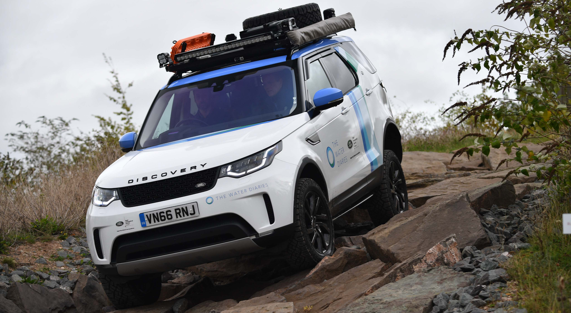
PLAN AN EXPEDITION
www.thewaterdiaries.com

Slide 4
Teacher
Brief
This lesson aims to inspire students to embark on expeditions.
Students will be inspired by explorers. Ben Saunders explains what motivates him to go above and beyond and Paul Salopek, Jennie Steele, Tom Allen, Phil Avery & Fearghal O’Nuallain outline the challenges and highlights of exploring.
Students then work independently to rapidly create an expedition plan before taking a role in a team and planning an expedition with three other classmates.
www.thewaterdiaries.com

Slide 5
Teacher
Brief
PLAN AN EXPEDITION
A C T I V I T I E S
T H I S D E C K C O N T A I N S:
RAPID
Planning
GROUP
ProjecT
Inspiration
www.thewaterdiaries.com

Slide 6
Teacher
Brief
PLAN AN EXPEDITION
S K I L L S
Research
Mapping
Decision Making
Group Work
Numeracy
www.thewaterdiaries.com

Slide 7
Teacher
Brief
PLAN AN EXPEDITION
A C T I V I T Y T I M I N G S
Total Duration
2hrs
This unit consists of 2hrs of total teaching content for 14-16ys. Each activity can be taught alone or several can be taught together. See the chart below for individual timings.
Inspiration
40mins
Group Activity
60mins
Rapid Planning
20mins
www.thewaterdiaries.com

Slide 8

Teacher
Brief
PLAN AN EXPEDITION
FOR THIS LESSON YOU WILL NEED:
PRINT RESOURCES
Internet Access
GIS FOR SCHOOLS
Print X1 sheet per student for each activity click the red words to download sheets.
Internet access will be required to view the online map and interview.
ESRI’s GIS for schools is a free and intuitive GIS platform. It will be useful for the mapping task of the group activity.
www.thewaterdiaries.com

Slide 9
PLAN AN EXPEDITION
www.thewaterdiaries.com

Slide 10
Class Map
At the end of this unit create a class display pinpointing the expeditions planned.
- Migration
- Glaciation
- Forest Ecosystems
- River Erosion
- Informal Settlements
- Coral Ecosystems
Volcanic Activity
Population
Standard of Living
www.thewaterdiaries.com

Slide 11
www.thewaterdiaries.com

Slide 12
Inspiration
expedition
ɛkspɪˈdɪʃ(ə)n/
noun
noun: expedition; plural noun: expeditions
1.
a journey undertaken by a group of people with a particular purpose, especially that of exploration, research, or war.
"an expedition to the jungles of the Orinoco"
synonyms: journey, voyage, tour, odyssey; More
www.thewaterdiaries.com

Slide 13
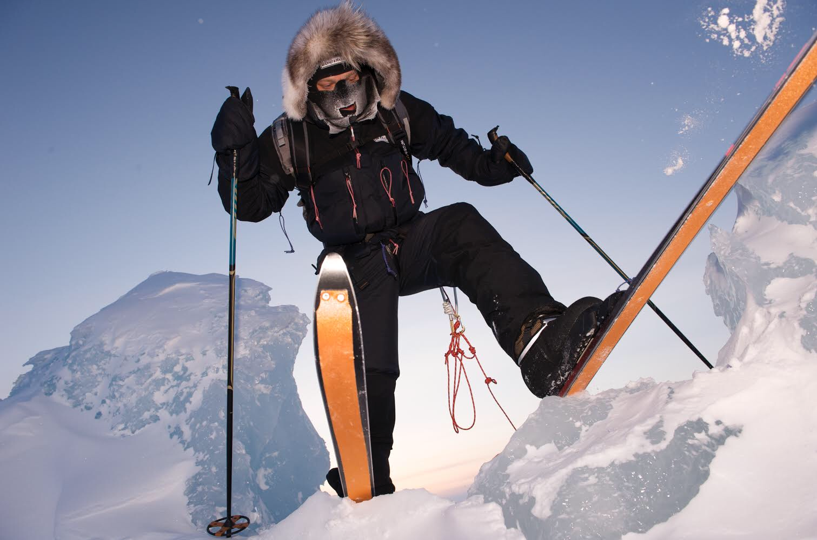
Inspiration
Read the transcript and watch Polar Explorer Ben Saunders explain what drives him and answer the question:
Why bother leaving the house?
www.thewaterdiaries.com

Slide 14



Inspiration
Read about the following expeditions.
Pick your favourite.
Explain why it is your favourite.
Suggest what you would add to the expedition if you were on the team.
www.thewaterdiaries.com

Slide 15
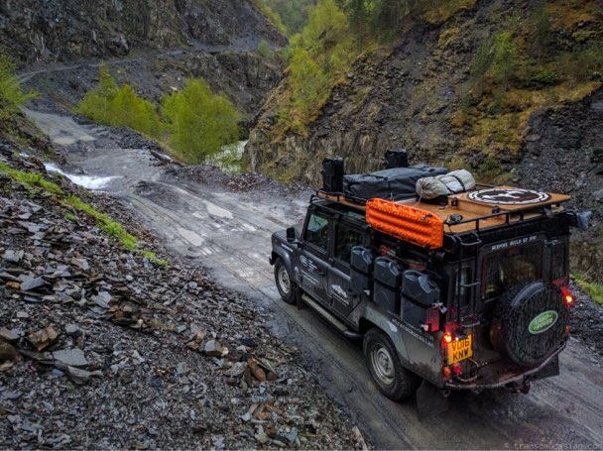
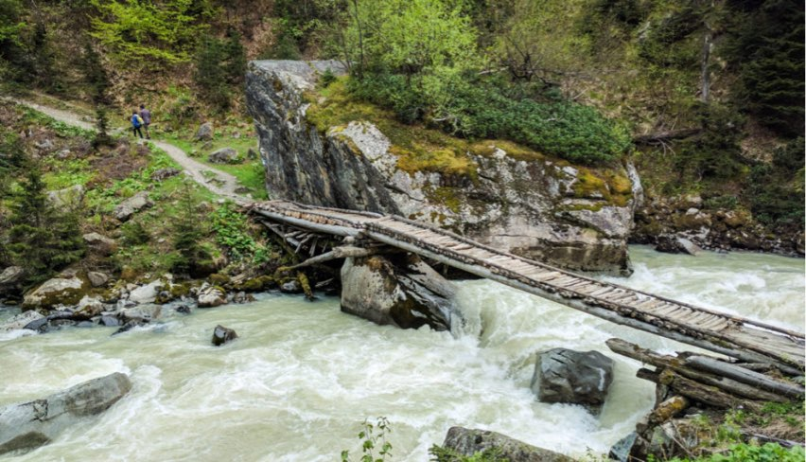
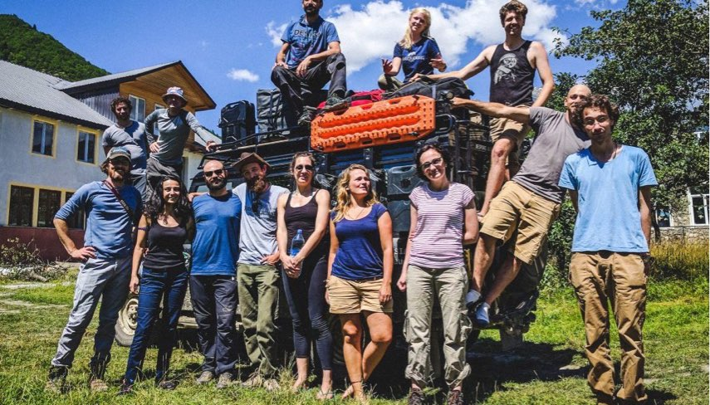
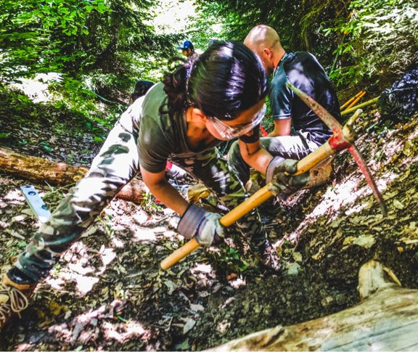
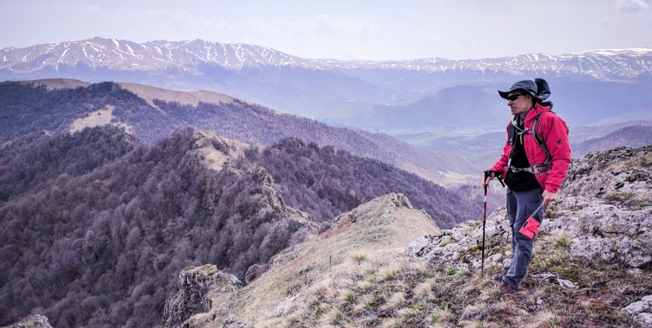
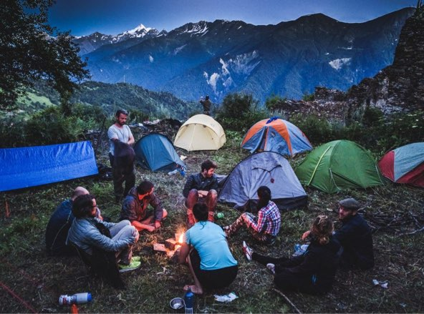
EXPEDITION PURPOSE: To drive to Armenia and create a hiking trial from the Black Sea to the Caspian Sea.
DESCRIPTION: Tom Allen lead a team of Adventurers, Geographers and volunteers to map a hiking trail across the Lesser Caucasus Mountains in Georgia and Armenia to bring Sustainable Development to rural areas through
adventure tourism.
CHALLENGES: The Caucasus is not well developed for
tourism. The team spent a lot of time creating maps and
meeting with villagers to ensure that the trail was built
around their needs.
HIGHLIGHT: Designing a journey that has never been made is the real highlight.
www.thewaterdiaries.com

Slide 16
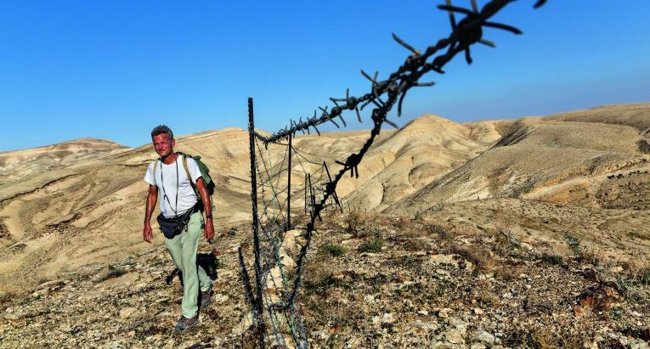
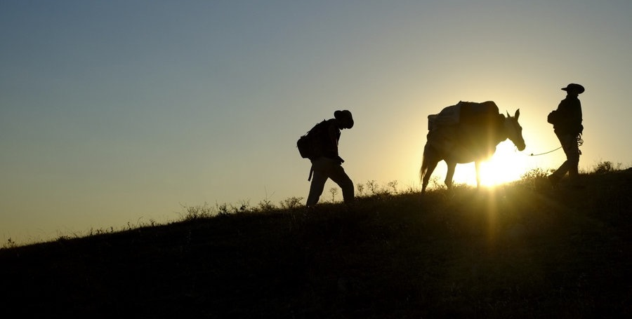
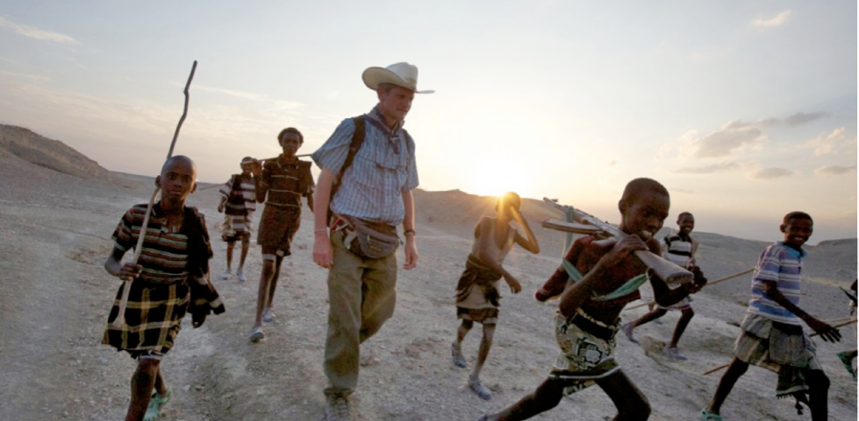
PAUL SALOPEK: Out of Eden
EXPEDITION PURPOSE: Storytelling. I believe that in a fast-paced world where everyone is increasingly busy and distracted, we sometimes can lose the thread of meaningful human connections that comes with slowing down, with observing and listening carefully. My long walk slows my life down to the pace of my own footsteps. I learn new things by not rushing. I hope my writing and photography reflect this.
DESCRIPTION: The great thing about walking through the world is that there is no typical day. Each day is different, depending on whether you are crossing a desert, a city, a farmer’s field, or a border. Endless variety. A walking journey is filled with surprises and novelty.
CHALLENGES: Paperwork. Visas. Permissions. Many governments are unused to a request from a foreigner asking to walk across their territory. It takes some explaining. And patience.
HIGHLIGHTS: At least one occurs every day. Walking across the Hejaz desert of Saudi Arabia along old pilgrim’s trails towards Mecca was special. So was the homemade yoghurt in the rolling hill farms of Anatolia. So was sitting for months in a quiet office in a museum in Georgia, writing. So was being detained by security forces in Pakistan, who later gifted me a wool scarf. You get the picture: The world is filled with wonders.
www.thewaterdiaries.com

Slide 17
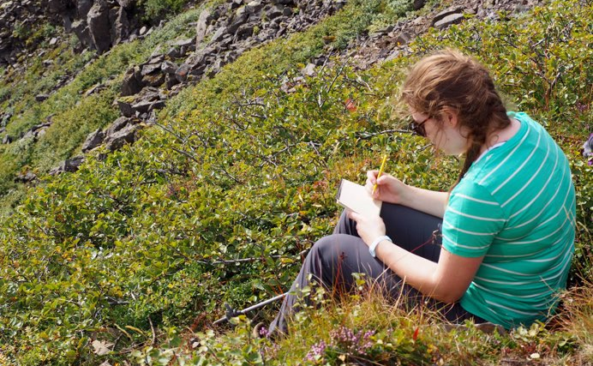
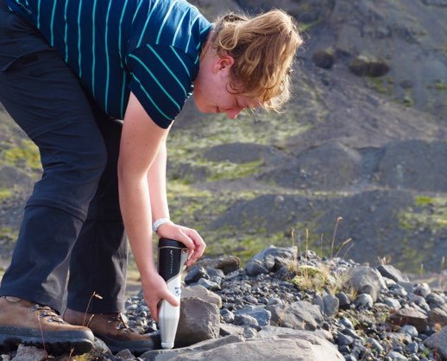
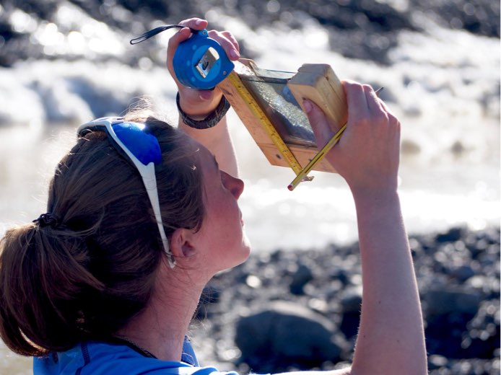
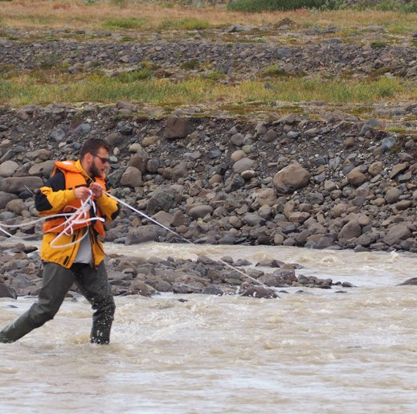
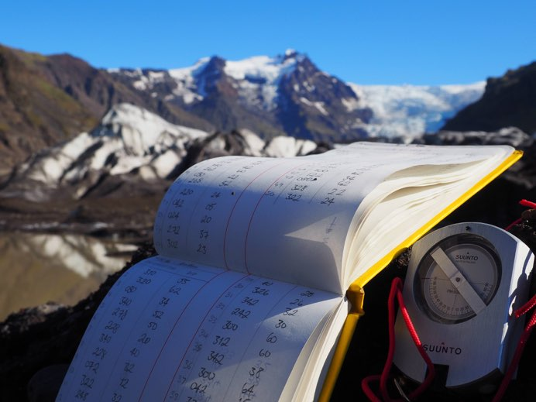
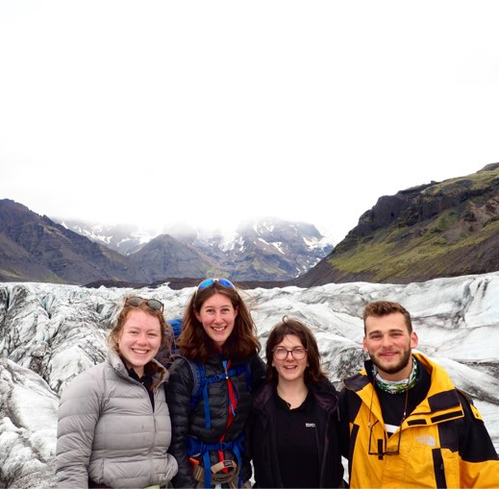
Icelandic Glacier Expedition
EXPEDITION PURPOSE: To explore glacial processes and geomorphology in the temperate glaciers of South East Iceland.
DESCRIPTION: We investigated the glaciers' response to climate change from current dynamics compared to evidence of past behaviour and collected data about subglacial processes like regelation and supercooling at the ice-bed interface.
CHALLENGES: Iceland's weather is notoriously changeable, gauging how serious bad weather could become was important; we had to be extremely flexible to collect all the data we needed and make the most out of each day.
HIGHLIGHTS: It was fascinating to witness the dynamic nature of the glaciers in real time. It was nice to just sit and watch the glacier while eating lunch and notice the tiny ways in which the glacier was constantly changing.
www.thewaterdiaries.com

Slide 18

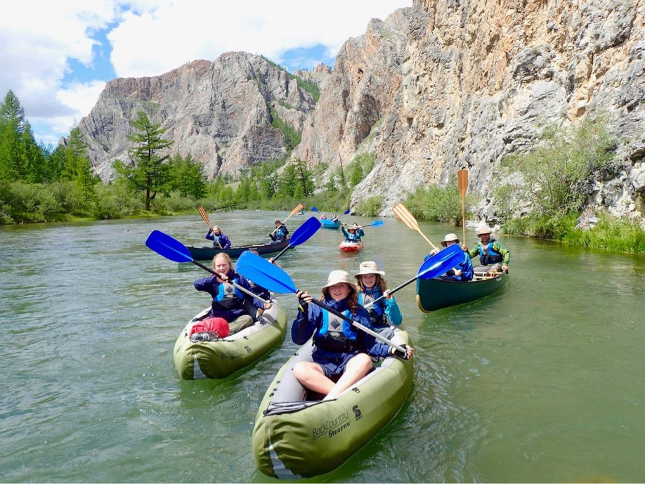
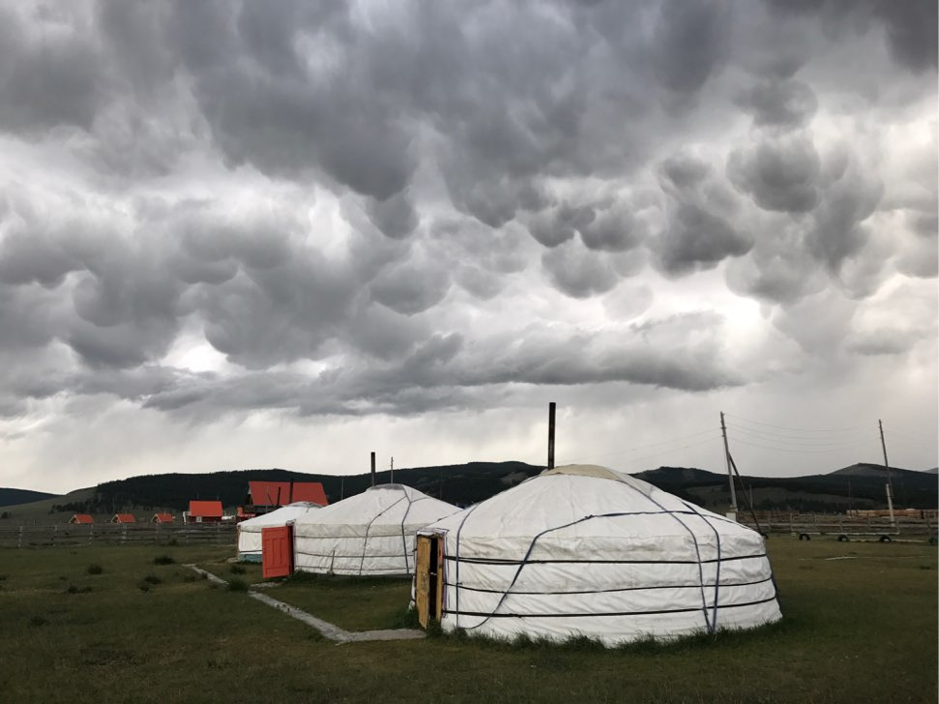
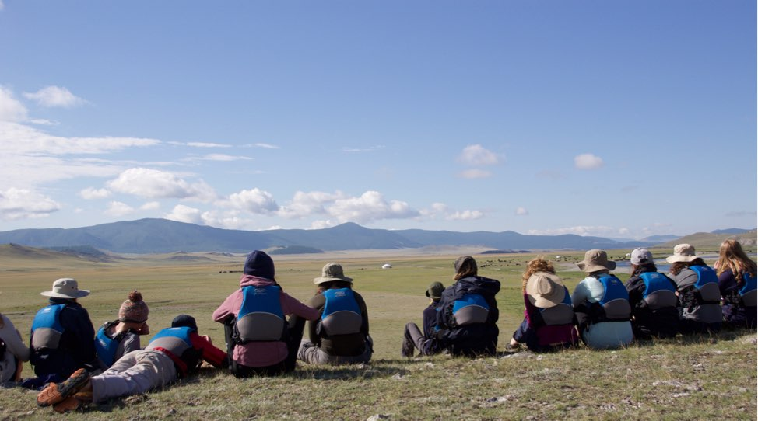
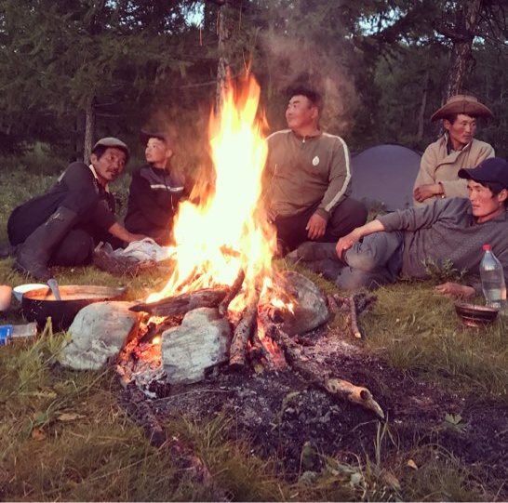
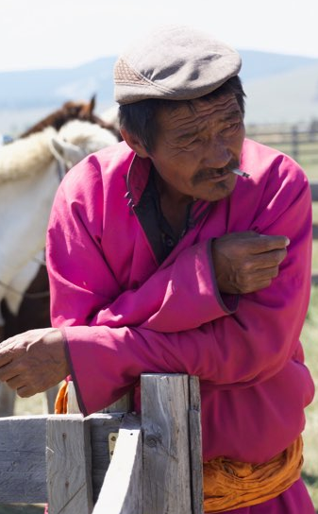
BOHUNT STUDENT EXPEDITION TO MONGOLIA 2017
PURPOSE: To visit remote nomadic communities to understand more about their cultural geography and the role of the young in creating change.
DESCRIPTION: 14 students and 3 adults from Bohunt School spent 3 weeks getting to and from Hatgal in the Lake Khovsgol region of Mongolia by truck, canoe, horse and foot. Whilst there they spent time living and working with nomads.
CHALLENGES: Two accidents meant that the adult leader was hospitalised. This loss of a team member, along with the resultant itinerary changes and a flood, meant the team had to work really hard to maintain positivity at points.
HIGHLIGHTS: Sitting with the Wranglers and drinking tea, singing and chatting about life into the small hours. Seeing nomads going about their day to day lives as we paddled or rode by. Seeing wild horses and eagles and hearing wolves.
www.thewaterdiaries.com

Slide 19
Inspiration
Which Expedition was your favourite?
Why did you choose it?
What do you think you could have added to the expedition if you were part of the team?
www.thewaterdiaries.com

Slide 20
Inspiration
If you could go on an expedition anywhere in the world;
Where would you go?
What environments would you explore?
What would you hope to find?
What questions would you ask?
www.thewaterdiaries.com

Slide 21
Inspiration
Norwegian Fjords
Glaciation
London
Regeneration
Kibera
Informal Settlements
Great Barrier Reef
Coral
Ecosystems
Amazon Rainforest
Deforestation
www.thewaterdiaries.com

Slide 22
RAPID
Planning
Use your sheet to help you plan an expedition.
You have 5 minutes per section.
www.thewaterdiaries.com

Slide 23
RAPID
Planning
TEAM
Team Name: _____________________________
PERSONALITY
LOCATION
EASY TO GET THERE?
SKILLS
WHAT ARE THE RISKS?
WHAT LANGUAGE DO THEY SPEAK?
KNOWLEDGE
EASY TO GET AROUND?
www.thewaterdiaries.com

Slide 24






RAPID
Planning
TOPIC
Team Name: _____________________________
What would you study on your journey?
TRANSPORT
Circle the ways you would travel
Explain your choices of travel:
EQUIPMENT
List the equipment you would need to bring
www.thewaterdiaries.com

Slide 25
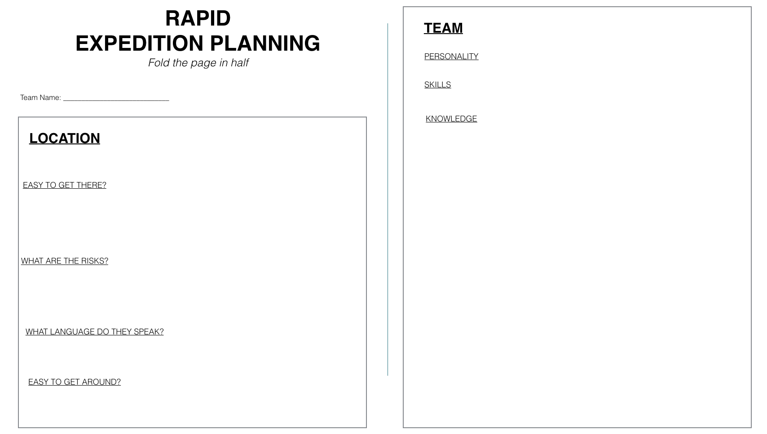
RAPID
Planning
Select a
location
www.thewaterdiaries.com

Slide 26
RAPID
Planning
Think of the characteristics of a good team-mate.
www.thewaterdiaries.com

Slide 27
RAPID
Planning
TOPIC
What would you study on your journey?
Team Name: _____________________________
TRANSPORT
Think of the things you’ve enjoyed studying in Geography. Choose a topic that interests you.
Circle the ways you would travel
Explain your choices of travel:
EQUIPMENT
List the equipment you would need to bring
www.thewaterdiaries.com

Slide 28
RAPID
Planning
TOPIC
The way you travel affects the things you see. Choose a type of travel that fits your topic.
What would you study on your journey?
Team Name: _____________________________
TRANSPORT
Circle the ways you would travel
Explain your choices of travel:
EQUIPMENT
List the equipment you would need to bring
www.thewaterdiaries.com

Slide 29
RAPID
Planning
TOPIC
What would you study on your journey?
Team Name: _____________________________
Think of the equipment you would need for travel and research.
TRANSPORT
Circle the ways you would travel
Explain your choices of travel:
EQUIPMENT
List the equipment you would need to bring
www.thewaterdiaries.com

Slide 30
GROUP
ProjecT
GROUP PROJECT
In a group of FOUR you are going to create an expedition plan.
Follow the instructions on your sheet.
Accountant: Looks after the budget.
Map Maker: Creates the map and organises travel
Scientist: Compiles an equipment list and describes the research
Journalist: Compiles the plan.
www.thewaterdiaries.com

Slide 31
GROUP
ProjecT
MAP MAKER: Looks after the expedition map and travel.
Work closely with the other team members to ensure that the route is followed.
Your job is to produce a digital or printed map showing where the team will travel to, what distances they will cover and what you will encounter on your expedition.
ACCOUNTANT: Looks after the finances and compiles the budget.
Work closely with the other team members, updating the budget to ensure that you do not overspend.
Your job is to produce a balanced budget.
RESEARCHER: Looks after the research on the expedition.
Work closely with the other team members to ensure that the route includes places that are useful for your research and you have the correct equipment.
Your job is to describe the research that the expedition will conduct.
JOURNALIST: Looks after communicating the expedition. Work closely with the other team members to learn about the route and research. Ensure that you have the correct equipment to tell the story from the field.
Your job is to describe, compile and bring together the map, budget and scientific objectives into a press co-ordinated release.
www.thewaterdiaries.com

Slide 32
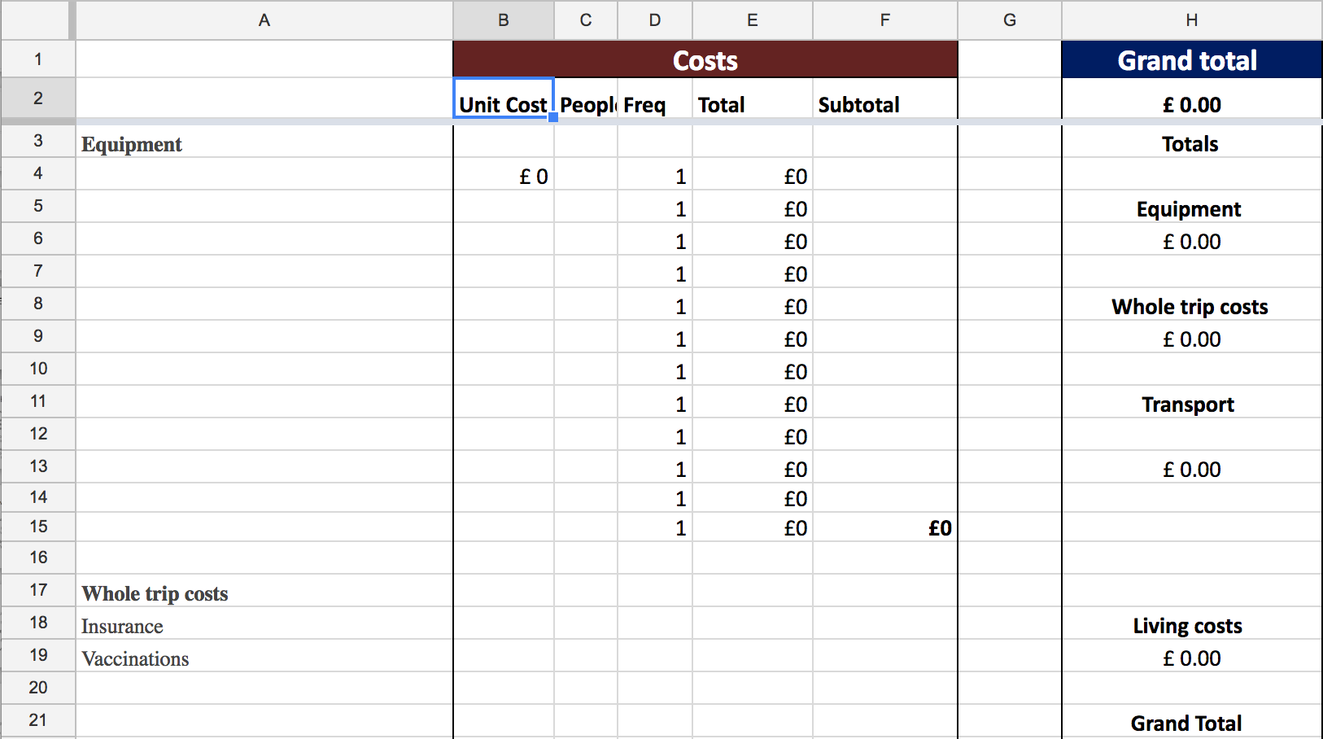
Accountant
Create a budget.
Work closely with the other members of the team to include the costs for travel equipment and communications.
Your budget must not exceed £20,000.
Use the template.
Ensure that your budget is
formatted correctly if you add extra cells.
www.thewaterdiaries.com

Slide 33
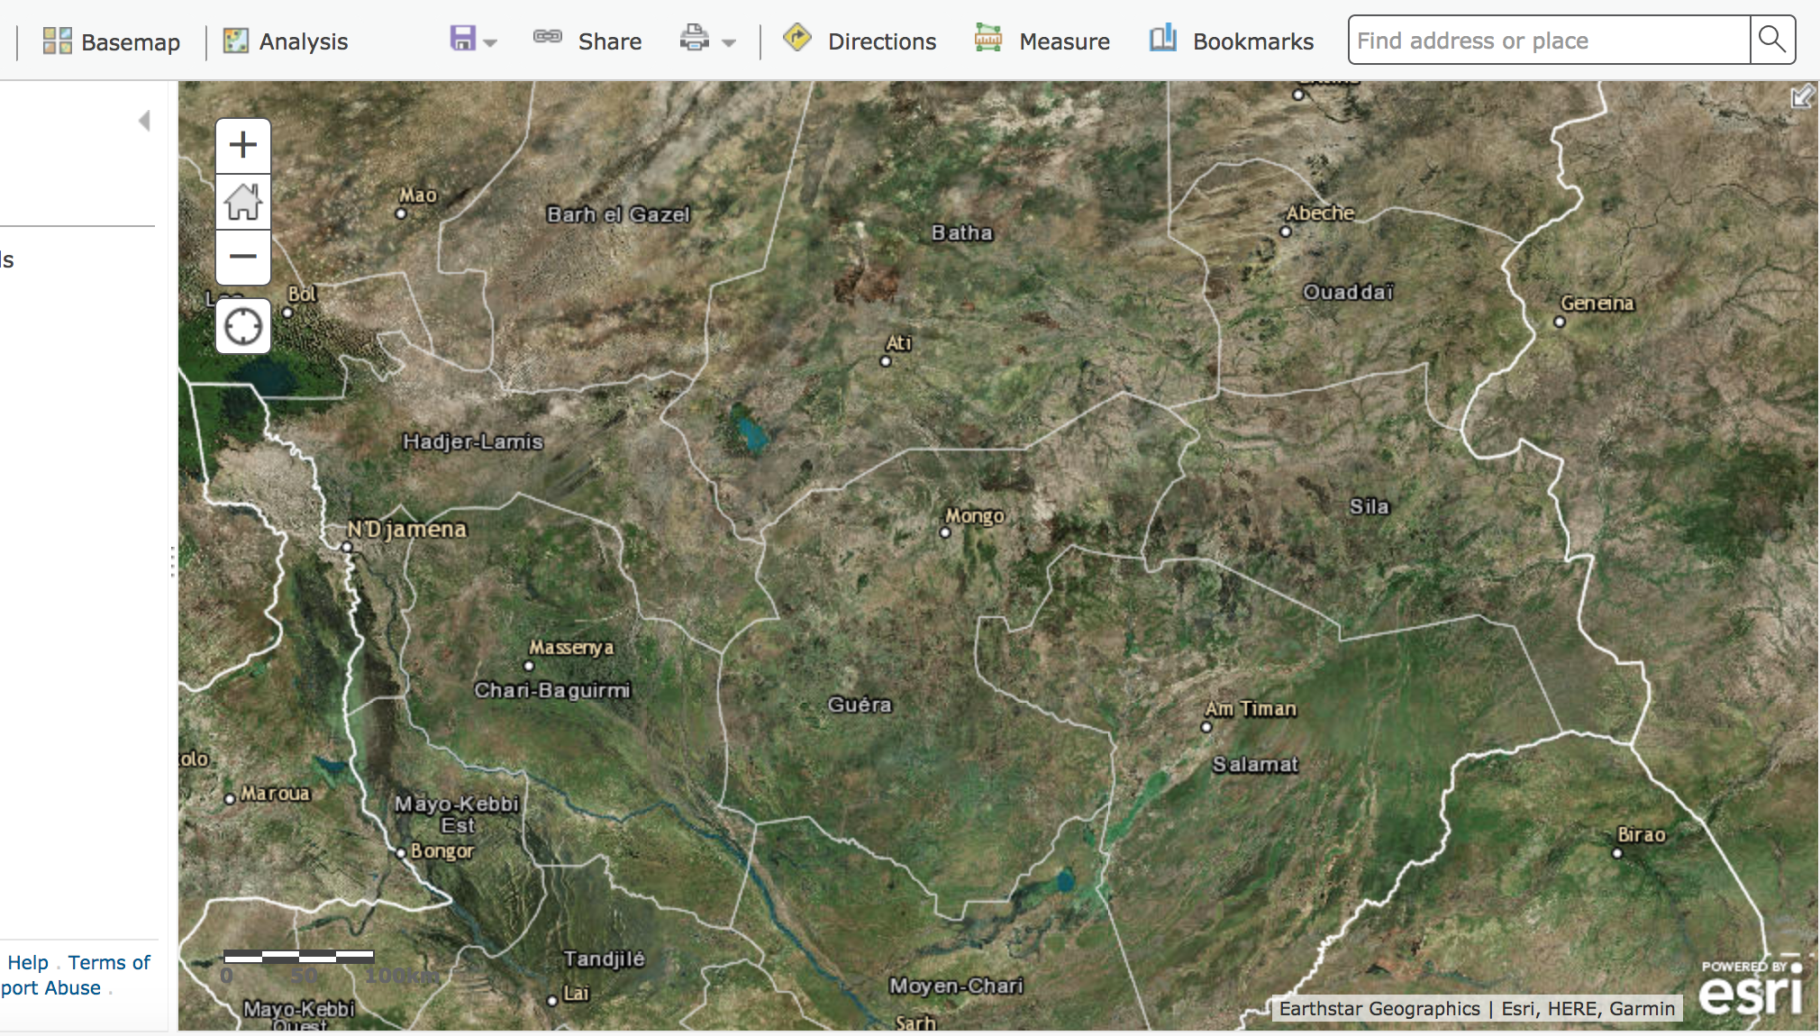
Map MAKER
Create a map using ESRI’s Arc Online.
Work closely with the other members of the team to plot the places that you’ll visit to research your topic.
Research the best modes of travel and provide the Banker with costs of each leg of travel.
Ensure that you take the time to learn how to format your map correctly.
www.thewaterdiaries.com

Slide 34
JOURNALIST
Create a document using the following headings.
  Headline
  Topic
  Route
  Research
  Team
Work closely with the other members of the team to ensure that you have the correct details of your route, research and map.
Produce a two page press release using the headings above.
Ensure that the language in your press release is short and snappy. It is aimed at people who may not have studied Geography so ensure that it is easy to understand.
www.thewaterdiaries.com

Slide 35
RESEARCHER
Create a document and answer the following questions.
  Where are we going?
  What will we study?
  Why is it important to learn more about this?
  What equipment will we need?
  What do we expect to find?
  What challenges do we expect to encounter?
Work closely with the other members of the team to ensure that you have the correct details of your route, research and map.
Produce a one page document using the headings above.
Your language can be technical and should include lots of key words, processes and concepts.
www.thewaterdiaries.com

Slide 36
PLAN AN EXPEDITION
www.thewaterdiaries.com

Slide 37
The water diaries team
Temujin Doran
Fearghal O'Nuallain
Shane McGuinness
Filmmaker
Teacher | Lead
Field Scientist
www.thewaterdiaries.com

Slide 38
SUPPORTED BY
THE RGS LAND ROVER BURSARY 2017
www.thewaterdiaries.com

