Slide 1
Lesson five:
B&B: Cities of Contrast

Slide 2
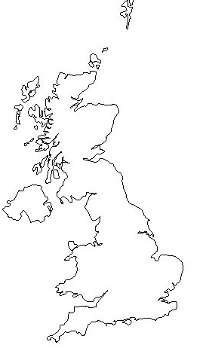
Birmingham and Blackpool – where are they located?

Slide 3
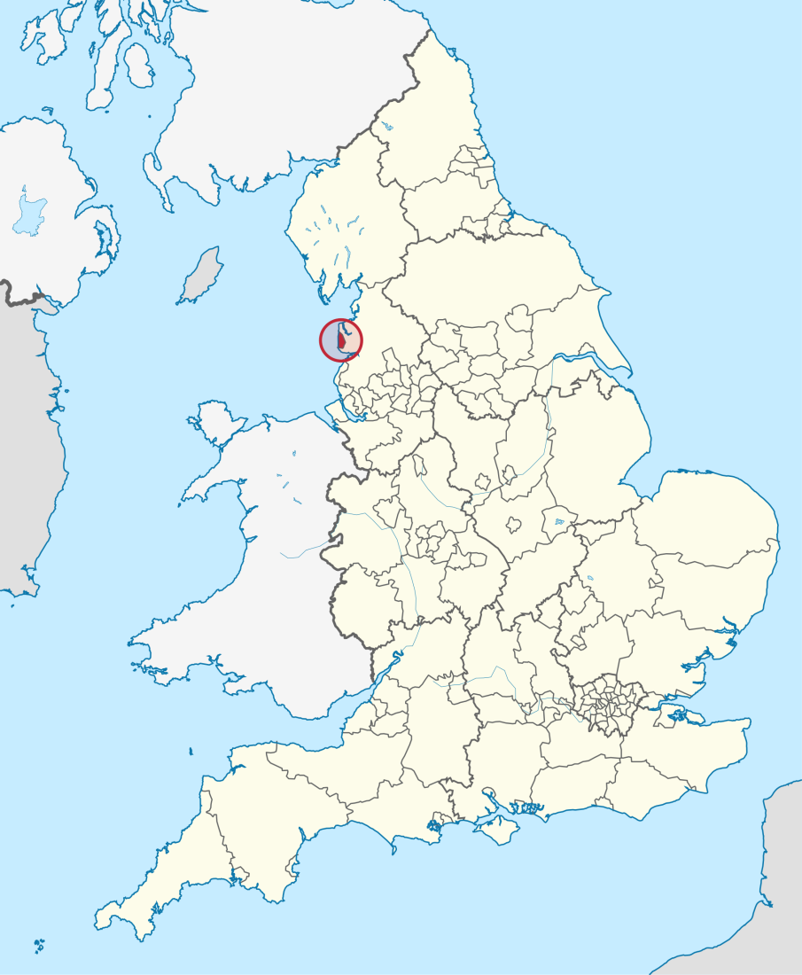
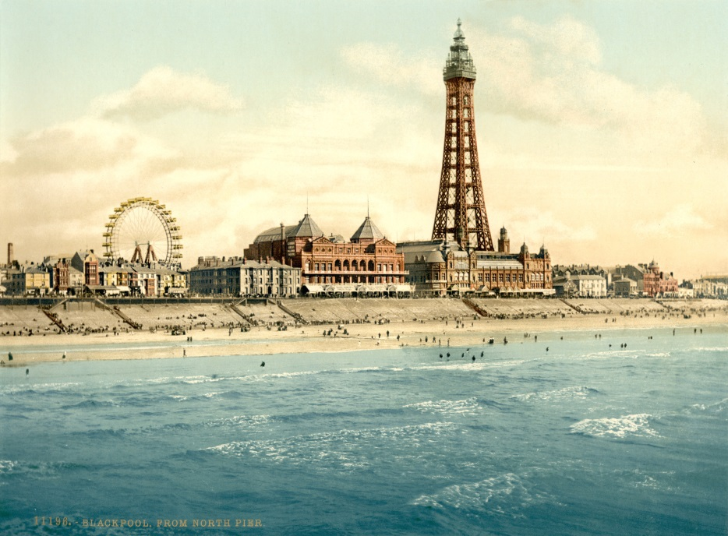
Blackpool
Wikipedia Commons
Wikipedia Commons
Notes:
Google images: File: Blackpool in England (special marker).svg. Accessible at:
https://upload.wikimedia.org/wikipedia/commons/thumb/8/85/Blackpool_in_England_(special_marker).svg/2000px-Blackpool_in_England_(special_marker).svg.png
Google images: Blackpool Tower, de.wikimedia.org. Accessible at: https://upload.wikimedia.org/wikipedia/commons/5/50/Flickr_-_%E2%80%A6trialsanderrors_-_View_from_North_Pier,_Blackpool,_Lancashire,_England,_ca._1895.jpg

Slide 4
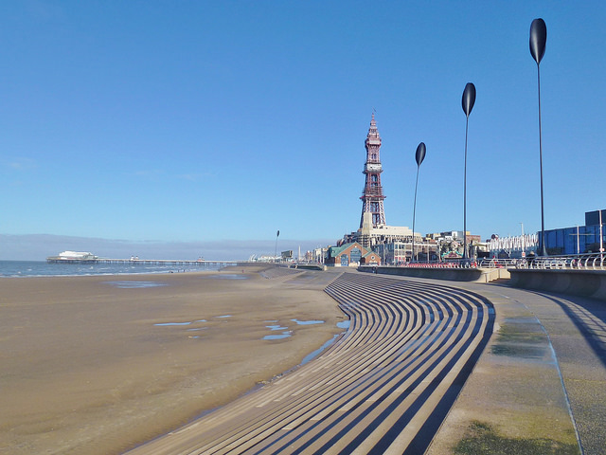
Blackpool: the seaside
Blackpool © Radarsmum67, Flickr:
Notes:
Flickr: Blackpool, Radarsmum67. Accessible at: https://www.flickr.com/photos/radarsmum67/12658136065/in/photolist-nrGiNm-ef2twD-naaxuo-gY6Ths-2thJit-npBqDQ-khyfRg-6KLepk-gY6Qjq-ebfWWX-djWgom-DZDrxa-ebnyoJ-bTa7be-ebSbnx-ebg42R-djWhpJ-9QXuop-2tn655-9R1gbW-9QXsw8-9QXppa-ebXQZb-awYwBp-ebnndJ-a4hXey-ebgeRP-9QXpbe-9QXp4n-bTacQV-4amwXS-9R1mou-a4f5Cz-kgcHeH-awYx7p-9QXuke-ax2dxS-qKSzCY-awYx16-ebSdJi-9QXsSt-awYwop-bTafaR-9QXpsp-awYwva-2thHfr-dm2xuo-dm1ZUk-a4hZU9-awYwKT

Slide 5
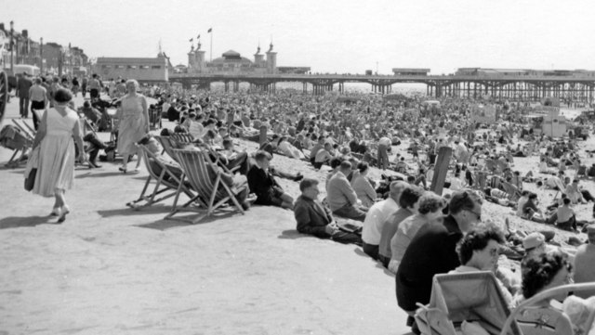
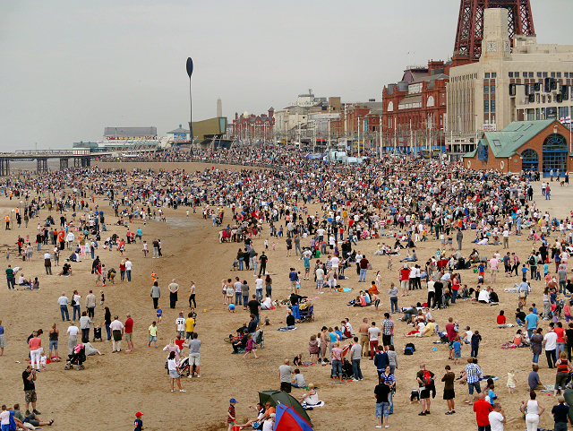
Blackpool: Tourism
Blackpool Beach on a sunny day in 1959. Source: geograph
Crowds on Blackpool Beach © David Dixon Source: geograph
Notes:
Google images: Blackpool Beach, on a sunny day in 1959, www.geograph.org.uk. Accessible at: http://s0.geograph.org.uk/geophotos/04/59/42/4594220_7ab3ff0d.jpg
Google images: Crowds on Blackpool Beach, David Dixon, www.geograph.org.uk. Accessible at: http://s0.geograph.org.uk/geophotos/03/08/82/3088282_695d023d.jpg

Slide 6
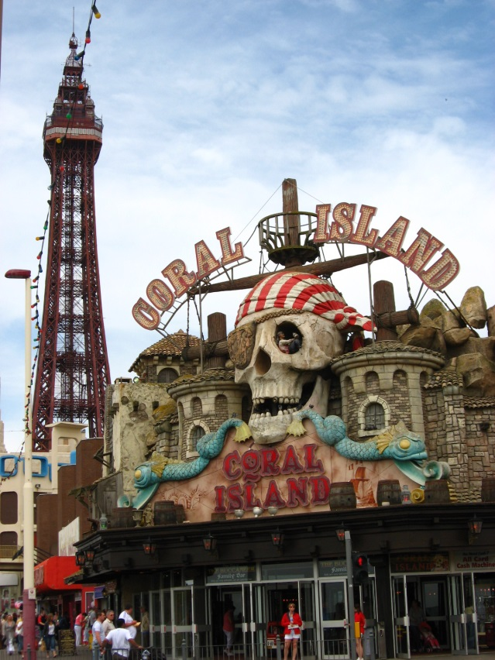
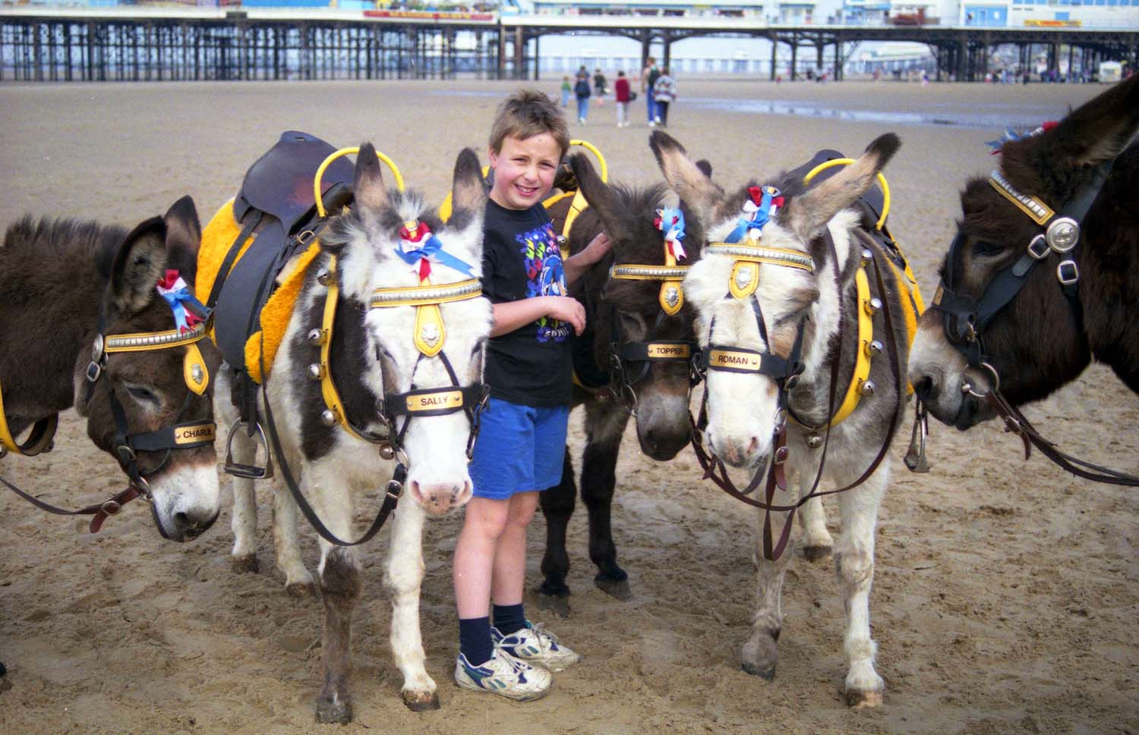
Blackpool: Services
Wikipedia Commons
Wikipedia Commons
Notes:
Google images: Blackpool Tower, en.wikipedia.org. Accessible at: https://upload.wikimedia.org/wikipedia/commons/a/a8/Blackpool_010.jpg
Google images: File: Donkeys on the beach, geograph.org.uk. Accessible at: https://upload.wikimedia.org/wikipedia/commons/f/fb/Donkeys_on_the_beach_-_geograph.org.uk_-_1702482.jpg

Slide 7
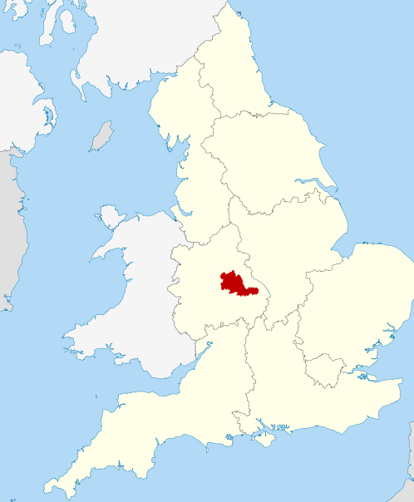
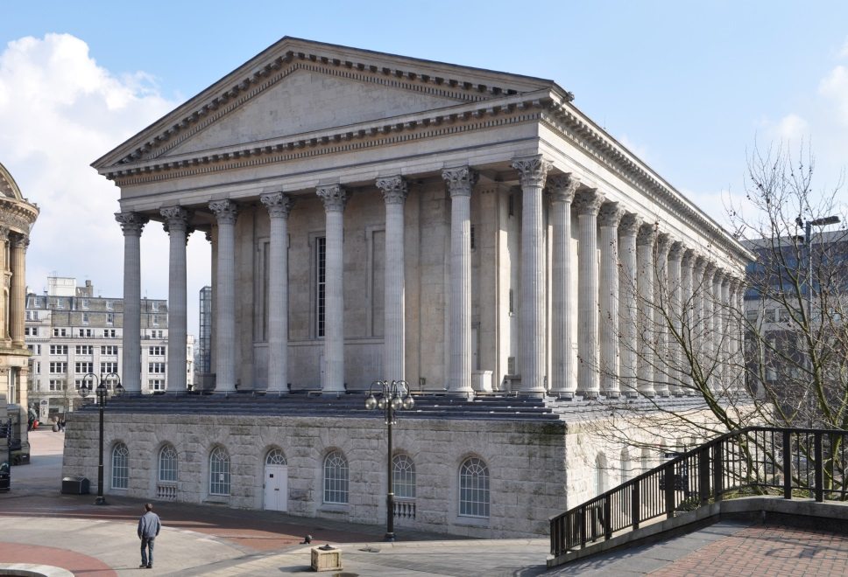
Birmingham
Birmingham Town Hall
Wikipedia Commons
Notes:
Google images: Springfield, Birmingham, en.wikipedia.org. Accessible at: https://upload.wikimedia.org/wikipedia/commons/thumb/3/35/West_Midlands_UK_location_map.svg/2000px-West_Midlands_UK_location_map.svg.png
Google images: Birmingham Town Hall, en.wikipedia.org. Accessible at: https://upload.wikimedia.org/wikipedia/commons/1/1a/Birmingham_Town_Hall_from_Chamberlain_Square.jpg

Slide 8
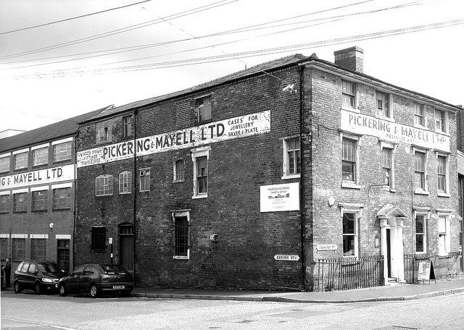
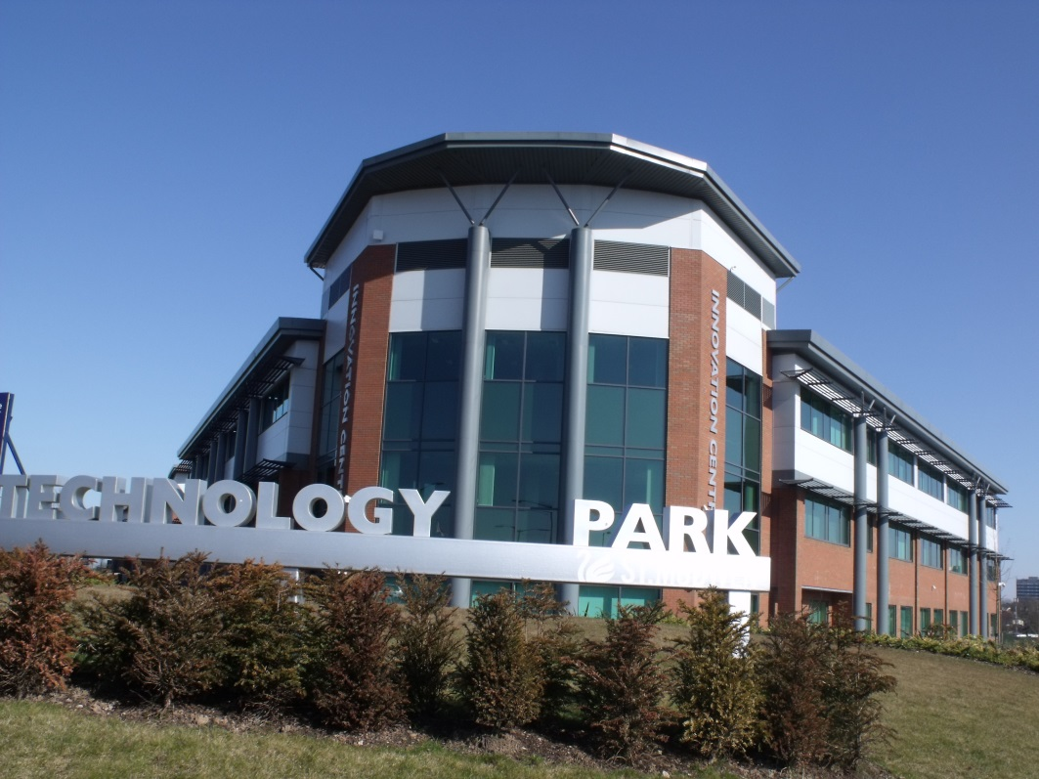
Birmingham : Industry
Pickering & Mayell LTD warehouse, © Jewellery Quarter, Klovovi, Flickr
Wikipedia Commons
Notes:
Flickr: Birmingham, UK. Pickering & Mayell LTD warehouse, Jewellery Quarter, Klovovi. Accessible at: https://www.flickr.com/photos/klovovi/7710432722/in/photolist-cKkZ2d-7s2L5y-5f2Zzf-4bV1DS-jZx9Bp-91gdyR-anZrjy-cULiWC-eueWEY-d5d4AL-oxuqjq-7mKnzm-8PgKiy-7nMWbf-7rtSKN-jJn2ZC-nTZZfN-guz8tX-cJZZ31-7gqoyB-h6sN9j-6x39FX-7RVgjD-beo4HH-oBbxp-k47vRL-ofce5H-d9ZJa-7mFvWH-75qDbw-bA52Vt-7AEhJg-6RRLvH-dMxYtM-7P2MGq-g3E5YK-96ToQw-7oJQkD-nDTsqe-7AJ1m9-9acZzF-6PmBRp-edfndd-6xmG7C-7ncq6F-e3CYpG-d856cG-7pJSGQ-8JxgZ6-9trfNj
Google images: Longbridge, en.wikipedia.org. Accessible at: https://upload.wikimedia.org/wikipedia/commons/c/c7/Longbridge_Technology_Park_-_Innovation_Centre.jpg

Slide 9
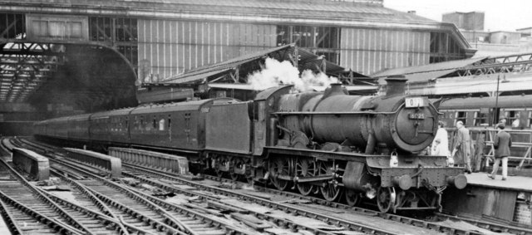
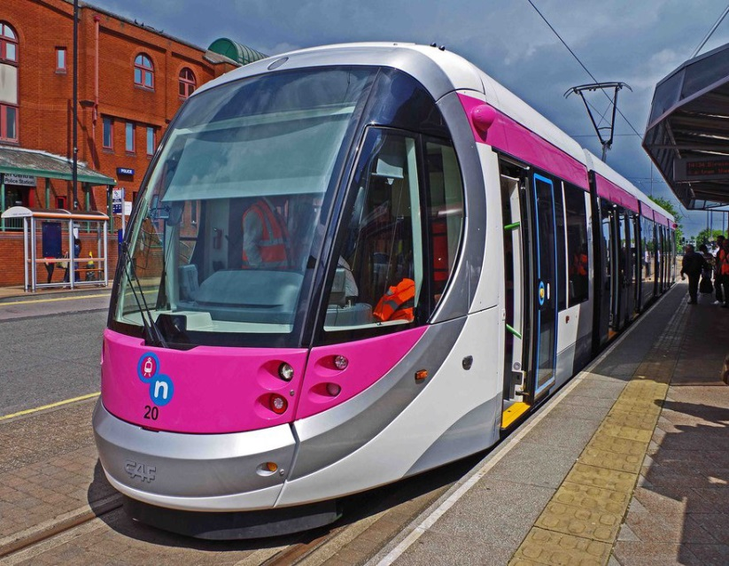
Birmingham: Transport
geograph
Wikipedia Commons
Notes:
Google images: Birmingham Snow Hill Station, down side view south, with express from Portsmouth, www.geograph.org.uk. Accessible at: http://s0.geograph.org.uk/geophotos/02/48/02/2480291_3f70fbb0.jpg
Google images: Centro (Network West Midlands), en.wikipedia.org. Accessible at: https://upload.wikimedia.org/wikipedia/commons/f/f9/Midland_Metro_tram_no._20_on_display_at_St._Georges,_Bilston_Street,_Wolverhampton,_geograph-4028311-by-P-L-Chadwick.jpg

Slide 10
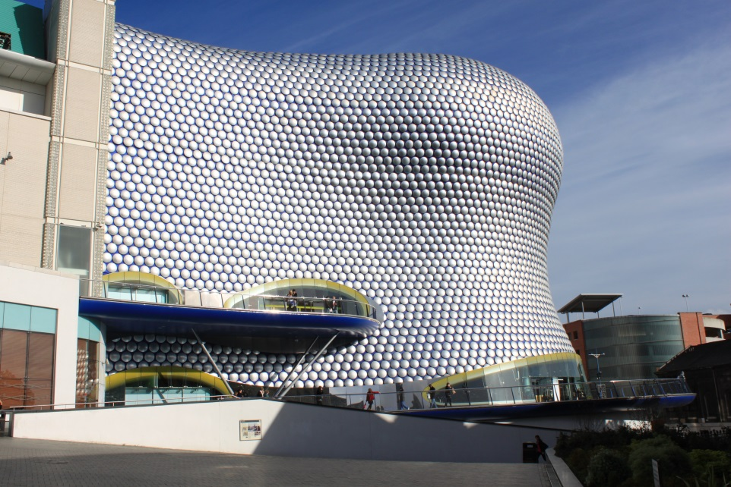
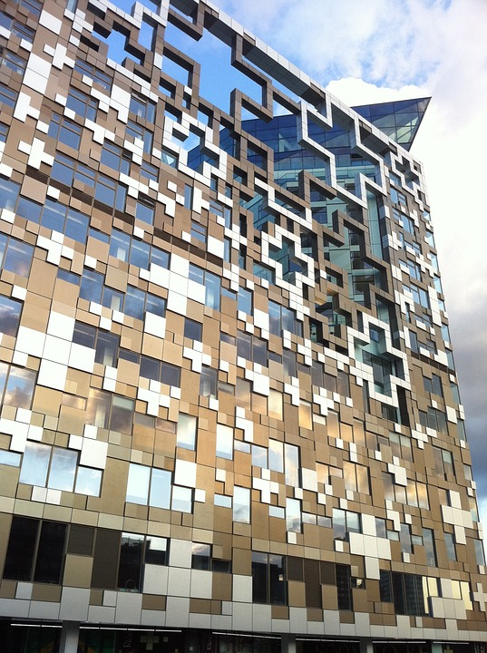
Birmingham: Business
Birmingham – Ringbull – Selfridges
The Cube Building
Wikipedia Commons
The Cube Building Architecture Façade Design © glidagida, pixabay
Notes:
Google images: File: Birmingham – Ringbull – Selfridges, commons.wikimedia.org. Accessible at: https://upload.wikimedia.org/wikipedia/commons/4/45/Birmingham_-_Ringbull_-_Selfridges_2.JPG
Pixabay: The Cube Building Architecture Façade Design, glidagida. Accessible at: https://pixabay.com/en/the-cube-building-architecture-973839/

