Slide 1
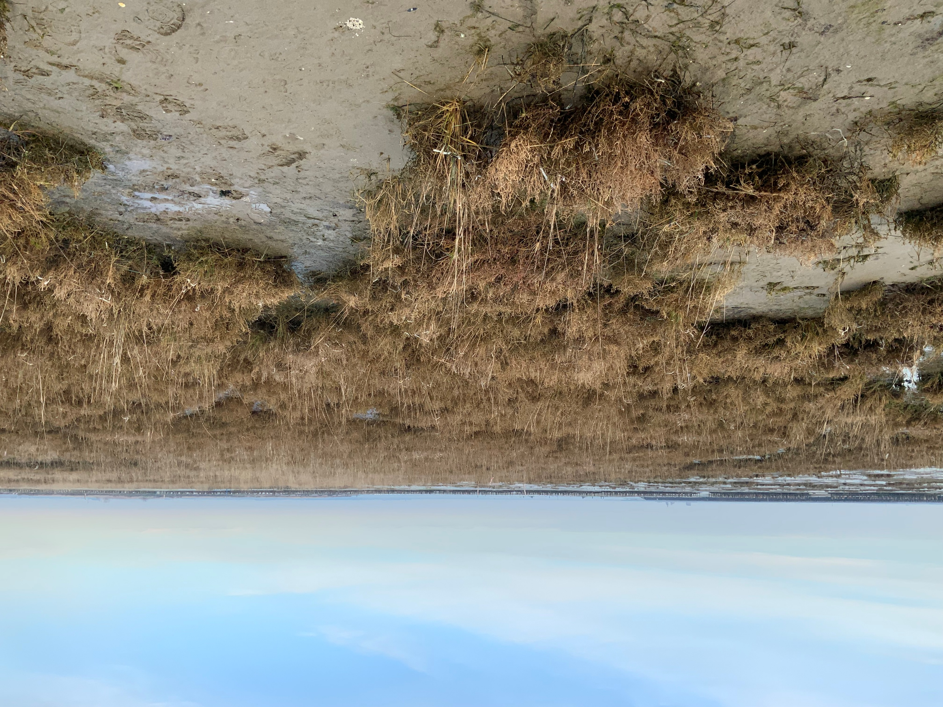
Salt marsh and coastal lagoons
Photo of blanket bog at Cuilcagh-Anierin Special Area of Conservation, Ireland (D.Anderson)
Photo of salt marsh at Lago Bastia, WaterLANDS Action Site, Venice Lagoon, Italy (D.Anderson)

Slide 2
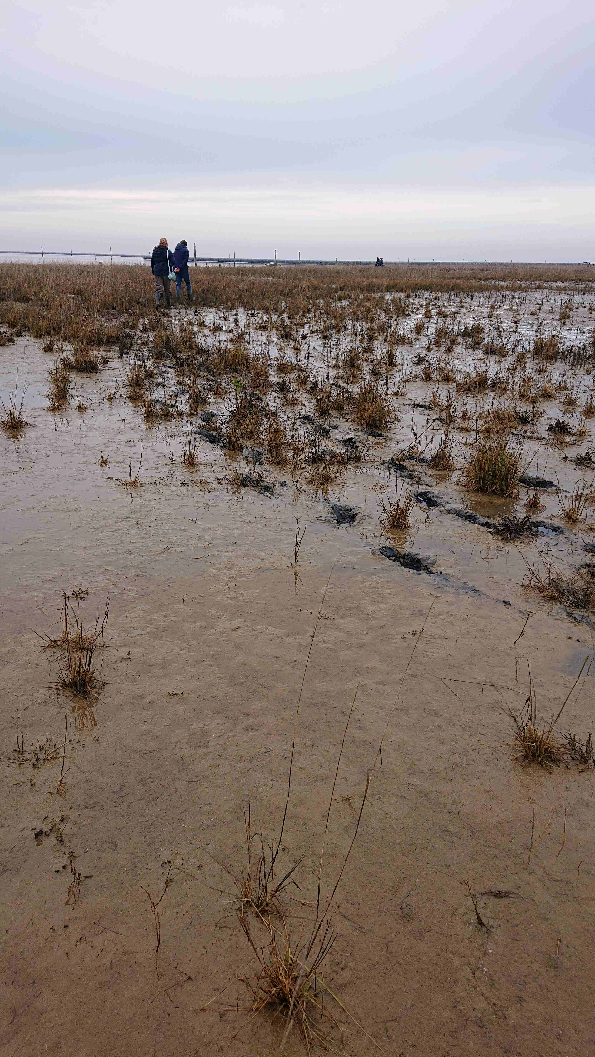
What is salt marsh?
Salt marsh is a low-lying coastal wetland environment that forms under calm water conditions within the intertidal zone.
  Salt marshes are alternately flooded and drained as the tide rises and falls.
  Different types of salt tolerant plants (halophytes) are adapted to grow at different levels of the marsh in relation to the tides.
Salt marsh plants colonize (and help to accumulate) muddy deposits of fine-grained particles (clay and silt).
As with terrestrial peatlands, the waterlogged and anoxic (low oxygen) conditions lead to the buildup over time of peat.
  Peat is an organic rich substance, made up of the remains of partially decomposed plants, of which at least 30% of the dry weight is organic.
Salt marsh at Lago Bastia, WaterLANDS Action Site (S.McGuinness)
Salt marsh plants colonize deposits of mud
(mud flats) once the upper surface of the mud
is exposed at about the average tide level.

Slide 3
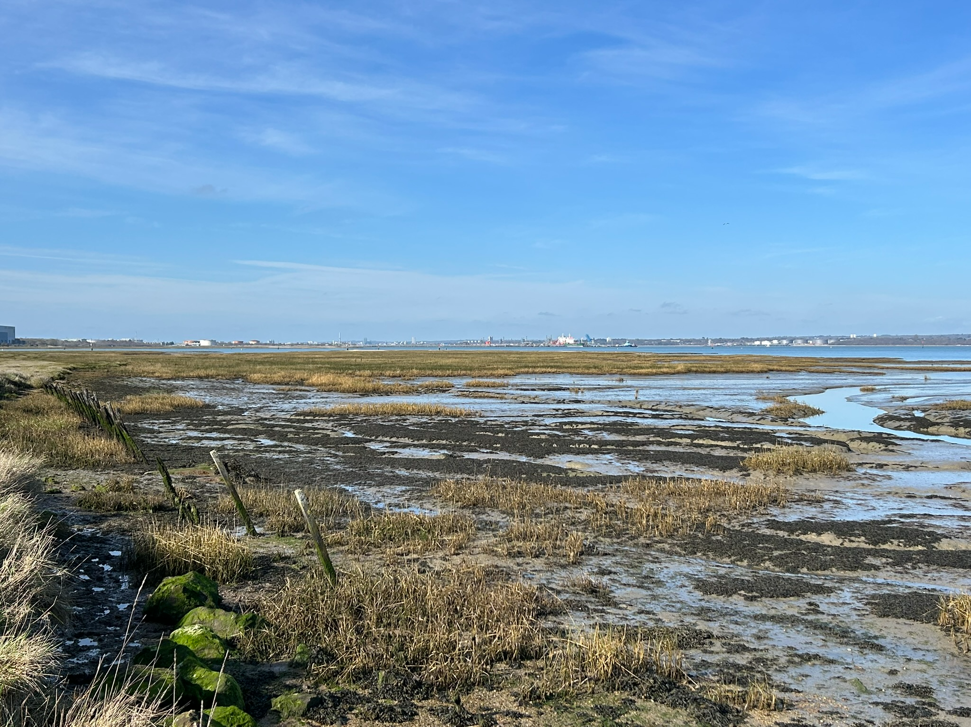
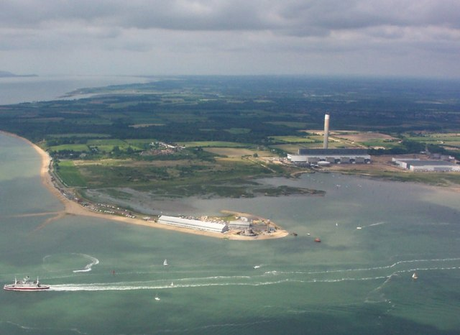
Conditions for salt marsh formation
The formation of salt marsh requires low wave energy, as well as an input of mud.
  The mud (clay and silt particles) are part of the suspended load of streams that reach the coast.
  Calm water conditions, along with the process of flocculation, enable microscopic clay particles to clump together and deposit.
Such conditions are found in estuaries, behind spits, and in coastal lagoons.
Salt marsh at Calshot, England (D.Anderson)
Salt marsh in the sheltered area behind Calshot Spit,
Hampshire, England. Photo taken at low tide.
Calshot Spit - Wikipedia

Slide 4
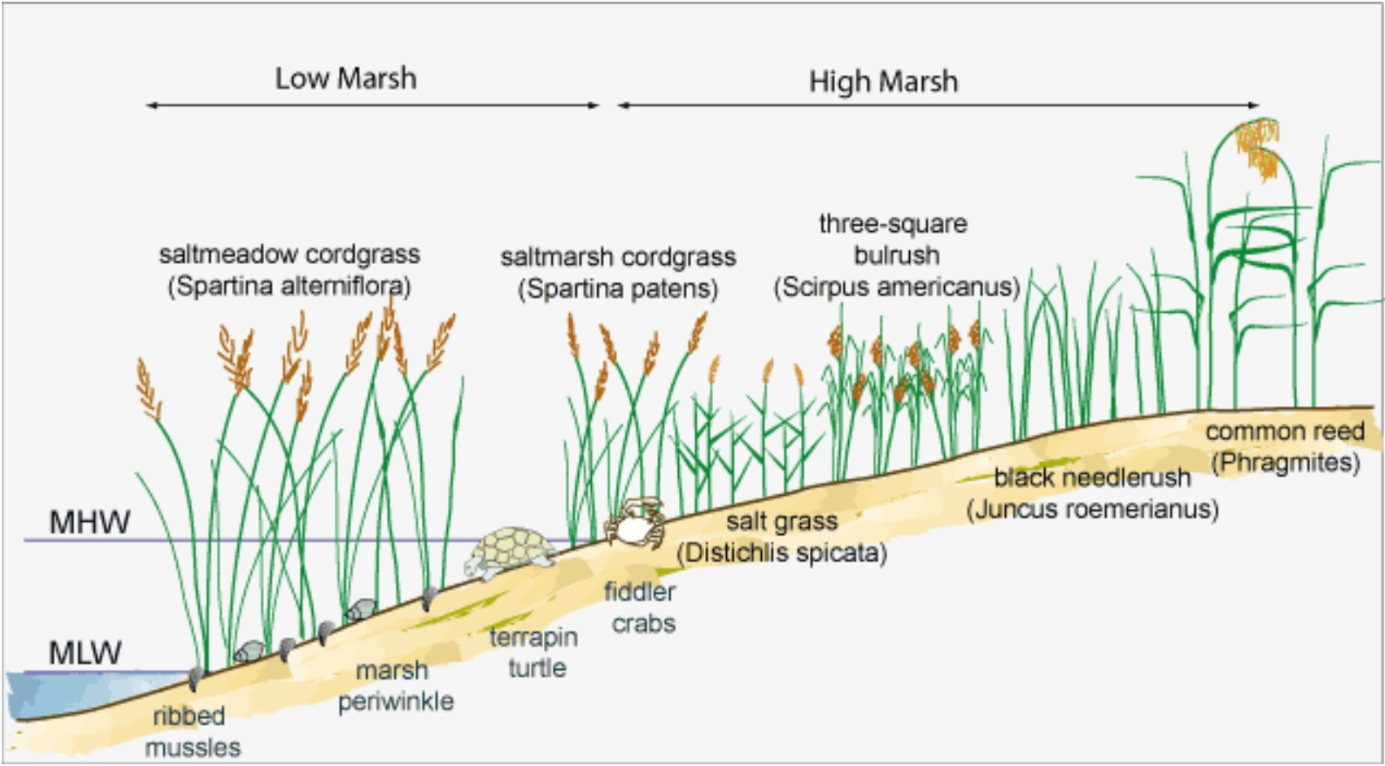
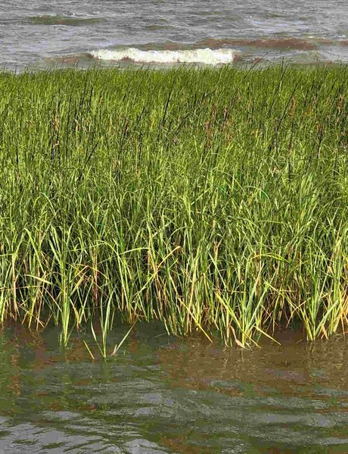
Processes in salt marsh formation
Microscopic clay particle surfaces are negatively charged, so repel each other.
To come out of suspension and be deposited, positive ions in sea water (e.g. sodium and calcium) neutralize the negative charge between clay particles, enabling them to stick together (flocculation).
  This forms clumps of mud that can fall through the water column.
Mud builds up if the net input from streams exceeds erosional loss by wave action and currents. Mats of blue-green algae also help to hold the mud.
With sufficient deposition, mud flats form that start to be colonized by specially adapted plants, initiating a process of plant succession.
Cordgrass colonizes the low marsh.
File:SpartinaAlterniflora.jpg - Coastal Wiki
File:ZonationSaltMarshes.jpg - Coastal Wiki

Slide 5
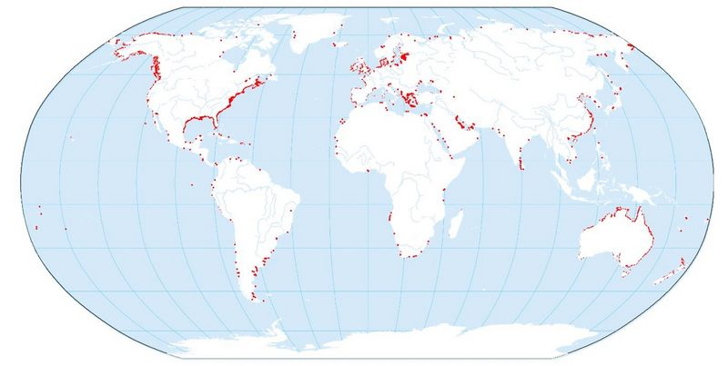
Global distribution of salt marsh
Salt marsh is widely distributed in the mid to high latitudes along low-lying and sheltered areas of the coast. Globally, it covers an area of under 53,000 km².
In lower latitude regions (between about 25°N and S), mangrove forest typically develops along coasts, rather than salt marsh.
File:GlobalDistributionSaltMarshes.jpg - Coastal Wiki
General distribution of salt marsh. Note that specific plant composition varies according to regional and local conditions.

Slide 6
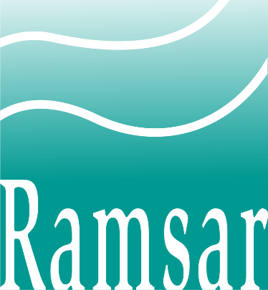
Classification of salt marsh
Ramsar classification
  The Ramsar Convention is an international treaty promoting the ‘conservation and wise use’ of wetlands that came into force in 1975.
  The ‘Ramsar wetland typology’ (classification) divides wetlands into three broad groups: marine/coastal, inland, and human-made.
  There are 12 categories of marine/coastal wetland, salt marsh is placed within type H, defined as: intertidal marshes; includes salt marshes, salt meadows, saltings, raised salt marshes; includes tidal brackish and freshwater marshes.
Salt marsh varies along an elevational gradient.
  Low marsh is the area most frequently inundated, with highest level of salinity. Salt tolerant, pioneer species, inhabit this zone, such as cordgrass (Spartina species) and glassworts (Salicornia species).
  Middle marsh is a transitional zone, where the mud is more stabilized and plant biodiversity is higher, including plants such as salt grass (Puccinellia species), sea purslane, and sea aster which become more abundant.
  High marsh is less frequently inundated by tides, so having a lower salinity. Plants more adapted to brackish water colonize, such as sea lavender, and species of rushes and reeds.
  With continued elevational gain and improved soil fertility, shrubs and trees eventually colonize the higher areas furthest back from the sea.

Slide 7
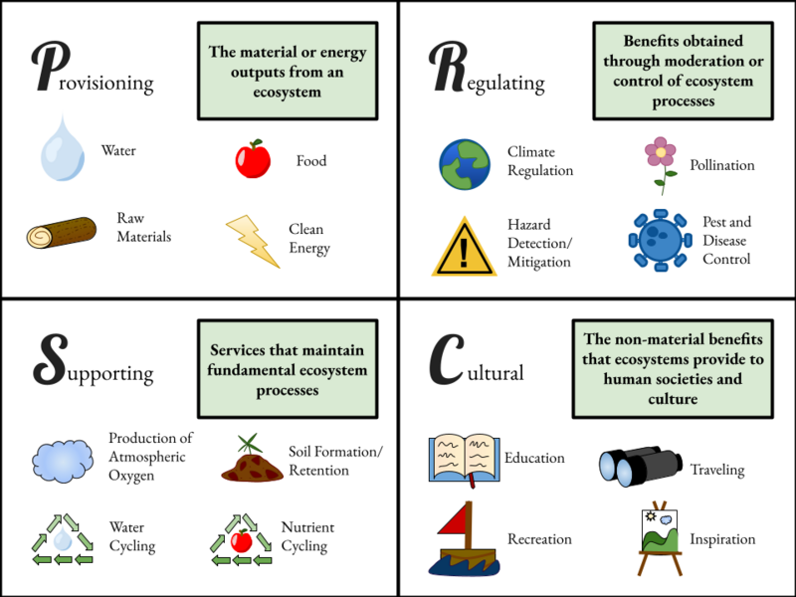
Salt marsh ecosystem services
Salt marsh is important for:
Coastal protection
  Slows tidal flows, absorbs wave energy and reduces erosion, defends coastal settlements against flooding and storm surge.
Habitat and biodiversity
  Nursery or food source for 75% of commercially valuable fish and shellfish.
  Supports many species of birds and a wide range of other organisms.
Pollution control
  Buffer for agricultural, industrial, or domestic pollution running off the land.
Carbon sequestration (a ‘carbon sink’)
  Very effective at accumulating carbon (per area, 50 times more effective at carbon sequestration than forests).
Recreation (outdoor activities, local economy)
Cultural/spiritual reasons (traditions, sense of place and connection to nature)
Generalized summary of types of ecosystem services (Wikipedia Creative Commons)

Slide 8
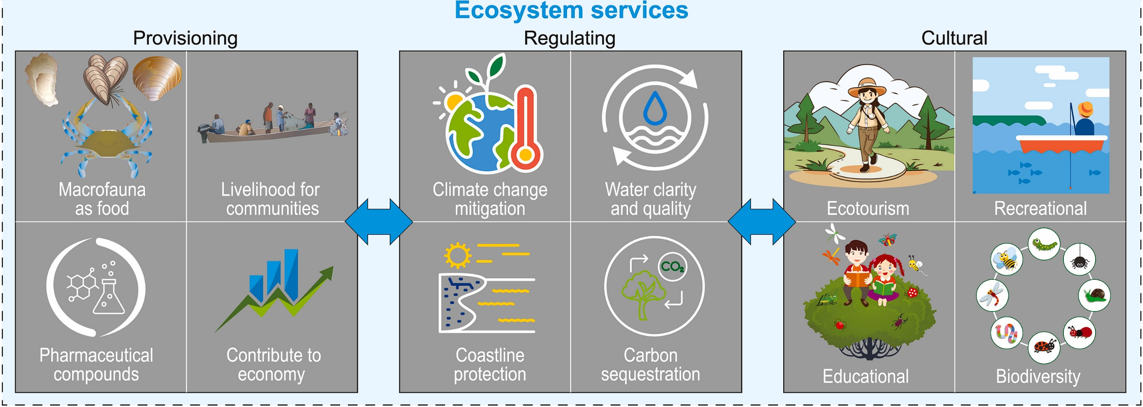
Salt marsh ecosystem services
Ecosystem services: functions or effects of natural ecosystems that provide direct or indirect benefits to people.
  Summary diagram of provisioning, regulating, and cultural services provided by salt marshes.
  Source: Salt marsh macrofauna: An overview of functions and services – ScienceDirect (Creative Commons, by 4.0)

Slide 9
The value of salt marsh for ‘blue carbon’
Blue carbon:
  Refers to organic carbon that is sequestered (absorbed) and stored by the oceans and coastal ecosystems.
Globally, the most important coastal ecosystems for storing blue carbon are, in order, mangrove forests, sea grass meadows, and salt marshes.
Similar to terrestrial peatlands, salt marshes accumulate organic matter much faster than it can decompose, due to waterlogged, anaerobic conditions.
The high rates of biological productivity of salt marsh leads to the formation of deep peat deposits. Accumulation rates can exceed 200 gCO₂/m²/year.
  Global carbon sequestration in tidal, saline wetland soils - Chmura - 2003 - Global Biogeochemical Cycles - Wiley Online Library
The presence of sulphate in coastal wetlands inhibits methane (CH₄) production, in contrast with terrestrial wetlands.
Coastal wetlands are almost ten times as effective as terrestrial peatlands at accumulating carbon per unit area, and they are more carbon dense, so storing more per unit area.

Slide 10
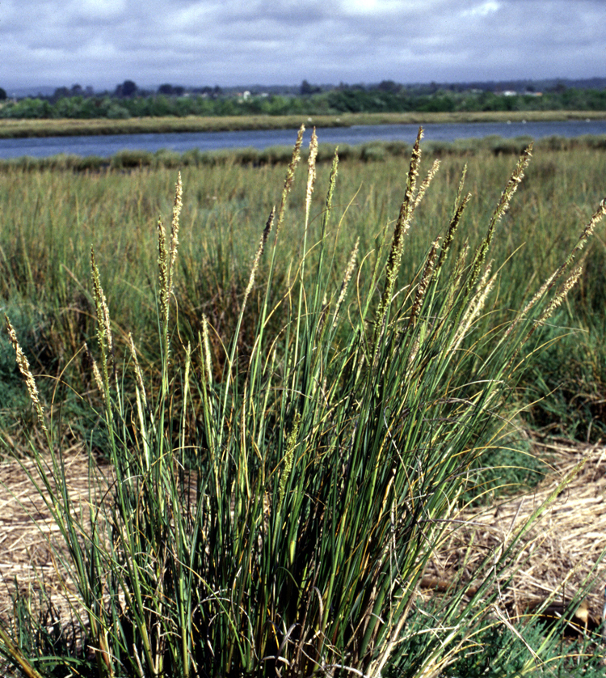
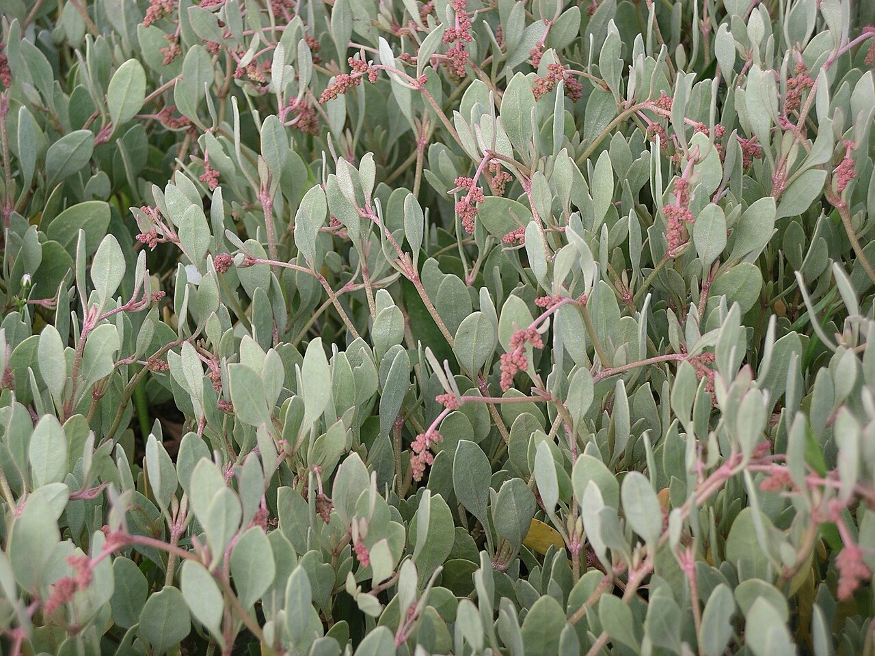
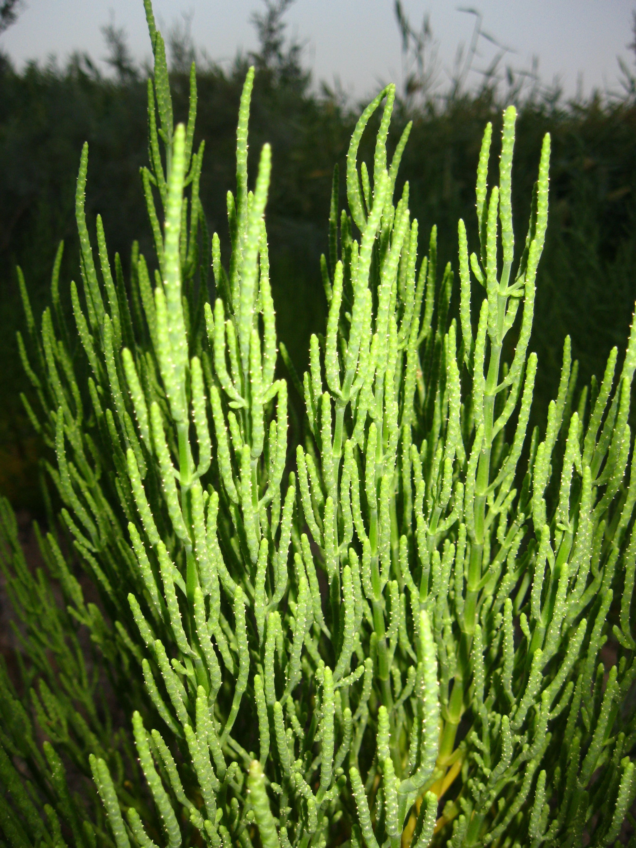
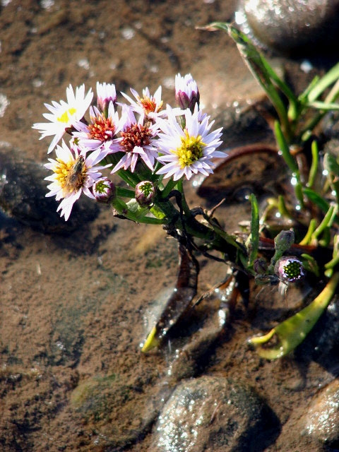
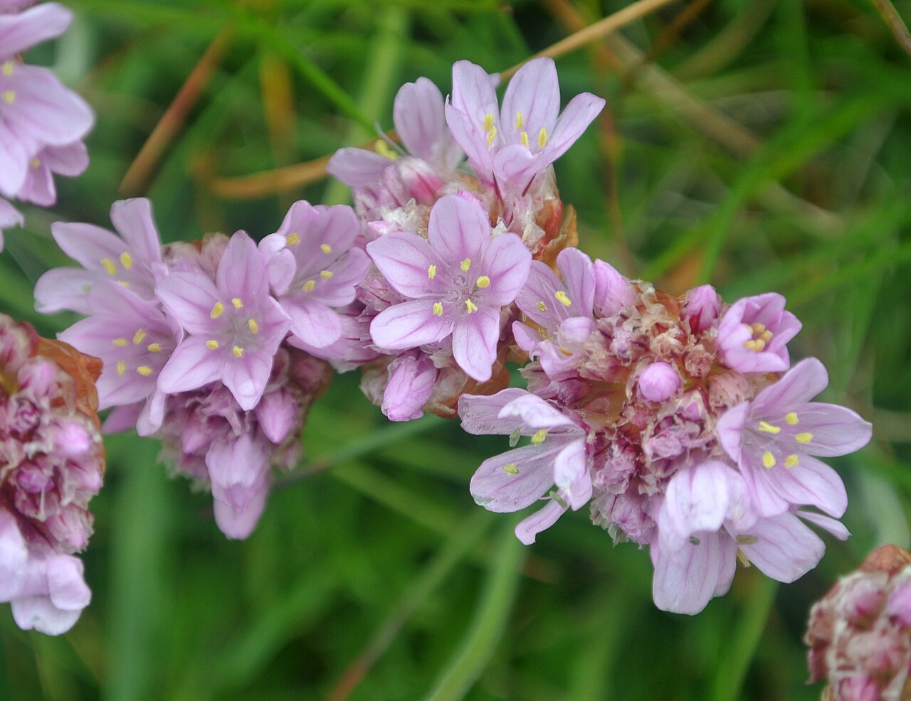
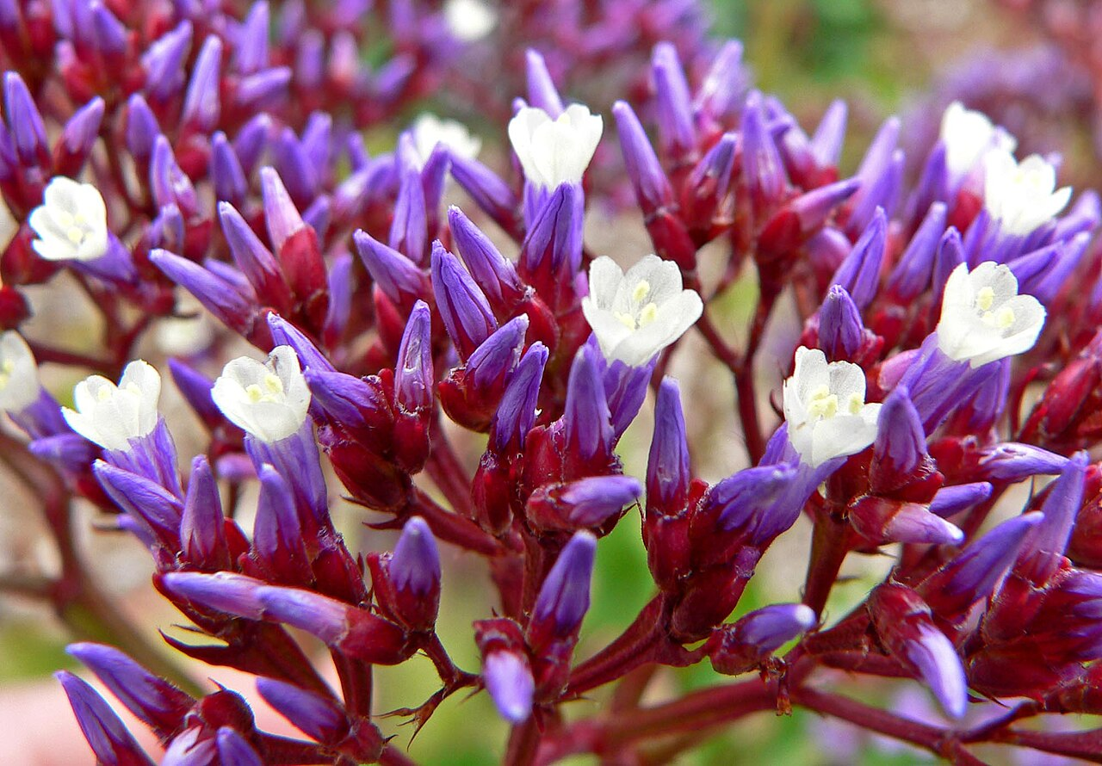
Biodiversity of salt marsh
Cordgrass (Spartina spp.)
Glasswort or marsh samphire (Salicornia spp.)
Sea purslane (Halimione portulacoides)
Sea aster (Tripolium spp.)
Sea lavender (Limonium spp.)
Sea thrift (Armeria maritima)
Examples of salt marsh plants
Source of photos: Wikipedia Creative Commons

Slide 11
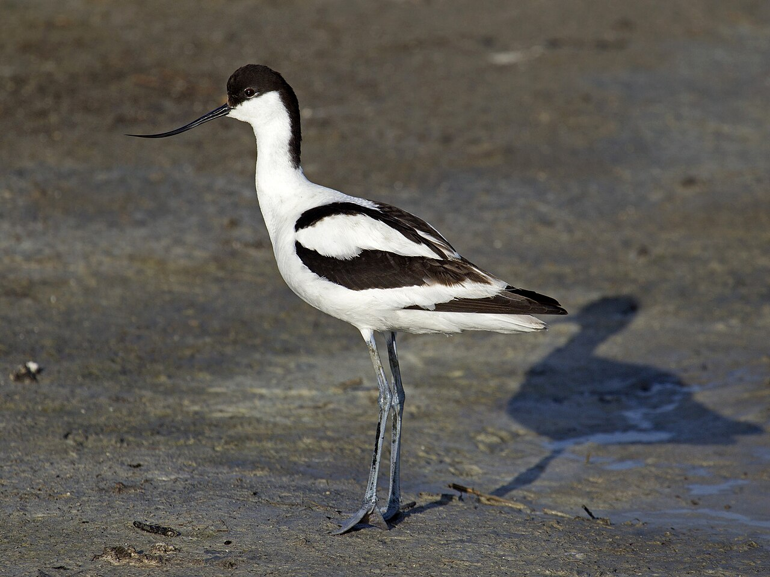
Biodiversity of salt marsh
Salt marsh habitat supports a vast range of organisms.
  Invertebrates include insects, worms, molluscs (e.g. clams, mussels, snails), crustaceans (e.g. shrimps, crabs).
  A great diversity of birds rely on salt marsh (both permanent and migratory). Well known wading birds include herons, curlews, avocets, and oyster catchers.
  Different levels of salt marsh support various species of fish, mammals, and some specially adapted amphibians.
Pied avocet (Andreas Trepte Vögel in Deutschland - in Deutschland,) Wikipedia Creative Commons)

Slide 12
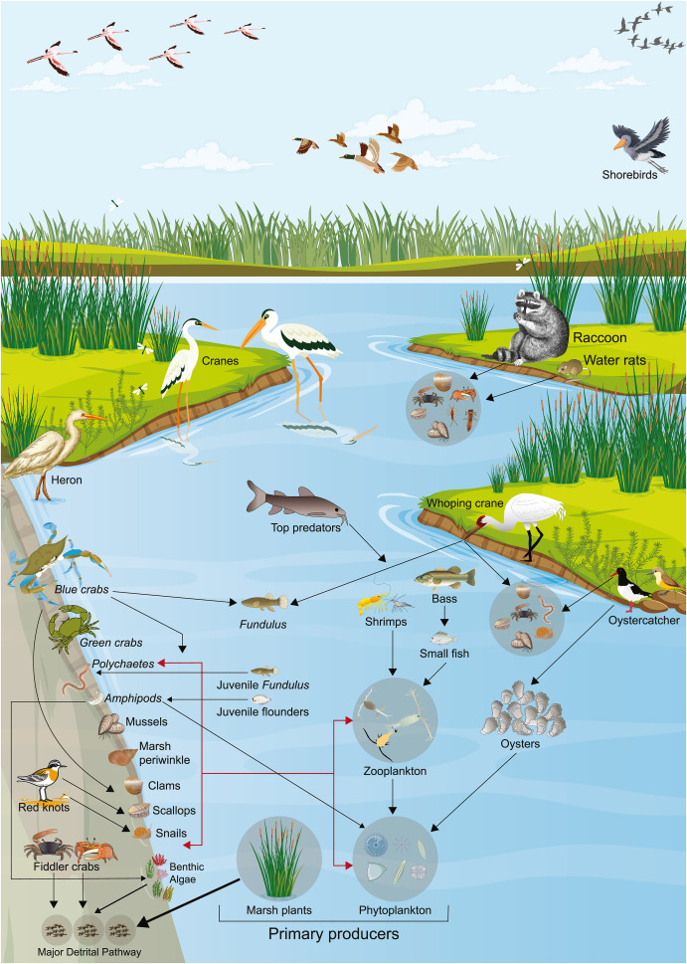
Biodiversity of salt marsh
This illustration provides an example of a food web in a North American salt marsh.
Notice the interconnections between different organisms.
Consider how the ecosystem would change if any one organism is removed.
Source: Salt marsh macrofauna: An overview of functions and services - ScienceDirect (Creative Commons, CC by 4.0)

Slide 13
Coastal lagoons
Coastal lagoons are shallow bodies of water sheltered from the open sea by barrier beaches, islands, or reefs.
They form along low gradient coastlines and have areas of brackish water, due to mixing between sea water and fresh water from streams.
On geological timescales they are short-lived systems that respond dynamically to sea level changes and changes in sediment inputs/outputs from terrestrial and marine processes.
They are usually connected to the open sea by passages (inlets) between barrier islands.

Slide 14
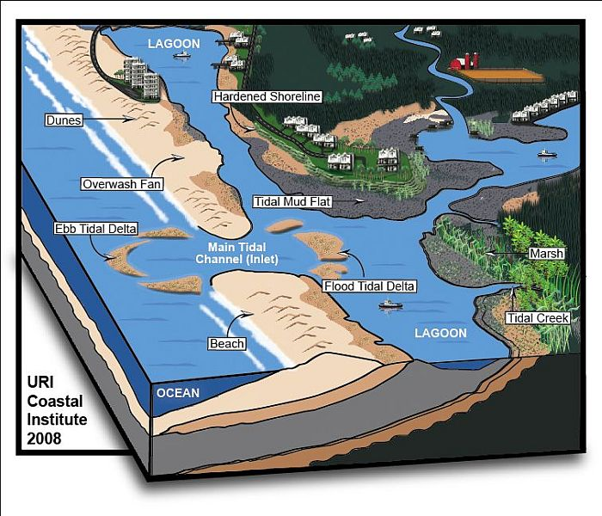
Features of coastal lagoons
Coastal lagoons extend along around 15% of the world’s coasts.
This illustration shows the types of features that are characteristic of coastal lagoons.
http://www.ecologyandsociety.org/vol14/iss1/art8/figure1.html

Slide 15
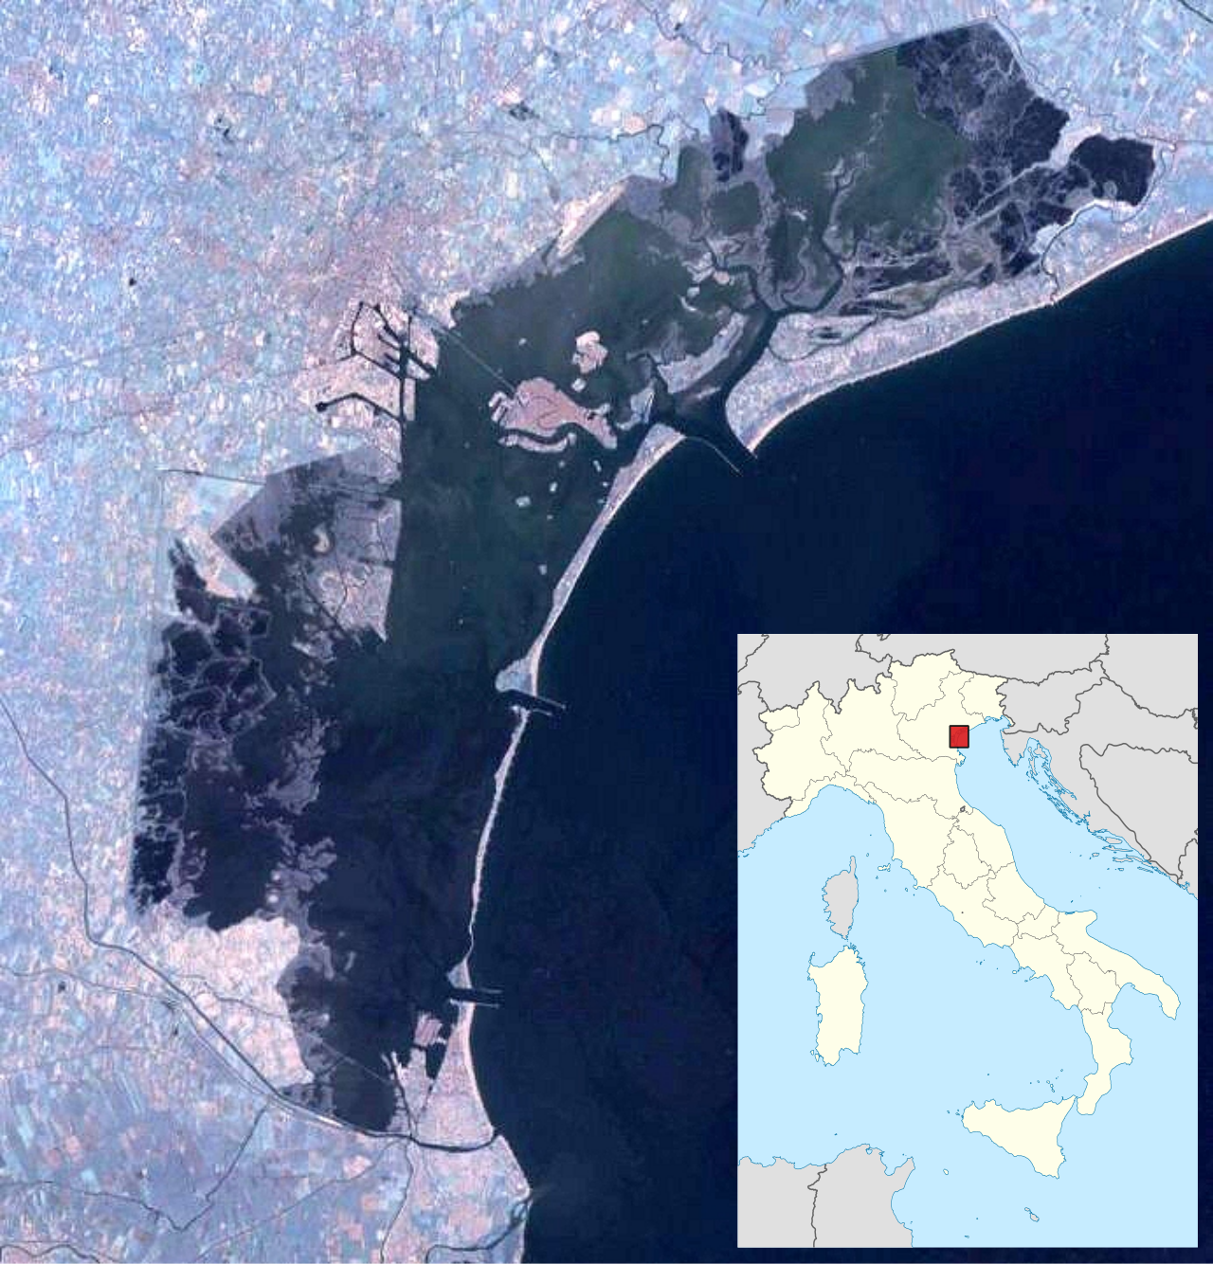
Example: the Venice Lagoon
The Venice Lagoon is located in north-east Italy, along the north-west Adriatic coast.
It is about 50 km long by 20 km wide (approx. 550 km²), comprising the largest area of wetland in the Mediterranean basin.
About 70% of the lagoon is open water (averaging about 1 m depth), and it is criss-crossed by a network of deeper artificial channels for shipping.
Within the lagoon there are islands, sandbanks, mud flats, and salt marshes.
The area of salt marsh in the lagoon has declined by 75% since 1810, with only about 45 km² remaining today.
Source: Venetian Lagoon - Wikipedia

Slide 16
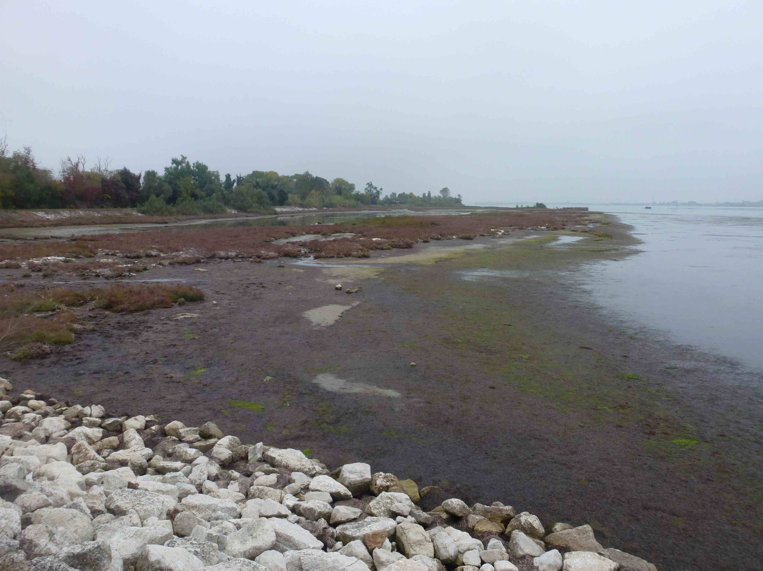
Salt marshes: a threatened ecosystem
Salt marsh is one of the most threatened ecosystems worldwide.
  Globally, the area of salt marshes has declined by around half since the year 1900.
  Today’s rate of salt marsh loss (0.28% per year) is similar to the global rate of forest loss.
    Vanishing saltmarshes threaten climate progress but recovery is within reach | UK Centre for Ecology & Hydrology
  Since the year 1860, the UK has lost 85% of its salt marshes, with about 45,000 hectares remaining. (Saltmarsh-factsheet-Oct2023.pdf)
Area of eroding salt marsh
Riprap in the foreground to
absorb wave energy and prevent
further erosion
Eroding salt marsh in the Venice Lagoon (D.Anderson)

Slide 17
Reasons for loss of salt marsh
The main drivers of salt marsh loss are:
  Land reclamation, coastal development
    Drainage for turning wetland to farmland, for industrial and residential developments on the coast, and also for ports and transport infrastructure.
  Pollution
    Runoff of agricultural fertilizers (causing eutrophication), industrial waste, oil spills, waste tipping.
    Eutrophication refers to the overloading of an aquatic ecosystem with nutrients, causing algal blooms. This has the effect of blocking sunlight for aquatic plants and depleting water of dissolved oxygen.
  Invasive species
    E.g. introduction of American Smooth cordgrass in UK caused hybridisation with the native cordgrass. The resulting ‘Common cordgrass’ causes decline of biodiversity due to its rapid spread, ability to outcompete other plants, and dense cover that harms invertebrate populations and wading birds.
  Climate change and sea level rise
    Hotter and drier summers change the habitat for organisms.
    Stronger storms, coupled with sea level rise, leads to episodes of high wave energy and drowning of salt marsh.
  Coastal erosion and lack of space for movement of salt marsh
    Linked to climate change and sea level rise, increased erosion can cause salt marsh to shift from net gain to net loss of sediment.
    Coupled with coastal development and hard engineering schemes, salt marsh cannot move inland in response to sea level rise. This is the problem known as coastal squeeze.

Slide 18
Sources of further information
Methods of conservation and restoration of salt marsh are covered later in this unit, using the example of the Venice Lagoon WaterLANDS Action Site, Italy.
You can find out more about the topics addressed in this slide set by following the hyperlinks listed here.
YouTube videos
  Exploring the Solent's Salt Marshes (10.55min video offering a good overview of the formation, features, and value of salt marsh, including the threats facing them. By the Hampshire & Isle of Wight Wildlife Trust.)
  Wetland Wise: What is a Salt Marsh? (2.49min video, including examples of salt marsh plants and animals. By Natural Areas Conservancy.)
General wetlands overview, including salt marsh:
  Ramsar website, for searching wetlands of international importance, including salt marshes Wetlands of International Importance | The Convention on Wetlands and data base of designated sites Home | Ramsar Sites Information Service
  Ramsar website, photo gallery: Photo gallery | The Convention on Wetlands There is also a video gallery.
Salt marshes overview:
  WWF 2025 report: State of the World's Saltmarshes 2025
  UK Centre for Ecology & Hydrology, salt marsh in the UK: Saltmarsh-factsheet-Oct2023.pdf
  Earth Org summary 2024: What Are Salt Marshes and Why Are They Important? | Earth.Org
  Global mapping of salt marsh distribution 2017: A global map of saltmarshes - PMC
Salt marsh ecology:
  Saltmarsh Plants – Portsmouth Museum and Art Gallery (includes descriptions, photographs, and herbarium specimens of salt marsh plants)
  The NHBS Introduction to Habitats: Saltmarsh
  Salt Marsh Plants - Friends of Portbury Wharf Nature Reserve
Importance of salt marsh and threats:
  Saltmarsh – Threats (East Grampian Coastal Partnership)
  Coastal saltmarsh – Buglife (A charity dedicated to the conservation of invertebrate organisms)

