Slide 1
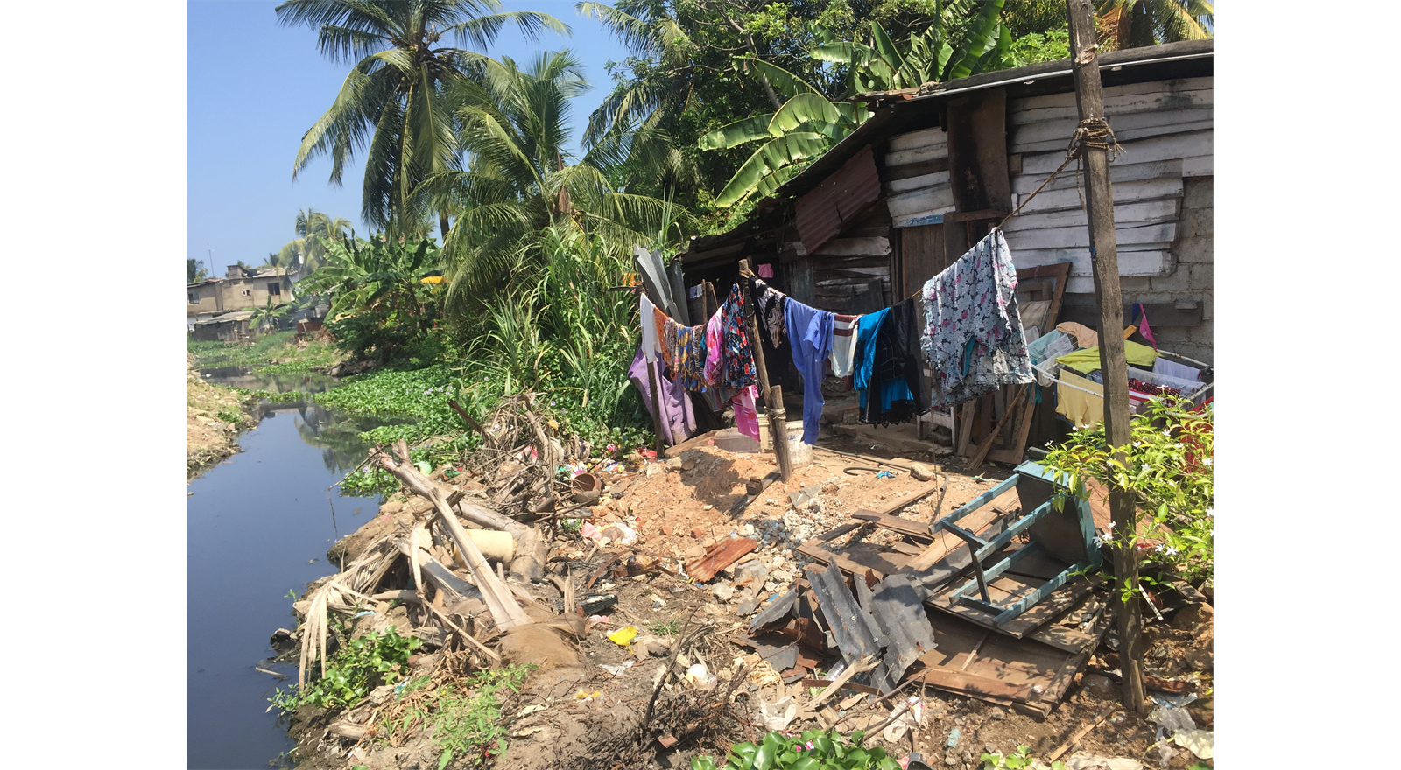
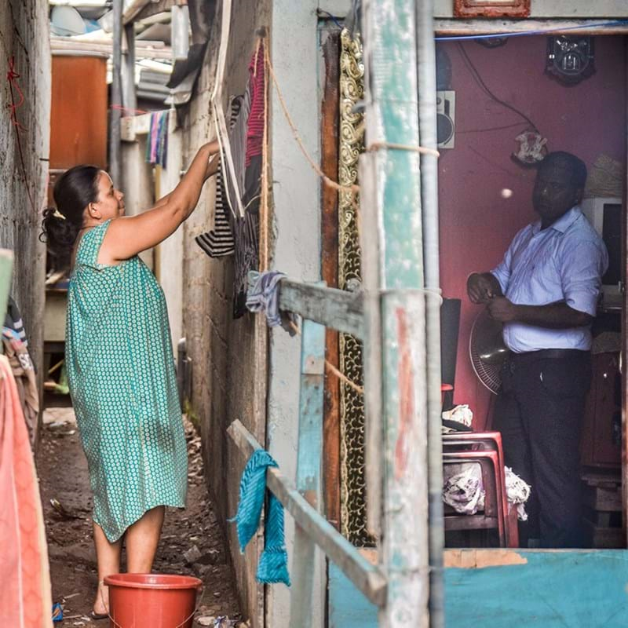
Colombo – Life as a migrant
Sammanthranapura neighbourhood, Colombo
© Natalie Soysa

Slide 2
What is daily life in Colombo like?
Watch the video clip about Colombo
Use the images on the slides below to build up a picture of daily life in Colombo
Complete a 5 W’s to help you
  Who are the people?
  What are they doing?
  Where do they live?
  Why do they live there?
  When might they have moved?

Slide 3
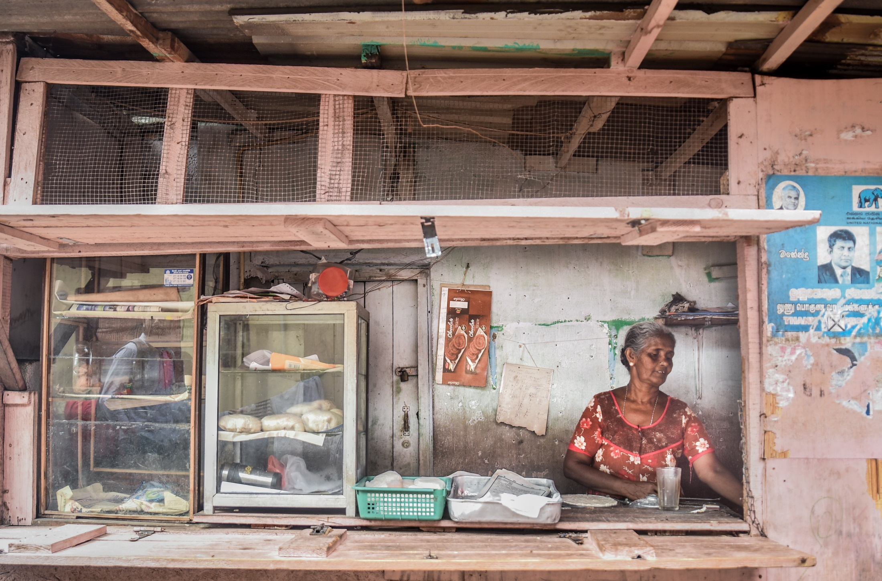
A local business in Colombo © Natalie Soysa

Slide 4
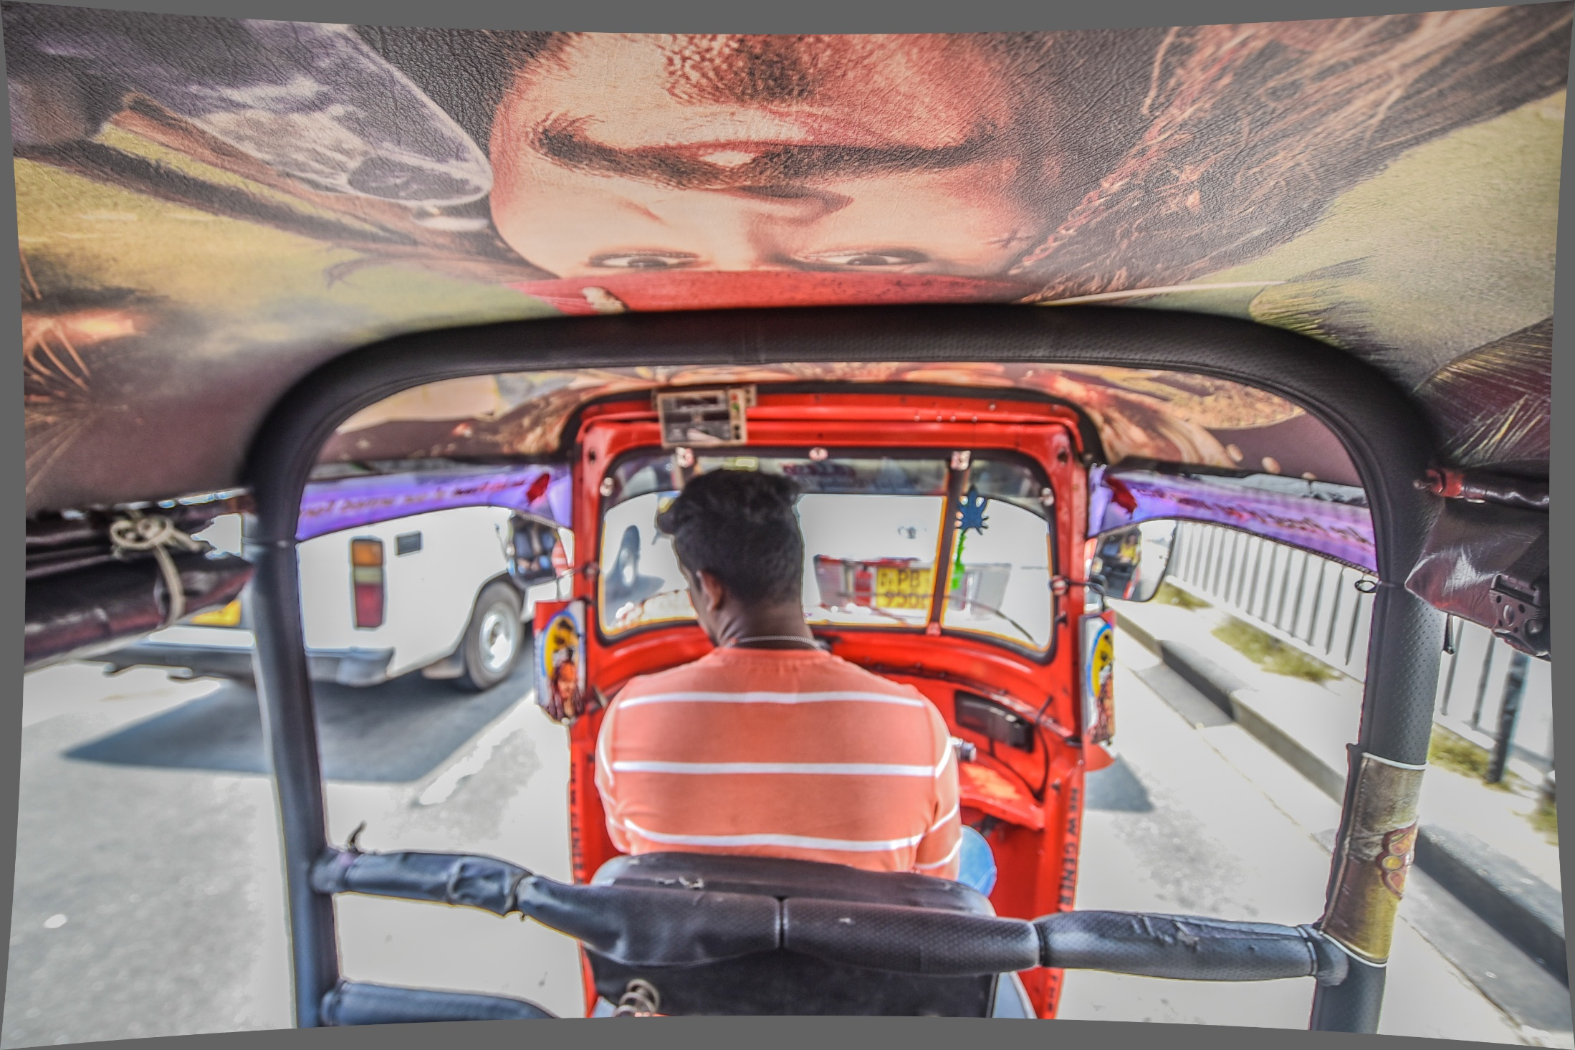
A rickshaw driver in Colombo © Natalie Soysa

Slide 5
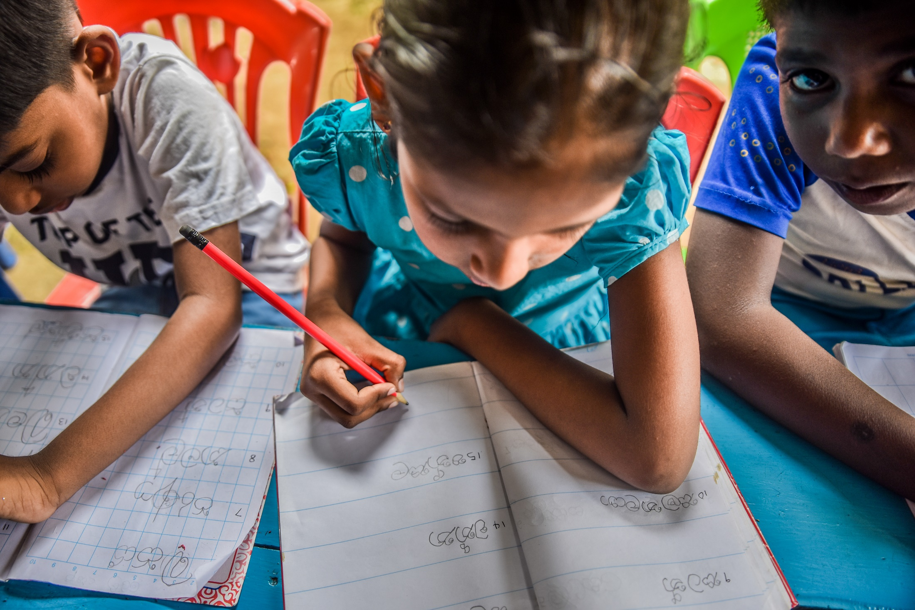
Children working at a school in Colombo © Natalie Soysa

Slide 6
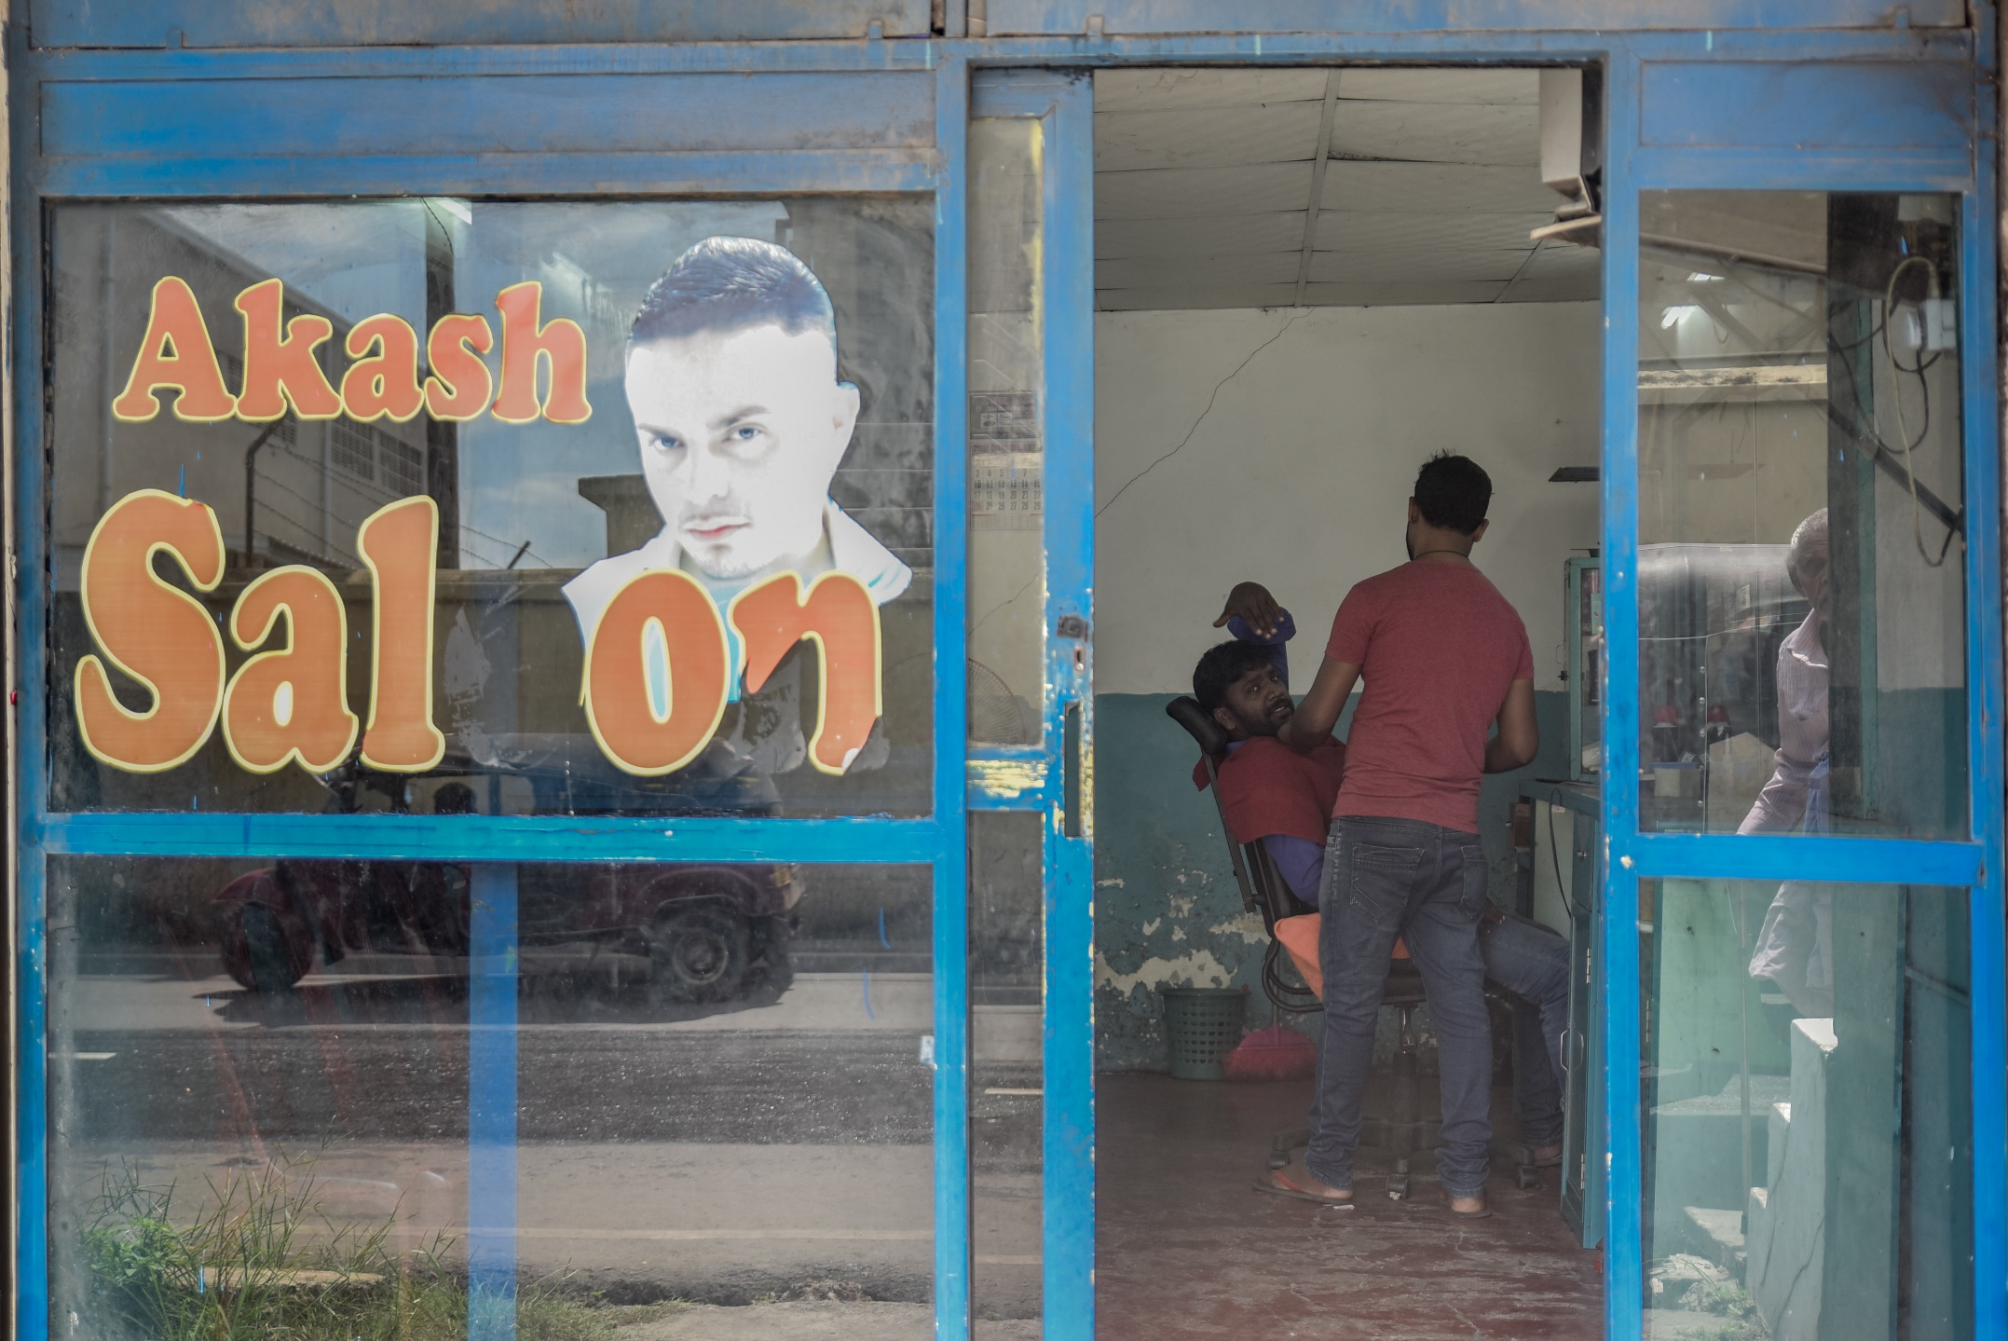
A barber shop in Colombo © Natalie Soysa

Slide 7
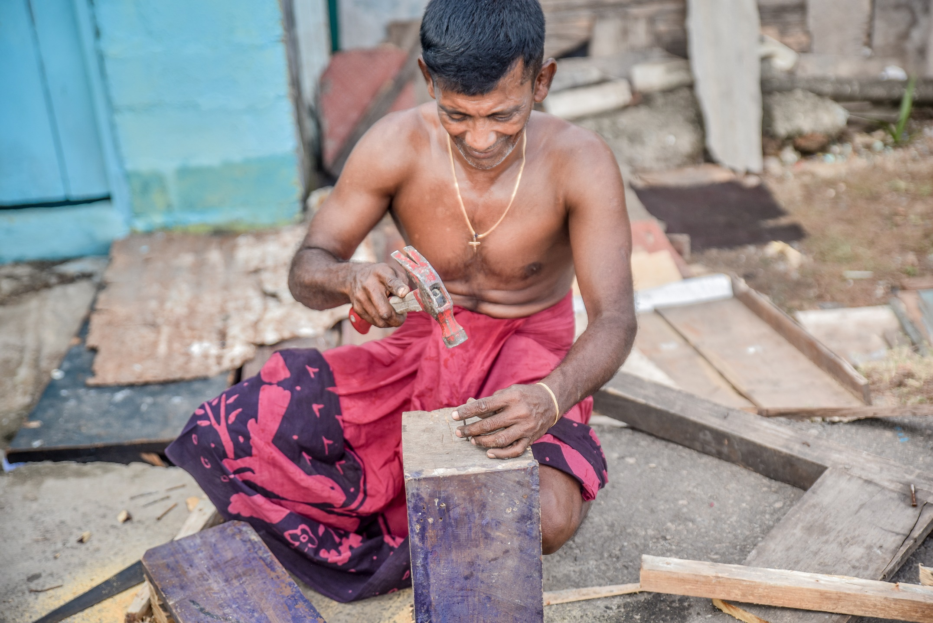
A local craftsman from Colombo © Natalie Soysa

Slide 8
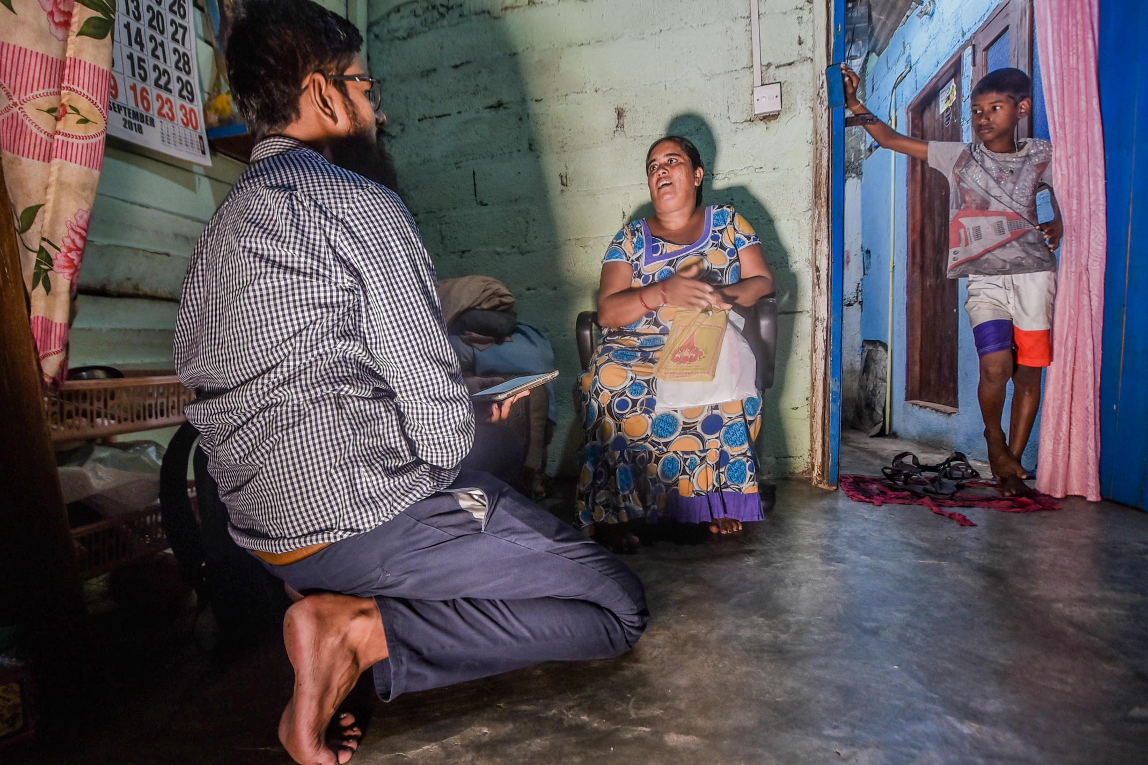
Inside a home in Colombo © Natalie Soysa

Slide 9
Interviews
The Migrants on the margins team used focus groups to interview people living in Colombo. The aim was to find out about people’s priorities and hopes.
36 statements, all of which were recorded during focus groups and then placed into a grid by the people in the interviews.
This research technique is known as the ‘Q Method’ and is used in geography to study people’s feelings and opinions.
Find out more about the Q-Method

Slide 10
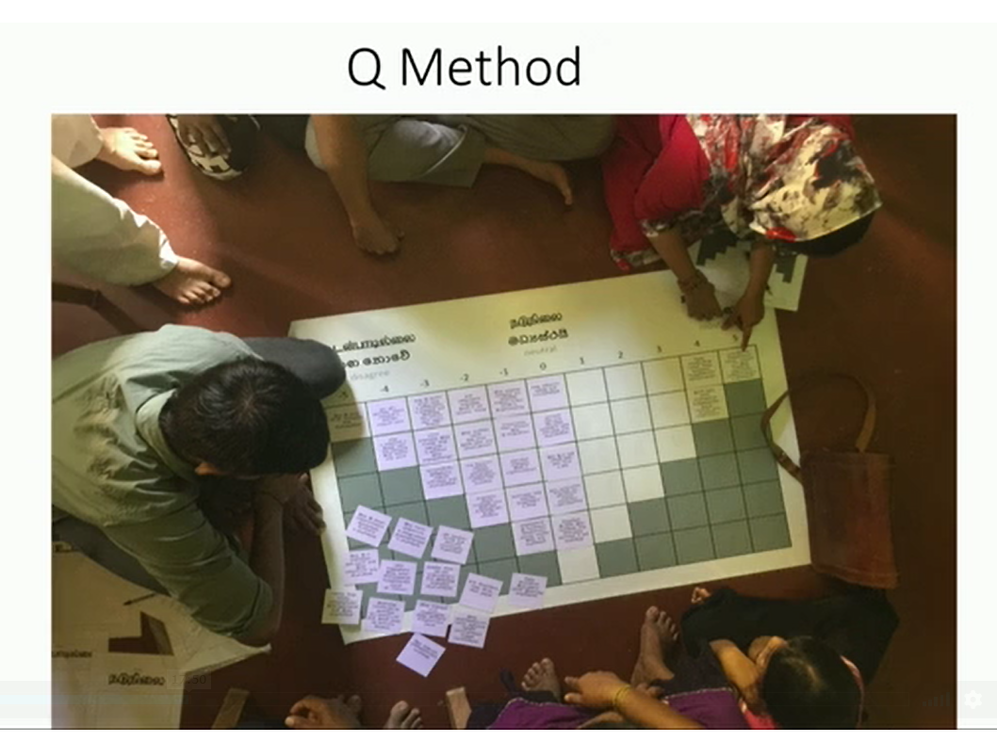
Example
Participants in Colombo taking part in the Q method © Michael Collyer

Slide 11
Your turn (a Q sort interview)
Divide the class into small groups
Using the 36 statement cards, you need to imagine that you are living in an informal settlement in Colombo and place the cards onto the Q-grid, according to how strongly you agree or disagree with the statement.

Slide 12
NOTE FOR TEACHERS
You will need to print the Q-grid in A3
Print out the statement cards from website (INSERT LINKS WHEN LIVE) and cut them up
The following two slides are for reference only. The language on the grid is Tamil (top language) and Sinhala (middle language) and were used during the Migrants on the margins fieldwork.

Slide 13
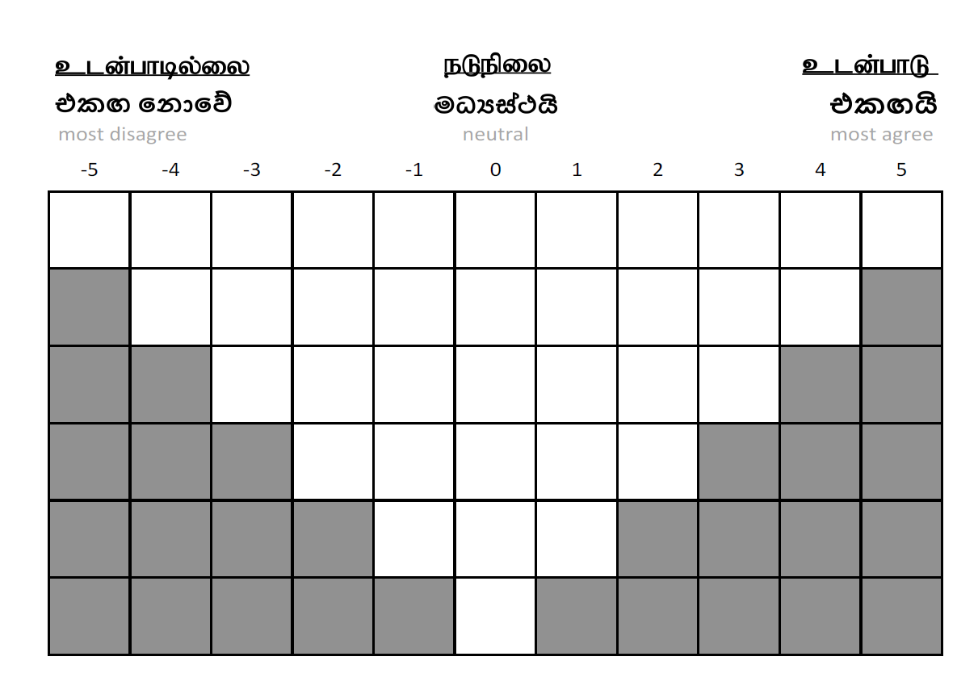
Slide title
Q Grid for Colombo
First level bullet
  Second level
    Third level
      Fourth level
        Fifth level

Slide 14
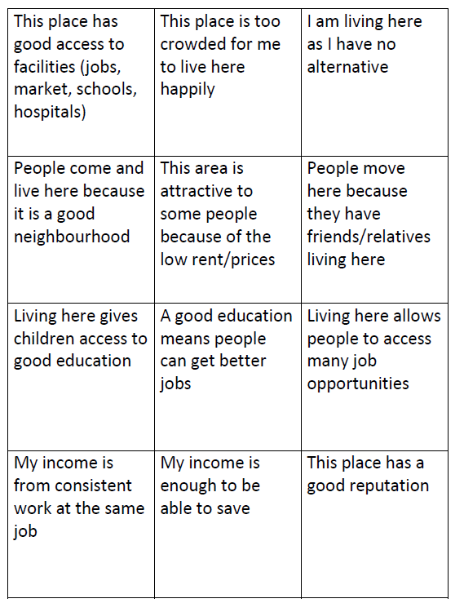
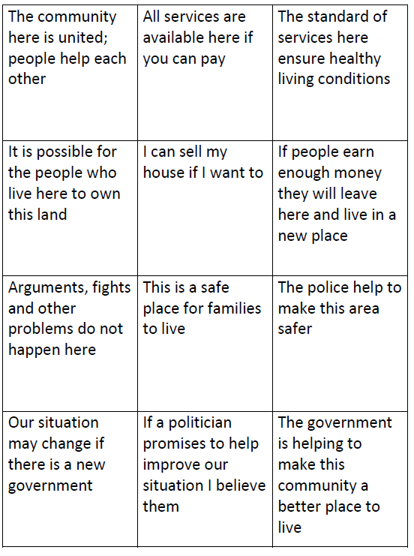
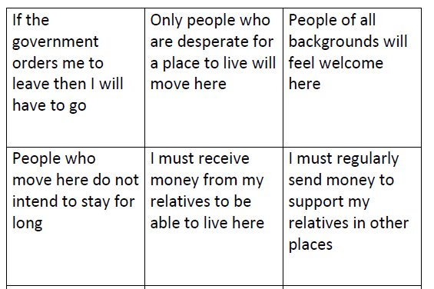
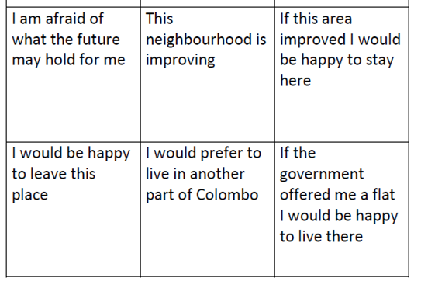
36 statements for Colombo

Slide 15
Reflection task
Did the activity reveal a positive or negative set of views?
How do you think that these views compared with those found by the Migrants on the margins team?
If you were asked to write your own statement to be included in the 36 statements, what would you write?
What challenges are faced by the city of Colombo in terms of providing for these migrants?

Slide 16
Note on the Q method
Note on the Q-method
The Q-method referred to in this presentation has been adapted to be used in the classroom. For further information about this method and the Migrants on the margins research findings in the reflection activity, please visit Q-Method

