Slide 1
Migrants on the margins
The densification of Hargeisa, Somaliland
  How has the density of housing in a squatter settlement changed through time?
  The following slides show how the State House settlement in Hargeisa has changed between 2002-2018

Slide 2
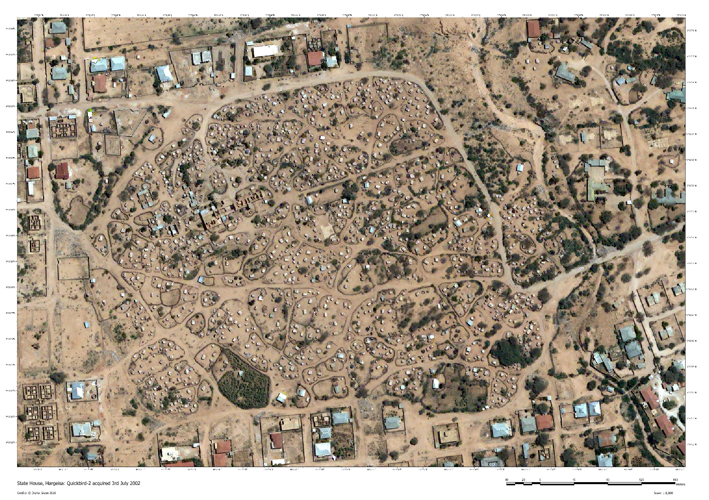
State House
Hargeisa - 2002

Slide 3
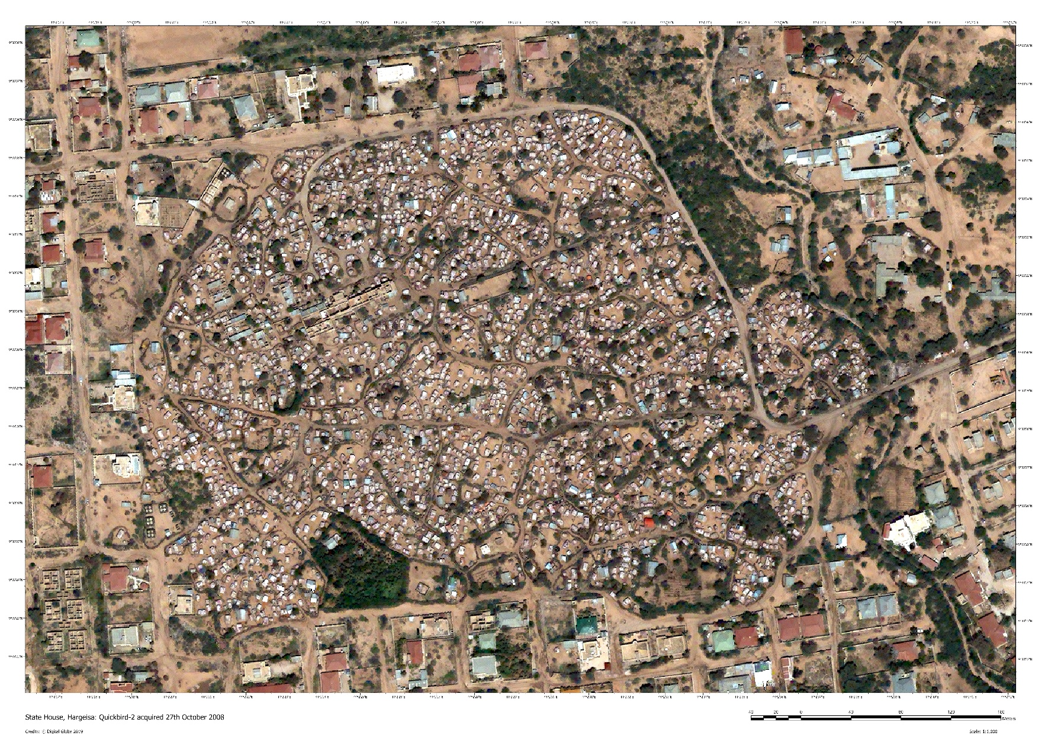
State House
Hargeisa - 2008

Slide 4
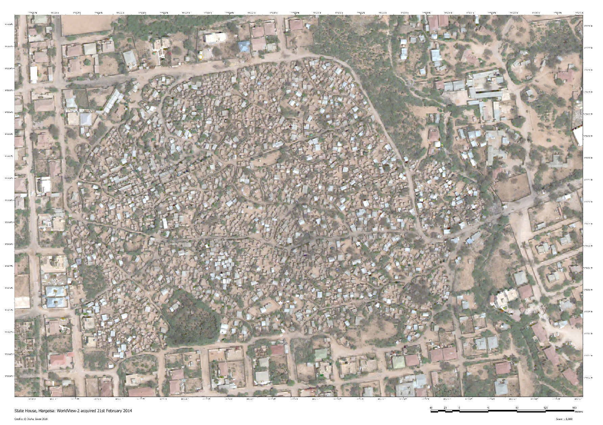
State House
Hargeisa - 2014

Slide 5
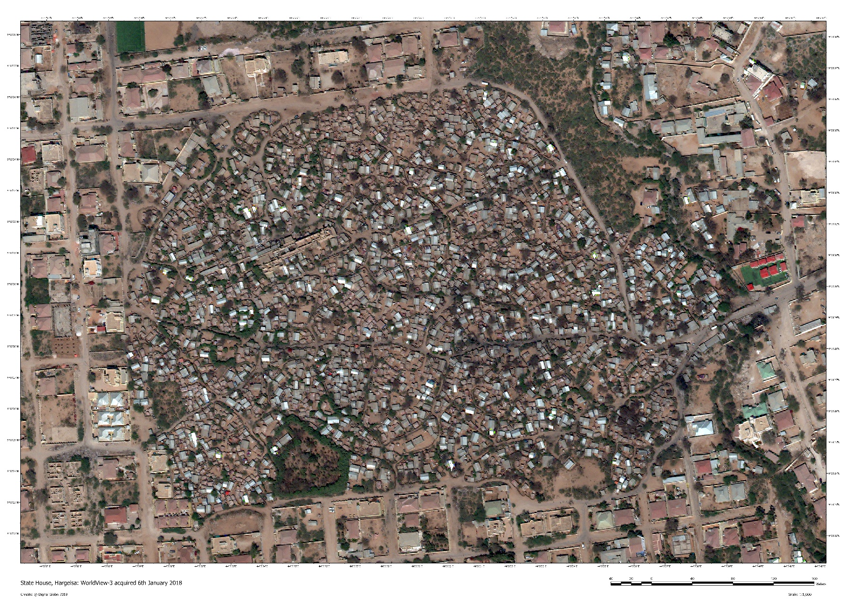
State House
Hargeisa - 2018

Slide 6
Densification activity
Using the satellite images from Hargeisa, estimate the density of settlements for each year
How has the density of the State House settlement changed through time?
What settlement patterns can you observe? Why do you think it has developed in this way?

Slide 7
Building size and occupancy
The slide below shows the size of the buildings in State House.
The average occupancy in the dwellings is 7.
Can you calculate how many people are living in State House?

Slide 8
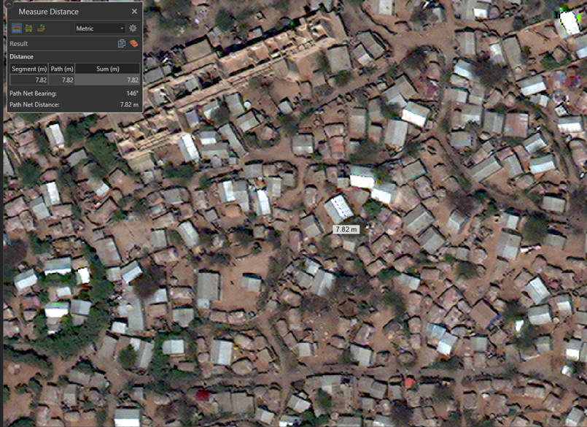
Building size

Slide 9
Types of dwelling
Look at the two different types of dwelling in the photographs on the next slides
Describe the materials used in the two different types of dwelling
Why do you think that the people living in this settlement aspire to live in the dwellings in the background?

Slide 10
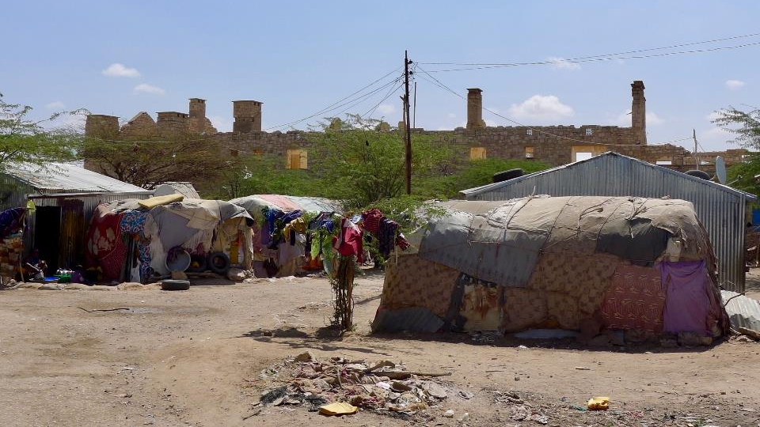
Types of dwelling
Examples of dwellings in Hargeisa © Chris Smith
State House, Hargeisa
Notes:
State House is the ruin in the background

Slide 11
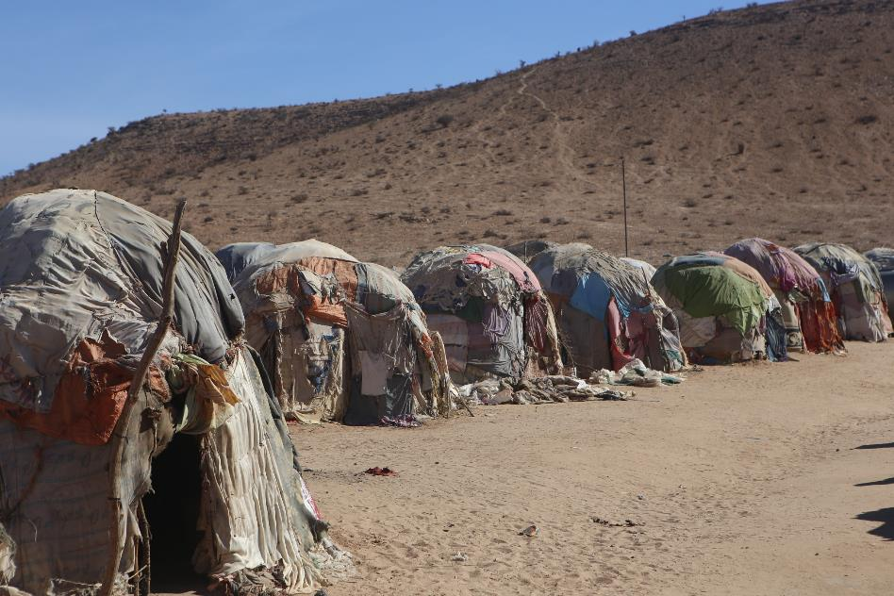
Tents made of recycled material and clothing in Hargeisa
© Chris Smith
Notes:
Typical structures for new arrivals into the State House settlement. These dwellings are constructed by the migrants themselves.

Slide 12
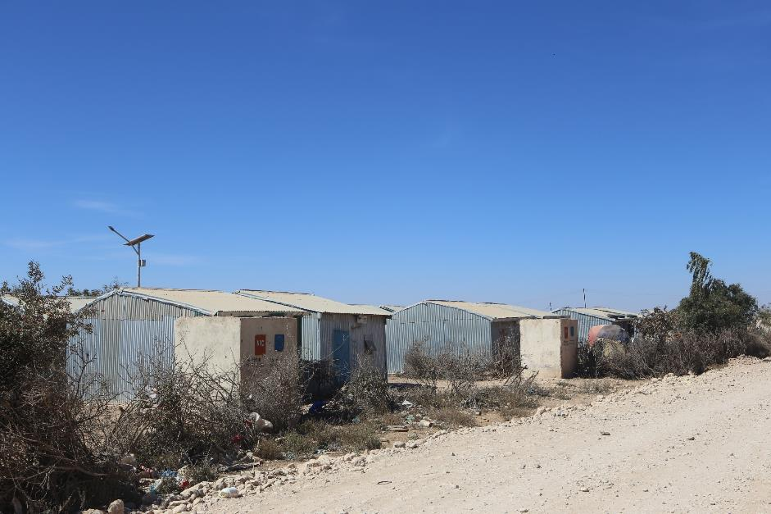
Dwellings made from tin sheeting and recycled materials in Hargeisa
© Chris Smith
Notes:
This type of structure is more permanent and the migrants aspire to this. It is typical for people to be able to move to this type of dwelling after a few years. These tend to be built by NGOs such as Norwegian Refugee Council. For further details please see https://www.nrc.no/news/2014/april/700-households-resettled-in-hargeisa-somaliland/

Slide 13
Types of dwelling - review
Those constructed by the individuals and are often a mixture of mud and materials such as clothing.
The dwellings are constructed from materials such as corrugated iron for the roofing and have been provided by NGO’s such as the example here - Norwegian Refugee Council
The more permanent structures offer a sense of security.

Slide 14
Discussion points
What are the challenges that rapidly growing settlements such as Hargeisa are facing in terms of meeting the needs of migrants?
The people who live in these squatter settlements often feel ‘trapped’ or ‘invisible’. What do you think they mean by this?

Slide 15
Possible solutions – discussion points
How do migrants build social networks? How do these networks help communities to feel a sense of belonging?
Whose responsibility is it to ensure that these communities receive the opportunities that they were seeking when they moved? Governments, NGO’s, private sector companies or the individuals themselves?

Slide 16
Useful links
Further resources on Hargeisa can be found here including a video interview, a map and the poster ‘How are cities changing?’

