Slide 1
Stay Home
Lesson 1
MY HOME
Paula Owens

Slide 2
My Home
What is your home like?
What do you like about it?
Which is your favourite room?
?

Slide 3
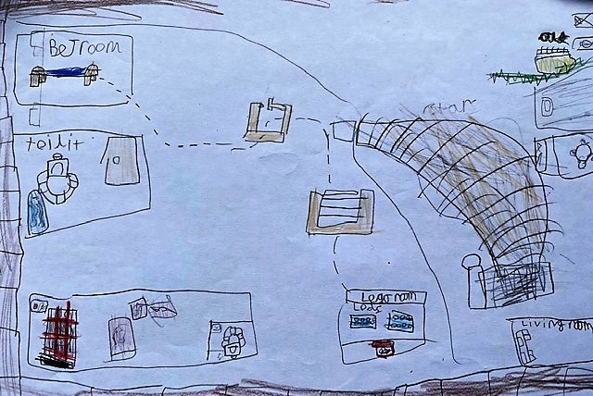
My Home
Can you draw a plan, or make a model, of your house or favourite room?
A child’s plan view of bedroom www.meaningfulmaps.com

Slide 4
What makes a home special?
WordArt.com

Slide 5
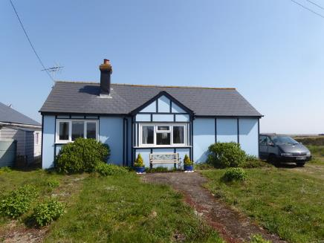
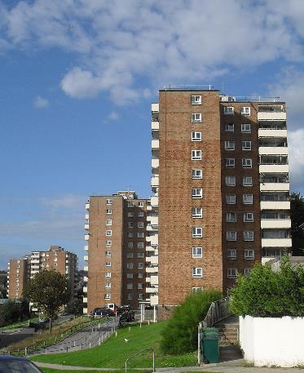
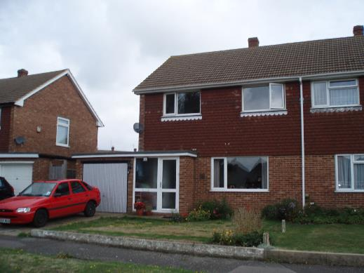
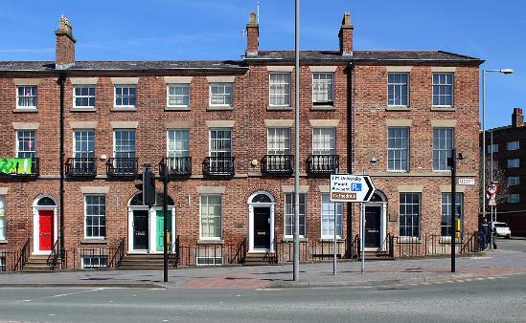
My Home
This Photo by Unknown Author is licensed under CC BY-SA
This Photo by Unknown Author is licensed under CC BY-SA
This Photo by Unknown Author is licensed under CC BY-SA
Can you find:
Flats?
A semi-detached house?
A bungalow?
A terraced house?
This Photo by Unknown Author is licensed under CC BY-SA

Slide 6
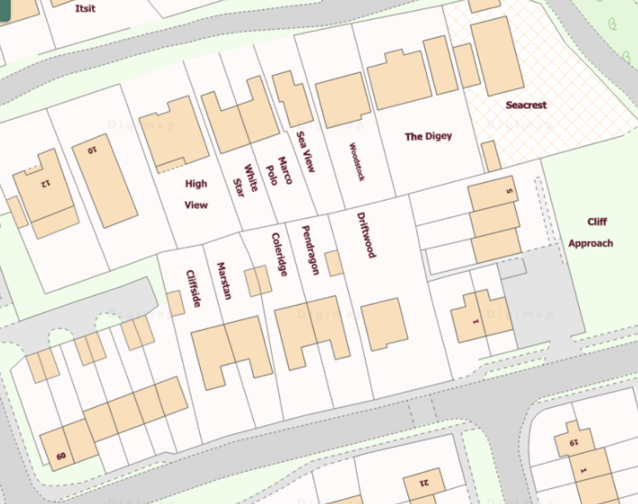
My Home
Can you find:
A detached house?
A terraced house?
A semi-detached house?
Not all of the possible answers are shown.

Slide 7
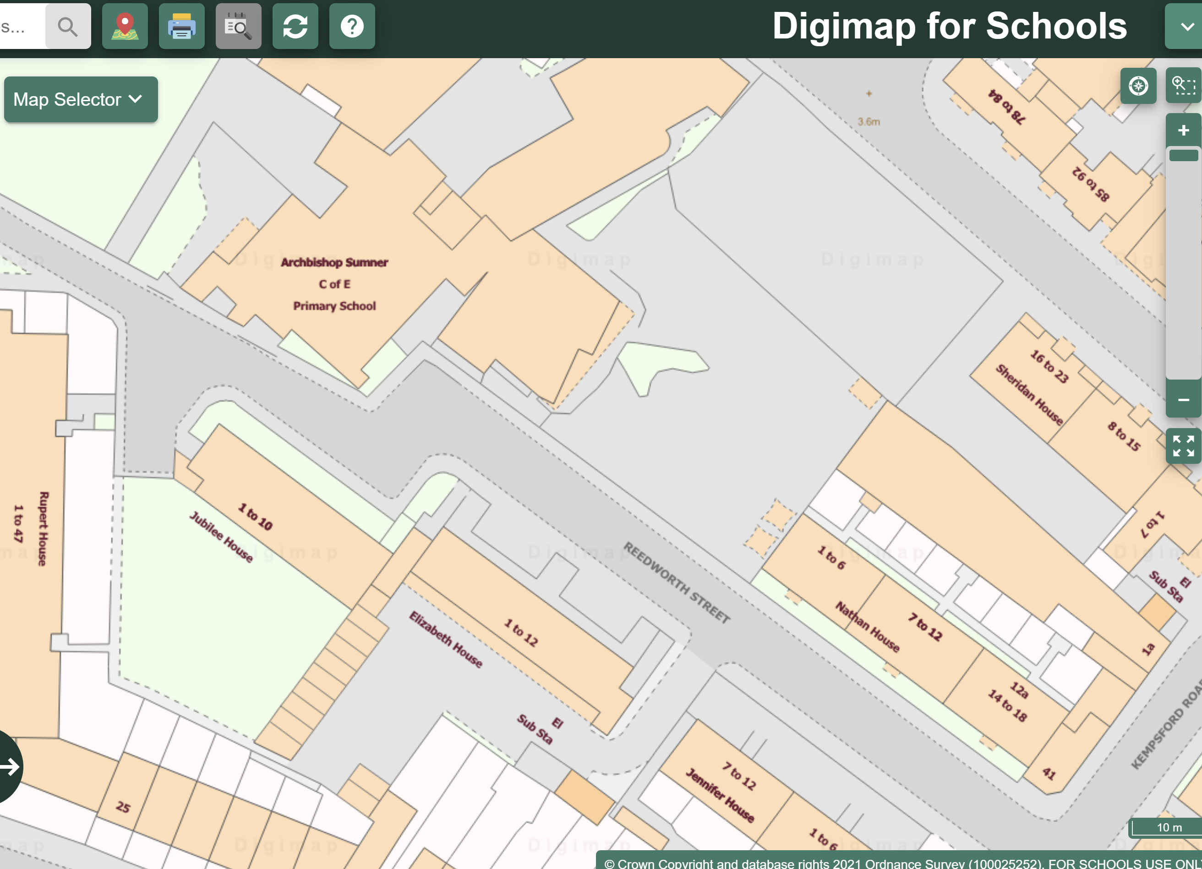
Flats or terraced houses?
?

Slide 8
Where do you live?
Maisie,
Flat 6,
Park Road,
Newington.
London SE11 4PH

Slide 9
Submit your maps
Please submit your Stay Home maps through www.rgs.org/stayhome –
we are really interested to see what you have created!

