Slide 1
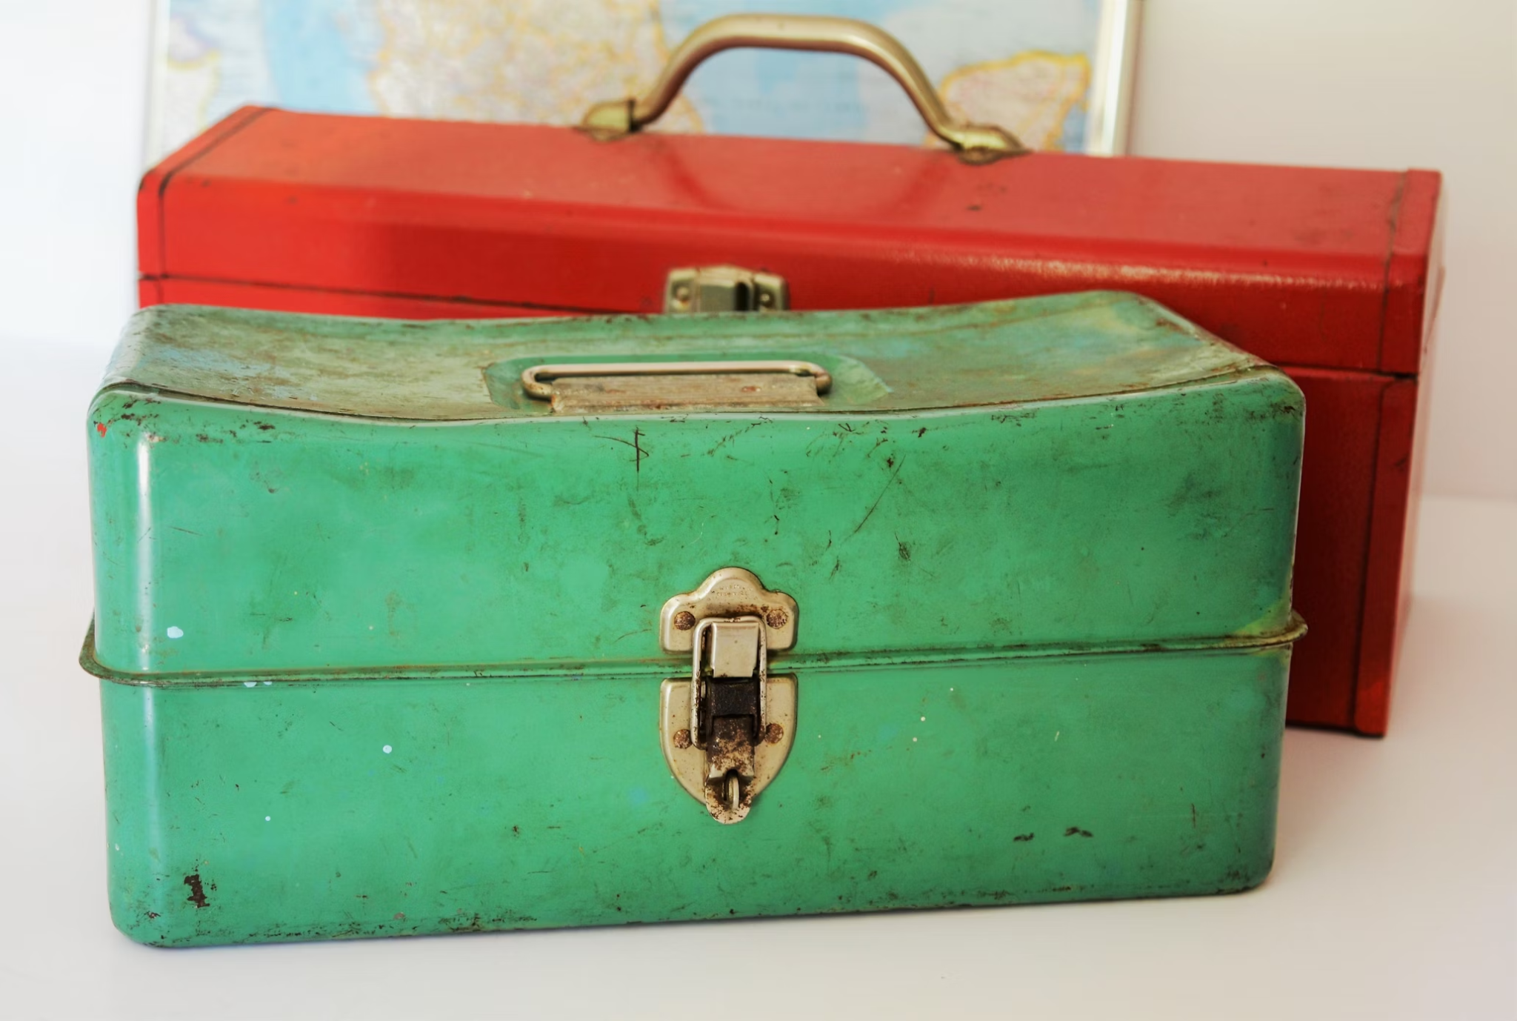
A Geographer's Toolbox: Maps
DO NOW: Imagine you are packing a Geographer’s ‘toolbox’ with equipment a geographer may need when exploring / researching - list what you would pack!
Challenge: What geographical skills would someone need to be able to use the equipment?
Notes:
Image:https://images.unsplash.com/photo-1558906050-d6d6aa390fd3?q=80&w=2063&auto=format&fit=crop&ixlib=rb-4.0.3&ixid=M3wxMjA3fDB8MHxwaG90by1wYWdlfHx8fGVufDB8fHx8fA%3D%3D

Slide 2
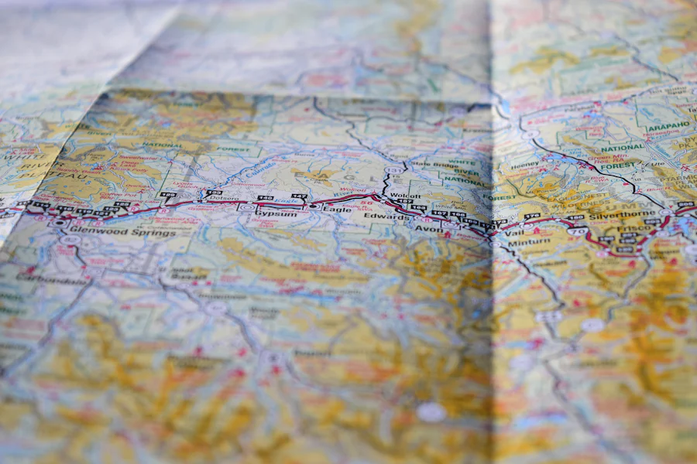
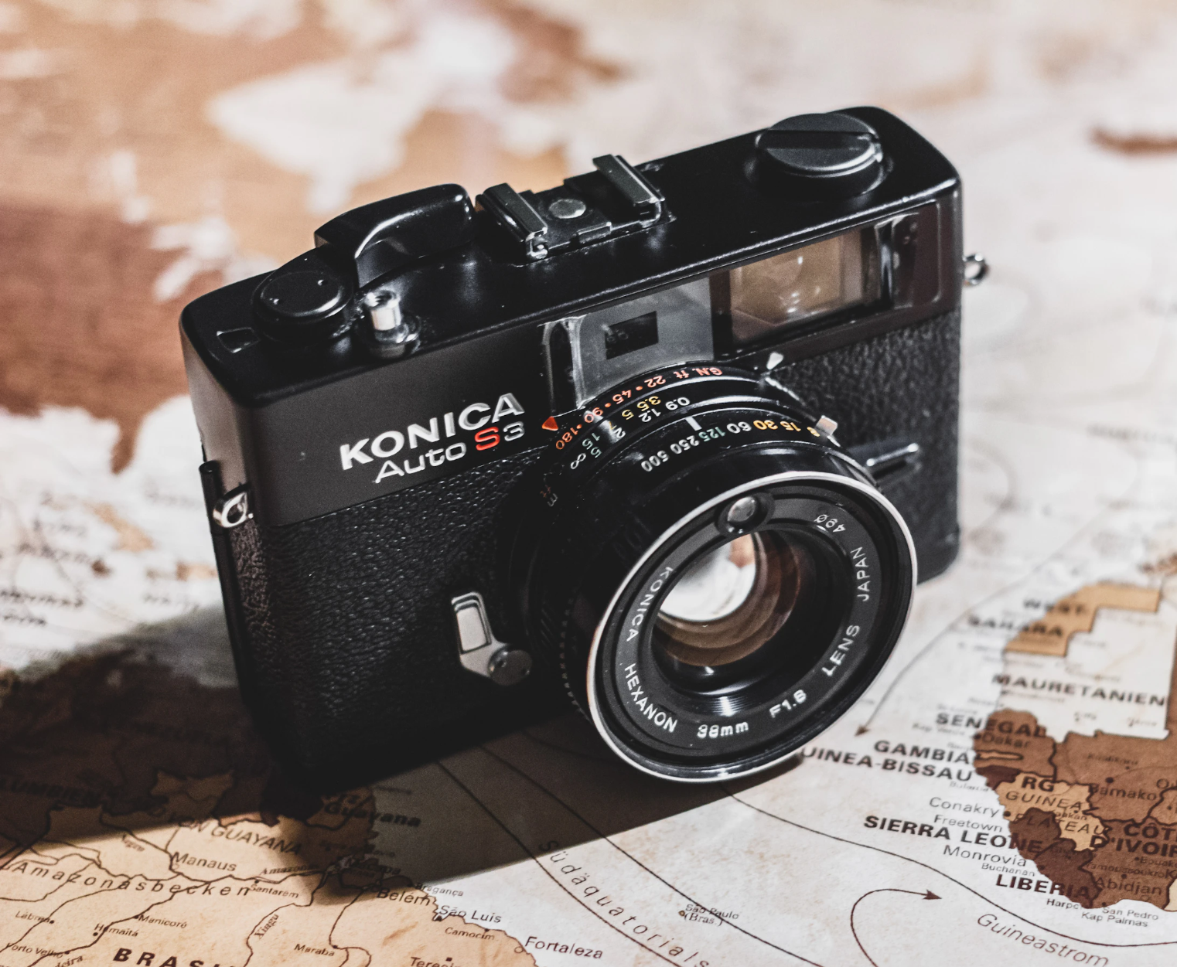
Potential answers…
Compass
Map
Field notebook
Today we are going to focus on one vital tool that all geographers use…
Camera
Binoculars
Notes:
Compass - https://unsplash.com/photos/shallow-focus-photography-of-compass-on-brown-table-4ozvhBh2LoY
Map - https://unsplash.com/photos/close-up-photography-of-map-yg8Cz-i5U30
Camera - https://unsplash.com/photos/black-konica-slr-camera-on-map-MDGpwpMY2Ws
Binoculars - https://unsplash.com/photos/black-binoculars-on-brown-wood-log-ae-NhYKAmEg

Slide 3
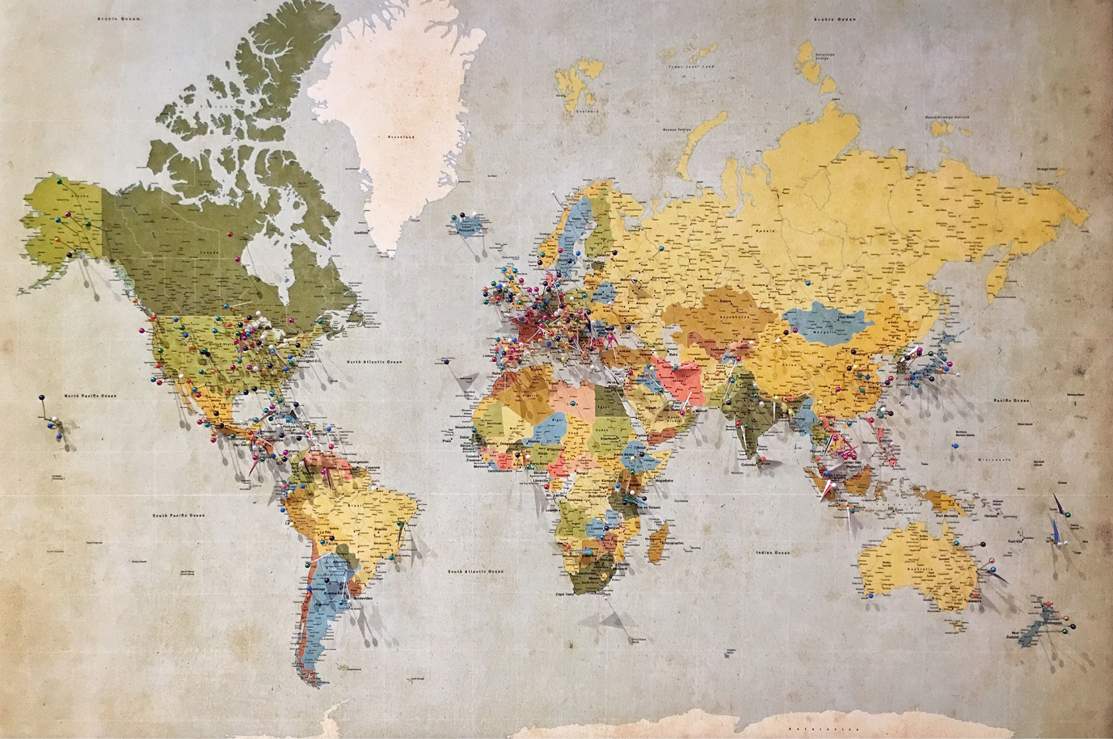
What is a map?
A map is symbolic representation of selected characteristics of a location.
THINK: When have you or your family used a map recently? What was it used for?
Who creates maps?
Cartographers create and update maps, incorporating both historical data and modern geospatial technologies like GIS (Geographic Information Systems)
Notes:
Map image: https://unsplash.com/photos/blue-green-and-yellow-world-map-l68Z6eF2peA

Slide 4
Key components of maps
Identifying map components:
Step 1 - Start at the contents page (p. 2-3)
Step 2 - Find a map of the United Kingdom (first pair to find the map will receive a house point each!)
Step 3 - Talk to your partner: What key components can you see on this map? What makes it a good map?
Notes:
Give students some time to explore the map and discuss with their partners
Image link: HE1536237_160456-P1_72m61SOK6k.jpg

Slide 5
Key components of maps
Key components of a map:
Title: The title of the map tells us what the map is about.
Key: The key explains the symbols used on the map. Show various symbols and what they represent, like mountains, rivers, cities, and roads.
Scale: The scale shows the relationship between distances on the map and actual distances on the ground. For example, one inch on the map might represent 100 miles in real life.
Compass Rose: This shows the cardinal directions (North, South, East, West). The compass rose helps us understand the orientation of the map.
Notes:
Ask students to bullet point the four key components (just the bold)
Image link: HE1536237_160456-P1_72m61SOK6k.jpg

Slide 6
Why are maps so important to geographers?
Turn and talk: With your partner, discuss why you think maps are so important to geographers.
Challenge: What geographical jobs can you think of that would require map skills?
The importance of maps to geographers

Slide 7
Why are maps so important to geographers?
Navigation: Geographers use maps to help them find their way when they explore new places or when they study areas in detail.
Decision Making and Planning: important for planning things like new roads, cities, or parks, and for helping people prepare for natural disasters.
Career link: Pilot / Navy Captain
The importance of maps to geographers
Career link: Transportation Planner
Connections and Links: Maps show how different things are connected, like how a river might affect where people build towns or how mountains can affect the weather.
Learning About History: Old maps help geographers understand how the world has changed over time and how people in the past saw the world.
Career link: Flood Risk Engineer
Career link: Archaeologist

Slide 8
Personal geographies: abstract mapping
Maps can represent space by highlighting locational patterns, as seen in an atlas, while others can representing place by illustrating the social and emotional connections people have with locations. We will now explore your personal geographies by creating maps that focus on the concept of place, specifically your journey to school.
Before we continue - Take a few moments to think about your daily journey to school. Consider the following questions:
What route do you take?
What transportation do you use (walking, biking, bus, car, etc.)?
What landmarks, neighbourhoods, or significant places do you pass?
Are there any specific experiences or memories associated with your journey?
What are some elements that make your journey unique (e.g., a favourite coffee shop, a park, or a busy crossing)?

Slide 9
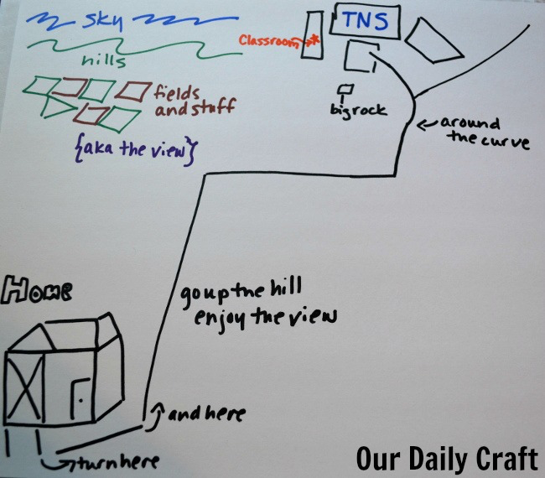
Personal geographies: abstract mapping
Design Your Map:
Create an abstract representation of your journey to school. It doesn’t need to be to scale.
Use geographic symbols for significant locations (e.g., a sun for a park, a bus for transportation) and include directional arrows to illustrate your route.
Personal ‘Place’ Elements:
Add symbols that represent your emotional experiences at key locations (e.g., a heart for a favourite spot).
Use colours to convey your mood during different parts of the journey.
Annotate Features:
Write descriptive labels for significant places (e.g., “The park where I relax” or “The busy crossing I cross”).
Notes:
Image - https://www.ourdailycraft.com/2016/04/04/map-your-route-craft-challenge-day-95/

Slide 10
Finally…
Try work out this geography riddle:
“You’re standing on the surface of the Earth. You walk one mile south, one mile west, and one mile north. You end up exactly where you started. Where are you?”
Notes:
Answer = the geographic North Pole

Slide 11
Prep Learning: Exploring Space and Place Maps
Prep Learning Task: Exploring Space and Place Maps
Objective: To understand how different types of maps represent both physical space and human connections to places
Instructions:
Map Comparison:
Find two different maps of the same area (e.g., your town or country). These could be:
A road map or satellite map (focused on space).
A cultural or historical map (focused on place).
Print or draw them, or provide links if digital.
Questions to Answer - you can answer these in your books or annotate the maps with your answers
Space Map:
What features does the map focus on (roads, buildings, natural landmarks)?
How does this map help you understand the physical layout of the area?
Place Map:
What social, cultural, or emotional connections does the second map show?
How does this map offer a different perspective on the area compared to the first map?
Reflection (1-2 paragraphs):
How do maps of space and place help us understand geography in different ways?

