Slide 2
Understanding and using the Chi-Squared test in geography

Slide 3
Have you taught chi-squared?
Yes – lots of times
Just once or twice
Not yet
Notes:
Poll

Slide 4
What do chi squared tests do?
Two sorts
Chi squared test for a two-way contingency table tests for association between the variables
Chi squared goodness of fit test is for when we think the sample might have come from a particular population distribution
Both sorts compare observed frequencies in the sample with expected frequencies
Notes:
In maths we tend to treat the two kinds of chi squared tests as two separate topics but in other subjects, they don’t always specify which they mean.

Slide 5
Information to find expected frequencies
Observed frequencies
OCR A level Biology 2017 Paper H420/02
Notes:
This is testing compared to an expected distribution

Slide 6
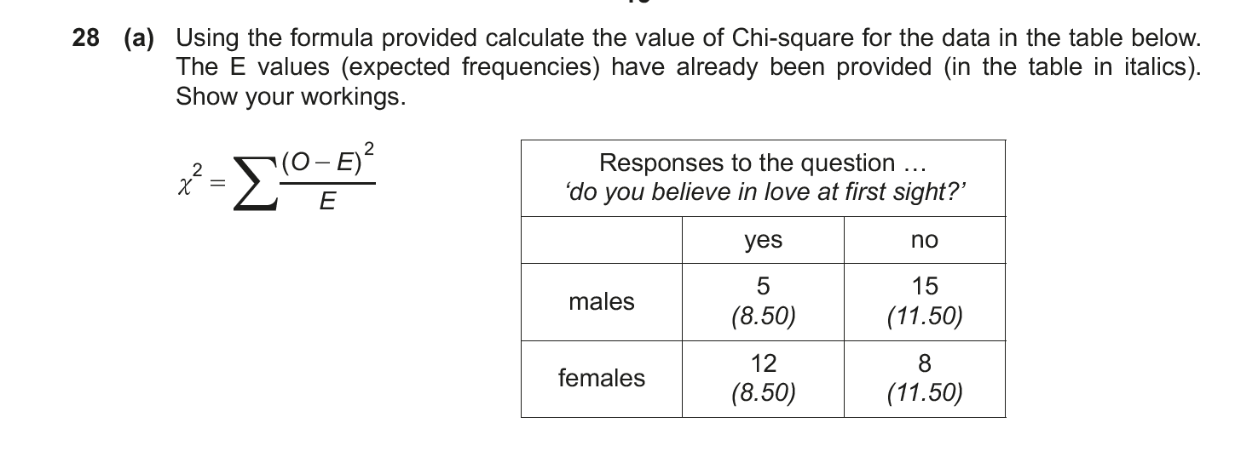
Two-way table of observed frequencies
Can you see how the observed frequencies have been calculated?
OCR A level Psychology 2018 Paper H657/01
Notes:
This is a two- way contingency table

Slide 7
Robin wants to investigate if there is a difference in the types of cycling accidents between adults and young people.
He considered cyclists of age 20 and under to be in the category ‘Young person’ and cyclists over 20 to be ‘Adult’.
He categorised the types of cycling accidents as ‘Hit by other vehicle’, ‘Hit something stationary’, ‘Skidded’ and ‘Fell off’. The counts are in the table below.
(i) Use the data to carry out a χ2 test, using a 5 % significance level. State clearly your null and alternative hypotheses.
 | Type of Accident
Age | Hit by other vehicle | Hit something stationary | Skidded | Fell off | Totals
Young person | 17 | 12 | 4 | 8 | 41
Adult | 32 | 5 | 7 | 4 | 48
Totals | 49 | 17 | 11 | 12 | 89
OCR Core Maths B, Practice paper

Slide 8
Where do the two types of chi squared tests come up?
 | Goodness of fit | Two way contingency table
Biology | AQA Biology AS and A level Edexcel Biology A & B AS & A level OCR A Biology AS and A level
Geography | AQA A level Geography Edexcel A level Geography OCR A level Geography | AQA A level Geography Edexcel A level Geography OCR A level Geography
Maths | Edexcel AS & A level Further Maths OCR A & B AS & A level Further Maths | OCR Core Maths B AQA AS & A level Further Maths Edexcel AS & A level Further Maths OCR A & B AS & A level Further Maths
Psychology | ? | AQA Psychology A level Edexcel Psychology AS and A level OCR Psychology AS and A level
Notes:
Specifications for subjects other than maths often just say “chi squared test” and may not specify which sort. If your school or college does Core Maths it’s a good idea to liaise with the maths dept to have them teach chi squared (even if it’s not on the Core Maths spec) but you will need to specify which sort(s) you want them to teach.

Slide 9
Visitors to a tourist attraction
A random sample of 50 visitors to a tourist attraction fills out a survey.
Does the age distribution of visitors match the age distribution of the population?
Age | No. of visitors | % of UK population this age
0-19 | 19 | 23.5
20-39 | 17 | 26.4
40-59 | 8 | 26.3
60+ | 6 | 23.8
TOTAL | 50 | 100%
Notes:
Expected distribution with one list of frequencies

Slide 10
Pebbles on a beach
A random sample of pebbles has been collected from 3 locations on a beach.
Is the distribution of types of pebble independent of location?
 | Angular or sub- angular | Sub-rounded | Rounded | Well rounded | TOT
A | 6 | 13 | 15 | 16 | 50
B | 2 | 13 | 20 | 15 | 50
C | 8 | 10 | 27 | 5 | 50
TOT | 16 | 36 | 62 | 36 | 150

Slide 11
Free toy car
A café gives a free toy car with each children’s meal: red, blue, white, black or silver.
A group of parents meet at the café regularly with their children – they collect data about the free cars.
Is each colour equally likely – what do you think?
Colour | Frequency
red | 7
blue | 2
white | 4
black | 5
silver | 12
TOTAL | 30
Notes:
Gather opinions

Slide 12
Over to you
You will work through a Desmos activity designed to help students think about how to decide whether there is enough evidence that all car colours are not equally likely
Colour | Frequency
red | 7
blue | 2
white | 4
black | 5
silver | 12
TOTAL | 30

Slide 13
Testing whether there is evidence that the car colours are not equally likely
Basic idea:
Start by assuming that they are equally likely.
The technical way of saying this is that the null hypothesis is that all car colours are equally likely.
Calculate the expected frequencies you would expect if they were equally likely.
Compare observed and expected frequencies.

Slide 14
Hypotheses
Null Hypothesis: car colours equally likely
Alternative hypothesis: car colours not equally likely
Assume null is true and look for evidence in favour of alternative
Notes:
We give the null hypothesis the benefit of the doubt – this lets us do some calculations

Slide 15
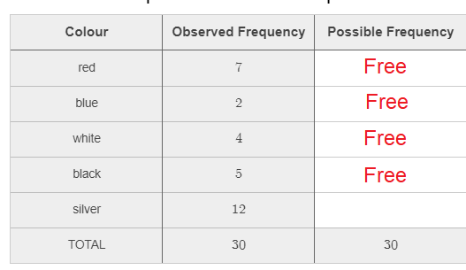
Degrees of freedom
When you were filling in possible frequencies, you could choose values for the 4 colours but the value for the last one had to make the total be 30.
There are 4 degrees of freedom
5-1=4

Slide 16
The chi squared test statistic
$X^{2}=\sum{\frac{{\left(obs−exp\right)}^{2}}{exp}}$
If the test statistic is large then this means that the observed and expected values are not close so evidence in favour of alternative hypothesis.
What do we mean by large?
Notes:
Spreadsheet with equal probs – do some simulations

Slide 17
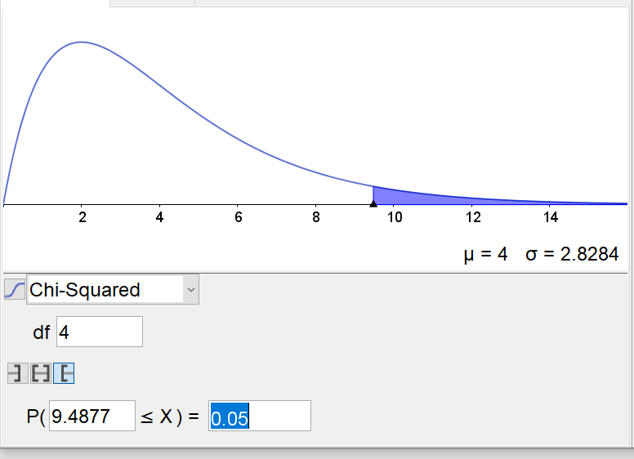
The critical value
For a chi-squared distribution with 4 degrees of freedom, 5% of the time you would get a value of 9.4877 or larger
This is the distribution we would get if the null hypothesis was true

Slide 18
Decision time
For the data we had, $X^{2}=9.668$
The critical value (at the 5% level of significance) was 9.4877
9.668>9.4877 so there is evidence that the car colours are not equally likely
Notes:
If time, show spreadsheet for not equally likely

Slide 19
What if – the colours were not equally likely?
The value of the test statistic would generally be bigger
The value of the test statistic would generally be smaller
There would generally be no effect on the size of the test statistic
Not possible to tell

Slide 20
What if – the colours were equally likely but the sample size was bigger?
The value of the test statistic would generally be bigger
The value of the test statistic would generally be smaller
There would generally be no effect on the size of the test statistic
Not possible to tell

Slide 21
What if – the colours were equally likely but fewer colours?
The value of the test statistic would generally be bigger
The value of the test statistic would generally be smaller
There would generally be no effect on the size of the test statistic
Not possible to tell

Slide 22
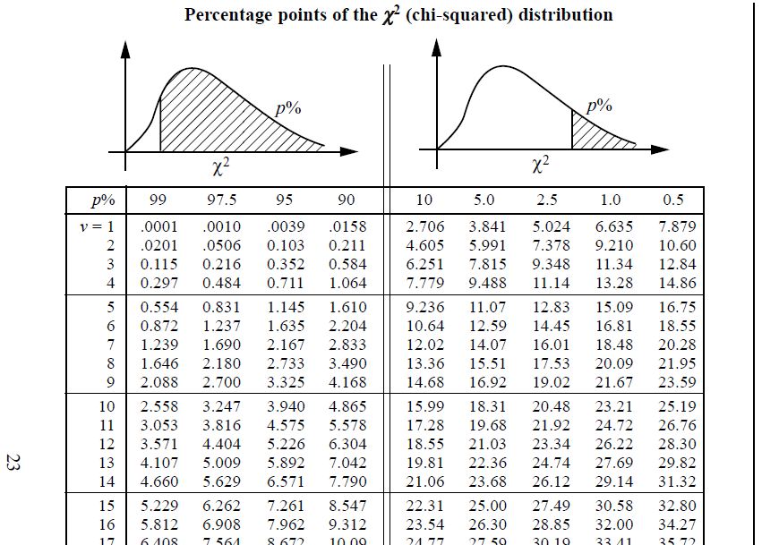
Notes:
As no of degrees of freedom increases, the critical values increase. Total frequency makes no difference.

Slide 23
Moving on to two way contingency tables

Slide 24
Pebbles on a beach
A random sample of pebbles has been collected from 3 locations on a beach.
Is the distribution of types of pebble independent of location?
 | Angular or sub- angular | Sub-rounded | Rounded | Well rounded | TOT
A | 6 | 13 | 15 | 16 | 50
B | 2 | 13 | 20 | 15 | 50
C | 8 | 10 | 27 | 5 | 50
TOT | 16 | 36 | 62 | 36 | 150

Slide 25
Pebbles on a beach
A random sample of pebbles has been collected from 3 locations on a beach.
Is the distribution of types of pebble independent of location?
The distributions are not identical in the samples BUT we are interested in the populations
 | Angular or sub- angular | Sub-rounded | Rounded | Well rounded | TOT
A | 6 | 13 | 15 | 16 | 50
B | 2 | 13 | 20 | 15 | 50
C | 8 | 10 | 27 | 5 | 50
TOT | 16 | 36 | 62 | 36 | 150
Notes:
We are always interested in what the sample tells us about the population

Slide 26
Let’s do some thinking
 | Angular or sub- angular | Sub-rounded | Rounded | Well rounded | TOT
A | 6 | 13 | 15 | 16 | 50
B | 2 | 13 | 20 | 15 | 50
C | 8 | 10 | 27 | 5 | 50
TOT | 16 | 36 | 62 | 36 | 150
Assume the three totals of 50 were part of the design of the study
Even if different samples had been chosen, these totals would be the same

Slide 27
Testing whether there is independence
Basic idea:
Start by assuming that there is independence.
The technical way of saying this is that the null hypothesis is that the distribution of pebble types is independent of location.
Calculate the expected frequencies you would expect if there was independence.
Compare observed and expected frequencies.

Slide 28
Calculating expected frequencies
 | Angular or sub- angular | Sub-rounded | Rounded | Well rounded | TOT
A |  |  |  |  | 50
B |  |  |  |  | 50
C |  |  |  |  | 50
TOT | 16 | 36 | 62 | 36 | 150
The sample sizes are equal so we would expect equal numbers of each type of pebble from each location.
Assume the totals at the bottom represent the distribution on the whole beach.
Notes:
What do you think the expected frequencies should be?

Slide 29
The expected frequencies
 | Angular or sub- angular | Sub-rounded | Rounded | Well rounded | TOT
A | 5.33 | 12 | 30.67 | 12 | 50
B | 5.33 | 12 | 30.67 | 12 | 50
C | 5.33 | 12 | 30.67 | 12 | 50
TOT | 16 | 36 | 62 | 36 | 150
The row totals are equal so each column total is split equally.
It is not possible to have part of a pebble but the expected frequencies show what would happen on average so they do not need to be whole numbers.
If the row totals were not equal, the column totals would be split in the ratio of the row totals.
Notes:
There is a formula for working out expected frequencies from the totals but it’s good for students to see an example where it is easy to work out first. Expected frequencies don’t have to be whole numbers.

Slide 30
Comparing observed and expected frequencies
Obs | A or SA | SR | R | WR
A | 6 | 13 | 15 | 16
B | 2 | 13 | 20 | 15
C | 8 | 10 | 27 | 5
(Obs – Exp)² Exp | A or SA | SR | R | WR
A | 0.083 | 0.083 | 1.554 | 1.333
B | 2.083 | 0.083 | 0.022 | 0.75
C | 1.333 | 0.333 | 1.941 | 4.083
Exp | A or SA | SR | R | WR
A | 5.333 | 12 | 20.67 | 12
B | 5.333 | 12 | 20.67 | 12
C | 5.333 | 12 | 20.67 | 12
X²=13.683. This is the total of all the contributions to the test statistic
Notes:
Do a check on one of the values in the RH table and roughly estimate the total; is 13.683 about right? Note: expected frequencies should be at least 5 – if not then combine groups (as for A or SA)

Slide 31
Degrees of freedom (ν)
 | Angular or sub- angular | Sub-rounded | Rounded | Well rounded | TOT
A |  |  |  |  | 50
B |  |  |  |  | 50
C |  |  |  |  | 50
TOT | 16 | 36 | 62 | 36 | 150
Suppose the totals are fixed and you can put what you like in the other cells (as long as the totals are correct).
How many numbers can you choose freely?

Slide 32
Degrees of freedom (ν)
 | Angular or sub- angular | Sub-rounded | Rounded | Well rounded | TOT
A | Free | Free | Free |  | 50
B | Free | Free | Free |  | 50
C |  |  |  |  | 50
TOT | 16 | 36 | 62 | 36 | 150
Suppose the totals are fixed and you can put what you like in the other cells (as long as the totals are correct).
How many numbers can you choose freely?
Notes:
Degrees of freedom = (r-1)x(c-1)

Slide 33
The probability distribution of the test statistic
The horizontal axis shows possible values of the test statistic.
The vertical axis measures how likely the value is if the null hypothesis is true.
This type of probability distribution is called a chi squared (²) distribution.

Slide 34
How big is “big”?
The area under the graph represents probability.
The probability that the test statistic is more than 12.59 is 5% (IF the null hypothesis is true).
The shaded area shows the total probability that the test statistic is more than 12.59

Slide 36
X² = 13.683
ν = 6
The 5% significance level is often used
Notes:
The critical value is the borderline for a big value of the test statistic

Slide 37
Conclusion
Our hypotheses were:
H₀: the distribution of pebbles is independent of location on beach.
H₁: distribution of pebbles and location on beach are not independent.
Our conclusion: 13.683> 12.59 so there is sufficient evidence to suggest the distribution of pebbles is not independent of location on beach.
Notes:
The stuff in green can change. Show use of spreadsheet to check.

Slide 38
Interpretation
Our test shows evidence of dependence– but there is a 5% chance that it could just have been an unusual sample
Notes:
Have a go at exam question? AQA specimen paper qu 3.2. Have a go at the tourist question? Any questions?

Slide 39
About the AMSP
A government-funded initiative, managed by MEI, providing national support for teachers and students in all state-funded schools and colleges in England.
It aims to increase participation in AS/A level Mathematics and Further Mathematics, and Core Maths, and improve the teaching of these qualifications.
Additional support is given to those in priority areas to boost social mobility so that, whatever their gender, background or location, students can choose their best maths pathway post-16, and have access to high quality maths teaching.

