Slide 1

development pathways
Changing lives in Pakistan, Malawi and South Africa

Slide 2
Presentation Content
What do we mean by the development process?
The Human Development Index (HDI) and the Millennium Development Goals
Fairtrade footballs and development in Pakistan
Microloans and development in Malawi
South African fruit farms and the development process
Conclusion: what we have learned

Slide 3
What does development mean?
Improved health care
Schooling and literacy
Increased money supply
Education for girls too
The right to vote
Living longer
A society enjoys greater economic growth
Economic growth allows human needs such as healthcare and education to be met too (see next slide)
The development process may also help establish human rights (democratic countries are more accountable to their populations)

Slide 4
Economic and social change
There is a strong correlation between how much money a society has and life expectancy ie how long people live for

Slide 5
human development index (HDI)
Average years of attending school
Average income
Life expectancy
HDI
The HDI is a composite measure of development
Every country is given a score based on the three measurements shown
In 2013, Norway had the world’s highest HDI score

Slide 6
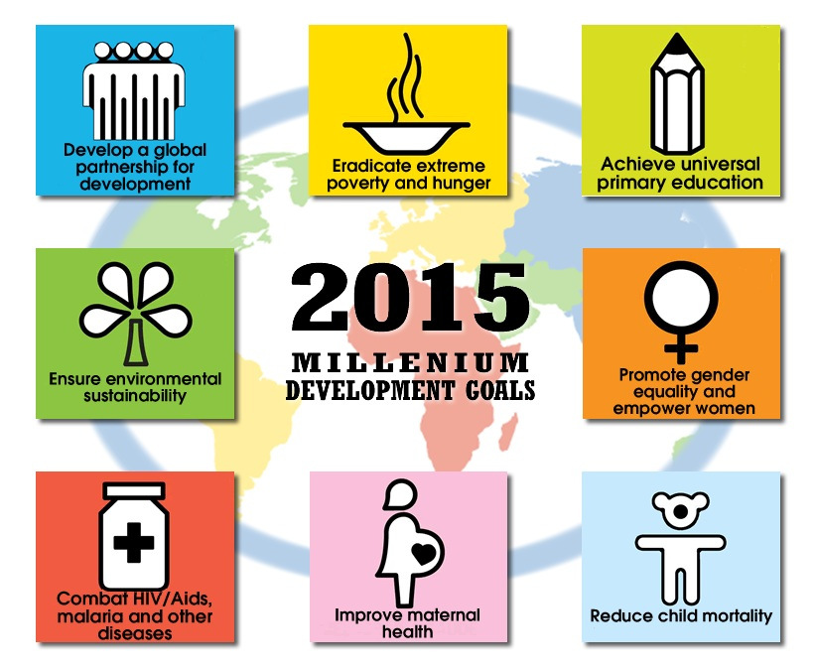
Millennium development goals

Slide 7

case study 1 Pakistan
Fairtrade footballs
Higher wages for villagers in Chagelen

Slide 8
case study 1 Pakistan
Sameena is a young woman who lives in Chagelen village
She stiches Fairtrade footballs for a living
With the money, she has been able to afford a vital operation
Sameena did not attend school but hopes her sisters will be able to, now that the family has more money
Fairtrade footballs
Higher wages for villagers in Chagelen

Slide 9
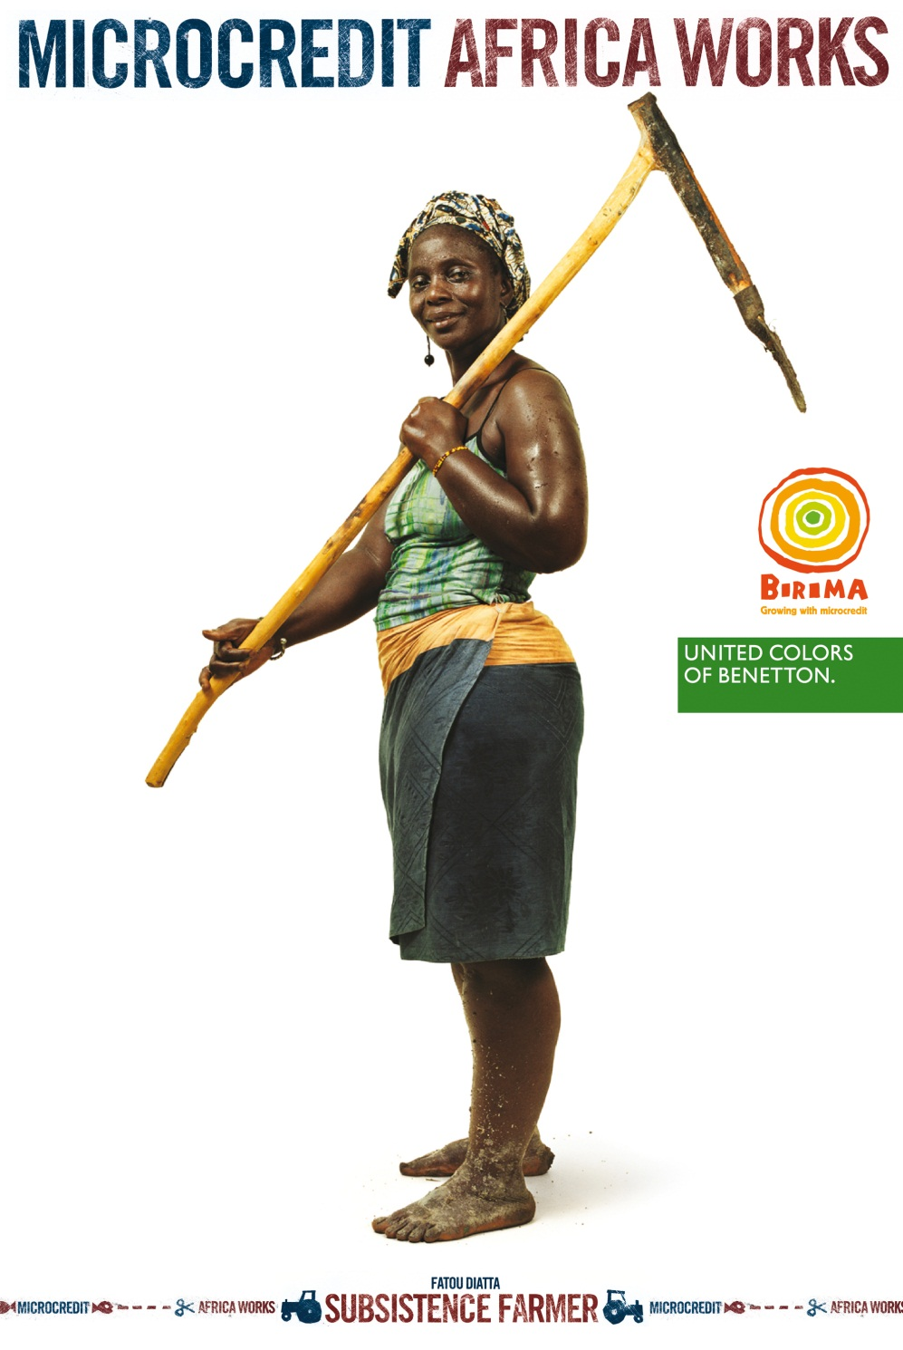
case study 2 malawi
Microloans for subsistence farmers
Megafarm project

Slide 10
case study 2 malawi
Subsistence farmers are escaping poverty through use of microloans
Just a small amount of money allows them to buy more productive seeds and fertiliser
Now they can sell surplus crops for a profit
There is enough profit for the farmers to pay back the loan and to send their children to school too
Microloans for subsistence farmers
Megafarm project

Slide 11
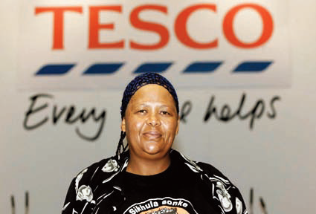
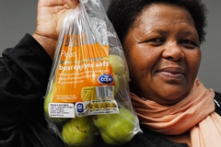
case study 3 South Africa
Improved pay for fruit farm workers
A charity helps the workers talk to Tesco

Slide 12
case study 3 South Africa
Gertruida Baartman works on a farm that supplies fruit to Tesco. The charity ActionAid flew her to a Tesco meeting in London
Gertruida told Tesco’s owners that pay and conditions on her farm were not good enough
After hearing her story, Tesco’s owners told the farm to raise pay. Now Gertruida’s children do not go to school hungry
Improved pay for fruit farm workers
A charity helps the workers talk to Tesco

Slide 13
What we have learned
The development process has several dimensions
If people are lifted out of poverty, important human needs like education and healthcare can also be met
As a society develops, children gain opportunities their parents lacked. A cycle of poverty is broken
There are a number of ways in which incomes can be increased for the world’s poorest people
Development can be achieved when different groups of people work together in partnership

Slide 14
credits
Microcredit: Benetton press room http://www.benetton.com/africaworks-press/en/image_gallery/alte/11_AfricaWorks_single%20page6.jpg
Fairtrade football: Fairtrade store http://www.fairtradestore.com/fair_trade_products/fair_trade_football/921
Gertruida Baartman: ActionAid http://www.actionaid.org.uk/who-pays-campaign/gertruida-baartman-at-tescos-agm

