Slide 1

Oman Vision 2040: climate change policy
Learning Goals
Know the geography and climate context of Oman
Identify the key elements of Oman’s 2040 climate change policy
To be able to analyse challenges and opportunities for Oman in addressing climate change
Key Terms
Oman Vision 2040
Oman Vision 2040 is a strategic framework from the Sultanate of Oman which aims to guide economic and social development from 2021 to 2040.
Cyclones
A tropical storm, otherwise known as a hurricane or typhoon.
Mitigation
Mitigation refers to actions aimed at reducing or preventing the emission of greenhouse gases (GHGs) to slow down global warming and its effects.

Slide 2
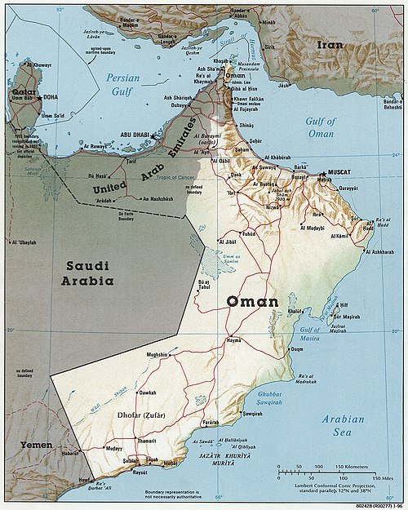
Climate change
Task
On your own copy of this map.
1. Annotate the geographical features of the country.
a. Can these features be categorised? for example, into water / landforms, or fluvial / geological.
2. Use this information to answer the following question: Why might Oman be vulnerable to climate change?
Image Source: Oman 1996 CIA map. Public Domain

Slide 3
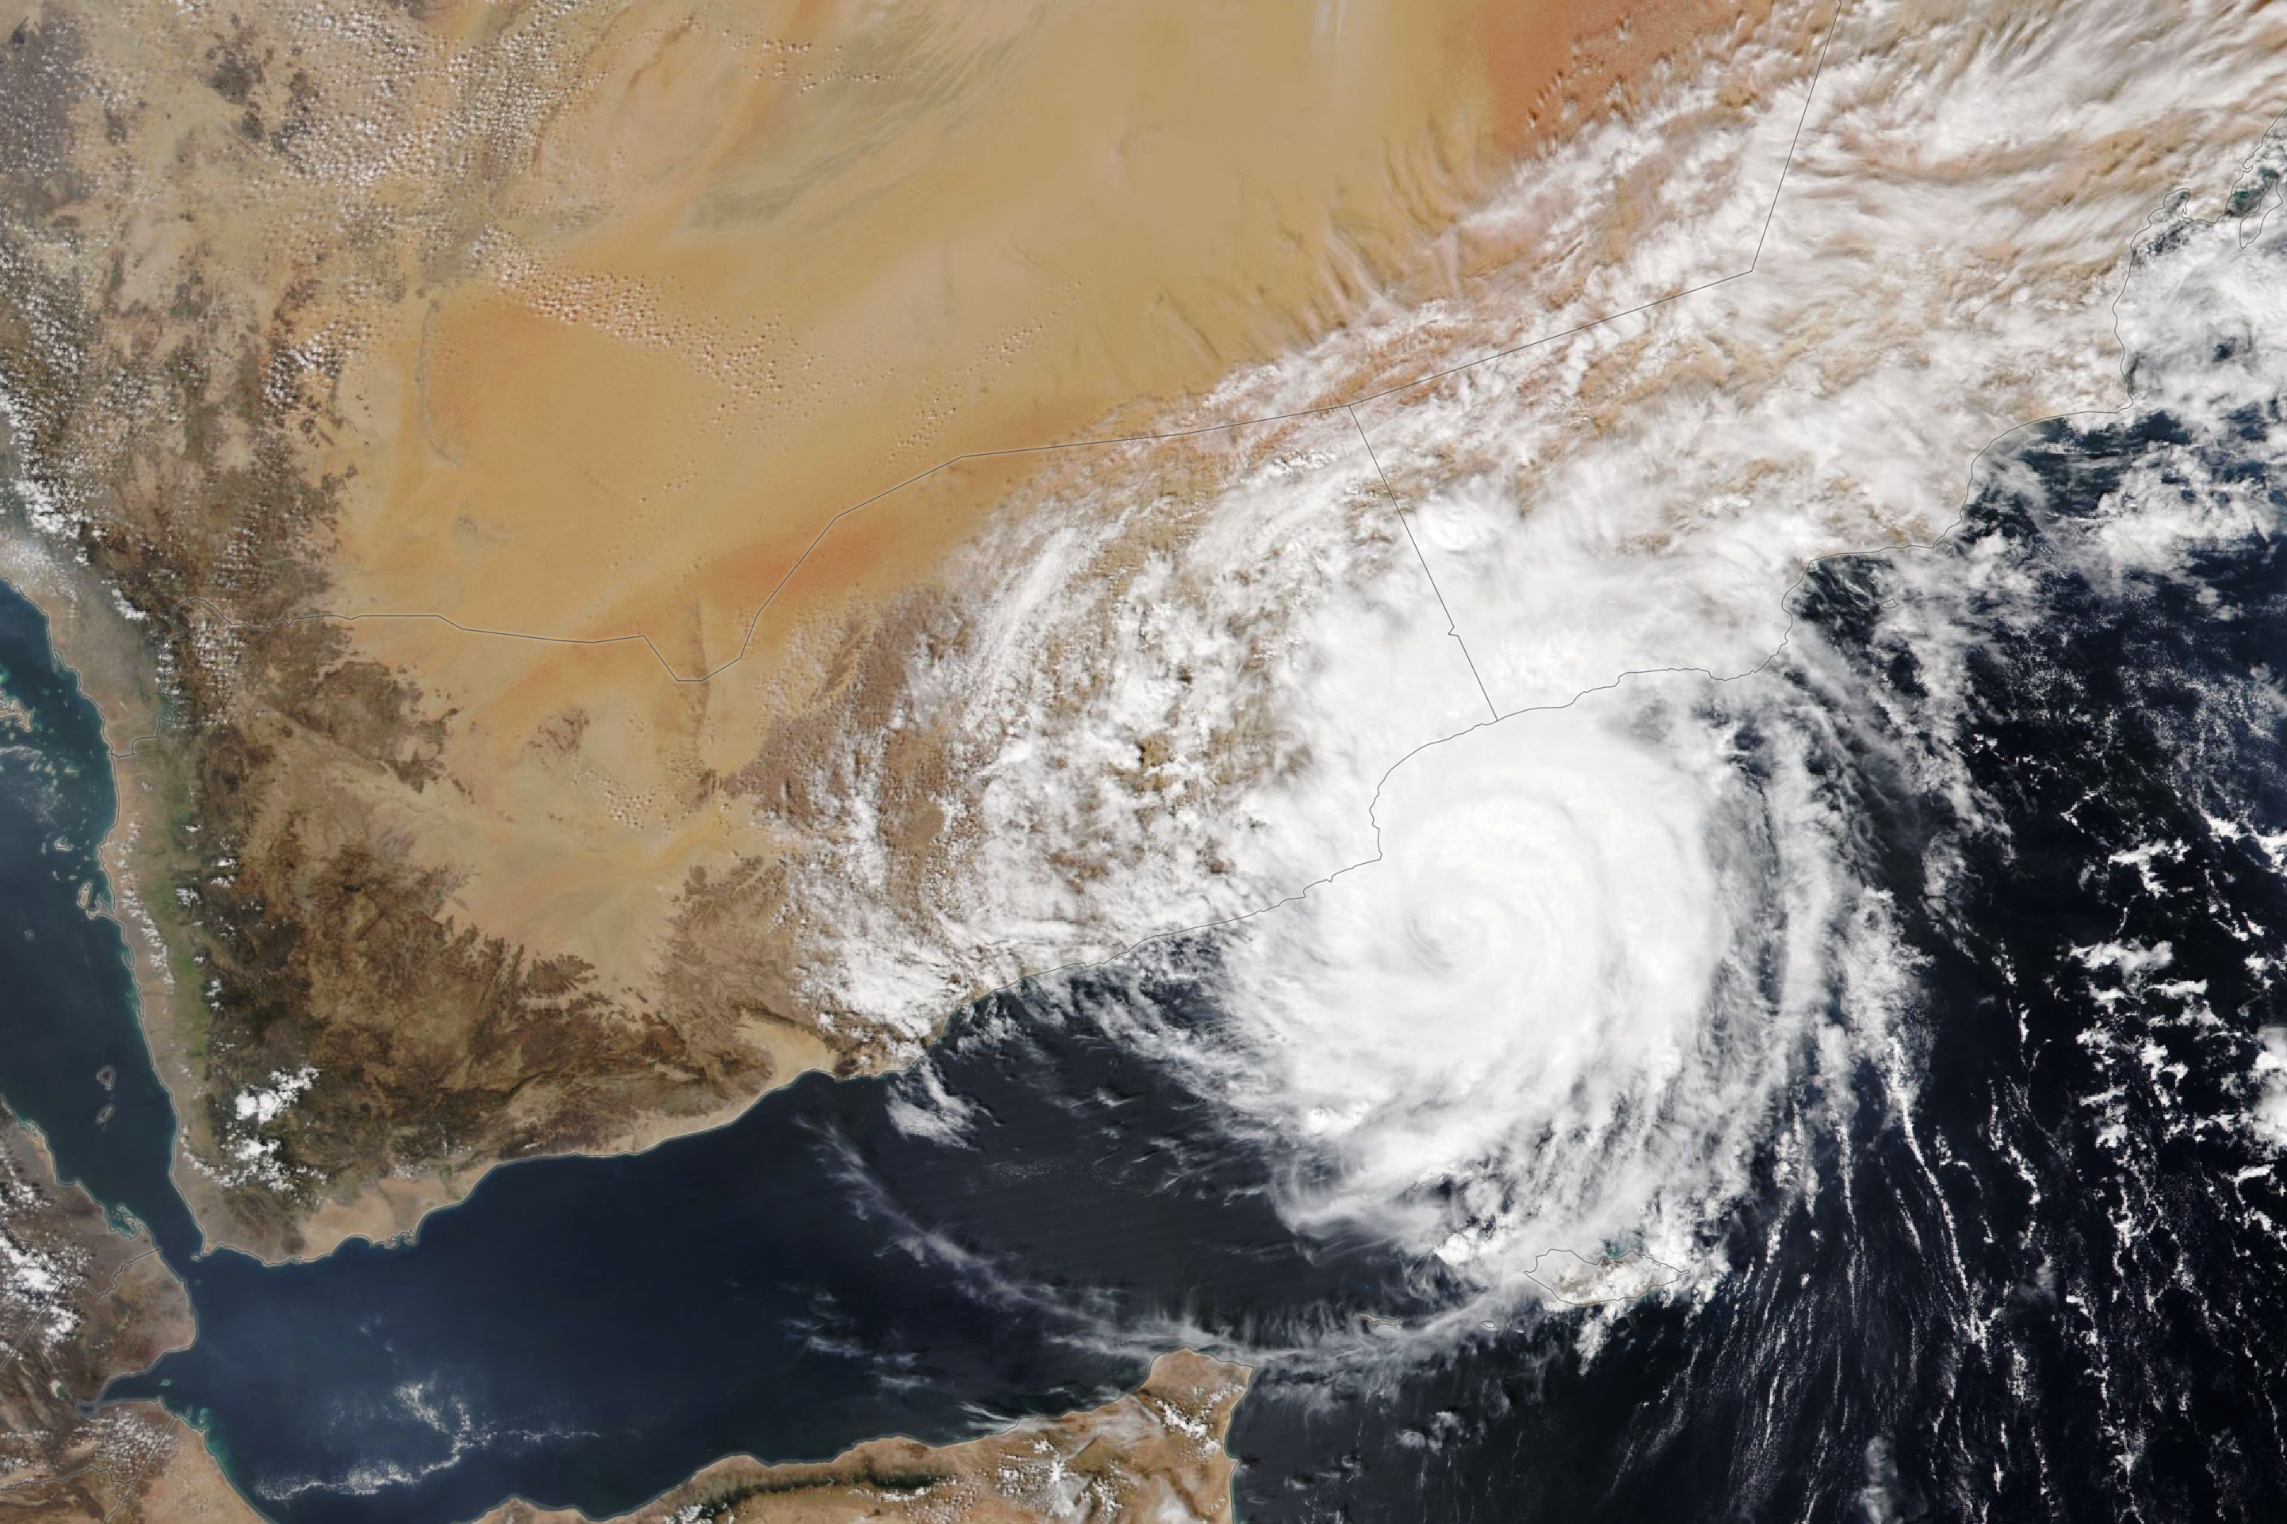
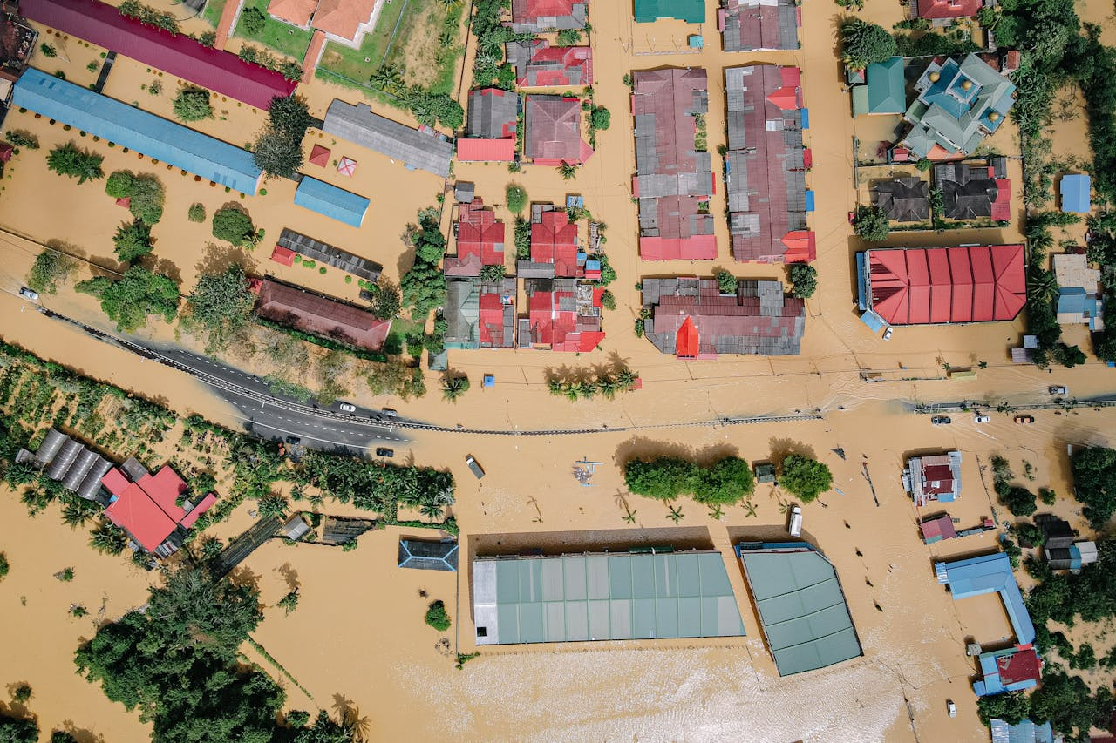
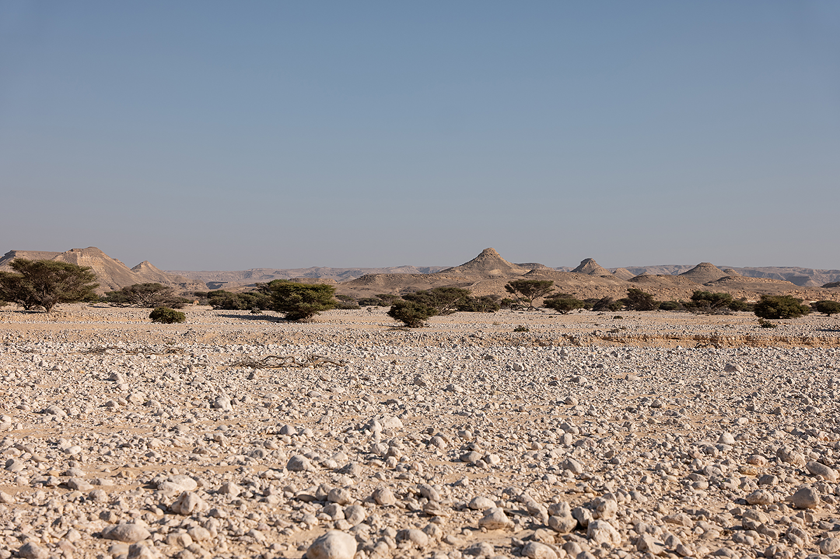
Photo analysis
Study the photographs which illustrate some of the impacts of climate change in Oman.
What environmental challenges does Oman face from climate change?
Image sources: Cyclone, NASA Earth Observatory, Flooding, Pok Rie Pexels, Drought © Ana-Maria Pavalache

Slide 4
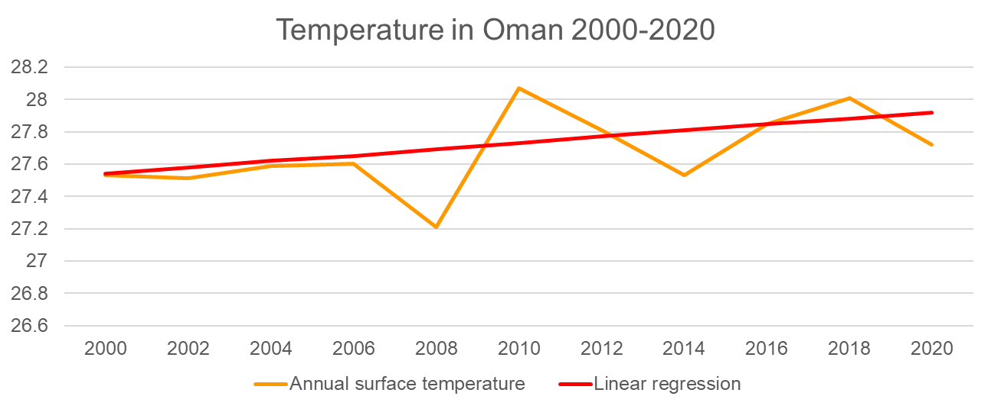
Graph
Oman has a dry hot climate. Since 1980 the country has experienced a gradual temperature increase. Due to climate change, average annual temperatures are expected to continue to rise.
Study the data table on your student sheet. It shows surface temperature and a linear regression line for Oman (linear regression fits a straight line through data points).
Task
Copy the data table into excel. Choose the Insert tab and select Recommended Charts. Accept the suggested line graph and click OK. Change the title to: Temperature in Oman 2000-2020.
Analyse the data presented from the graph.

Slide 5
Specific risks from climate change
Oman faces 4 specific climatic risks from its proximity to tropical waters, an arid climate, economic dependency, and fragile biodiversity. The information below explains each one of these risks in turn.
Task
On your student sheet, match the explanation to the climatic risk.

Slide 6
Specific risks: answers
Climatic risk |  | Explanation
Tropical waters |  | ~82% of Oman is desert, with limited water resources. Climate change exacerbates water scarcity, impacting agriculture and drinking water supply
Arid climate |  | Being near the Strait of Hormuz, a major oil transit route, the economy relies heavily on oil and gas exports
Economic dependency |  | Oman’s diverse ecosystems (mountainous regions to coastal areas) are at risk due to changing weather patterns
Fragile biodiversity |  | Oman's coastal position makes it vulnerable to rising sea levels and extreme weather events like cyclones, which have increased in intensity due to climate change

Slide 7
Oman’s climate change policy
There are several elements to Oman’s climate change policy for the twenty-first century.
Oman plans to invest in renewable energy, specifically solar power, in the coming decades. Water resource management, international cooperation through, for example, the Gulf Cooperation Council as well as mitigation and adaptation strategies for vulnerable communities are all key priorities.
Task
Get into groups of 3 or 4. Research and make notes on one of the four elements of Oman Vision 2040:
  Renewable energy
  Water resource management
  International cooperation
  Mitigation strategies
Suggested webpages have been shared with you. Once finished, you will present your findings to the rest of the class.

Slide 8


Plenary – be the advisor
Task
Imagine you are a government advisor. If you were advising Oman’s government, what would you prioritise in their climate change policy?
How does Oman’s climate change policy differ from others in the region?

