Slide 1

development challenges
Investigating conflict and natural disasters

Slide 2
Presentation Content
Geographical challenges for development
The earthquake in Haiti
War in the Democratic Republic of Congo
The Syrian refugee crisis
Vulnerability and resilience
Priorities for development
Conclusion: what we have learned

Slide 3
Do you know where Haiti, Democratic Republic of Congo (DRC) and Syria are?
Syria
Haiti
Democratic Republic of Congo (DRC)

Slide 4
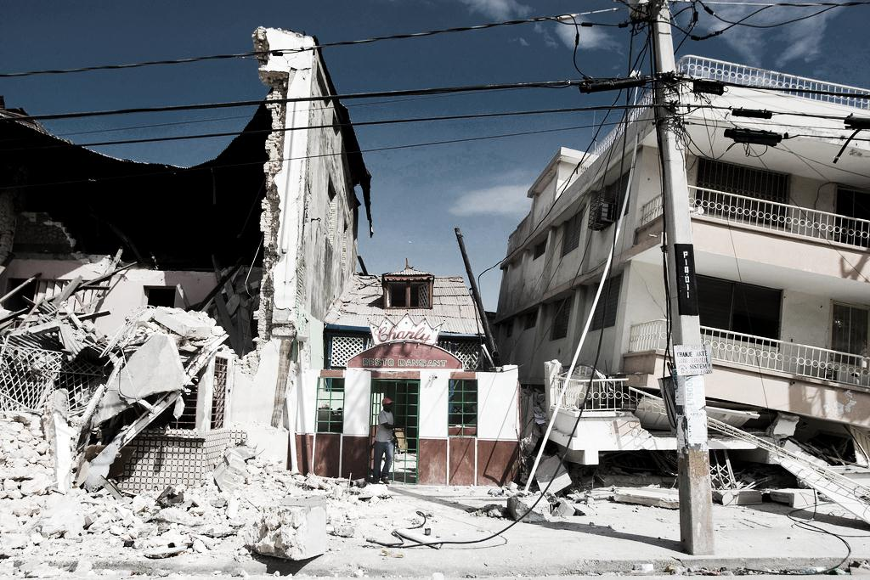
case study 1 Haiti
2010 earthquake
Vital infrastructure and schools lost

Slide 5
case study 1 Haiti
300,000 died and over one million people were left homeless
The Caribbean island is still struggling with the after-effects
Many schools were destroyed, leaving children without an education
Re-equipping schools has become a priority for the reconstruction workers
2010 earthquake
Vital infrastructure and schools lost

Slide 6
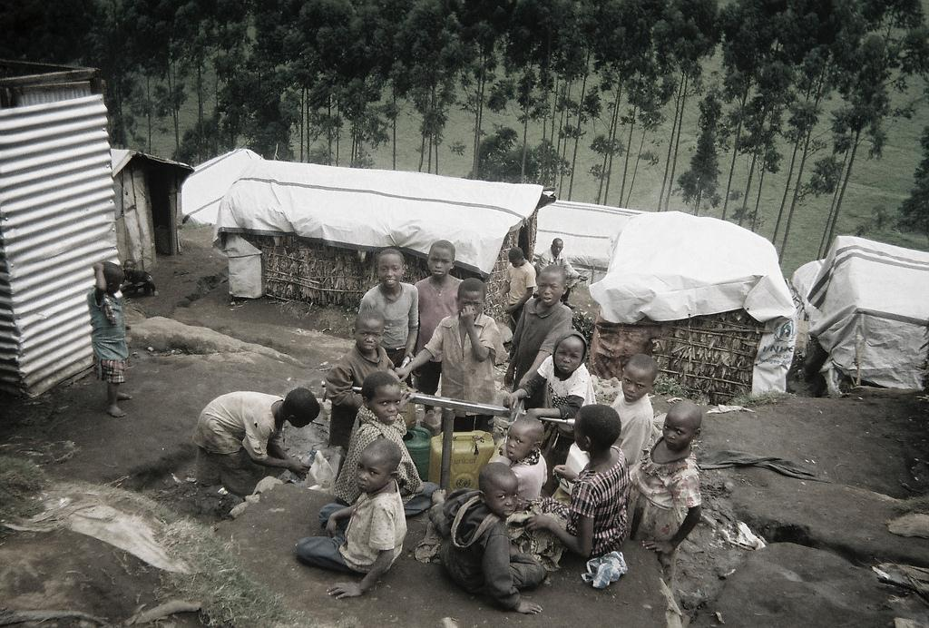
case study 2 Congo
‘African World War’
5 million lives lost to a conflict with no easy resolution

Slide 7
case study 2 Congo
Over the last 20 years, armies and militia groups from nine neighbour states have invaded Democratic Republic of Congo (DRC)
DRC is an ethnically and politically unstable state, becoming independent from Belgium rule in 1960
A generation of children’s lives have been ruined by warfare linked to control of natural resources
‘African World War’
5 million lives lost to a conflict with no easy resolution

Slide 8
case study 2 Congo
The conflict in numbers
240 | Number of ethnic groups that share the territory of DR Congo
US$24 trillion | Value of mineral wealth that lies beneath DRC, including diamonds, gold and 'rare earths'
US$0.41 | Daily income for the 66 million people, based on a gross national income (GNI) figure of $150 per person per year
47% | Proportion of the population aged 14 or under. Male children have been conscripted as boy soldiers and girls as prostitutes
US$1.4 billion | Cost of the annual United Nations peacekeeping budget for DR Congo
‘African World War’
5 million lives lost to a conflict with no easy resolution

Slide 9
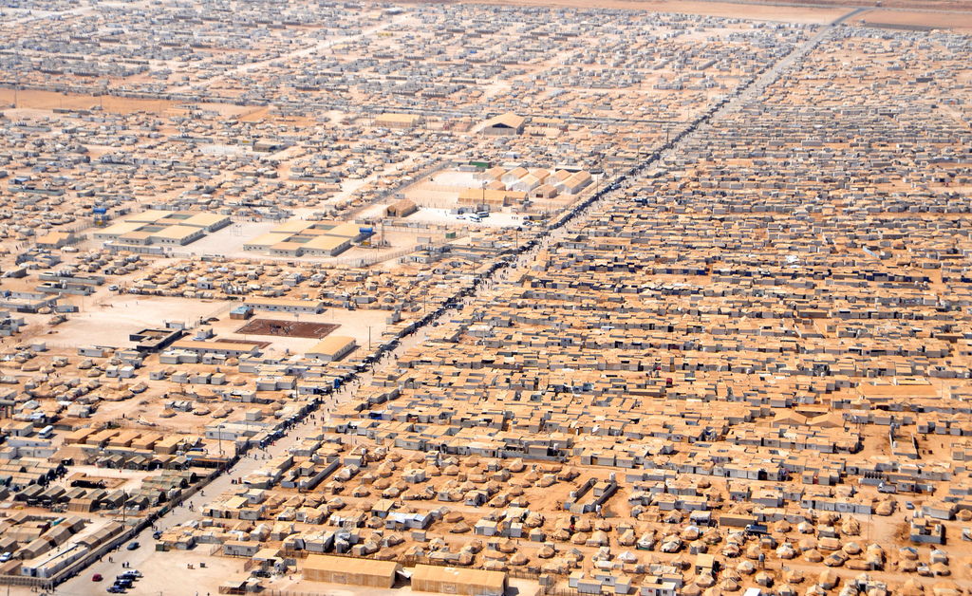
case study 3 Syria
Civil war since 2011
Millions of refugees

Slide 10
case study 3 Syria
Crisis began when rebel groups demanded the resignation of President Bashar al-Assad in 2011, accusing him of misrule
Foreign powers provided political and other support to different side of the conflict
In 2013, the number of international refugees from Syria rose to 2 million. 4 million people are displaced within Syria
Development is hard to achieve when people are living in refugee camps
Civil war since 2011
Millions of refugees

Slide 11
How is development at risk?
The development process is complex
Conflicts and natural disasters can interfere with many different, linked aspects of development
It becomes harder for the most vulnerable people to escape poverty
Conflict or disaster
Property damage
Lack of schools
Lack of employment
Lives lost
Families shattered
Development challenge
Immediate impacts
Long-term development challenge

Slide 12
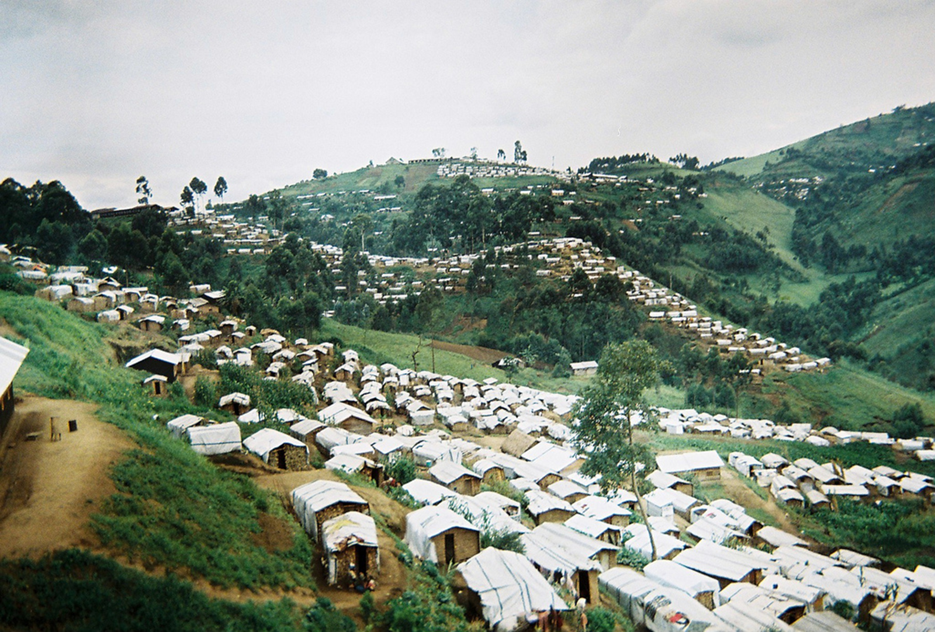
Living in a refugee camp
What are the prospect for economic development and for meeting people’s human needs and rights?

Slide 13
Post-crisis (re)development
Shattered society
People lose their homes, families, schools, employment and healthcare
Resilient society
What should the priorities be for reconstruction?
In order to promote long-term development, how should the international community respond to conflicts and disasters? What should the priorities be?

Slide 14
What we have learned
Human and physical challenges can jeopardise the development process
Conflict and disasters threaten the long-term gains from the development process
Children are especially vulnerable to the immediate and lasting effects of conflicts and disasters
Loss of family and access to education can jeopardise progress for an entire generation of children
Post-crisis recovery may need to focus on helping children become more resilient, especially when they have been forced to play a role in conflict

Slide 15

credits
DRC: European Humanitarian aid http://www.flickr.com/photos/69583224@N05/11187832486/sizes/l/in/set-72157638312212236/
Haiti: UNDP (Flickr Creative Commons)
Syria: Sharnoff’s Global Views http://www.flickr.com/photos/sgviews/11110449505/sizes/l/in/photostream/

