Slide 1
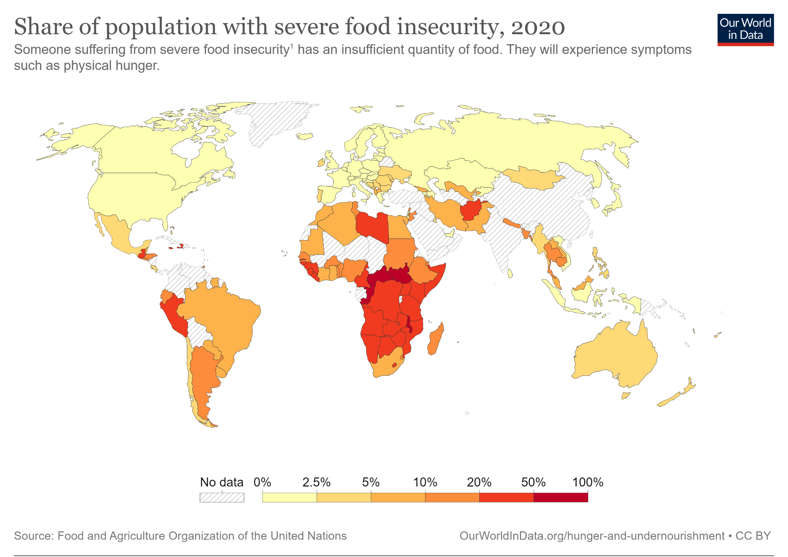
How Food Secure is the World?
Learning Objective: To describe patterns of global food security and explore potential solutions.
Starter:
Describe the pattern of severe food insecurity across the world using PHAL (pattern, high, anomaly, low).
Challenge:
Consider potential reasons for the pattern of food insecurity.
Could you make a link to a topic/topics you have previously studied?

Slide 2


What is food security?
Food security: the state of having reliable access to a sufficient quantity of affordable, nutritious food.
Which of the Sustainable Development Goals does food security link to?
Explore examples of food security in a HIC, NEE, and LIC:
https://storymaps.arcgis.com/stories/fde9a959f8ef41d59acb53dec54ad8bd
Notes:
https://ourworldindata.org/food-insecurity

Slide 3
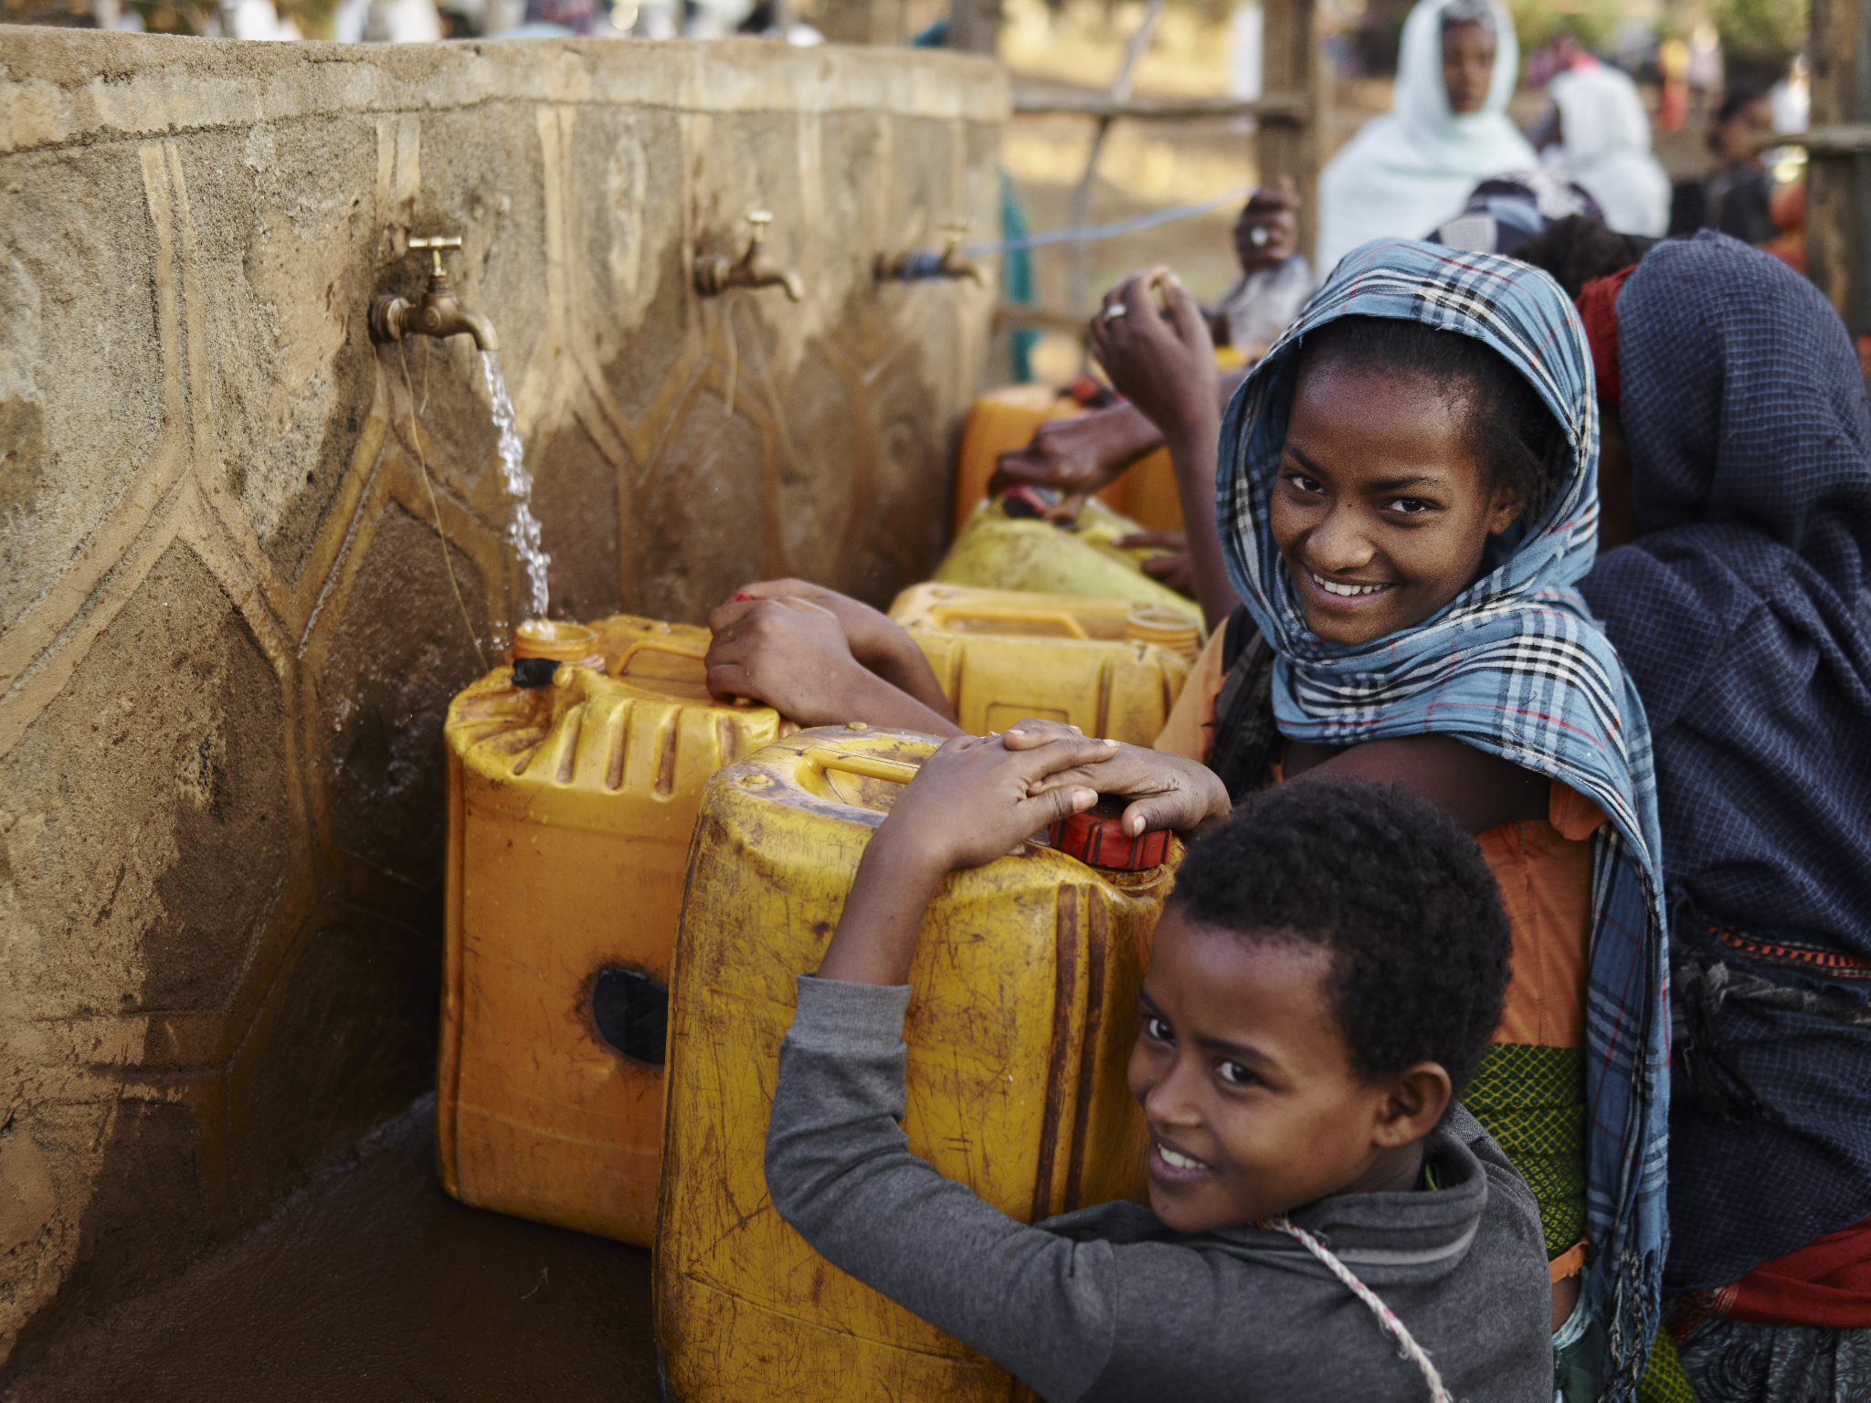
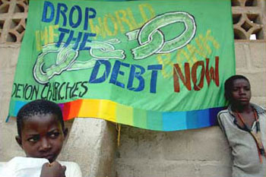
Types of development projects
Which type of development project might be best to address food security? Why?
Top-Down Development: Support and decisions are made at a government level and improvement ‘trickle down’ to citizens. These are usually expensive, large-scale projects.
Bottom-Up Development: Small-scale schemes put in place that support people at a ‘grassroots level’ to focus on immediate problems.
Debt Cancellation
WaterAid

Slide 4
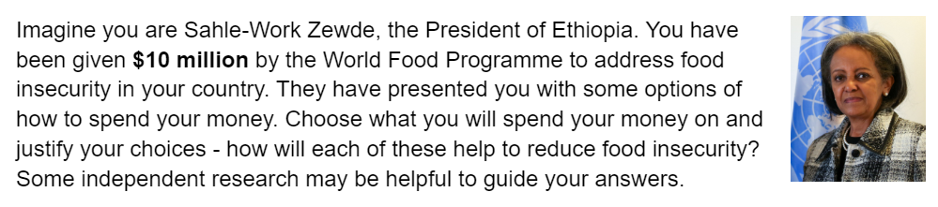
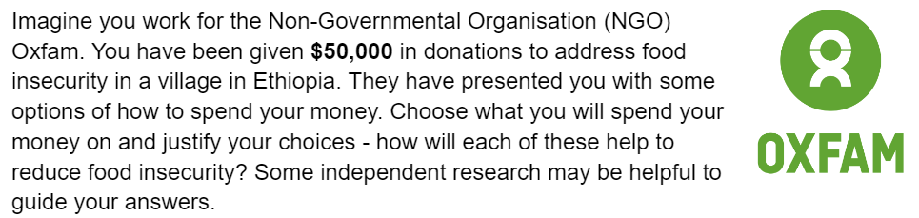
How can we address food insecurity?
Task: You have either been assigned as the President of Ethiopia or an employee at Oxfam, and have been given a sum of money to help to tackle food insecurity in Ethiopia. Decide how to spend your money and justify your choices, explaining the impact they will have.

Slide 5

Plenary: JAM
Top-down development projects
Bottom-up development projects

Slide 6
Homework: (Flipped learning) How can we manage water as a resource?
Use the following links and your own research to fill out the sheet about managing water.
https://www.rff.org/topics/natural-resources/water/water-allocation/
https://www.bbc.co.uk/bitesize/guides/zqv3dmn/revision/1
https://www.worldbank.org/en/topic/waterresourcesmanagement#2
https://www.savemyexams.co.uk/a-level/geography/edexcel/18/revision-notes/7-the-water-cycle-and-water-insecurity/7-3-water-insecurity/7-3-3-managing-water-supply/

Slide 7
Dams and reservoirs
Water transfers
Desalination plants
Sustainable schemes of water supply & water conservation

