Slide 1

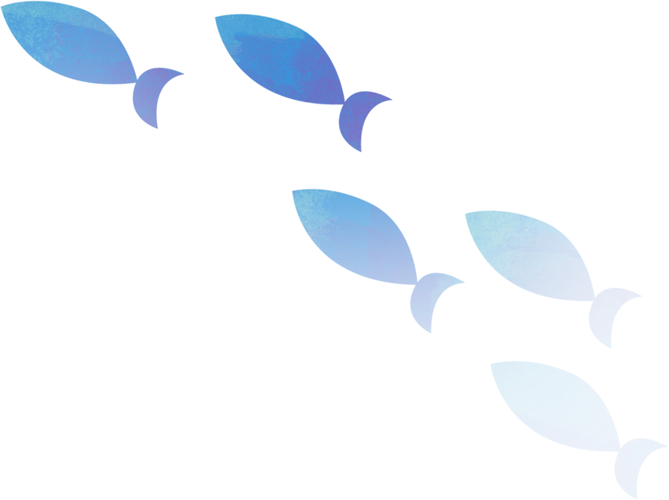

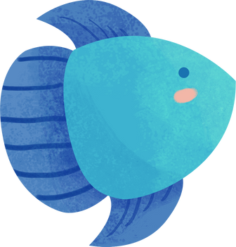
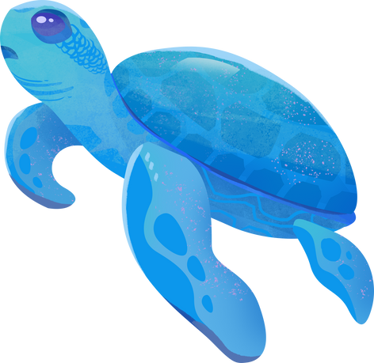

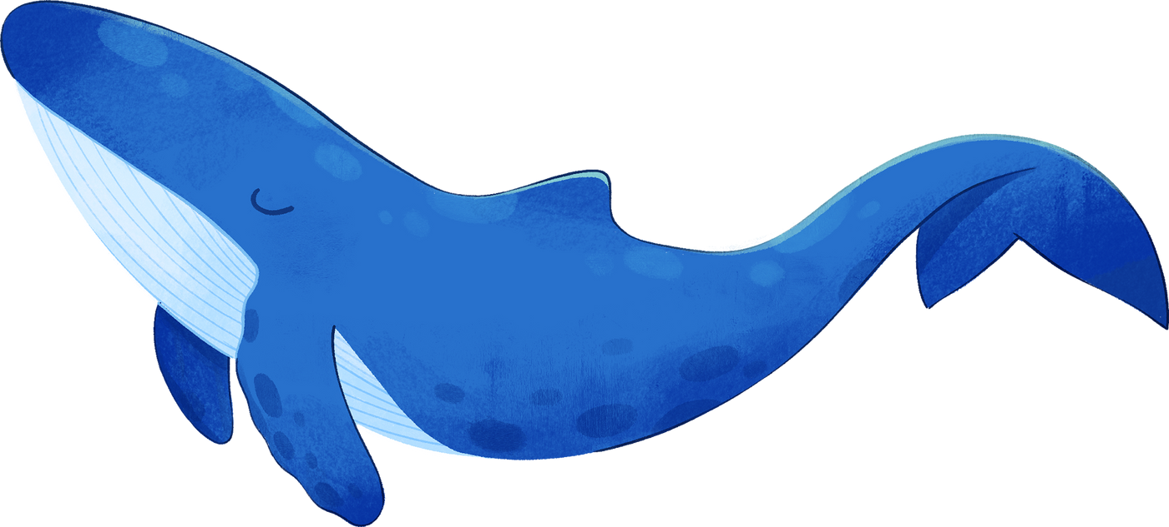


While you wait... thinking about the title of this lesson, are there any connections which come to mind?
I CAN SEE THE SEA!
Connections to the sea
Notes:
Presentation adapted from the blue illustrative organic ocean habitat presentation © Olmos Carlos via Canva.com

Slide 2
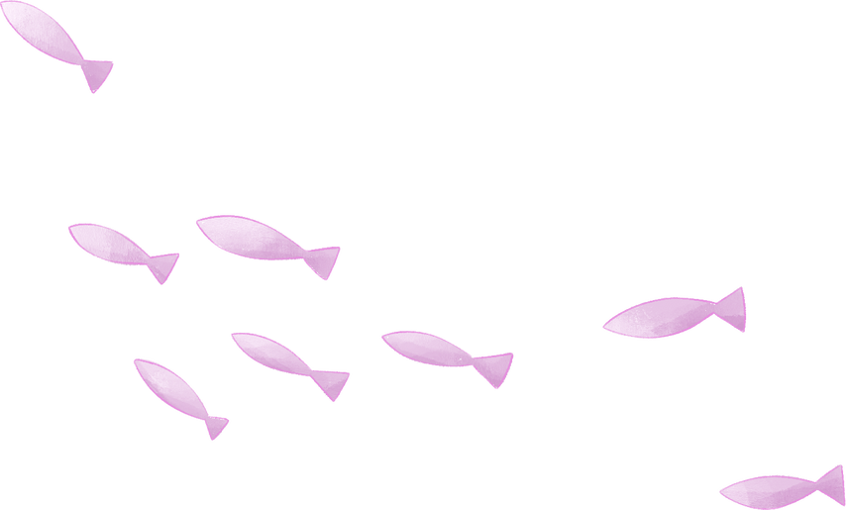
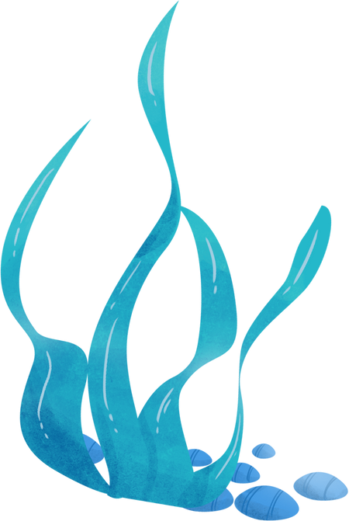
Connections to the sea
Learning Goals
1
2
3
4
To look at ways people around the world connect to the sea.
To summarise our findings.
To identify the similarities and difference between the connections to the sea.
To create our own connection to the sea.
Key Terms
Myth ~ Legend ~ Deity
Notes:
Presentation adapted from the blue illustrative organic ocean habitat presentation © Olmos Carlos via Canva.com

Slide 3
Connections through storytelling
Deity A supernatural being which is considered sacred and worthy of worship. They are believed to have authority over the universe, nature or human life. | Spirit A supernatural being which might take the form of a human that has magical powers.
Myth A story which usually involves a way to explain a natural phenomenon. Many myths involve deities and / or demigods and might not have a clear origin. | Legend A story from the past that is believed by many people but cannot be proved to be true.
Storytelling has been a way in which humans could pass down information way before the written word.
Some of these stories are embedded within a place’s belief system through deities and spirits which are respected and worshiped accordingly.
Others are found in myths and legends.
However these stories are received, they can help people become more connected to their place.
Notes:
Presentation adapted from the blue illustrative organic ocean habitat presentation © Olmos Carlos via Canva.com

Slide 4



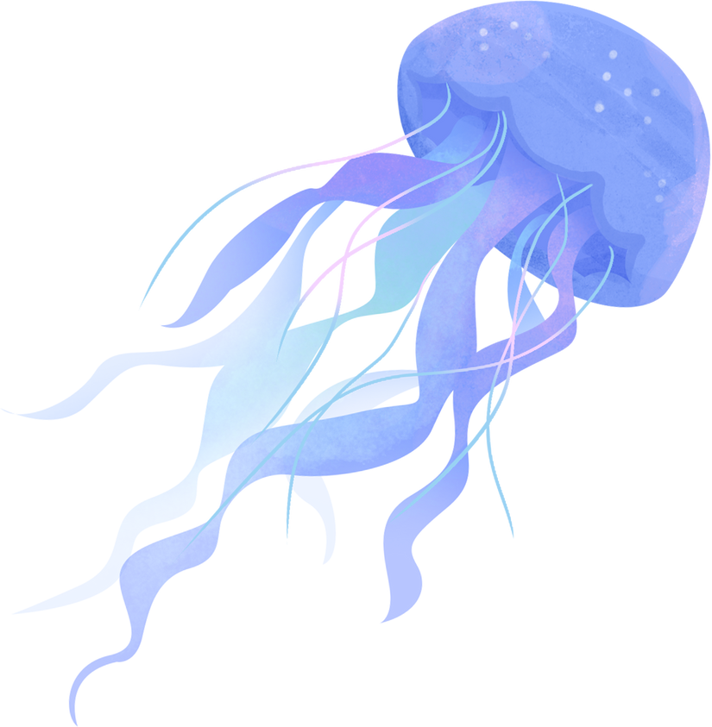



Some of the world’s myths, legends, deities and spirits around the sea and oceans.
Atlantis
Longwang: The Dragon King
The Bermuda Triangle
Image credit: guavanaboystudio
Mami Wata
Kraken
Image credit: Sparklestroke
Image credit: OpenClipart-Vectors, pixabay
Notes:
Presentation adapted from the blue illustrative organic ocean habitat presentation © Olmos Carlos via Canva.com

Slide 5
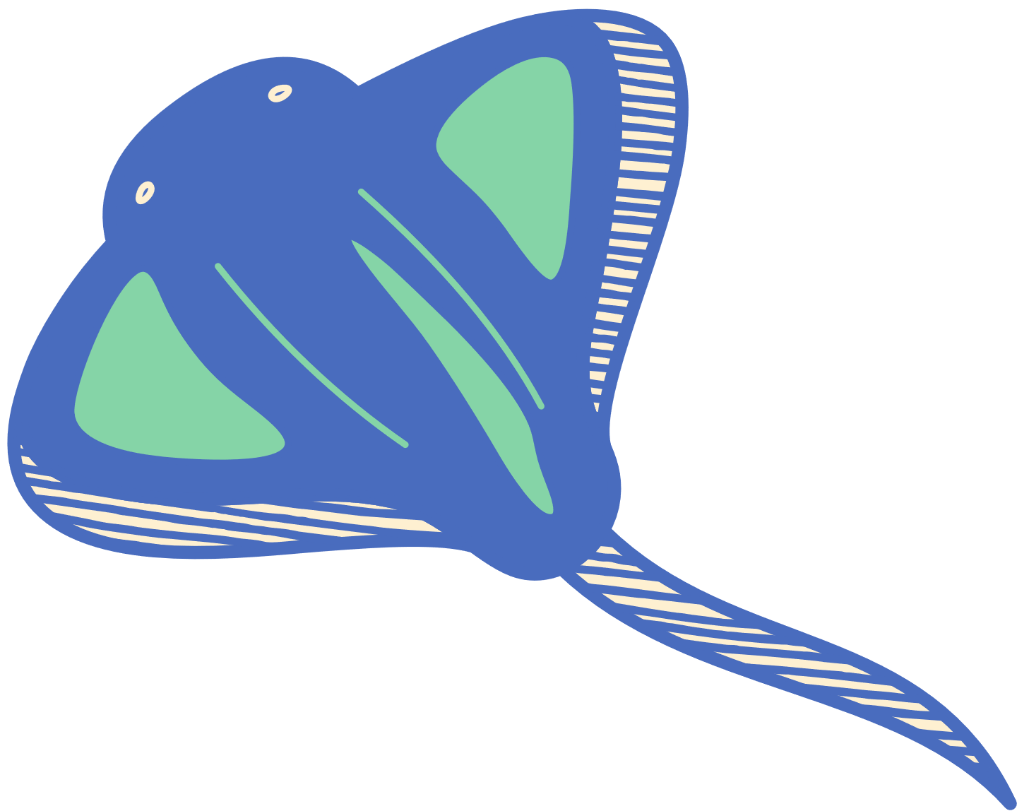
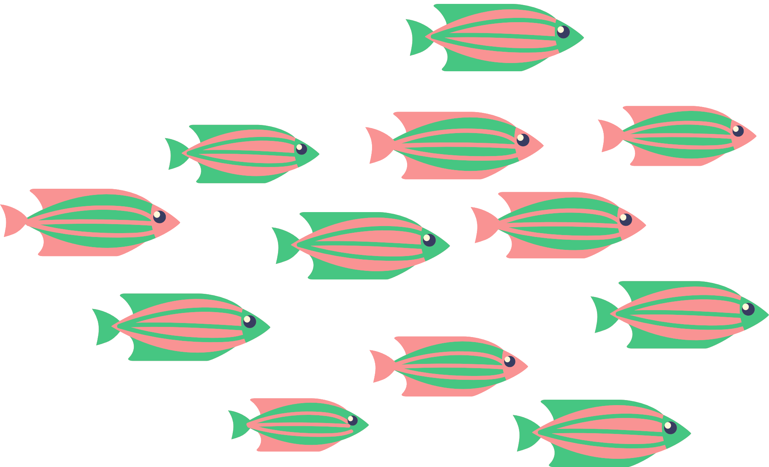
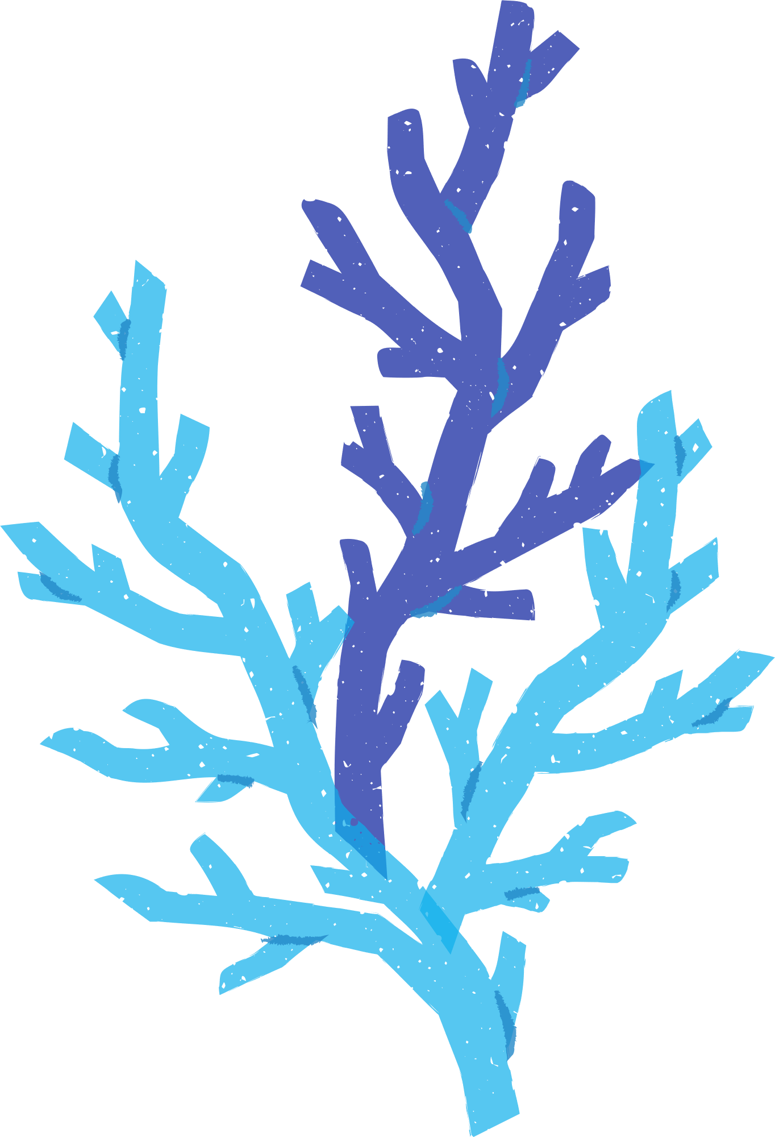
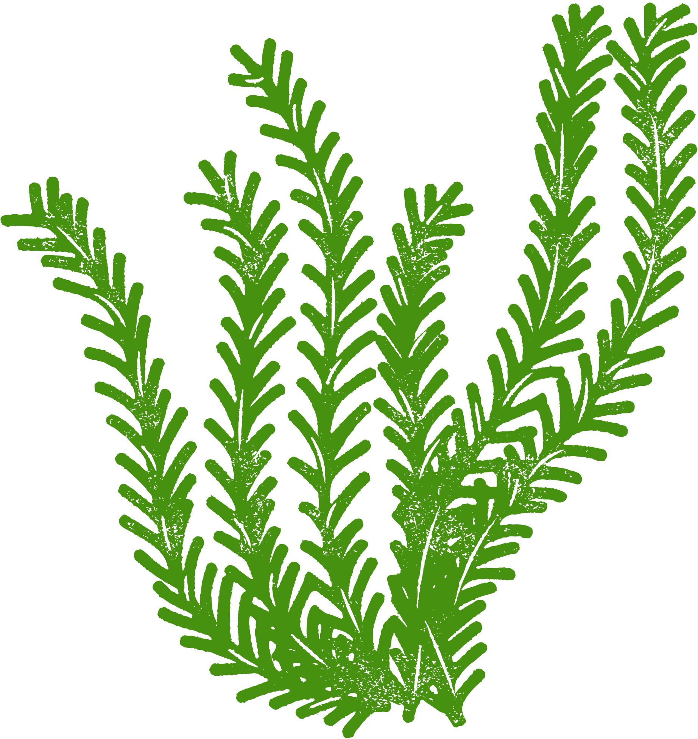
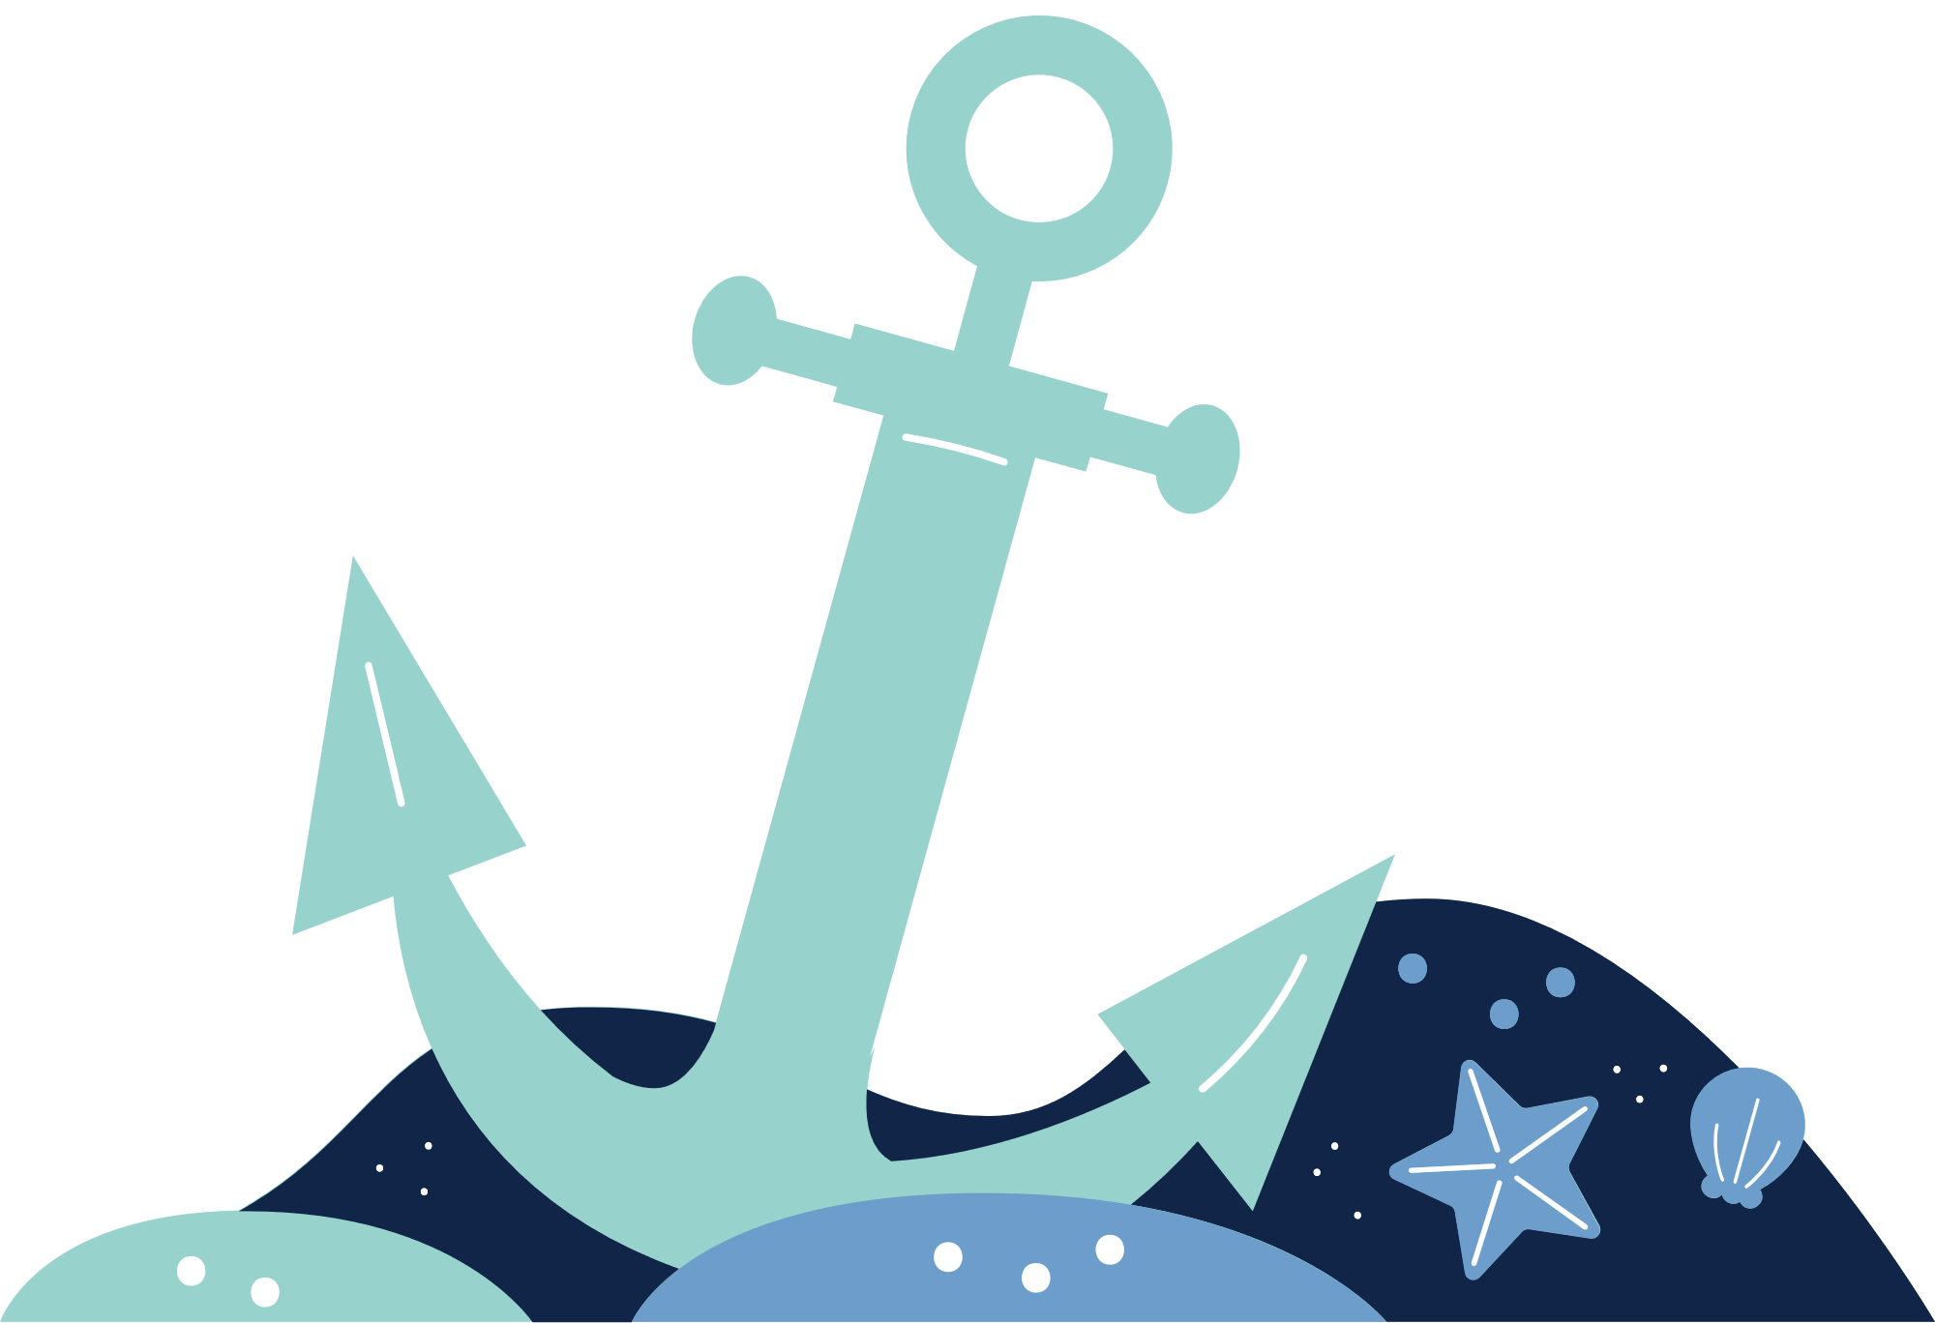
What was similar and different about each of the myths, legends, deities and spirits you have looked at?
Notes:
Presentation adapted from the blue illustrative organic ocean habitat presentation © Olmos Carlos via Canva.com

Slide 6

Make your own connection to the sea
  Task 1
Think about what you have learnt in the past few lessons about what is happening to our seas and oceans as well as how we could protect them. Note down some of the qualities you would like your connection to have. i.e. the ability to remove plastic from the oceans.
What form do you think your connection might take? Will it be a spirit, a monster or a place which has been lost?
  Task 2
Create your own connection to the sea in any way you would like. Some ideas could be a poster, model, poem, story etc.
Don’t forget to add a name!
Notes:
Presentation adapted from the blue illustrative organic ocean habitat presentation © Olmos Carlos via Canva.com

