Slide 1
Data Presentation Hints

Slide 2
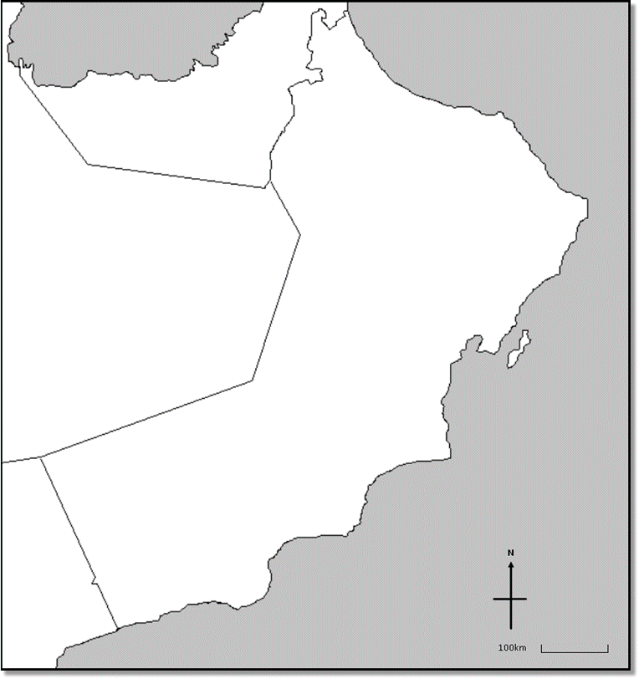
Data Presentation Hints
Defence
Drainage
Soil
fertility
Bridging point
Building materials

