Slide 1
Mapping population and migration in Bangladesh
Migrants on the margins
Lesson

Slide 2
Learning objectives
To be able to use gridded population cartograms to show the number of people living in a country
To be able to compare information shown on Worldmapper cartograms
To critically review different sources of data

Slide 3
Population in Bangladesh
Some of the migration stories that the Migrants on the margins team heard about in Dhaka mentioned flooding.
The low-lying position of Bangladesh has meant that climate change has played a part in forcing communities to become internally displaced, but has also played a part in causing communities to become trapped.

Slide 4
Where do people live?
The map below is known as a gridded population cartogram
A gridded population cartogram is a projection map, where each area is proportional to the number of people living there.
Further information about this technique can be found on the WorldMapper website

Slide 5
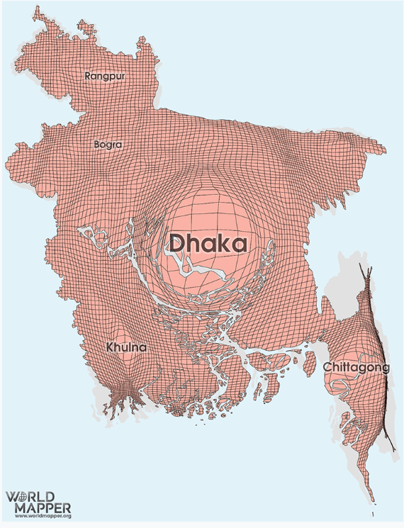
Bangladesh
First level bullet
Second level
Third level
Fourth level
Fifth level
Click on the map to visit the WorldMapper website
Describe the population distribution shown

Slide 6
Why do people so many people live in Dhaka?
Can you think of 3 reasons why people may choose to live in Dhaka?
Can these be grouped together?
For example are they all economic reasons?

Slide 7
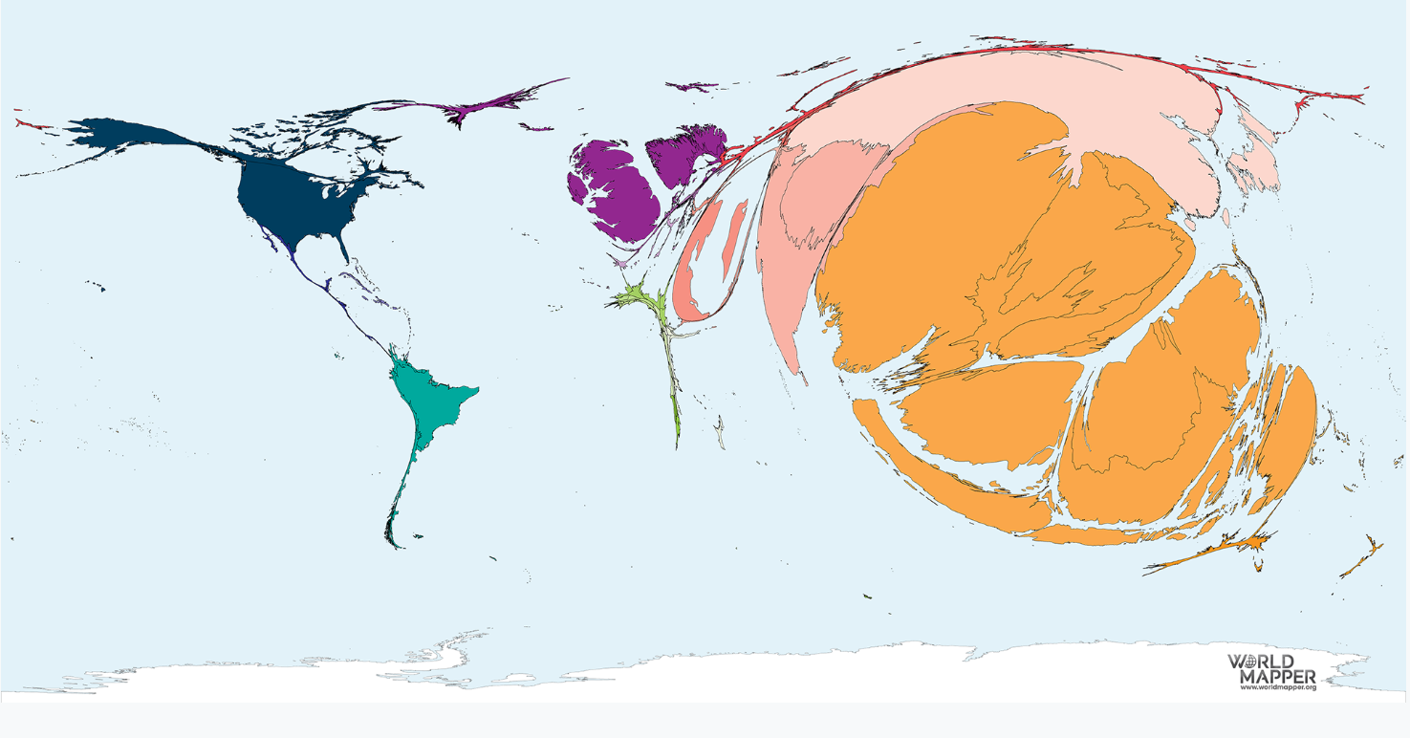
Where do people come from?
The WorldMapper map shows most of the around 1.1 million migrants that came to Bangladesh between 1990 and 2017 came from Myanmar, followed by Malaysia, China, Indonesia and Laos

Slide 8
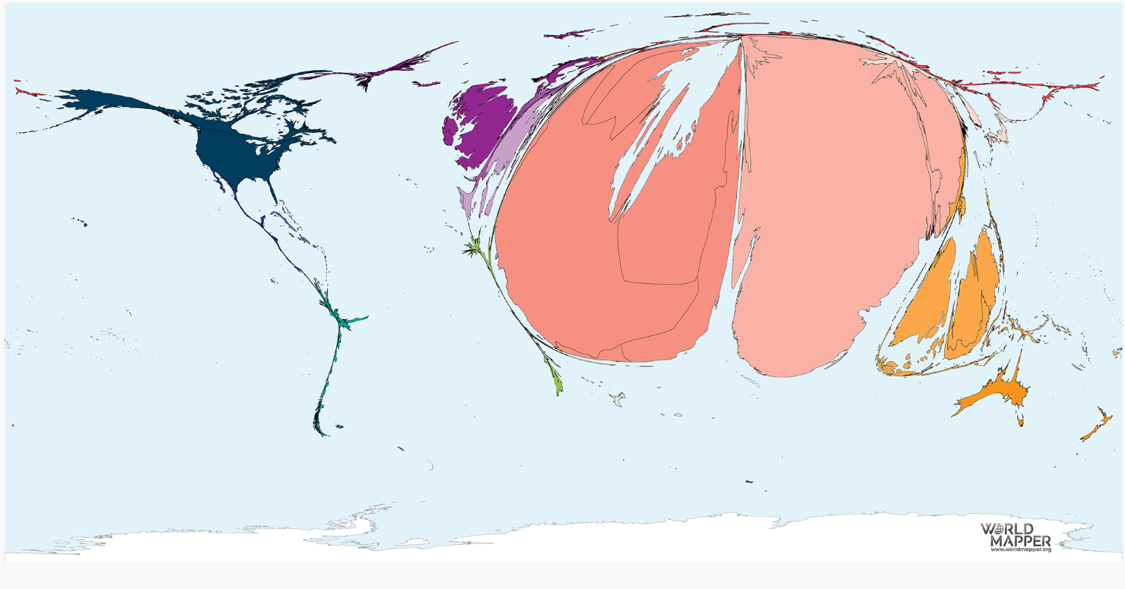
Where do people move to?
First level bullet
Second level
Third level
Fourth level
Fifth level
Most of the migrants from Bangladesh between 1990 and 2017 went to India, followed by Saudi Arabia and United Arabian Emirates

Slide 9
Review
Critically reviewing data sources is an important part of geographical research.
What are the advantages of using maps such as the WorldMapper projections rather than using tables or graphs to show population movements?
Can you think of any disadvantages to using such maps?

