Slide 1
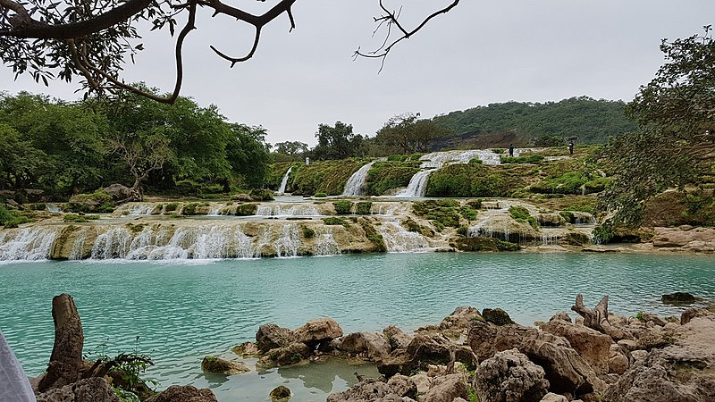
If we were on a fieldtrip and looking at this place, what might you feel about it?
What can you remember from last lesson which might link to this picture?

Slide 2
Features of the Wādī Darbāt
Learning Goals
Locate key features of a river profile.
Show how waterfalls are formed.
Know how processes can affect the formation of a waterfall.

Slide 3
What does the Wādī Darbāt look like?
Can you describe the topography* of the Wādī Darbāt?
Think-pair-share your ideas. You can use your own and the terms in the box below to help.
steep ~ gentle ~ valley ~ narrow ~ wide ~ gap ~ cut
*Topography – the shape of the land.

Slide 4
The Khareef
The Khareef is a type of seasonal rainfall like a Monsoon.
The Khareef falls near Salalah in the south of Oman.
The rains come from June to September every year.
The Khareef brings heavy rain that feeds into river valleys creating seasonal rivers called Wadis. The Wādī Darbāt is one of those.
It also brings life to the landscape turning it from yellow to green.
Label your own copy of the Wādī Darbāt with key features of a river. You can use the words around the room to help you.

Slide 5
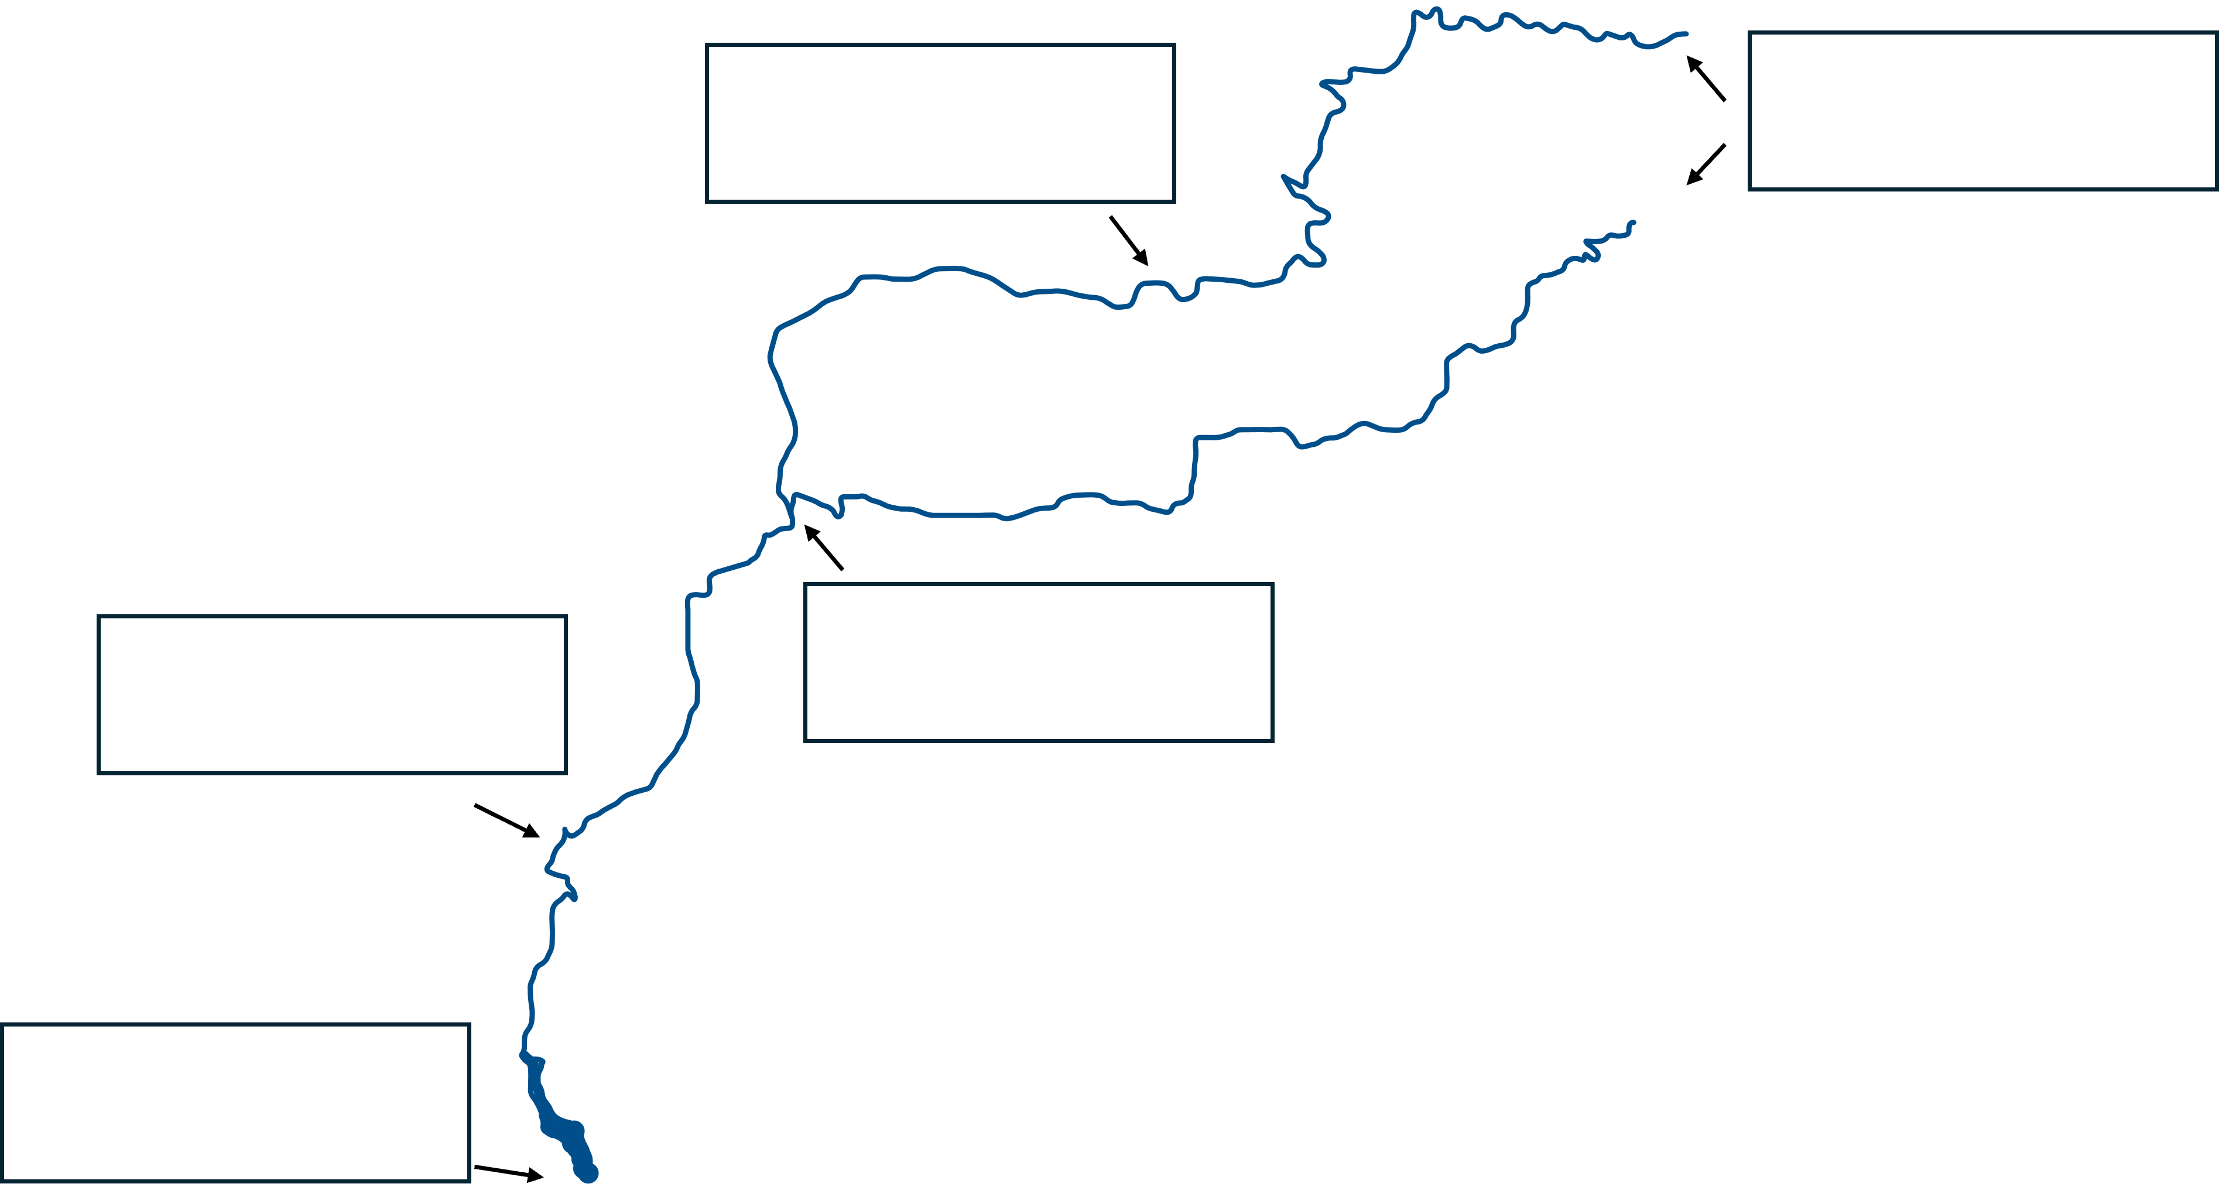
Check your labels
Meander
Source
Confluence
Valley
Mouth

Slide 6
Make your own waterfall model
One of the landforms which is brought to life during the Khareef is the waterfalls at Wādī Darbāt.
You are going to work in teams to recreate a waterfall in a model.
To do this, you will need to follow the instructions on the next slide.

Slide 7
Waterfall model
In your groups, number yourselves 1, 2 & 3.
You will each get a chance to look at the image on the teacher’s desk.
You will go in turn-all the 1s then 2s, then 3s.
You will then get another chance to go up in those turns.
You then need to go back to you your group and tell them what you saw. YOU CANNOT START MAKING IT YOURSELF.
Make model of a waterfall using this information.
There are images of the different waterfall features around the room to help you if you need it.

Slide 8
Waterfall – Success Criteria
Your model should look like a waterfall.
It should have the key features (bolded ones) in the model.
We should be able to see a sequence showing its formation.
Did your model meet the success criteria?

Slide 9
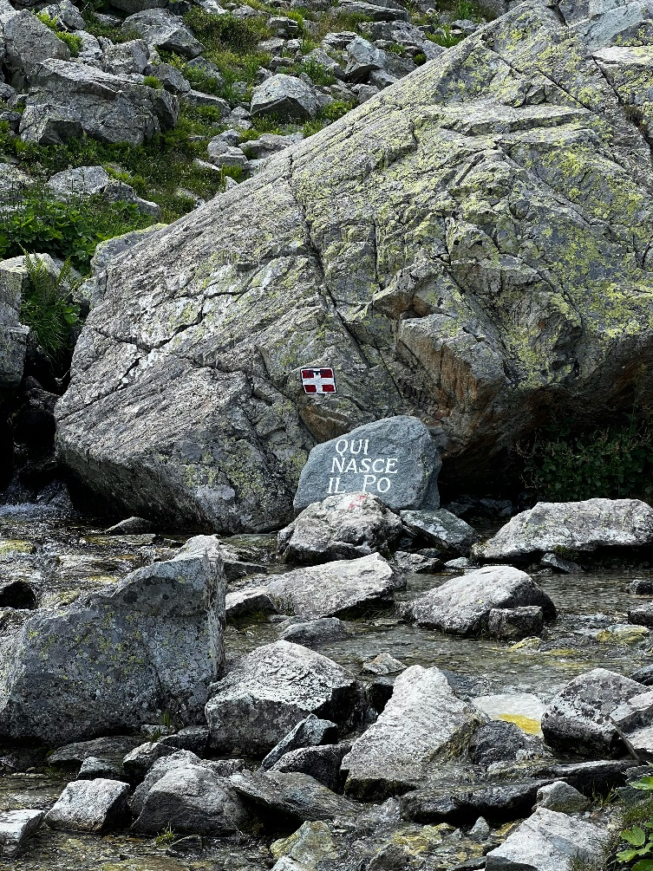
Source
The start of a river – usually in the upper hills of a river valley.

Slide 10
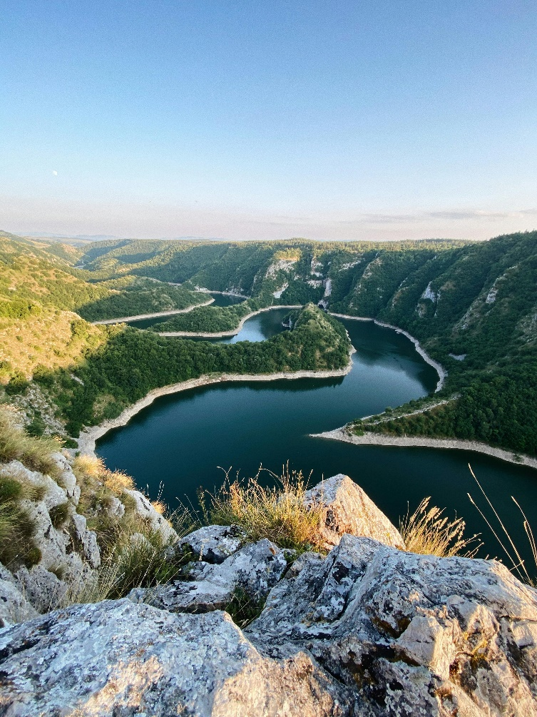
Meander
A bend (or several bends – like a snake) in a river created by a combination of erosion and deposition.

Slide 11
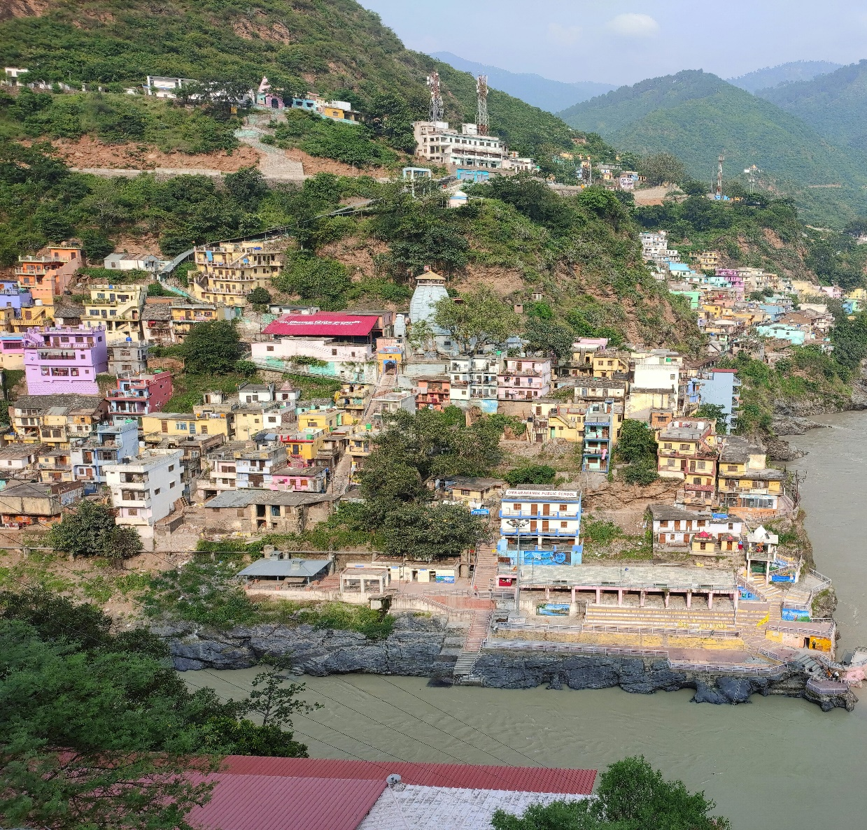
Confluence
The place where two rivers meet.

Slide 12
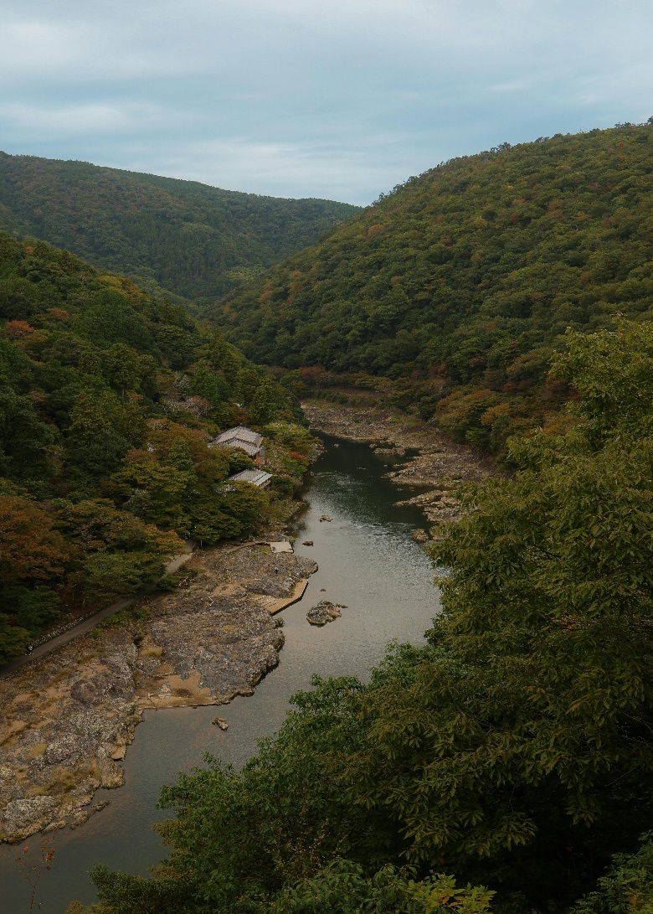
Valley
Hills either side of the river channel. For rivers, they are usually ‘V’ shaped and have hills which look like they overlap called interlocking spurs.

Slide 13
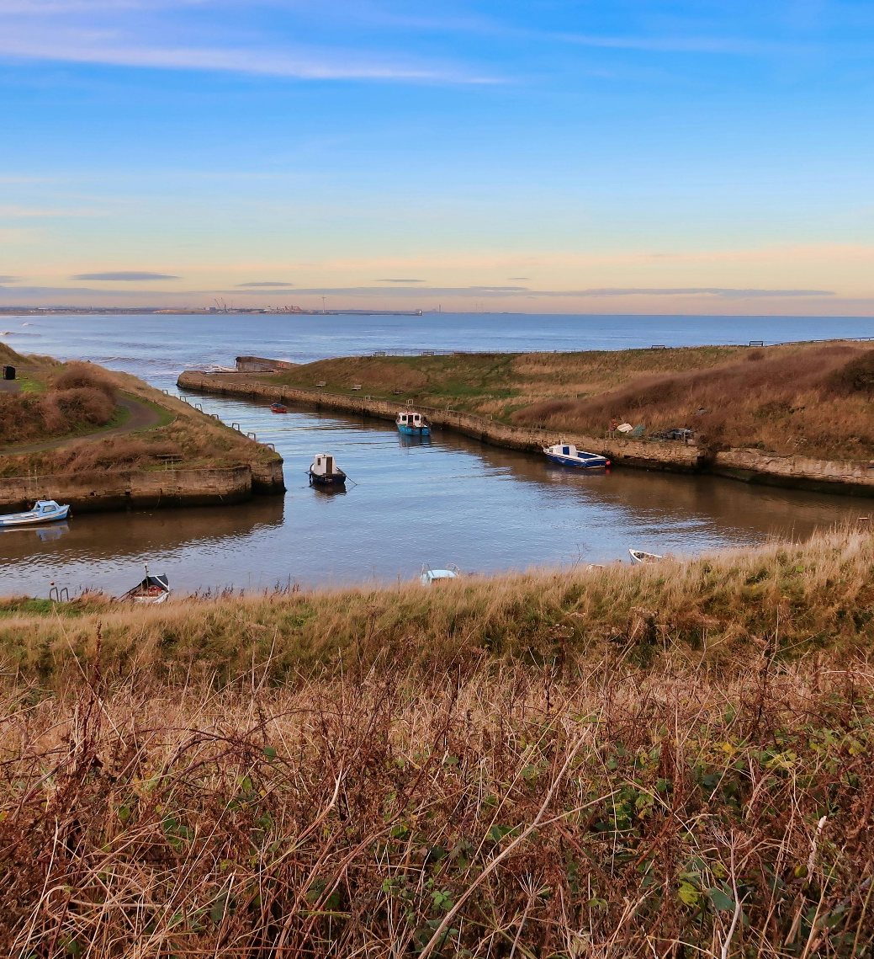
Mouth
The place in which the river water exits into a lake, sea or ocean. This is usually the flattest part of the river.

