Slide 1
2.The Crew
Shackleton 100
Endurance 100
Geography History

Slide 2
The Story So Far…
In brief
The story so far in brief…
In 1914 the explorer Sir Ernest Shackleton set out on an ambitious expedition to cross the continent of Antarctica from one side to the other. He failed. However he achieved one of the greatest feats of turn of the century polar exploration; he returned with all his 27 men – alive, despite the loss of his ship. Shackleton’s ship, the Endurance, was crushed and sank in ice in the Weddell Sea, before his team could even begin that ill-fated attempt to cross the hostile continent of Antarctica.
Find out more here Royal Geographical Society - Geography resources for teachers (rgs.org)
In 2022, the Centenary of Shackleton’s death, Dan Snow travelled to Antarctica on board the S.A. Agulhas II, as part of the Endurance22 expedition, in a successful attempt to locate the missing wreck of Shackleton’s ship.
Find out more here Expedition Team - Endurance22

Slide 3
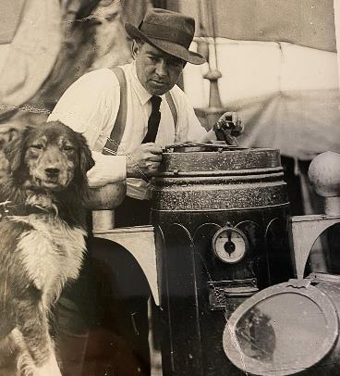
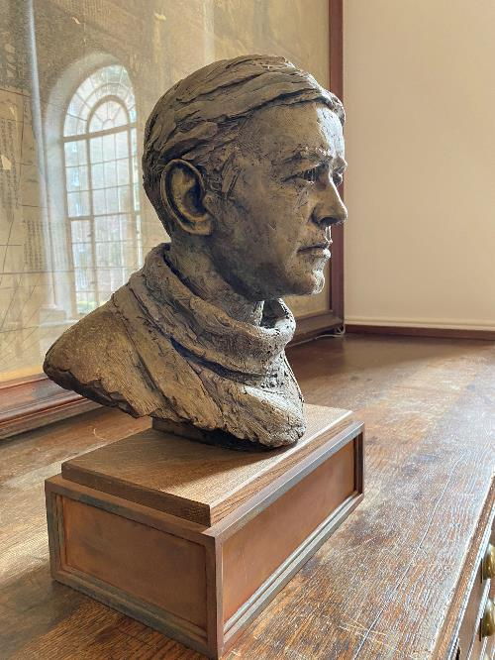
What kind of a leader was Ernest Shackleton?
What do these two images tell you about Shackleton?
What kind of a person do you think he was?
Shackleton on board the Imperial Trans Antarctic Expedition. Photograph by Frank Hurley.
A statue of Ernest Henry Shackleton at the Royal Geographical Society (RGS) in London

Slide 4
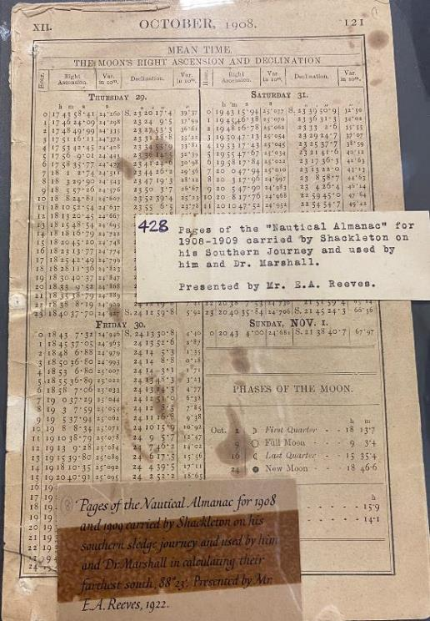
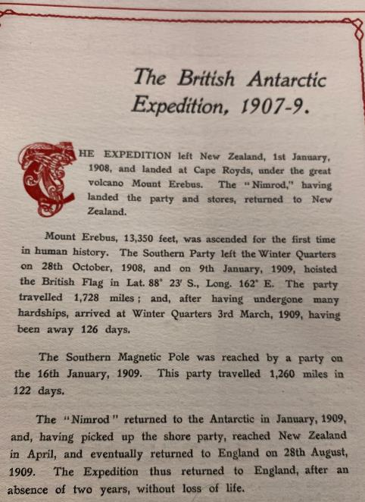
What kind of a leader was Shackleton?
Shackleton returned to England in 1909 after the British Antarctic Expedition had:
Been the first to climb the volcano Mount Erebus
Reached the furthest Southerly point travelled to by humans*
Reached the Southern Magnetic Pole
Returned after two years with no loss of life
A Nautical Almanac is a calendar of the planets movements and positions that helps sailors navigate.

Slide 5
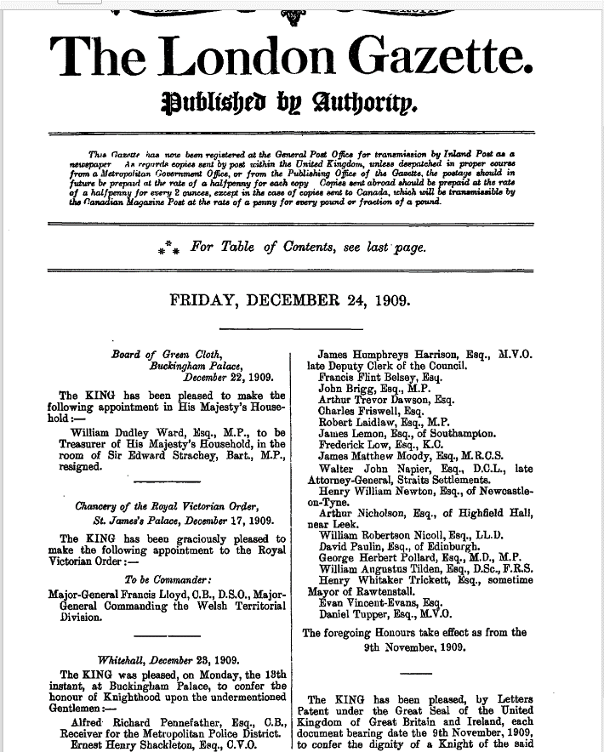
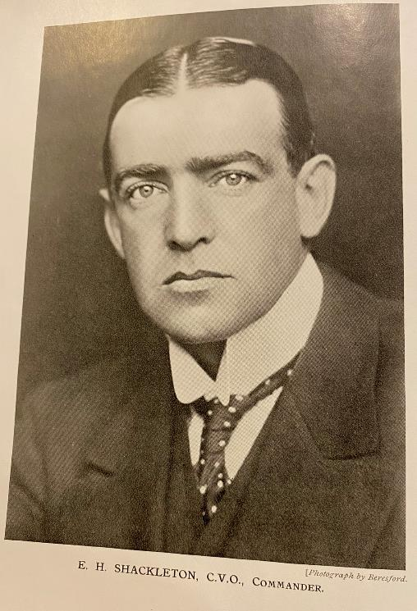

Shackleton was Knighted
Shackleton was knighted on his return from Antarctica in 1909 by King George VII, as reported
The King said that this was the greatest geographical event of his reign, and awarded Shackleton the CVO (Commander of the Victorian Order). He was knighted, as the London Gazette reports on the 24th December 1909.
Page 9763 | Issue 28321, 24 December 1909 | London Gazette | The Gazette

Slide 6
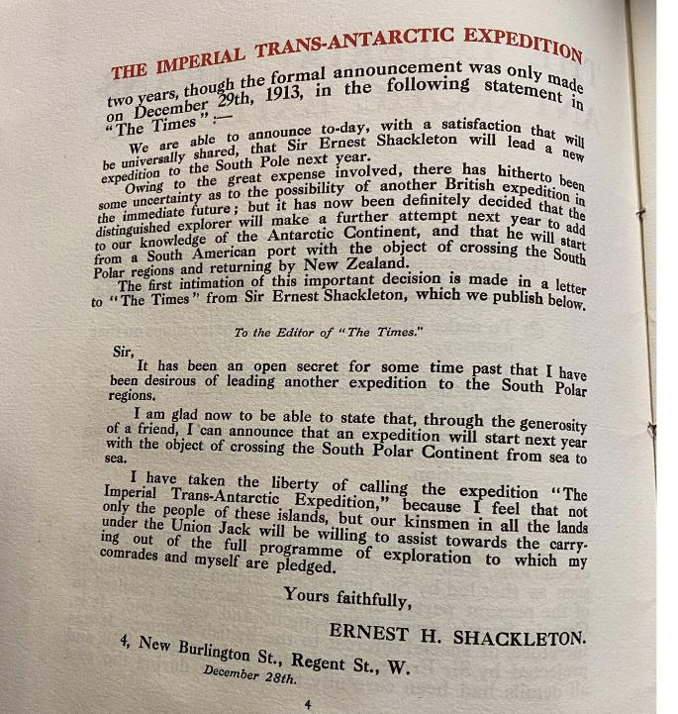
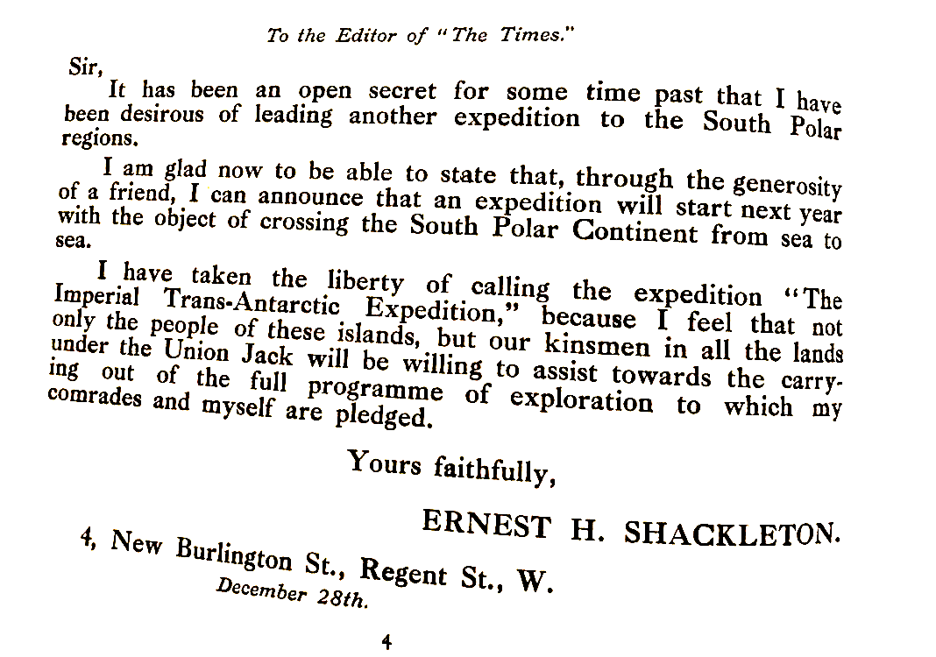
Shackleton’s Letter to the Times

Slide 7
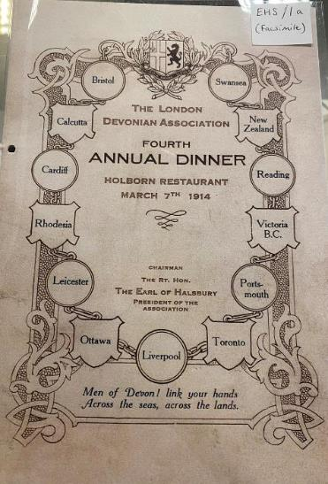
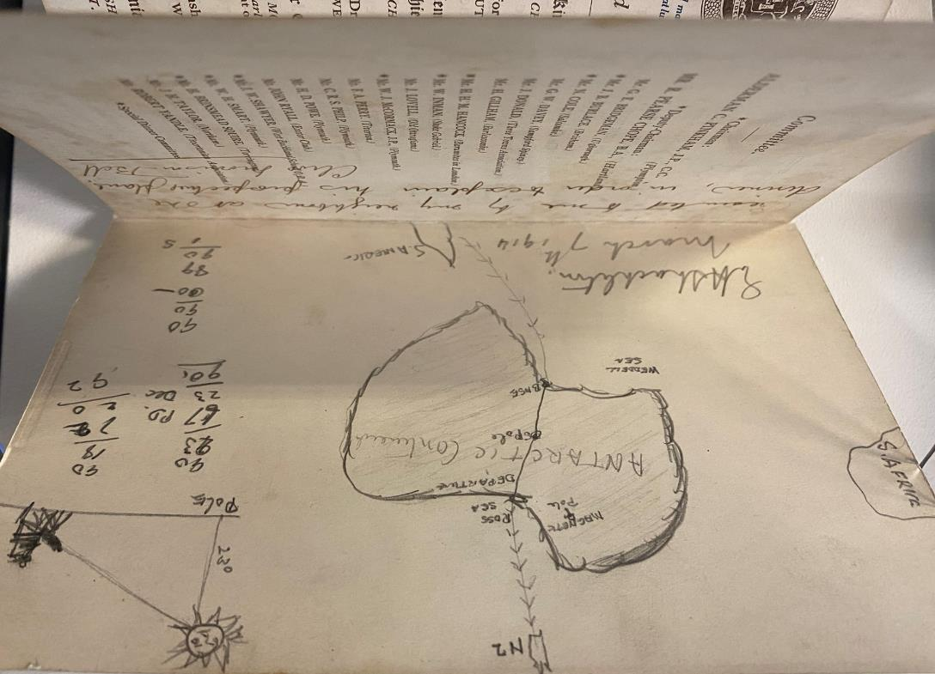

Shackleton’s sketch of his expedition plans
March 7th 1914
Sketched by Shackleton on the back of a menu card in 1914

Slide 8
What qualities make a successful polar explorer?
Asked to name the basic qualities necessary to become a successful polar explorer Shackleton listed:
‘First, optimism; second, patience; third, physical endurance; fourth, idealism; fifth, and last, courage.’
Source: Pearsons Magazine, ‘The Making of an Explorer’, August 1914
Optimism - being hopeful about outcomes
Patience - accepting trouble and delay without getting upset
Physical Endurance - fit enough for energetic and prolonged activity
Idealism - being imaginative and
Courage - able to confront danger or uncertainty

Slide 9
Members of the Imperial Trans-Antarctic Expedition on board the Endurance
William Bakewell, Able Seaman
Perce Blackborow, Steward
Alfred Cheetham, Third Officer
Robert Clark, Biologist
Tom Crean, Second Officer
Ernest Holness, Stoker
Walter How, Able Seaman
Charles Green, Cook
Lionel Greenstreet, First Officer
Hubert Hudson, Navigator
Frank Hurley, Photographer
Leonard Hussey, Meteorologist
Reginald James, Physicist
Alexander Kerr, Engineer
Mrs Chippy, tom cat
What do you notice about this list?
Look at the list of jobs: which do you think were most essential and why?
Alexander Macklin, Surgeon
George Marston, Artist
Timothy, McCarthy, Able Seaman
James Mcllroy, Surgeon
Thomas McLeod, Able Seaman
Harry ‘Chippy’ McNish, Carpenter
Thomas Orde-Lees, Motor Expert and Storekeeper
Lewis Rickinson, Engineer
Ernest Shackleton, Expedition Leader
William Stephenson, Stoker
John Vincent, Boatswain
Frank Wild, Second-in-Command
James Wordie, Geologist
Frank Worsley, Captain

Slide 10
What jobs did the crew do?
 | Stoker
 | Meteorologist
 | Boatswain
 | Geologist
 | Captain
Match the correct job description to the name.
Choose one more job type from the list and write a definition.
A | In charge of the ship’s deck and the ship’s hull.
B | Keep the fires going or ‘stoked up’ so there is enough steam to produce power.
C | Someone who studies the materials and processes of the Earth.
D | The person in command of a ship
E | Someone who gathers data to forecast what the weather will be like.

Slide 11
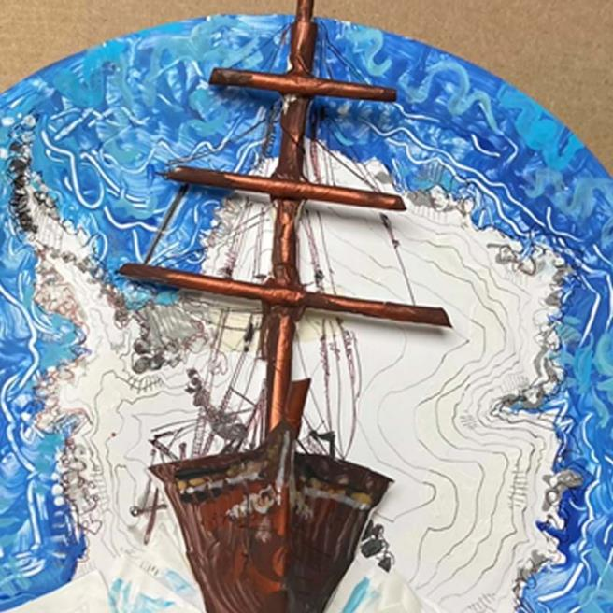
The ships: Endurance and Aurora
The Imperial Trans-Antarctic Expedition set out in 1914 with two ships — the Endurance, captained by Shackleton, and the Aurora, captained by Aeneas Mackintosh.
Why not have a go at making your own model of the Endurance?
https://www.rgs.org/schools/teaching-resources/make-your-own-model-of-endurance/

Slide 12
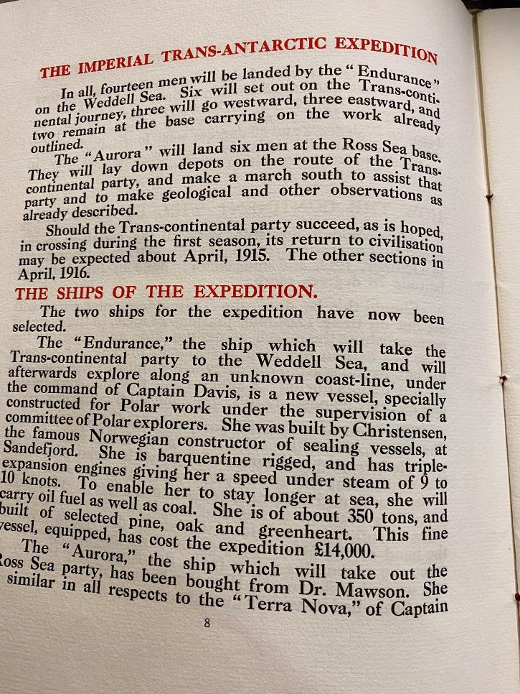
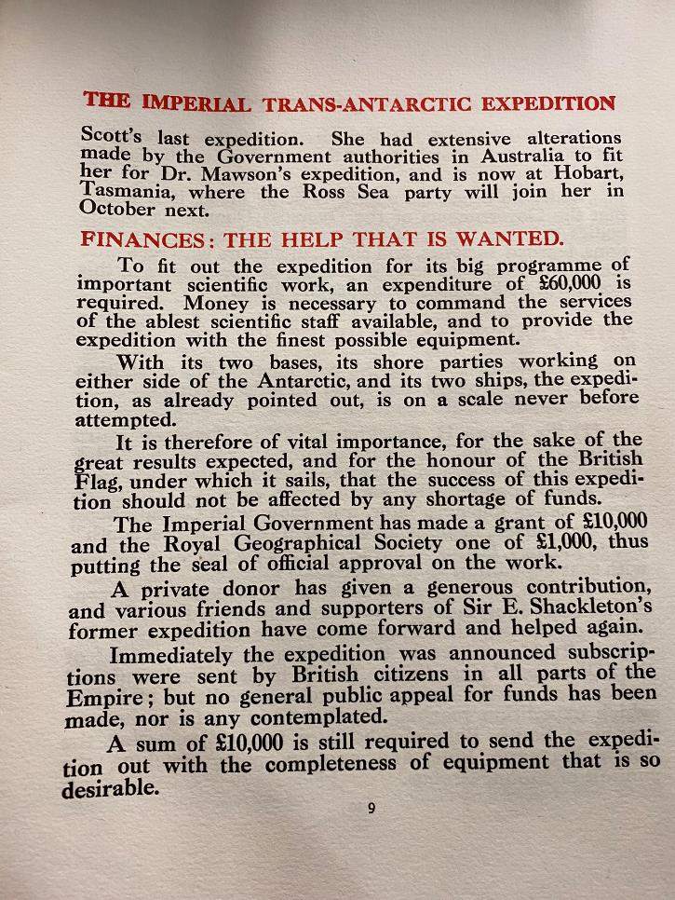
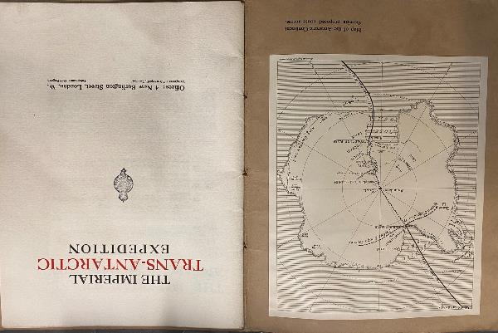
Source: pages from the Trans-Antarctic Expedition booklet detail information about both ships.

Slide 13
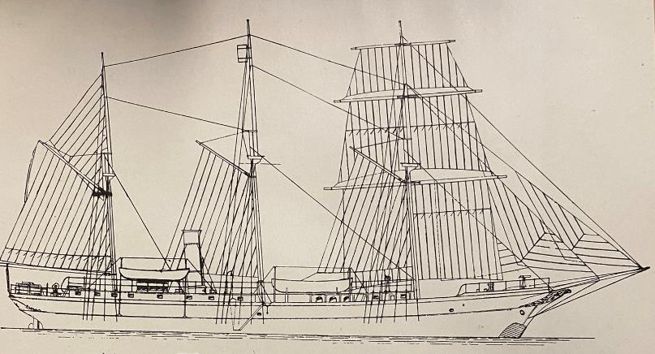
The Endurance
Barquentine rigged
Triple expansion engines
Speed of 9-10 knots
Carry oil fuel as well as coal
Weight 350 tons
Built of pine, oak and greenheart wood
Cost £14000

Slide 14
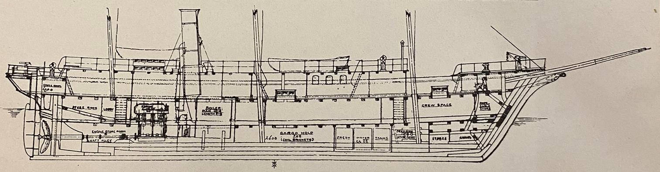
The Endurance is to take the Trans – continental party to the Weddell Sea. She was built by the shipmaster Christensen, a famous Norwegian ship-maker
Crew space
Boiler Room
Barge hold for coal
Water tanks

Slide 15
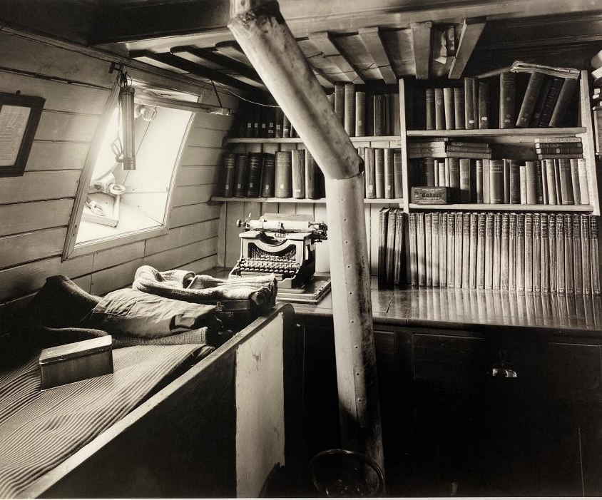
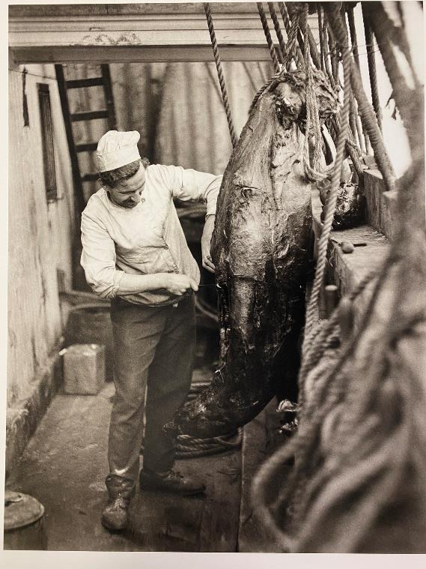
Life on board Endurance
Shackleton’s cabin on the Endurance
The cook Charles Green carving a seal.

Slide 16
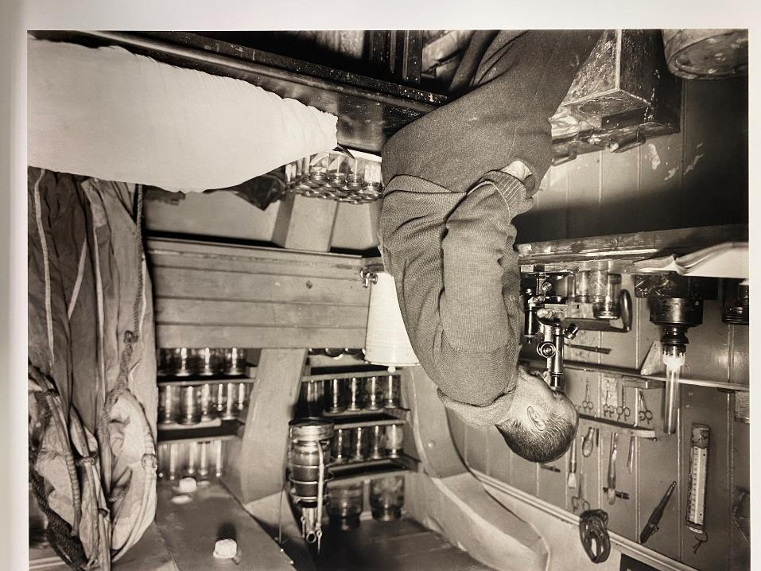
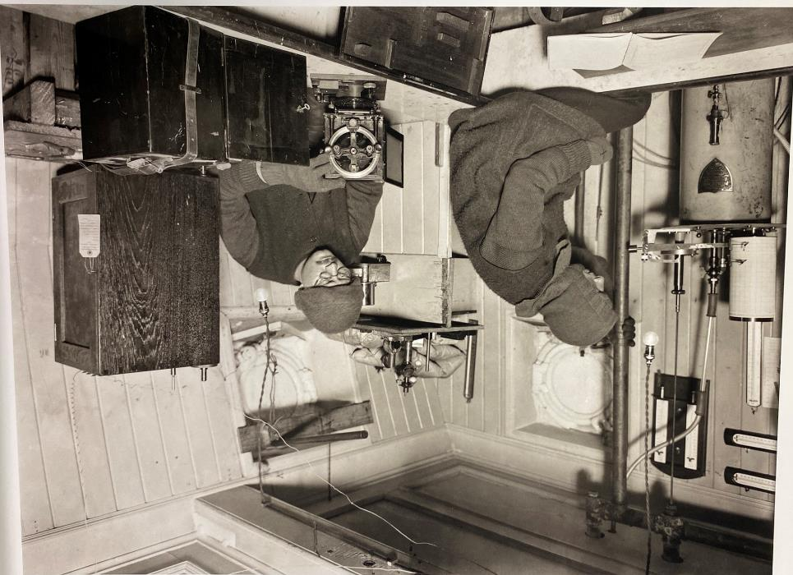
Clark in the biological laboratory on the Endurance
March 1915
Hussey and James taking observations in ‘The Rookery’ March 1915.

Slide 17
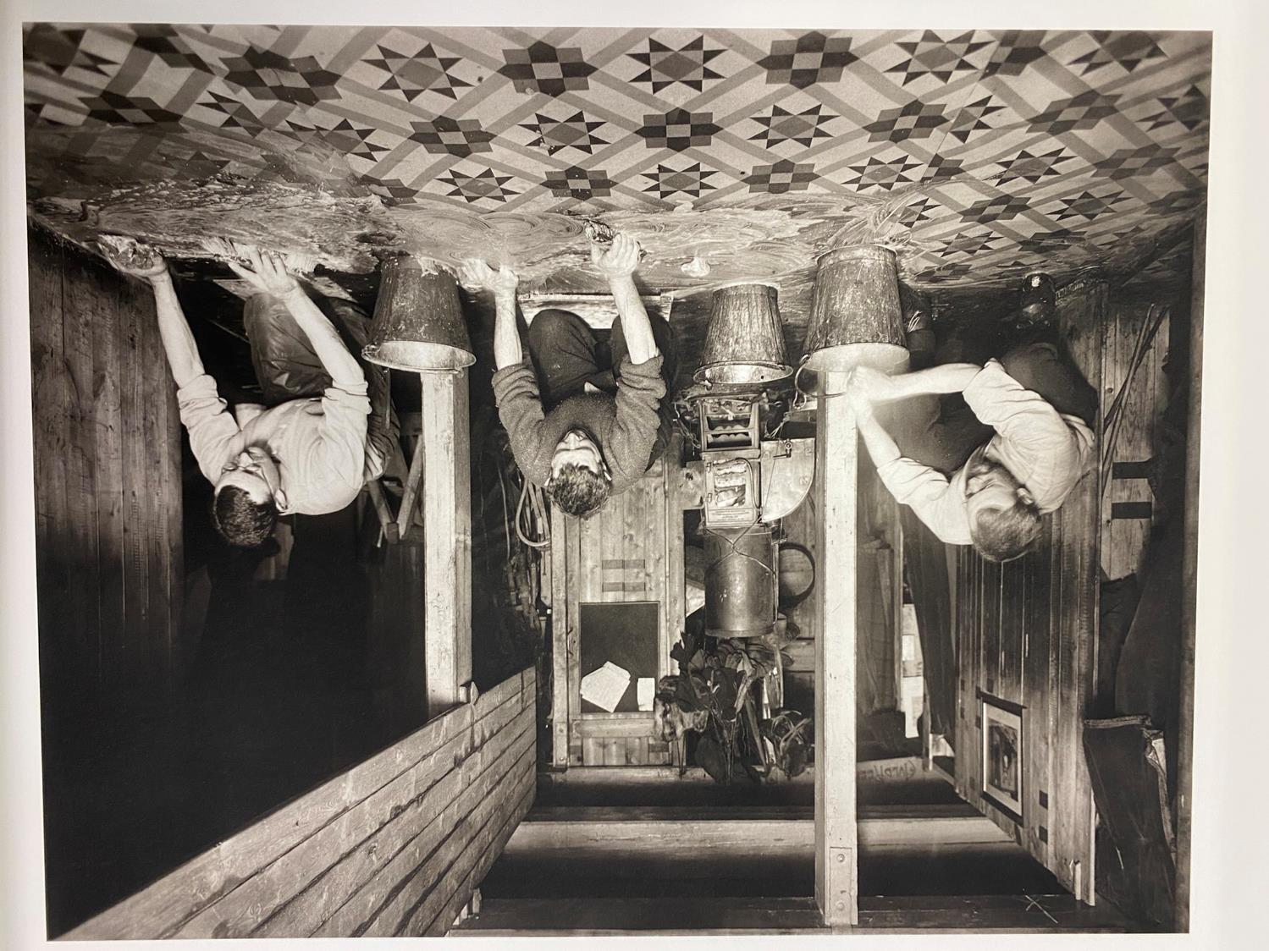
Wordie, Cheetham and Macklin washing the galley floor. March 1915.

Slide 18
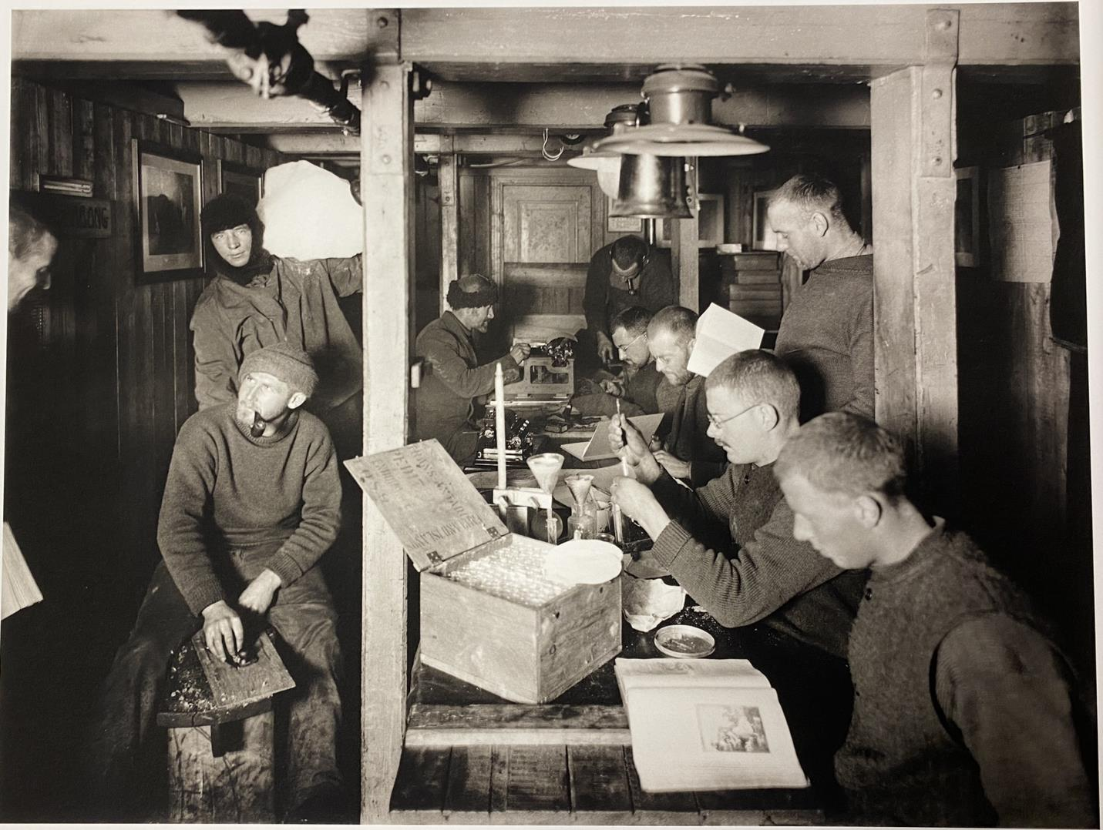
A morning on board the Endurance in midwinter. June 1915

Slide 19
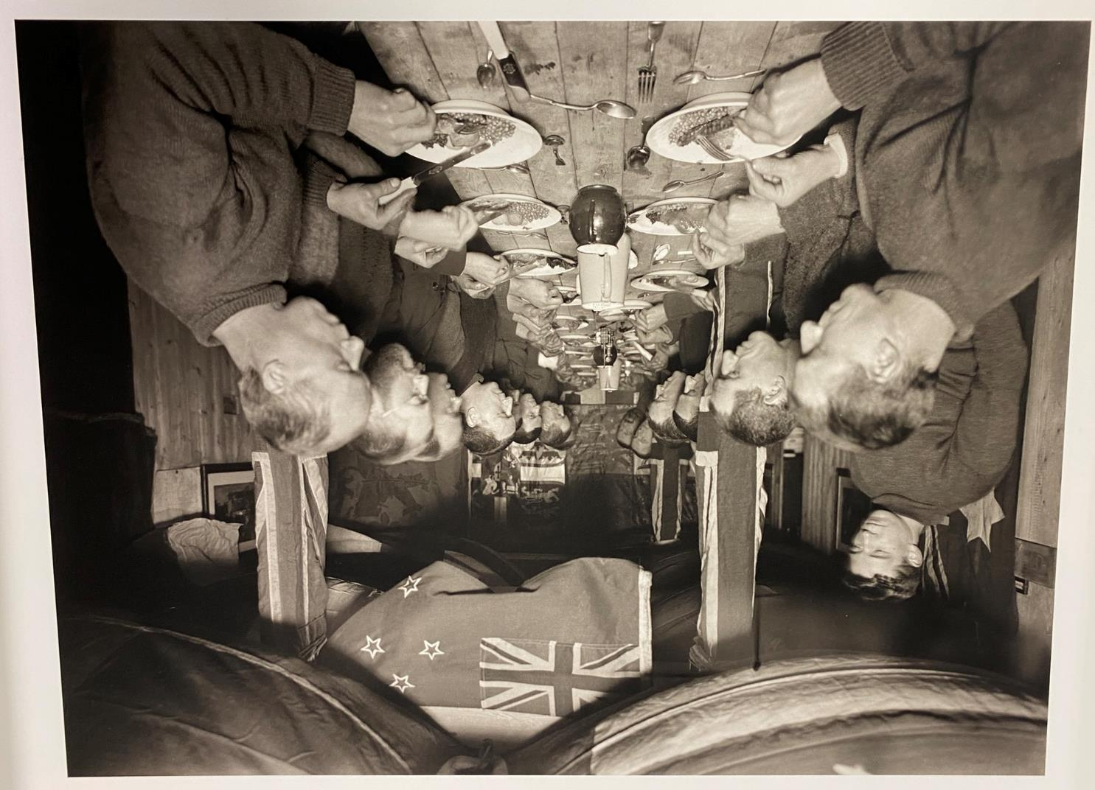
Midwinter dinner aboard the Endurance 22 June 1915

Slide 20
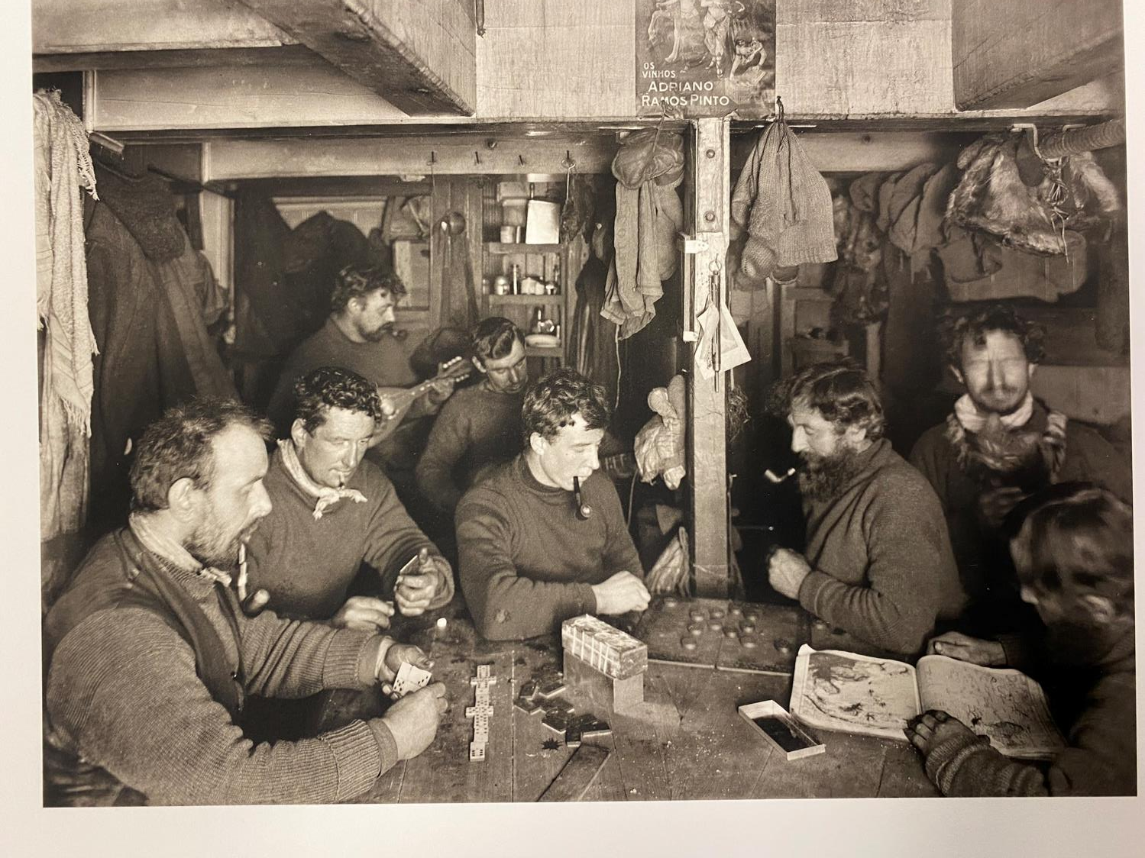
Winter 1915: men playing games and looking at an atlas.

Slide 21
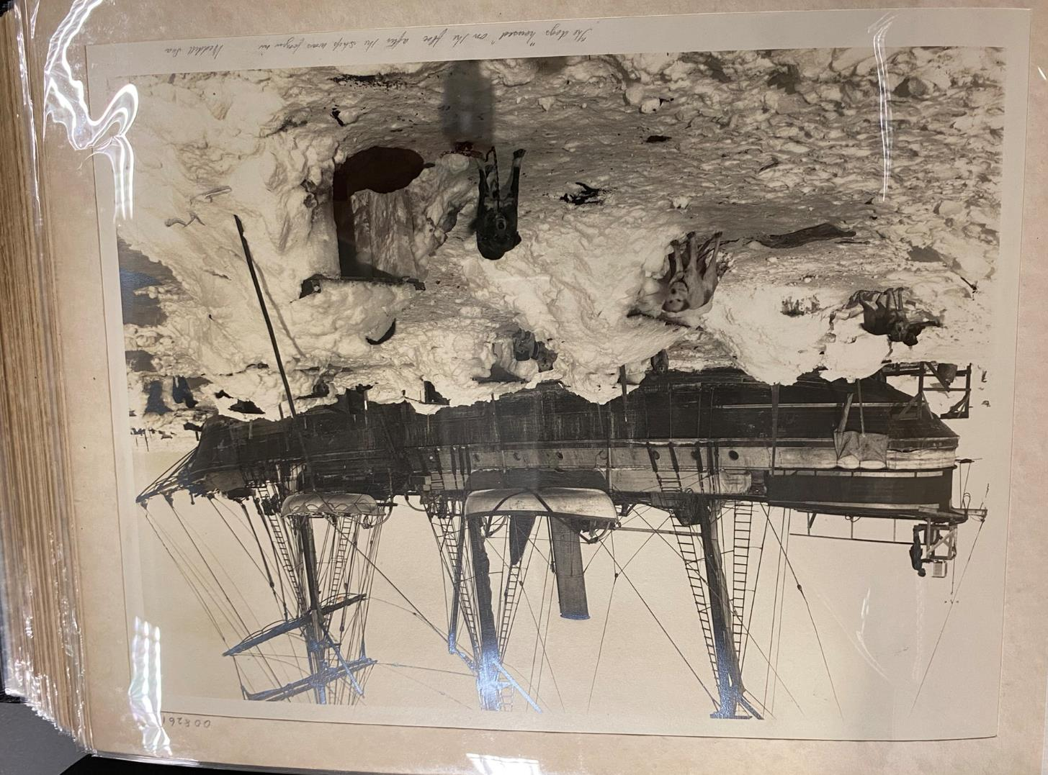
Endurance frozen in ice. The dogs are ‘housed’ on the floe.
Photograph: Hurley

Slide 22
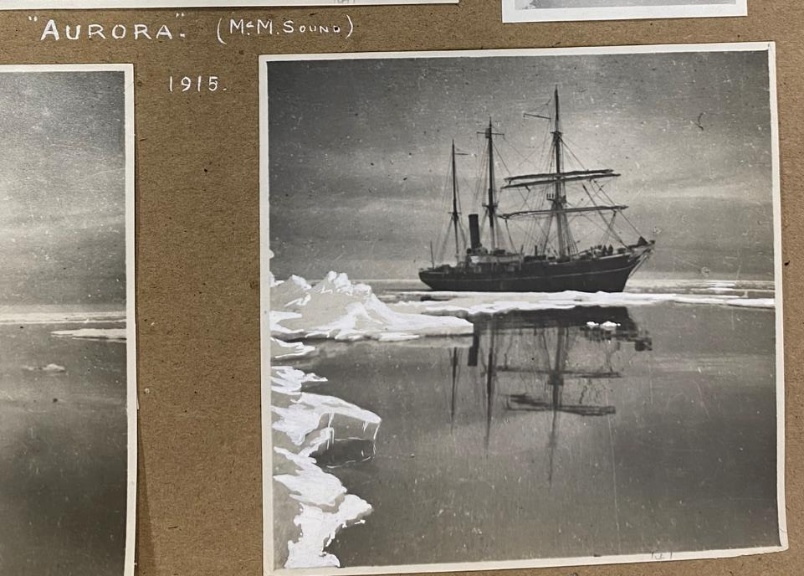
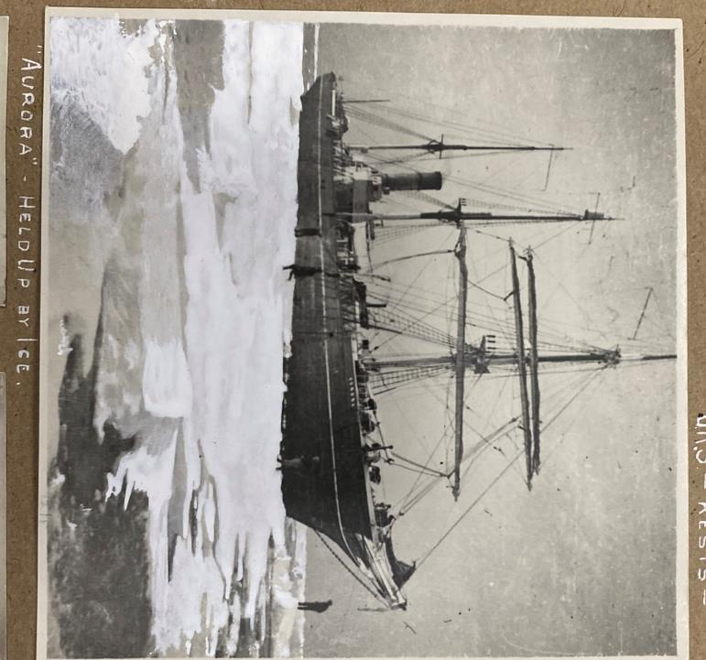
Life on board Aurora
How similar is the Aurora to the Endurance?
These photographs of her were taken in 1915

Slide 23
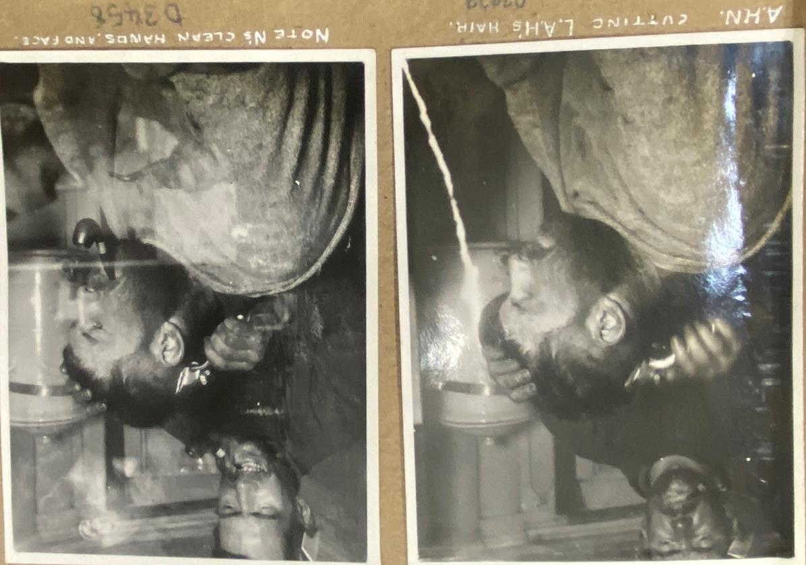
A haircut aboard Aurora

Slide 24
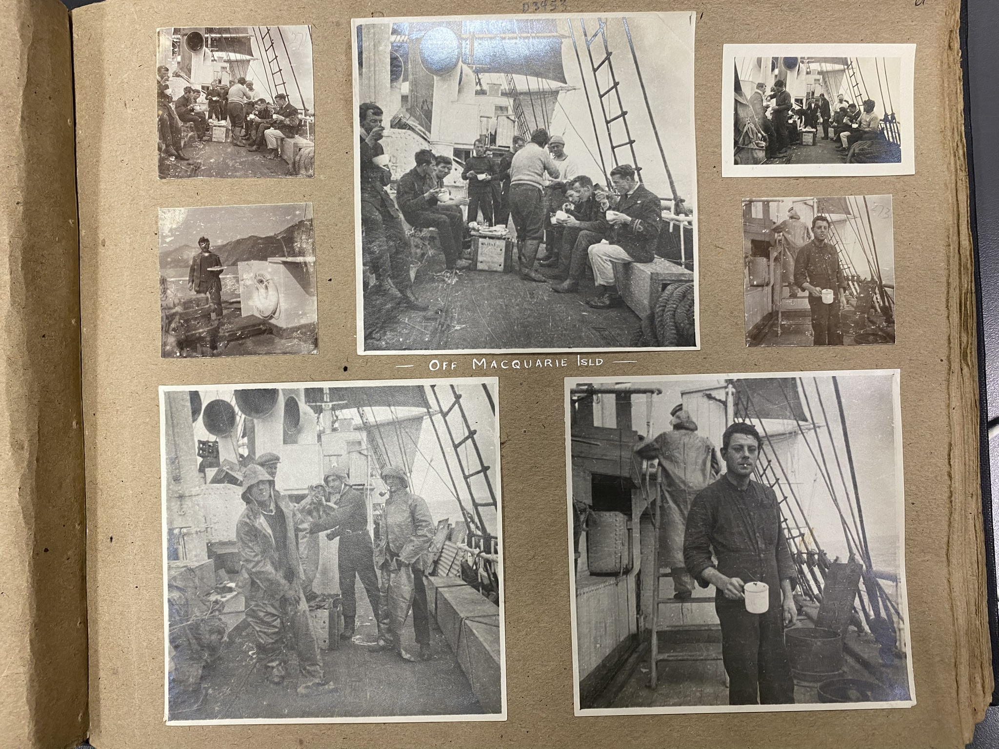
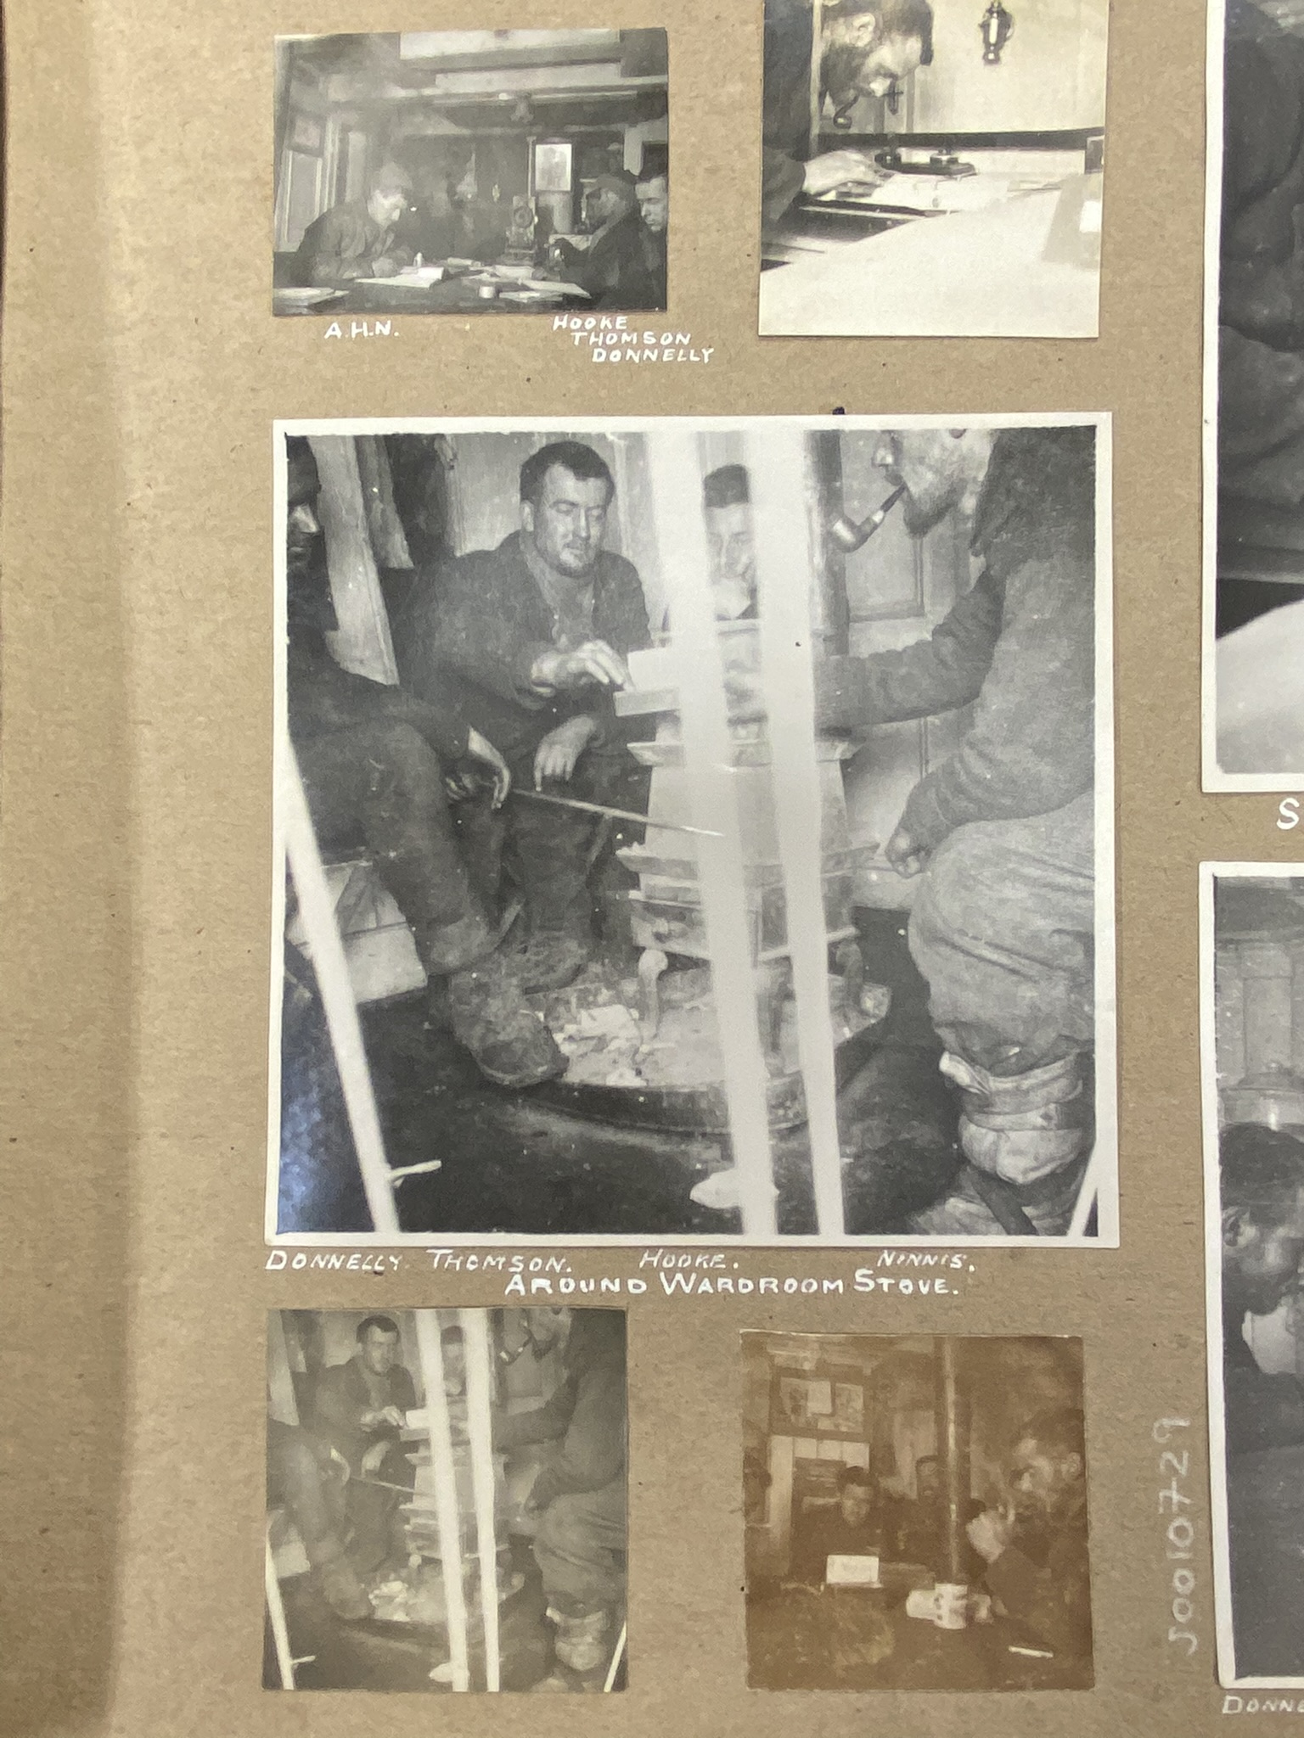

Slide 25
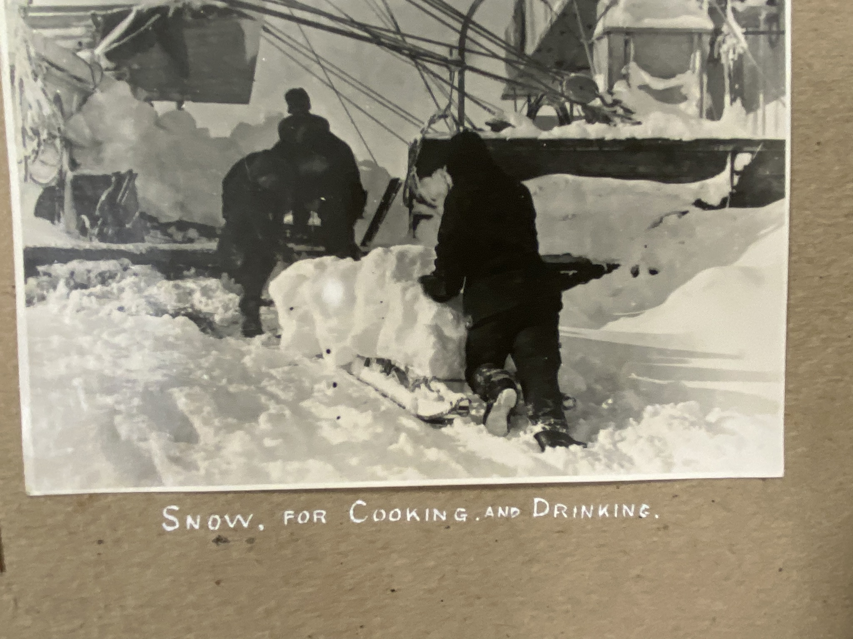
What do these photographs tell us about life on board Aurora?
Why do you think they are not as clear as those of the Endurance?
How would you feel having to melt snow everyday for drinking water?

