Slide 1
Dispelling migration myths

Slide 2
Learning objectives
Explore why do people move?
How is this impacting urban growth?
Why comics and zines can link local stories to global issues

Slide 3
What is a zine?
Inspired by everyday stories and comics we want you to make your own publication
What is a zine?
  Small DIY publication, made cheaply, like a physical blog – it can be anything
  https://www.youtube.com/watch?v=9INUang4oMA

Slide 4
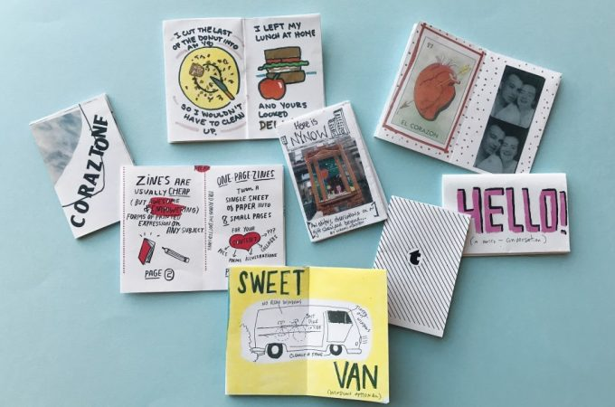
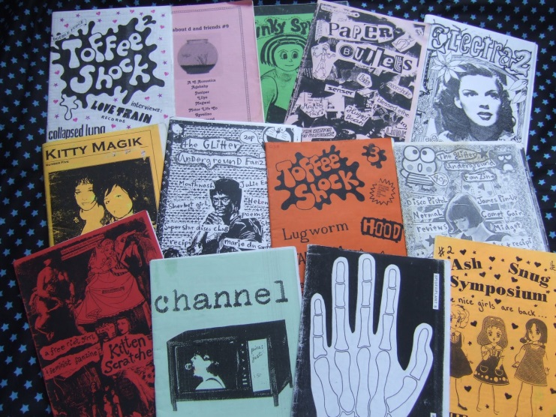
What is a zine?
What goes into a zine?
  Short stories
  Cuttings
  Drawings
  Annotated images
  Maps
  Diagrams
  Poems
  Art

Slide 5
Why use zines?
  Anyone can make one, you don’t need to be an artist – it is democratic, and can include anything!
  Cutting and pasting is key – you can cut, paste, and repurpose images from dominant print media to tell different stories (Bagelman, 2015)
  Be inspired by PositiveNegatives comics, and their stories

Slide 6
Make your own zine
Use your knowledge of the Migrants on the Margins to produce a zine on the theme of migration and urban change
Use the materials and resources provided – cut and paste, write stories, poems, annotate images, draw diagrams, adverts etc. to explore themes across the migrants on the margins project.

Slide 7
What are the themes?
In groups, choose ONE theme that will form the basis of your zine.
Food and water security
Housing and planning
Employment
Environment and climate
Family and networks
Education and health

Slide 8
Make your own zine
The objective is the share reasons ‘why people move’ and to dispel negative myths and stereotypes around global migration
  Explore why do people move?
  How is this impacting urban growth?
  Why comics and zines can link local stories to global issues

Slide 9
Make your own zine
Each page should be ¼ sheet of A4 paper
Use the folded sheets of paper as sections of the zine
Write the theme at the top of your first page – this can be drawn creatively too!
Use www.rgs.org/migrantsonthemargins for your research

