Slide 1
Starter
What do you think this graph is showing?
How would you explain this graph?
How might it link to today’s lesson?
Insert graph of sea level rising

Slide 2
Islands at Risk
L:O – to understand islands might be impacted by natural hazards & the impact of climate change

Slide 3
Why does Delfino care so much about his hammock?
This is the overall question that we will be looking at in today’s lesson.
What information do we need to know to help us answer this?
You need to write 5 questions of things you can learn to help you with answering this question.
Use the 5 W’s as a template: Who?, What?, Where?, When?, Why?
Use the image to help you.
Insert image of Delfino from news article
Climate change: The Panama community that fled its drowning island - BBC News

Slide 4
Where does Delfino live?
Delfino lives on the tiny low-lying island of Gardi Sugdub in Panama.
It is one of many other archipelago islands found off the North coast of Panama.
The island is just 400m long and 150m wide.
Task:
Stick your copy of the map into your book
Describe the location of the Gardi Sugdub island
Challenge: use the geographical terms continent, ocean , latitude and longitude in your answer.
Work out the distance between Panama city and Gardi Sugdub
Insert map of Panama & Gardi Sugdub (from news article)

Slide 5
Where does Delfino live?
Use these maps to describe the location of Gardi Sugdub
Insert plenty of maps of Panama, South America & the world, highlighting where the island is.

Slide 6
Insert map that has scale bar.
Work out the distance between Panama city and Gardi Sugdub.
Think back to your map skills topic. How do we do this?

Slide 7



What are some of the effects of climate change?
Extreme weather events
Rising sea levels
Ocean acidification
Loss of biodiversity
Health impacts
Water scarcity
This is the one we are looking at in today’s lesson

Slide 8
How does climate change cause rising sea levels?

Slide 9
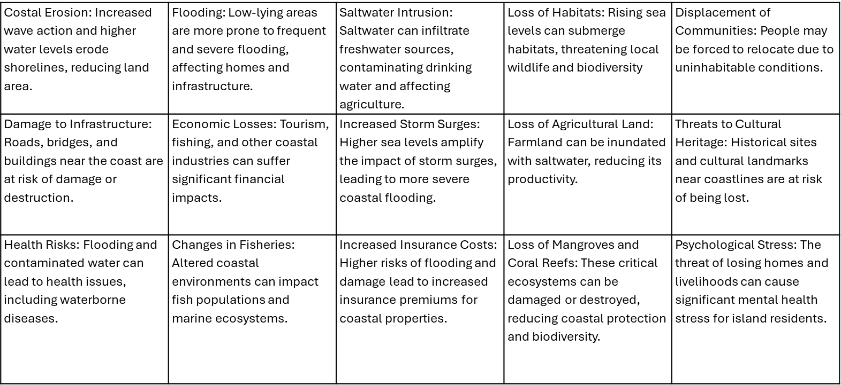
What are the impacts of rising sea levels on islands?
Sort these into social, economic, environmental & political factors.
Rank them in order of which one you think has the most impact to the least impact.
Explain your reasoning for your first and last choice?
I think this will have the most impact because…
I think this will have the least impact because…
Challenge: how might this link to our enquiry question? Why does Delfino care so much about his hammock?

Slide 10
Costal Erosion: Increased wave action and higher water levels erode shorelines, reducing land area. | Flooding: Low-lying areas are more prone to frequent and severe flooding, affecting homes and infrastructure. | Saltwater Intrusion: Saltwater can infiltrate freshwater sources, contaminating drinking water and affecting agriculture. | Loss of Habitats: Rising sea levels can submerge habitats, threatening local wildlife and biodiversity | Displacement of Communities: People may be forced to relocate due to uninhabitable conditions.
Damage to Infrastructure: Roads, bridges, and buildings near the coast are at risk of damage or destruction. | Economic Losses: Tourism, fishing, and other coastal industries can suffer significant financial impacts. | Increased Storm Surges: Higher sea levels amplify the impact of storm surges, leading to more severe coastal flooding. | Loss of Agricultural Land: Farmland can be inundated with saltwater, reducing its productivity. | Threats to Cultural Heritage: Historical sites and cultural landmarks near coastlines are at risk of being lost.
Health Risks: Flooding and contaminated water can lead to health issues, including waterborne diseases. | Changes in Fisheries: Altered coastal environments can impact fish populations and marine ecosystems. | Increased Insurance Costs: Higher risks of flooding and damage lead to increased insurance premiums for coastal properties. | Loss of Mangroves and Coral Reefs: These critical ecosystems can be damaged or destroyed, reducing coastal protection and biodiversity. | Psychological Stress: The threat of losing homes and livelihoods can cause significant mental health stress for island residents.

Slide 11
How do you think the impacts of climate change might affect different islands around the world? Why?
Insert images of different climate change impacts.

Slide 12
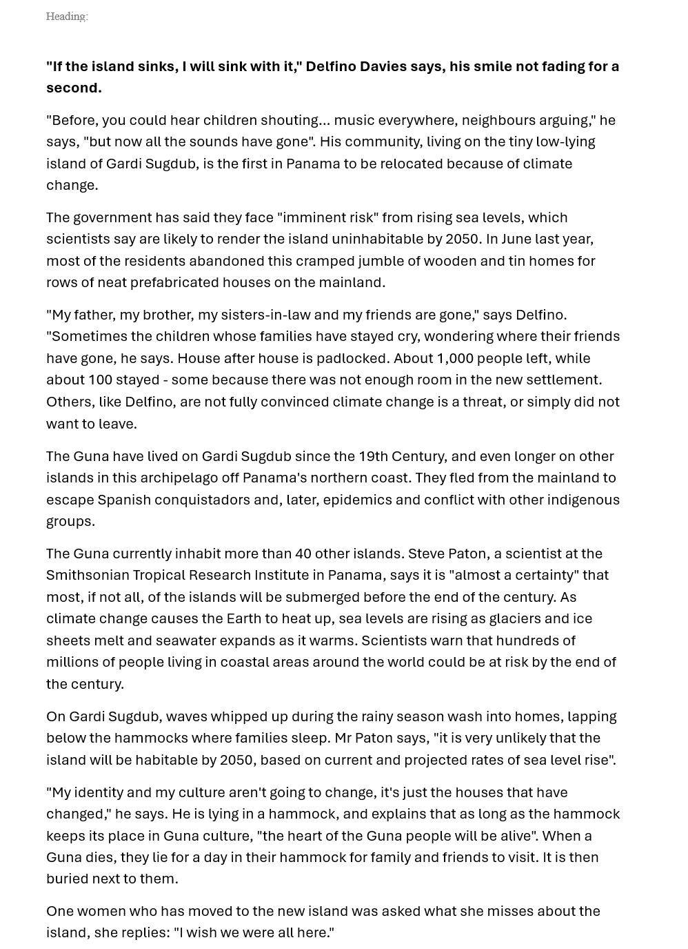


You each have a copy of the news article this lesson is focused around. You will be reading the article & then completing the following tasks:
Create a heading for the news article
Highlight any key geographical terms/words
Using the information in the article, you need to come up with at least 3 questions which could be used if someone else was to complete this activity. E.g. What might some of the challenges with moving elsewhere be?
Challenge – complete a creative writing piece of work, imagining that you are one of the people in the article. This could be a story, diary entry etc.

Slide 13
Why does Delfino care so much about his hammock?
Returning to our main question…
What might the answer be?
Write a few sentences in your book, to explain your ideas.

Slide 14
Return to your A3 sheet from last lesson. What information can you add?
Make sure to include enough room for the next few lessons, as we will be adding to it each time.
ISLANDS
Jersey, Channel Islands
An estimated 670,000 islands.
11,000 of which are permanently inhabited.
A body of land surrounded by water

Slide 15
Plenary: Quote of the day
"You have stolen my dreams and my childhood with your empty words."
Greta Thunberg
What do you think about this quote?
To what extent do you agree/disagree with it?

Slide 16

WANT TO KNOW MORE?
LESSON THREE
"You have stolen my dreams and my childhood with your empty words."
Greta Thunberg
USEFUL WEBSITES
CAREERS
TIER 3 VOCAB
GAME
EXTENSION ACTIVITY
Follow the links to learn more about the topic!
Which possible future careers can todays lesson lead to?
Write a definition for the following words
Play this game, to test your knowledge
complete this activity to stretch your learning further
Climate change: The Panama community that fled its drowning island - BBC News
Small Island Developing States
Island Vulnerability
Sea level rise, facts and information | National Geographic
Environmental scientist
Climate change analyst
Meteorologist
Urban planner
Disaster risk manager
Aid worker
Civil engineer
Policy advisor
Teacher
Latitude
Longitude
Archipelago
Climate
Precipitation
Biodiversity
Acidification
Displacement
Hazards
Disasters game -Stop Disasters Game | UNDRR
Make a list of all the different natural hazards that you can think of. Create a piece of work to demonstrate the impact of these hazards on islands.
Write a speech from the perspective of an MP, with suggestions on reducing the impact of rising sea levels.

Slide 17
Homework

Slide 18
What do we call this type of graph?
What does it show us?
Why is it useful?
How would we describe this example of this type of graph?
Insert climate graph

Slide 19
What are climate graphs?
Climate graphs = These graphs can be used to describe the annual pattern of rainfall and temperature for one location or to compare the pattern between two or more locations.

Slide 20
Homework: Using this data, plot your own climate graph for the island that Delfino lives on.
Remember the key things you need to remember when completing.
This is showing data from 2024.
 | Jan | Feb | Mar | Apr | May | Jun | Jul | Aug | Sep | Oct | Nov | Dec
Rainfall (mm) | 29 | 10 | 13 | 65 | 225 | 235 | 170 | 220 | 250 | 331 | 252 | 105
Temperature (°C) | 33 | 34 | 35 | 35 | 34 | 33 | 33 | 33 | 32 | 26 | 28 | 33
Challenge:
Analyse the graph. Remember GCSE.
General trend
Comment & Calculate
Specific Examples
Exceptions

Slide 21
Extension slides

Slide 22
How many natural hazards can you name?
Can you name specific islands where some of these hazards are found, or hazardous events have occurred.
Write a list on your mini whiteboards.

Slide 23
In your pairs, you will be researching different natural hazards found on islands.
Create a piece of work that explains the impact that this natural hazard has/has had on the particular island.
Some suggestions:
Krakatoa eruption
2004 Boxing day tsunami
2010 Haiti earthquake
1980 Mt St Helens eruption
2011 Tōhoku Earthquake and Tsunami

