Slide 1



Extreme heat in urban areas in Africa
Climate change and its impacts
“Climate change has increased heat waves (high confidence) and drought (medium confidence) on land, and doubled the probability of marine heatwaves around most of Africa.
Heat waves on land, in lakes and in the ocean will increase considerably in magnitude and duration with increasing global warming.
Most African countries will enter unprecedented high temperature climates earlier in this century than generally wealthier, higher latitude countries, emphasising the urgency of adaptation measures in Africa.”
All data on the following slides and some text on slide 12 adapted or used from Rohat, G et al (2019)

Slide 2
Curriculum Links
AQA
Edexcel
3.1.1 Water and carbon cycles
3.1.1.4 Water, carbon, climate and life on Earth
3.1.1.5 Quantitative and qualitative skills
3.4.2.3 Graphical skill - Graphs with logarithmic scales.
3.4.2.5 ICT skills
Enquiry question 1: How does the carbon cycle operate to maintain
planetary health?
6.3 A balanced carbon cycle is important in sustaining other earth systems but is increasingly altered by human activities.
6.8 There are implications for human wellbeing from the degradation of
the water and carbon cycles.
6.9 Further planetary warming risks large-scale release of stored carbon, requiring responses from different players at different scales
Understand the nature and use of different types of geographical information, including linear and logarithmic scales, GIS
OCR
WJEC
Topic 3.1 Climate Change
Geographical skills: 4.2 Geo-located data
4.3 Development in Sub Saharan Africa.
4.5.4 Causes and consequences of recent and cyclic climate change including extreme weather events.
4.5.7 People, climate and the future.

Slide 3

Extreme Heat days
Copy the following: An extreme heat day is defined as one in which the temperature exceeds 40.6 °C (105 °F)
Have any of you experienced this temperature? How did it feel and how did it affect you?
What would the health risks of extreme heat days on the human body?
Watch the video, take notes on the key points made
https://youtu.be/vyiRXBBdB4Y

Slide 4
How are people in African cities affected by extreme heat?
Extreme Heat Exposure (in billion person-days per year)
Study the data opposite.
The data is for RCP (Representative Concentration Pathway) 4.5,this is mid level climate change pathway with warming of 1.8 degrees and medium effort to curb emissions. Assumptions in this study were based on Medium population growth, a central level of urbanisation that also follows historic patterns of spatial distribution.
Map the 10 cities shown
Produce a simple graph showing the change in exposure to extreme heat in the African cities displayed. This could involve plotting the Historic values against the 2090 values as a bar graph
Describe your graph – are all of the cities affected in the same way? Which cities have the most and least risk?
What do you think happens to the RELIABILITY of these forecasts as time progresses?
City | Historical | 2030s | 2060s | 2090s
Bamako | 141.07 | 652.21 | 1369.45 | 1936.75
Cairo | 419.56 | 1425.74 | 2910.53 | 3777.41
Cape Town | 0.09 | 0.80 | 2.39 | 3.40
Harare | 0.08 | 0.71 | 2.53 | 5.41
Kano | 248.98 | 1484.36 | 3674.96 | 5849.81
Khartoum | 368.39 | 1517.69 | 2780.37 | 3542.77
Kigali | 0.00 | 0.07 | 0.97 | 4.88
Kinshasa | 33.79 | 401.60 | 1120.69 | 1764.03
Niamey | 104.47 | 560.86 | 1873.22 | 3790.87
Yaoundé | 7.03 | 66.55 | 138.23 | 180.86
Notes:
Source of all data - Rohat et al. (2018) Projections of human exposure to deadly heat in African cities under multiple socioeconomic and climate scenarios, Earth's Future, under review

Slide 5
A map of Africa
Tunisia
Algeria
Morocco
Libya
Egypt
Western Sahara
Mauritania
Map the 10 cities shown
Mali
Niger
Chad
Sudan
City
Bamako
Cairo
Cape Town
Harare
Kano
Khartoum
Kigali
Kinshasa
Niamey
Yaoundé
Cape Verde
Eritrea
Djibouti
Senegal
Djibouti
Gambia
Burkina Faso
Nigeria
Ethiopia
Guinea
Benin
Cameroon
South
Sudan
Somalia
Ghana
Central African Republic
Guinea Bissau
Cote D’Ivoire
Togo
Indian Ocean
Liberia
Sierra Leone
Dem. Republic
of Congo
Uganda
Kenya
Sao Tome & Principe
Congo
Gabon
Rwanda
Equatorial Guinea
Burundi
Tanzania
Atlantic Ocean
Cabinda (Angola)
Angola
Zanzibar
Zambia
Seychelles
Mozambique
Comoros
Malawi
Madagascar
Namibia
Zimbabwe
Botswana
Mauritius
South Africa
Reunion (France)
Lesotho
Swaziland
0 900km
Approx.
Notes:
Map https://www.coolgeography.co.uk Rob Gamesby

Slide 6
What problems or issues does this graph have as a method of data presentation?
The main issue with this graph is the limited representation of the very small values displayed on it. This can be resolved using a logarithmic scale

Slide 7
Using Logarithmic scales – Is this graph an improvement on the previous presentation method?
This is a logarithmic graph, the axis goes up by a factor of 10. This allows us to plot data that has a very wide range of values and allows use to see a rate of change.
90
80
70
60
50
40
30
20
For example, Harare, although it has some of the smallest values shown on the graph, has changed a lot. This is displayed by the large gap between the start value (the historic values) and that value predicted for 2090. It has a large percentage change

Slide 8
To support the logarithmic graph you could calculate a percentage change
Extreme Heat Exposure (in billion person days per year)
City | Historical | 2090s | Column 4 = Change (2090-historical) | Column 5 = Change/Historical | Column 6 = Column 5 X 100 = % Change
Bamako | 141.07 | 1936.75 | 1936.75-141.07 = 1795.68 | 1795.68/141.07 = 12.73 | 1273%
Cairo | 419.56 | 3777.41
Cape Town | 0.09 | 3.40
Harare | 0.08 | 5.41
Kano | 248.98 | 5849.81
Khartoum | 368.39 | 3542.77
Kigali | 0.00 | 4.88
Kinshasa | 33.79 | 1764.03
Niamey | 104.47 | 3790.87
Yaoundé | 7.03 | 180.86
Complete the table by finishing columns 4,5 and 6
Which city has had the greatest percentage change in extreme heat exposure?
Which city has had the least percentage change?
Account for these results.
How could you use this in data analysis or source questions in your examination?
800%
3610%
6465%
2250%
862%
No Value
5121%
3529%
2474%
There is no value here as the initial value was 0

Slide 9
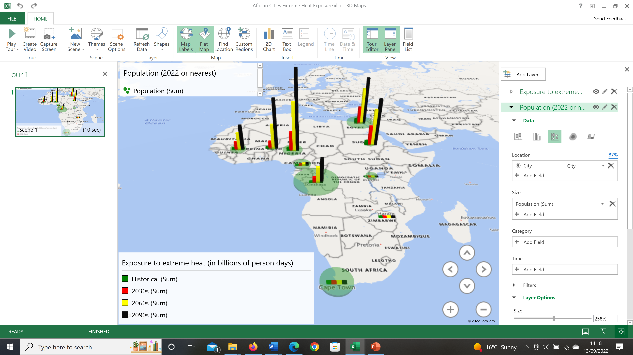
Alternatively, you could use GIS to graph the data

Slide 10
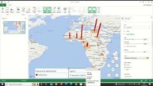
How to use the mapping tool in Excel

Slide 11
Why do some cities have more exposure to extreme heat days than others in Africa?
City | Historical | 2030s | 2060s | 2090s | Population in 2022 or closest date | Altitude | Latitude
Bamako | 141.07 | 652.21 | 1369.45 | 1936.75 | 2,817,000 | 350.00 | 12.6392
Cairo | 419.56 | 1425.74 | 2910.53 | 3777.41 | 10,025,657 | 23.00 | 30.0444
Cape Town | 0.09 | 0.80 | 2.39 | 3.40 | 4,710,000 | 1590.00 | -33.9249
Harare | 0.08 | 0.71 | 2.53 | 5.41 | ‎2123132 | 1490.00 | -17.8216
Kano | 248.98 | 1484.36 | 3674.96 | 5849.81 | 4,219,000 | 488.00 | 12.0022
Khartoum | 368.39 | 1517.69 | 2780.37 | 3542.77 | 639,598 | 381.00 | 15.5007
Kigali | 0.00 | 0.07 | 0.97 | 4.88 | 1,132,686 | 1567.00 | -1.9441
Kinshasa | 33.79 | 401.60 | 1120.69 | 1764.03 | 17,071,000 | 240.00 | -4.4419
Niamey | 104.47 | 560.86 | 1873.22 | 3790.87 | 1,026,848 | 207.00 | 13.5116
Yaoundé | 7.03 | 66.55 | 138.23 | 180.86 | 2,765,600 | 726.00 | 3.848
Why do some cities have more exposure to extreme heat days than others in Africa?
Use all of the data and presentation sources, the table below and some research to answer the question above

Slide 12
All of the data you have worked with came from a report by Rohat et al (2019) entitled “Projections of human exposure to dangerous heat in African cities under multiple socioeconomic and climate scenarios.” They concluded:
Key Points
Exposure to dangerous heat in African cities will increase by a multiple of 20–52 to reach 86–217 billion person-days per year by the 2090s
Future exposure is predominantly driven by changes in urban population alone or by concurrent changes in climate and urban population
Shifting from a high to a low urban population growth pathway reduces exposure by as much as a shift from a high to a low emissions pathway
Plain Language Summary
Very hot and humid weather often leads to numerous health issues, ranging from heat cramps to death. Due to changing climatic conditions and to demographic growth, the number of people exposed to very hot and humid days is increasing worldwide.
This is particularly the case across the African continent, where population growth is rapidly increasing and very hot and humid days are becoming more and more frequent, particularly in tropical areas. In this study, we consider more than 150 large African cities across 43 countries and project the number of people that will be exposed to dangerous heat conditions.
Our projections suggest that this number will be 20 to 52 times higher at the end of the 21st century than currently. Large cities in Western and Central Africa appear to be particularly at risk, whereas cities in Southern Africa will remain relatively unscathed.
We also show that a restrained urban demographic growth could lead to a 50% reduction in the number of people exposed to dangerous heat conditions. Population and urbanization policies should be part of the wide range of urban climate adaptation options in order to minimize future exposure to extreme heat. Rohat et al (2019)
Take notes based upon the summary
Do these findings tally well with your graphical and statistical work?
Notes:
Rohat, G., Flacke, J., Dosio, A., Dao, H., & van Maarseveen, M. (2019). Projections of human exposure to dangerous heat in African cities under multiple socioeconomic and climate scenarios. Earth's Future, 7, 528– 546. https://doi.org/10.1029/2018EF001020. Accessed 13th September 2022 at https://agupubs.onlinelibrary.wiley.com/doi/full/10.1029/2018EF001020

