Slide 1
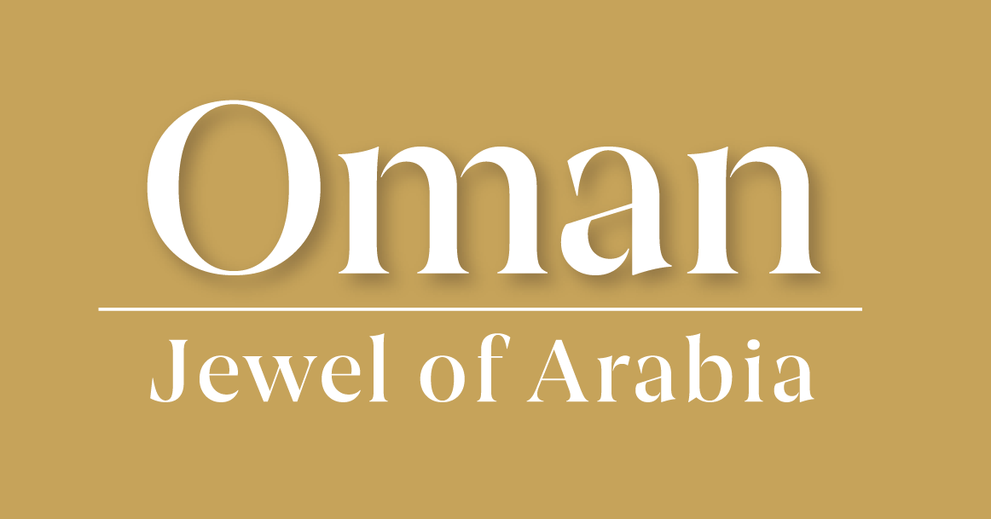
Who am I?
I eat grass, herbs, roots, bulbs and melons.
I am between 153-235 cm long.
I can weigh between 54 and 75kg.
While you wait…have a look at these statements and see if you can guess what the lesson is about today.
I became extinct in the wild in 1972.
I can live for over 20 years.

Slide 2
Unicorns of the desert
Friday, 07 March 2025
Did you know? The Arabian Oryx is thought to be the animal which started the unicorn myth. Can you label your own image to see why this might have been?
Learning Goals
Know ways in which the Arabian Oryx have adapted to the desert biome.
Understand why the Arabian Oryx had been near extinction.
Identify ways in which the Arabian Oryx can be conserved.

Slide 3
Why were Arabian Oryx thought to be unicorns?
A unicorn is often described as a white horse with a single straight horn. When seen sideways, the oryx’s horns appear as one spiral. Much like a unicorn.
The tale of a unicorn can be traced back to Syriac tales when Arabia (where the oryx is from) was the land of the unknown building on the mystery of the creature.
Bedouins believed that if they captured an oryx, they would take on its powers of endurance, strength and courage. Unicorns are seen as symbols of strength.
The meat of an oryx was believed to have medical qualities. Many legends speak of a unicorn’s healing power.
Up until modern weapons, oryx’s were hard to capture. Many tales speak of unicorns being the same.
The Arabs of the Arabian desert celebrated the oryx in poetry and legends telling tales of the majestic beauty of the animal. Much like how unicorns are described.

Slide 4
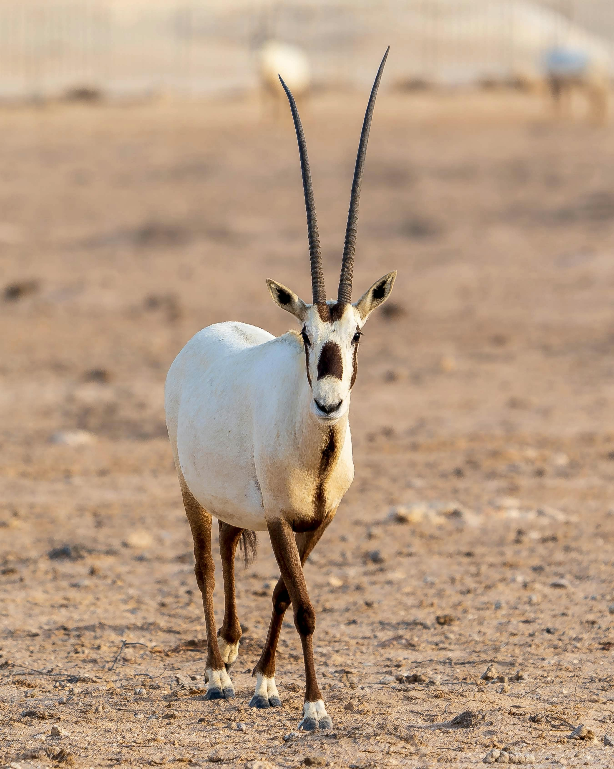
How have the oryx adapted to the desert biome?
They have a bright white coat which reflects the sun’s rays.
Their skin is black to absorb some heat to keep them warm at night.
They have wide hooves to help walk on the sandy ground more easily.
They can survive without water for a long time as they get the moisture, they need from eating desert plants and licking the due off plants and rocks.
They tend to be active at dawn and dusk and hide in the shade in the day.
They use their hooves to dig to create a bed of cooler sand.
They can let their body temperature increase by 10ºC.
To help conserve water, they can remove moisture from their poo!
Their tall, thin legs help them to be away from the heat radiating from the ground.
They can travel long distances to find food and water.
Arabian Oryx in the desert © Chris Clark, Pexels

Slide 5
What happened to the Arabian Oryx?
1945
Availability of high-speed vehicles and automatic weapons meant that hunting for the oryx became easier.
1965
Less than 500 Arabian Oryx’s left in the wild.
1972
All wild herds were extinct. Thankfully, several Oryx’s were being bred in captivity in zoos around the world.
What other animals have you heard of that are threatened or are at risk of extinction? What reasons is this happening?

Slide 6
It’s not all bad news
Thankfully, there are many organisation which work with endangered species to help conserve them.
Conservation is a way in which species (and other things) are protected so that they can survive and ultimately, one day thrive again in their natural environment.
As a result of the conservation efforts of the Arabian Oryx, over 1,000 of them are back in the wild.
Watch the following video to look at how places are trying to conserve the species in their country. What are the different ‘types’ of conservation?
Create a mind map to think about the different ways the Arabian Oryx could be conserved.
Notes:
Teacher Notes:
There’s a longer video on 5 animal conservation stories from BBC Earth if you have time to explore this further: https://www.youtube.com/watch?v=zQZndqa2bIw

Slide 7
Design a safe habitat for the oryx
Imagine an ideal home or the Arabian Oryx
What would their home look like?
What would they eat?
How would they find water?
How would they be safe?
On your own image of the oryx from last lesson, draw their new safe habitat. Include ideas that you had thought about from the questions above.
Is there anything else you would add?

Slide 8
Tasks:
Label the image of the oryx to explain why they might have been mistaken for a unicorn.
Using the information (and your own knowledge) add more labels to detail how the oryx has adapted to the desert.
At the end of the lesson draw the ideal habitat for the oryx.
Unicorns of the desert – Arabian Oryx
Arabian Oryx in the desert © Chris Clark, Pexels

