Slide 1
6. Uncharted
Shackleton 100
Endurance 100
Geography History

Slide 2
The Story So Far…
In brief
The story so far in brief…
In 1914 the explorer Sir Ernest Shackleton set out on an ambitious expedition to cross the continent of Antarctica from one side to the other. He failed. However he achieved one of the greatest feats of turn of the century polar exploration; he returned with all his 27 men – alive, despite the loss of his ship. Shackleton’s ship, the Endurance, was crushed and sank in ice in the Weddell Sea, before his team could even begin that ill-fated attempt to cross the hostile continent of Antarctica.
This resource accompanies Chapter 6 of the story. Shackleton is attempting to reach South Georgia to find help to rescue his remaining crew from Elephant Island.
Find out more here Royal Geographical Society - Geography resources for teachers (rgs.org)
In 2022, the Centenary of Shackleton’s death, Dan Snow travelled to Antarctica on board the S.A. Agulhas II, as part of the Endurance22 expedition, in a successful attempt to locate the missing wreck of Shackleton’s ship.
Find out more here Expedition Team - Endurance22

Slide 3
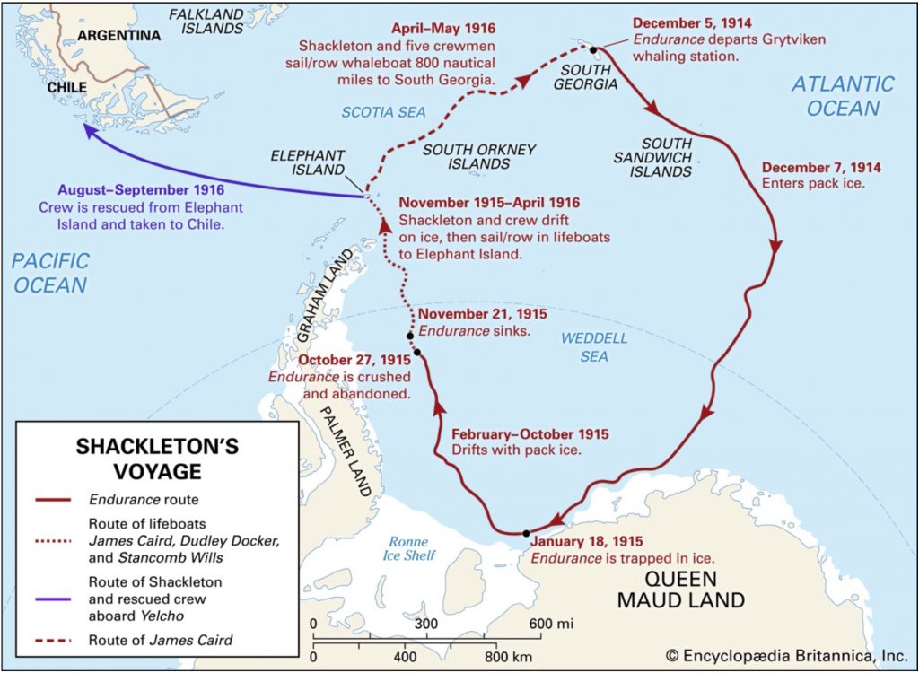
Elephant Island to South Georgia

Slide 4
The Journey to South Georgia
Date: 24 April1916
Time: 12 noon
Season: approaching winter southern hemisphere
People: Shackleton, Worsley, Crean, McNeish, McCarthy and Vincent
Plan: Sail from Elephant Island to South Georgia through the Drake Passage
Boat: The James Caird lifeboat, 6.9 metres long
Distance: 800 miles, 1288 Kilometres

Slide 5
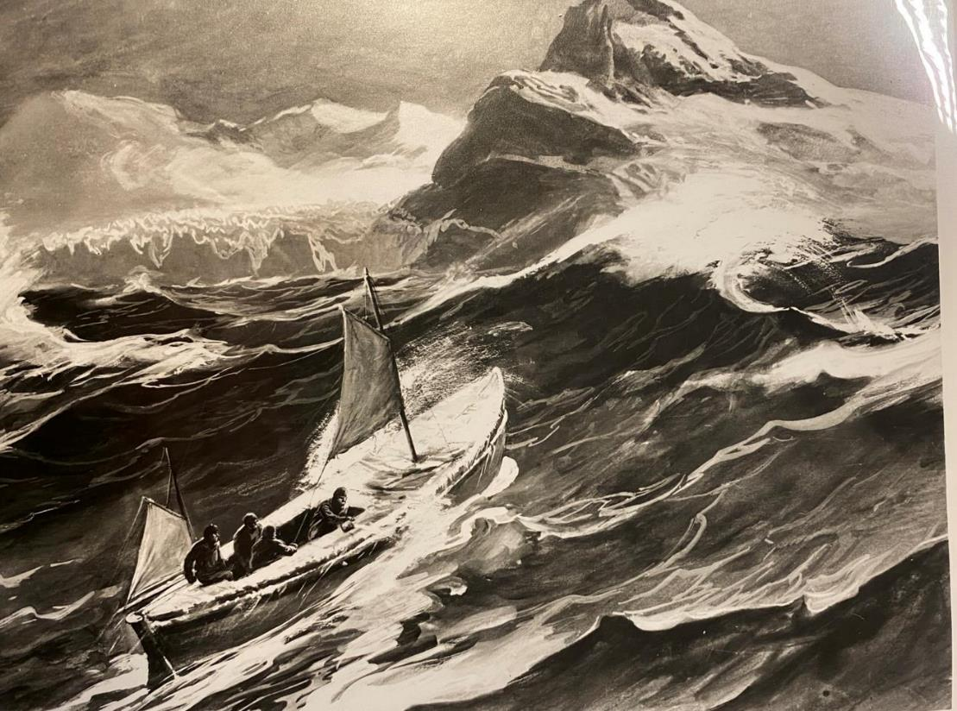
The James Caird
“The ocean south of Cape Horn in the middle of May is known to be the most tempestuous storm-swept area of water in the world.”
Ernest Shackleton
Describe the scene
‘Boat at Sea’
A painting by George Marston

Slide 6
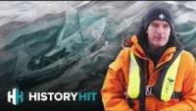
Dan Snow on the Endurance 22 Expedition
Watch a clip from 05:18 minutes in to 07:00 mins
Endurance22 | Our Voyage Across The Treacherous Southern Ocean! - YouTube

Slide 7
How did Worsley Navigate?
‘Navigation is an art, but words fail to give my efforts a correct name. Dead reckoning or DR— the seaman's calculation of courses and distance — had become a merry jest of guesswork.… The procedure was: I peered out from our burrow — precious sextant cuddled under my chest to prevent seas falling on it. Sir Ernest stood by under the canvas with chronometer pencil and book. I shouted “Stand by,” and knelt on the thwart — two men holding me up on either side. I brought the sun down to where the horizon ought to be and as the boat leaped frantically upward on the crest of a wave, snapped a good guess at the altitude and yelled, “Stop,” Sir Ernest took the time, and I worked out the result. … My navigation books had to be half opened page by page till the right one was reached, then opened carefully to prevent utter destruction.’
Remember: never look directly at the Sun
https://erenow.net/biographies/the-endurance-shackletons-legendary-antarctic-expedition/6.php

Slide 8
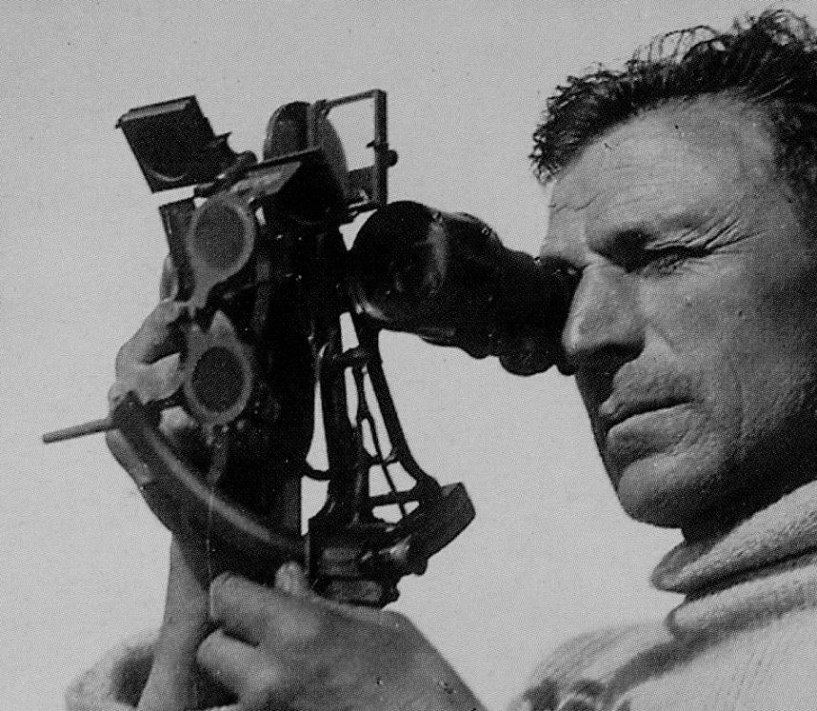
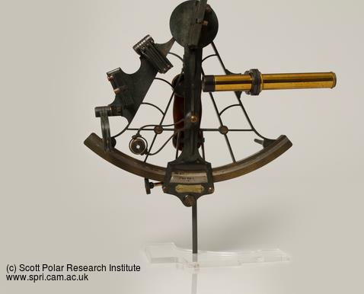
Worsley with sextant
In that 16 day, 800 mile journey, Worsley was only able to take four sightings, and in very difficult conditions. He still navigated accurately to South Georgia.
(This photograph was not taken during the voyage of the James Caird).
https://www.spri.cam.ac.uk/collections/catalogue/images/records/size600/y2010.75h_1.jpg
107418.worsley-1.jpg (3430×2990) (fer3.com)

Slide 9
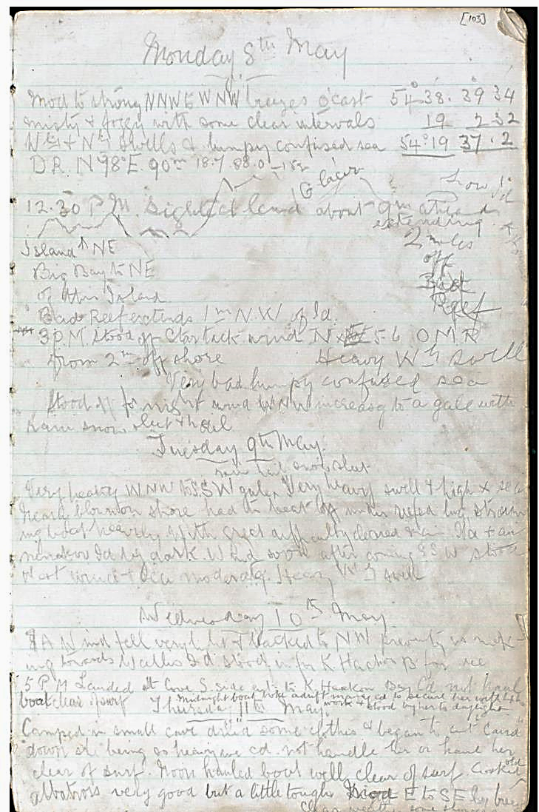
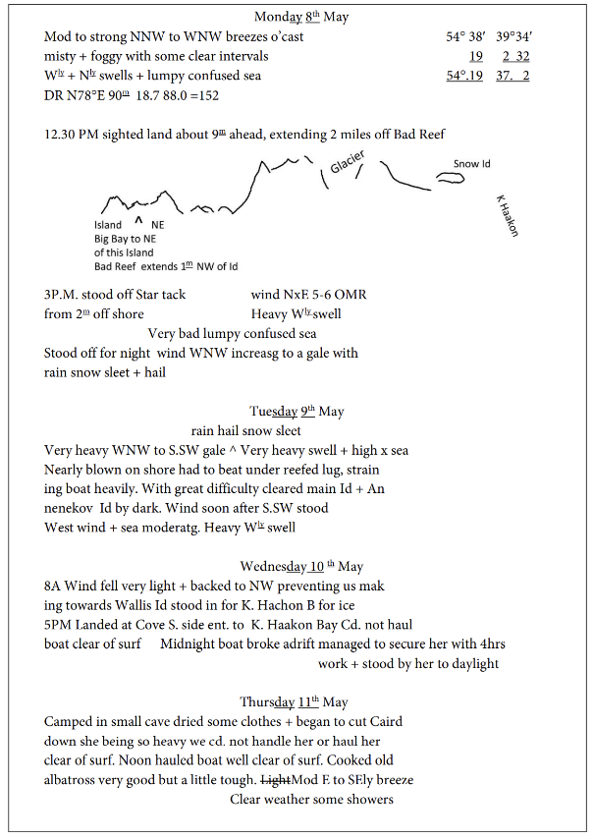
Extract from Worsley’s journal from the journey in the James Caird (left) and the same notes interpreted and written up (right)
Navigation-of-the-Shackleton-Expedition-on-the-Weddell-Sea-pack-ice.pdf (canterburymuseum.com)

Slide 10
What instruments did they take?
Instruments for navigation:
Sextant.
Sea-anchor.
Binoculars.
Charts.
Prismatic compass.
Aneroid.
See: How a Sextant works https://www.pbs.org/wgbh/nova/shackleton/navigate/escapeworks.html
From ’South’ by Ernest Shackleton CHAPTER IX THE BOAT JOURNEY https://www.gutenberg.org/files/5199/5199-0.txt

Slide 11
Glossary
Sextant | The Sextant is an instrument that measures the angle of a star, planet sun or moon, with the horizon.
Binoculars | An instrument with a lens for each eye, used to view distant objects
Prismatic compass | A special kind of compass that is highly accurate
Charts | Marine charts are detailed maps of the sea and coastline
Aneroid | An instrument used to measure air pressure and help with weather forecasting
Sea-anchor | a device that is streamed from a boat in heavy weather to act as a brake and stabiliser.

Slide 12
What else did Shackleton take?
30 boxes of m___________
6½ gallons p_____________
1 tin methylated spirit.
10 boxes of flamers.
1 box of blue lights.
2 Primus stoves with spare parts and prickers.
1 Nansen aluminium cooker.
6 _________ ________
A few spare _________
A few candles and some blubber-oil in an oil-bag.
Can you guess the missing words?

Slide 13
What else did Shackleton take?
30 boxes of matches.
6½ gallons paraffin.
1 tin methylated spirit.
10 boxes of flamers.
1 box of blue lights.
2 Primus stoves with spare parts and prickers.
1 Nansen aluminium cooker.
6 sleeping-bags.
A few spare socks.
A few candles and some blubber-oil in an oil-bag.
How many did you guess?
From ’South’ by Ernest Shackleton CHAPTER IX THE BOAT JOURNEY https://www.gutenberg.org/files/5199/5199-0.txt

Slide 14
What food did Shackleton take?
Food:
3 cases sledging rations = 300 rations.
2 cases nut food = 200 rations
2 cases biscuits = 600 biscuits.
1 case lump sugar.
30 packets of Trumilk.
1 tin. of Bovril cubes.
1 tin of Cerebos salt.
36 gallons of water.
250 lbs. of ice.
From ’South’ by Ernest Shackleton CHAPTER IX THE BOAT JOURNEY https://www.gutenberg.org/files/5199/5199-0.txt

Slide 15
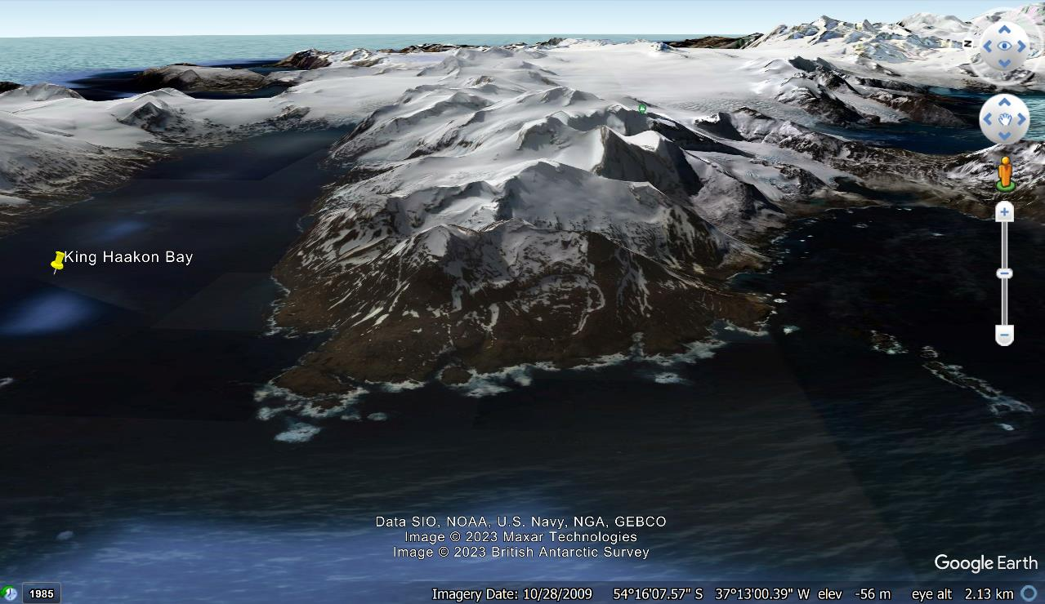
Arriving at South Georgia
MAY 10 1916
After 16 days, the James Caird lands at King Haakon Bay, South Georgia
Image Google Earth

Slide 16
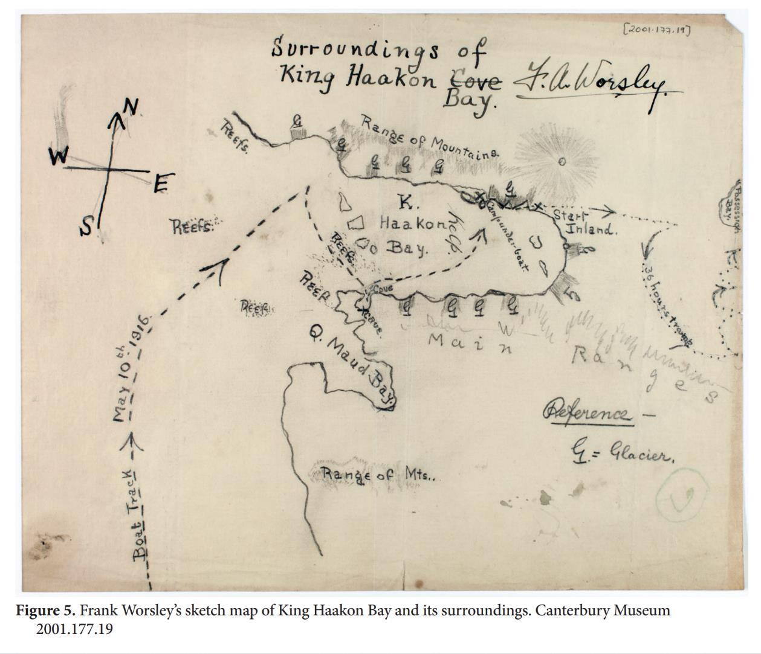
Create a sketch map of a favourite arrival at a place you are glad to see. Perhaps it is your school? Or a local park or play area?

Slide 17
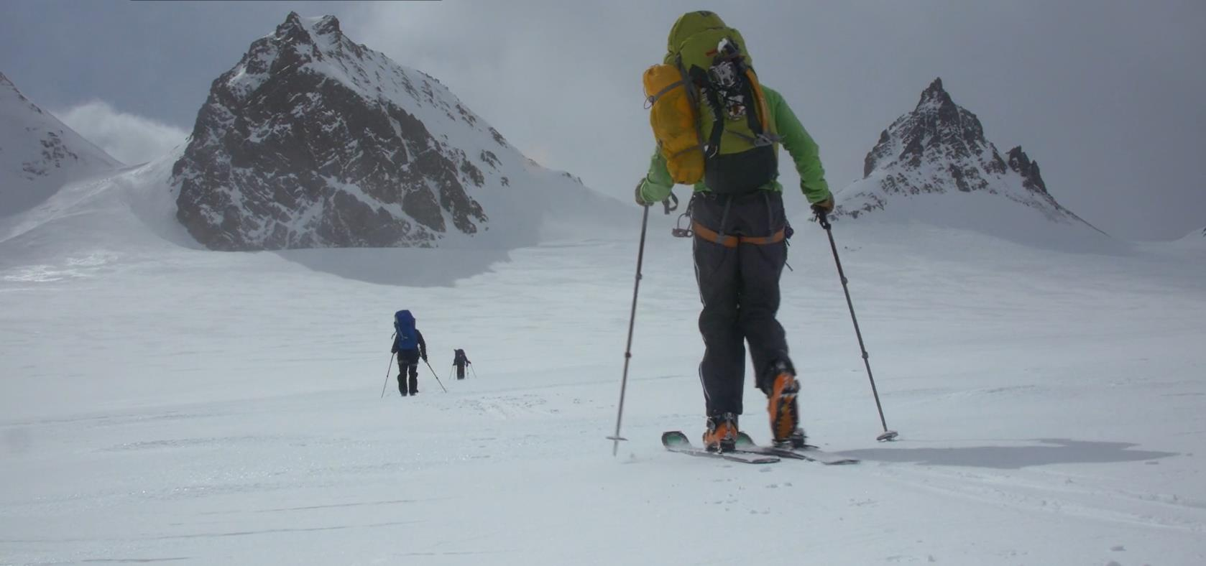
Crossing South Georgia
This 20 minute film shows young explorers replicating the routeof Shackleton’s team journey across South Georgia
Crossing South Georgia | Antarctic Heritage Trust (nzaht.org)

Slide 18
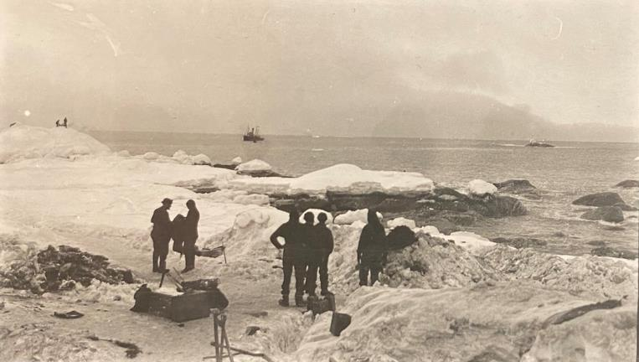
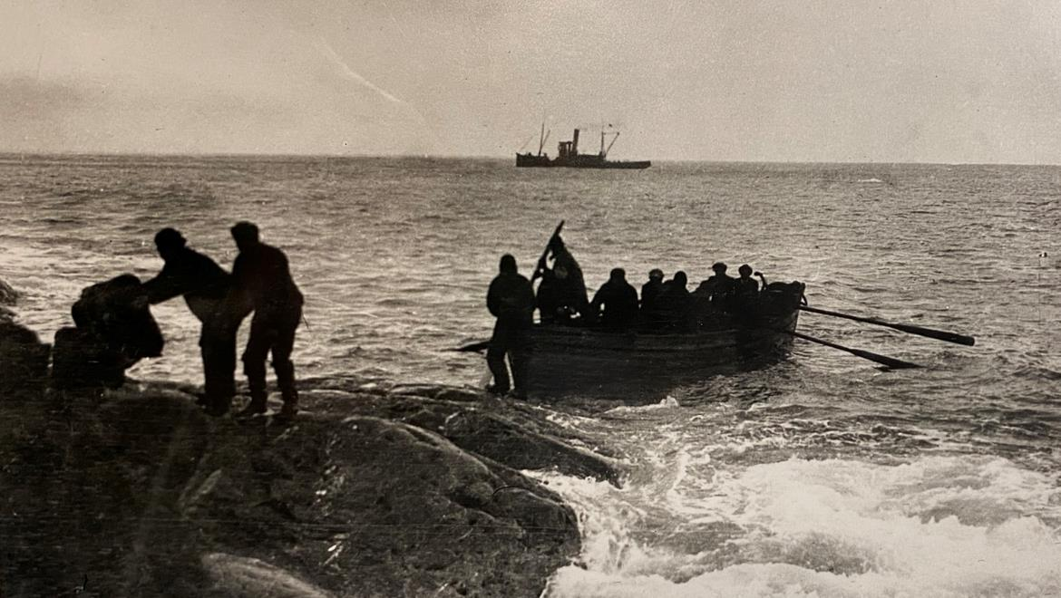
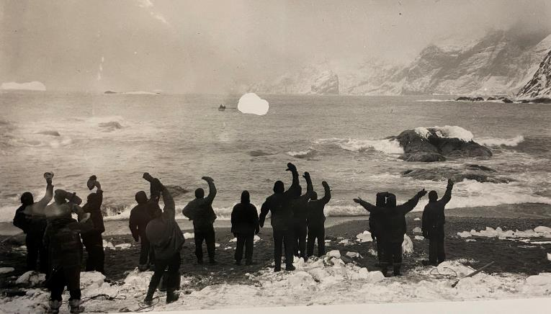
Rescue! 30th August 1916
Shackleton’s crew on Elephant island about to be rescued after 22 months. The Yelcho is seen in the distance.
Photographs Frank Hurley

Slide 19
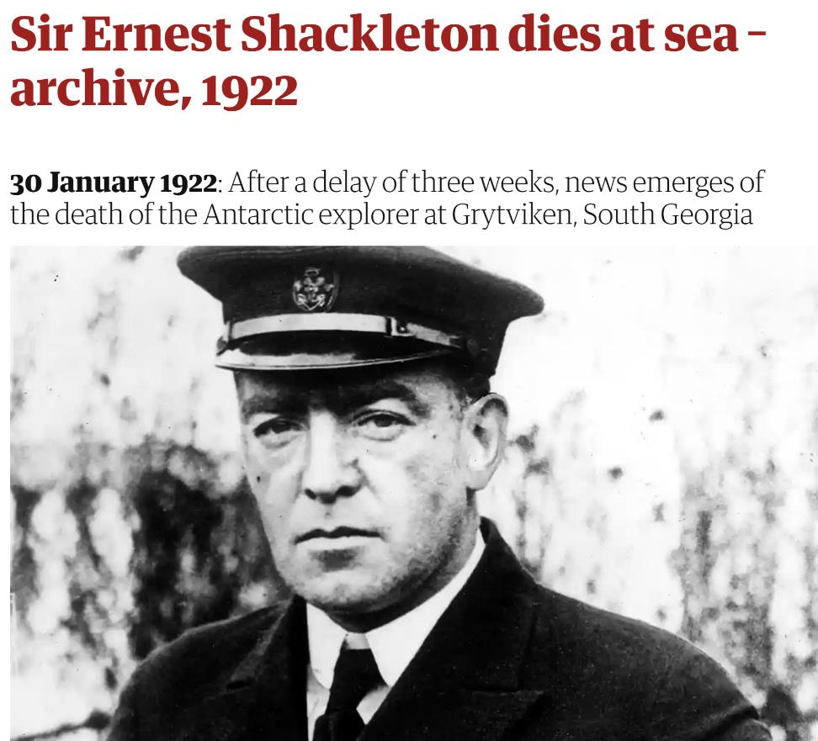
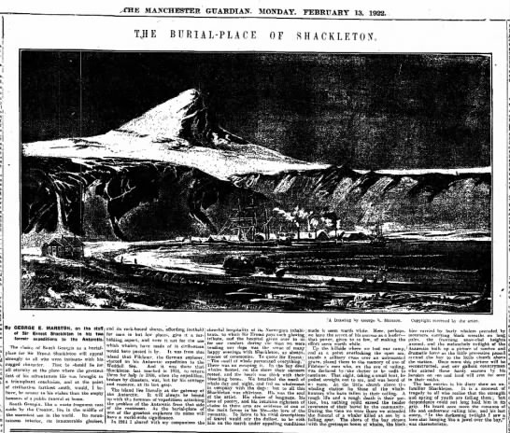
What can you find out about Shackleton’s death? Where is he buried?
https://theguardian.newspapers.com/clip/93498182/the-guardian/
https://www.theguardian.com/world/2022/jan/28/ernest-shackleton-dies-at-sea-archive-1922

Slide 20
Members of the Weddell Sea Party Imperial Trans-Antarctic Expedition on board the Endurance
William Bakewell, Able Seaman
Perce Blackborow, Steward
Alfred Cheetham, Third Officer
Robert Clark, Biologist
Tom Crean, Second Officer
Ernest Holness, Stoker
Walter How, Able Seaman
Charles Green, Cook
Lionel Greenstreet, First Officer
Hubert Hudson, Navigator
Frank Hurley, Photographer
Leonard Hussey, Meteorologist
Reginald James, Physicist
Alexander Kerr, Engineer
Mrs Chippy, tom cat
Alexander Macklin, Surgeon
George Marston, Artist
Timothy, McCarthy, Able Seaman
James Mcllroy, Surgeon
Thomas McLeod, Able Seaman
Harry ‘Chippy’ McNish, Carpenter
Thomas Orde-Lees, Motor Expert and Storekeeper
Lewis Rickinson, Engineer
Ernest Shackleton, Expedition Leader
William Stephenson, Stoker
John Vincent, Boatswain
Frank Wild, Second-in-Command
James Wordie, Geologist
Frank Worsley, Captain

Slide 21
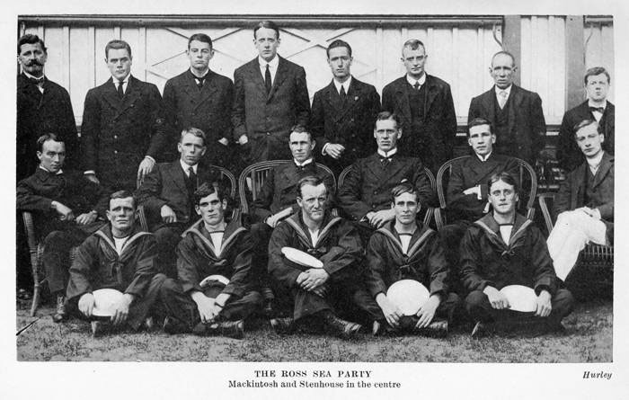
Members of the Ross Sea Party Imperial Trans-Antarctic Expedition on board the Aurora
Postscript
January 10th 1917, over four months after Ernest Shackleton, Tom Crean and Frank Worsley had rescued the last of the Endurance crew from Elephant Island, Shackleton arrived at Cape Royds, Antarctica, to save the stranded men of the Aurora.
https://tomcreandiscovery.com/day-january-10th-1917/
“RossSeaParty” by Frank Hurley – This photograph comes from the expedition and was taken by Frank Hurley.. Licensed under Public Domain via Commons.
Ross Sea party members: Back row from left: Joyce, Hayward, Cope, Spencer-Smith. Centre: Mackintosh third from left, Stenhouse fourth from left.

