Slide 1
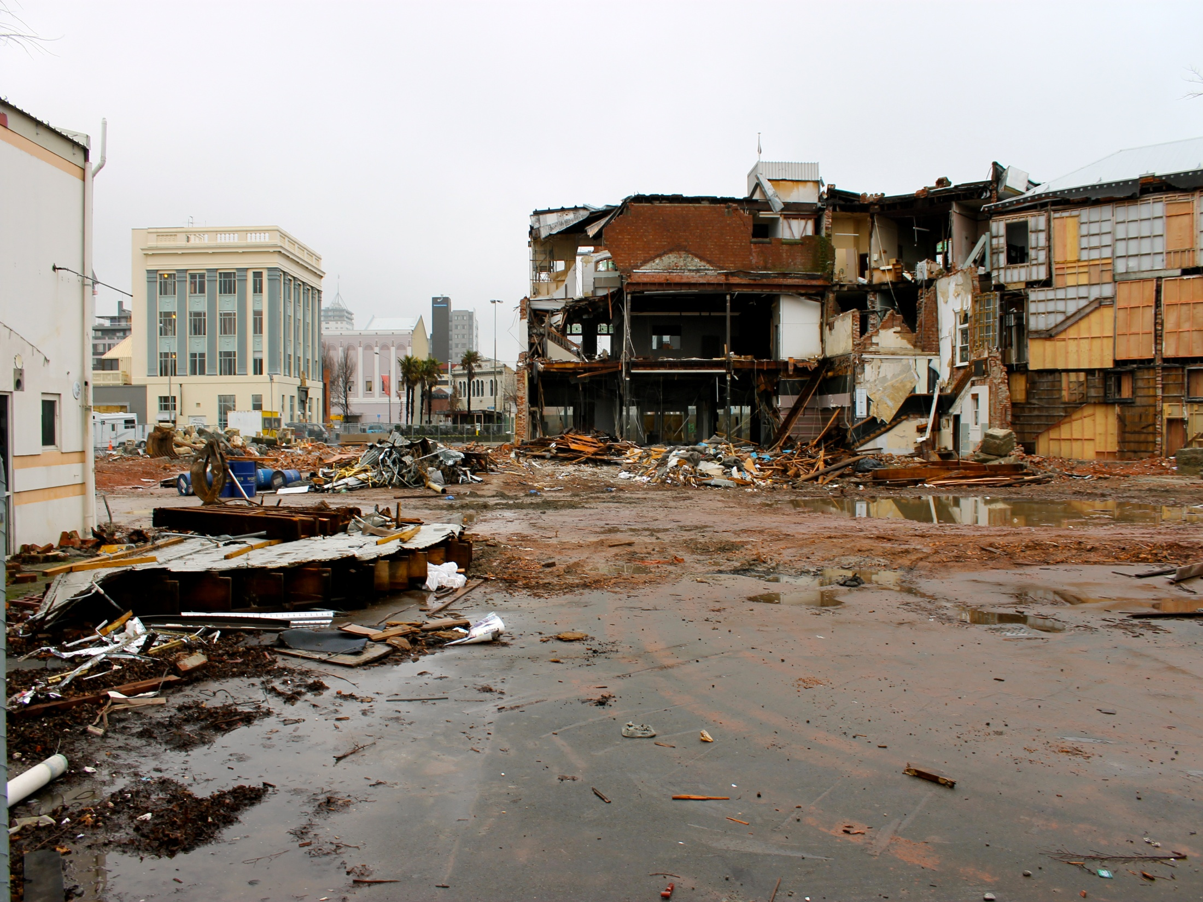

Geographical Skills
Interview Techniques

Slide 2
What is an interview?
An interview is a form of primary data collection that allows a researcher to pose questions directly to an interviewee.
Interviews are a good technique to use when you want to understand a person’s attitude towards an issue or how they would react in a specific situation.

Slide 3
Why did you interview displaced residents in Christchurch?
In this geographical research, interviews offer a way to understand individual experiences. They are useful in investigating topics relating to belonging, migration and emotion.
Finally, they helped to explore the complex processes people engage in to make decisions about migration. Their flexibility and informal structure provides the in-depth discussions required to explore the emotional motivations that impact return migration decisions in the post-disaster context. Stephanie Morrice

Slide 4
Scope of Interviews
An interview is a far more personal method of data collection and allows a researcher to explore issues in far more detail than can often be achieved using a questionnaire.
The interviewer also has the opportunity to clarify ideas and follow up any points that are raised.
It must be remembered that interviews can be very time consuming both to conduct and to transcribe. Be realistic about how many interviews you will be able to complete as part of your research.

Slide 5
How did you conduct the interviews?
“I carried out interviews at community centers in Christchurch. They lasted between 30 minutes and 1 hour, depending on participant responses. Interviews were based around five broad questions and expanded depending on participant responses. Interviews were emotionally powerful and astute, illuminating the complexity of a post-disaster return decision and the ongoing nature of the earthquakes.” Stephanie Morrice

Slide 6
Interview Questions
Base questions:
1. What was life like before the earthquake?
2. What happened when the earthquake struck?
3. Can you tell me about your migration experiences?
4. What has life been like since the earthquake?
5. Why did you decide to or not to relocate?
Subsequent discussion topics:
Loss of personal possessions
Insurance (claims/battles)
Support/aid
Employment
Creation/disruption of social networks
Creation/disruption of family networks
Affect on your children
Host community integration/segregation
Canterbury Earthquake Recovery Authority (CERA)

Slide 7
How did you analyse the data collected?
“Each interview was audio-recorded and transcribed. This was a time consuming process, as each transcription could take up to 2 days to complete.
Interview transcripts were compared with each other to highlight common themes. In particular, I identified positive and negative emotions, as well as discussions of home, insurance struggles, zoning, and personal possessions/objects. This enabled me to understand what influences earthquake victims when they are deciding whether to relocate/return following displacement.” Stephanie Morrice

Slide 8
How willing were the residents to be interviewed?
“Despite initial concerns, I was overwhelmed by the willingness of residents to be interviewed. Due to the limited time I had in Christchurch, participants were recruited fairly informally, through connections I established through the University of Canterbury, by talking to the owners of the hostel I stayed at and through Lyttelton Community House.
At the outset of our interview, research participants were given an informed consent form explaining my project in detail and reinforcing the voluntary nature of participation. I made it clear that participants could withdraw from the study at any time. Many participants took part simply because they wanted to talk to someone; they wanted someone to listen to their story and give them a voice.” Stephanie Morrice

Slide 9
How did you maintain data protection?
“All interviewees in my project are given a pseudonym. This is used to identify them in my study, so their identity is kept anonymous. Interview transcripts are kept in a secure location and will be kept for approximately five years, after which time they will be destroyed. The key linking the audiotapes to the identity of the individuals is kept separate from the complete data (transcripts and recordings will be kept separate).” Stephanie

Slide 10
Interview Dos
Prepare carefully for the interview – have a list of questions ready to ask (don’t waste the interviewee’s time).
It may be beneficial to contact the interviewee in advance and give them an idea of the sort of questions that you would like to ask so that they too can prepare and have any necessary information available.
If you intend to record the interview you must ask permission to do this before you start.
Always ensure that the interviewee knows in what capacity the information that you collect will be used and to whom the information will be available.

Slide 11
Interview Don’ts
Avoid asking questions about information that you could easily obtain yourself.
Don’t waste the interviewees time – be prepared.
Interviews are time consuming, be realistic with the number that you can conduct effectively.

