Slide 1
UK Climate Graph

Slide 2
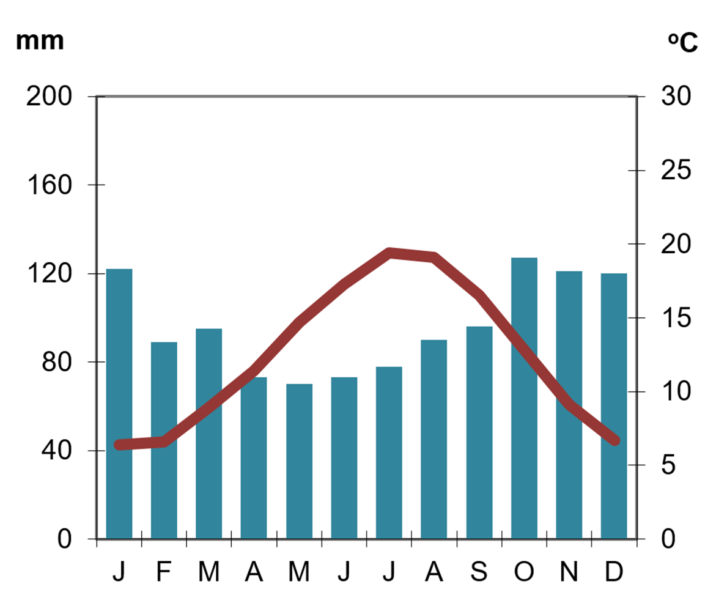
UK Climate Graph
Defence
Drainage
Soil
fertility
Bridging point
Building materials

