Slide 1
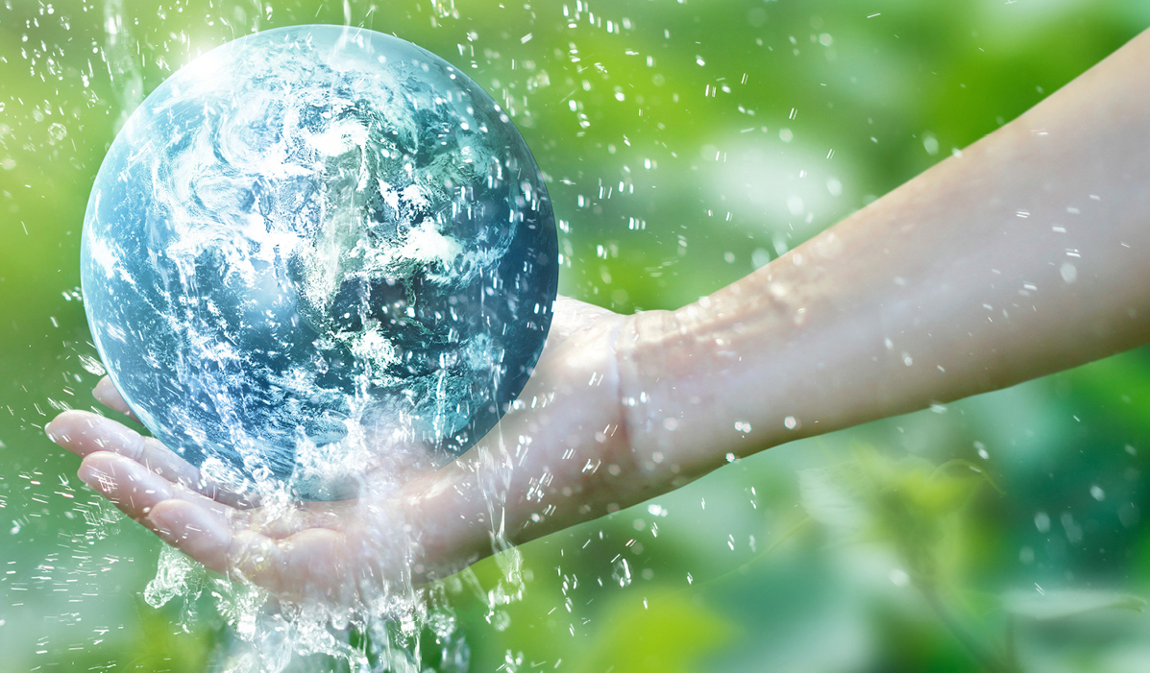
Is Water an Infinite Resource?
Learning Objective: To describe the availability of water as a resource and consider how we can ensure water remains a renewable resource.
Starter: What do you already know about water as a resource?
What are the problems related to distribution and consumption?
What are the problems associated with quality?
Challenge: Can you link these problems to another topic you have studied?

Slide 2
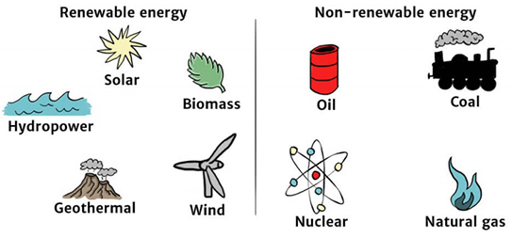
Renewable and non-renewable resources
A renewable resource is one which is replaced by the natural processes of the Earth’s spheres. These are air, water, wind, sunlight, and living organisms.
Non-renewable resources such as coal and oil take millions of years to be replaced naturally. Within a human’s lifetime, these resources would seem like they are never replaced.

Slide 3
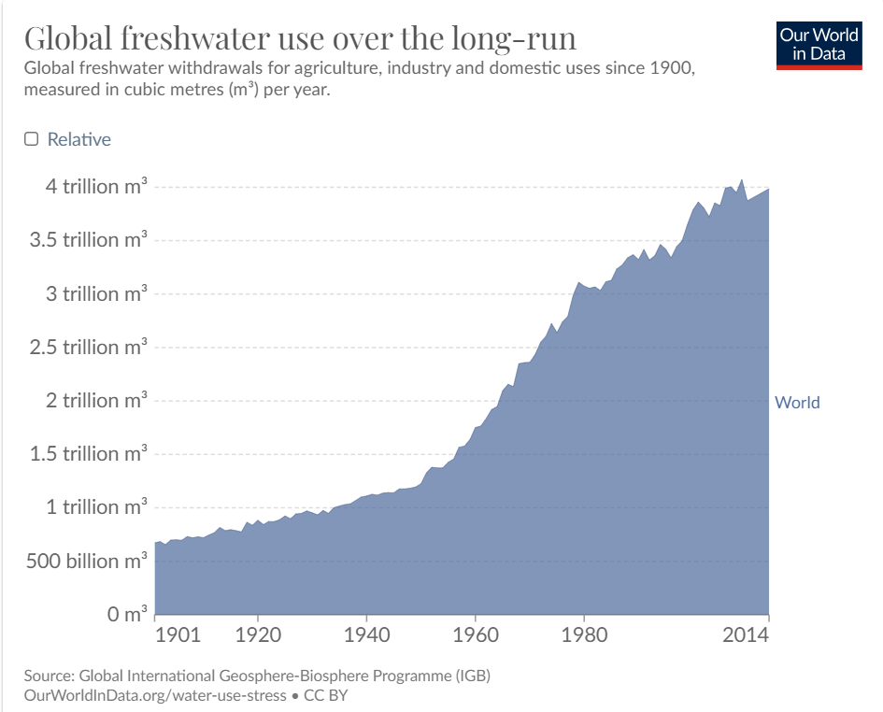
Why is water currently a non-renewable resource?
We are currently using more water than will be naturally replenished by the water cycle in our lifetime, meaning we will eventually run out of potable water.
Water security: When the entire population of a country has sustainable access to adequate quantities of acceptably clean water.

Slide 4
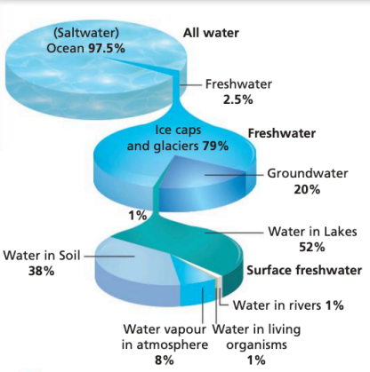
Where is the world’s water stored?
Water is stored within 4 major physical systems: the cryosphere, lithosphere, hydrosphere, and atmosphere.
Cryosphere: frozen water (stored as ice - glaciers, icebergs, sea ice, and permafrost).
Lithosphere: Earth’s crust - water stored in the land/rocks
Hydrosphere: liquid water (rivers, lakes, seas, oceans)
Atmosphere: in the air (clouds, fog)

Slide 5
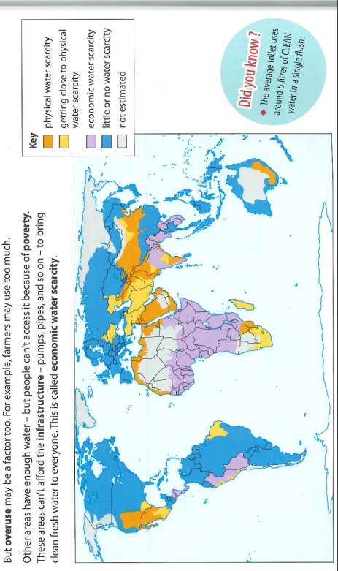
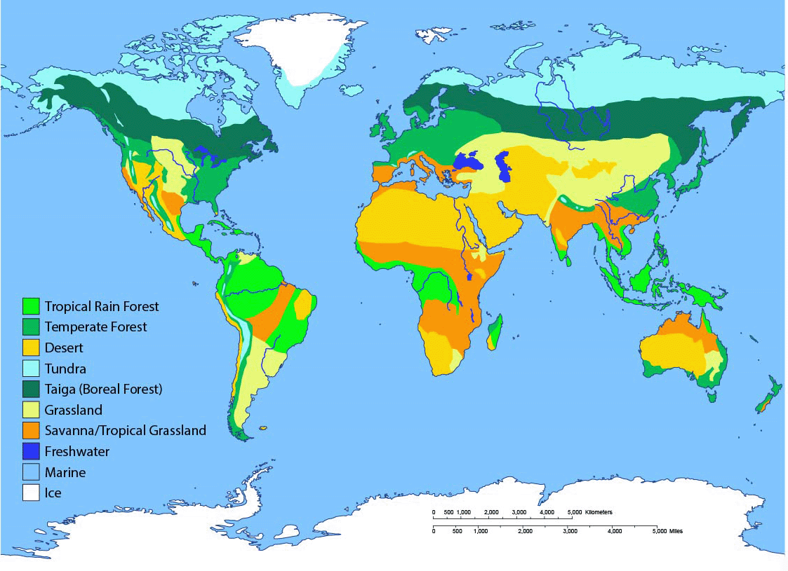
Extension: What is the difference between physical and economic water scarcity?
Which do you think may be easier to tackle? Why?
Task: Using PHAL (pattern, high, anomaly, low), describe the global pattern of water scarcity.
Challenge: Use the map of global biomes and your own knowledge to suggest reasons for the patterns.

Slide 6
Quick quiz
Define water security.
Name the 4 major global stores of water.
Give one reason for physical water scarcity.
Make a link between water security and one topic we have previously studied.

Slide 7
Quick quiz
Define water security.
When the entire population of a country has sustainable access to adequate quantities of acceptably clean water.
Name the 4 major global stores of water.
Cryosphere, lithosphere, hydrosphere, atmosphere
Give one reason for physical water scarcity.
Drought, location within a desert biome, over-abstraction, pollution, climate change, etc.
Make a link between water security and one topic we have previously studied.
Links to population increases, food security

Slide 8
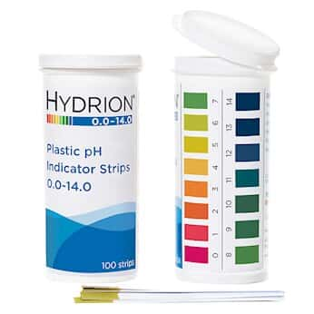

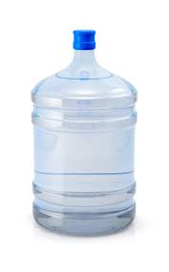
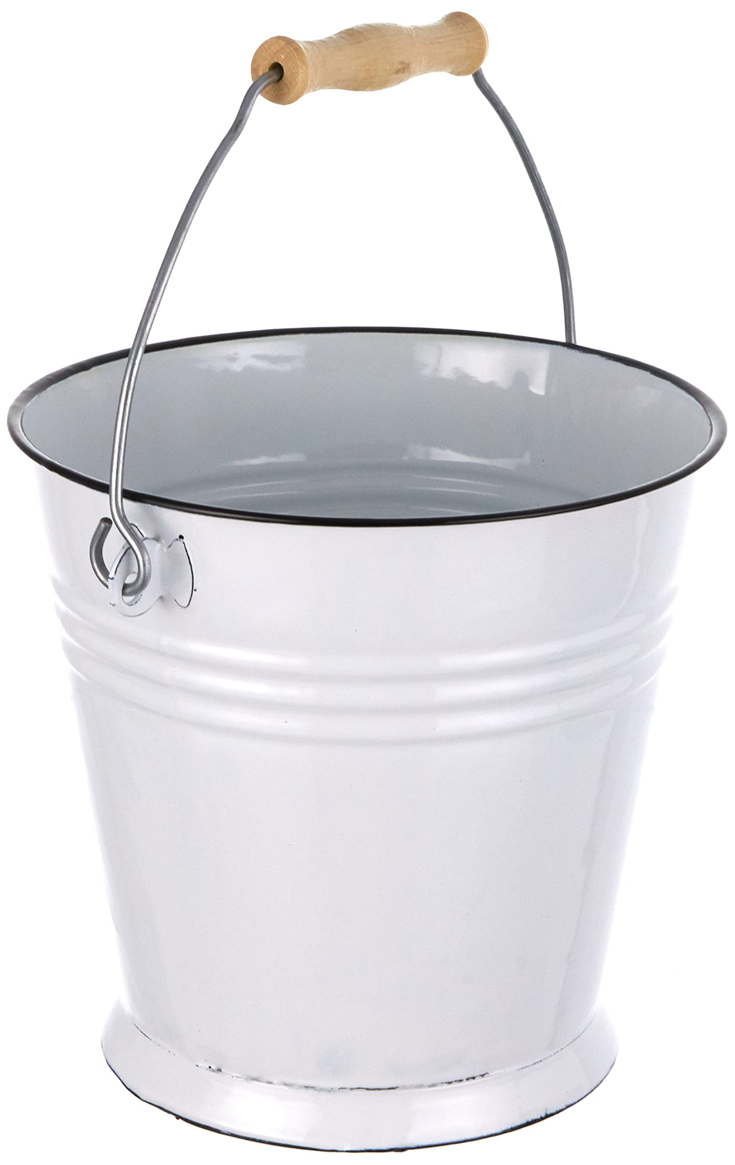

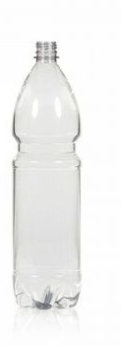
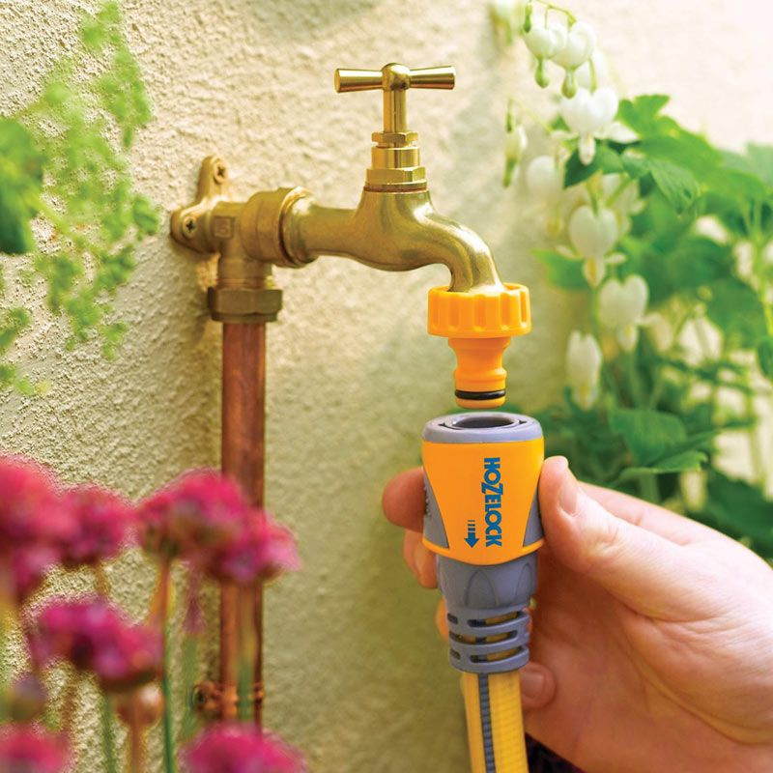
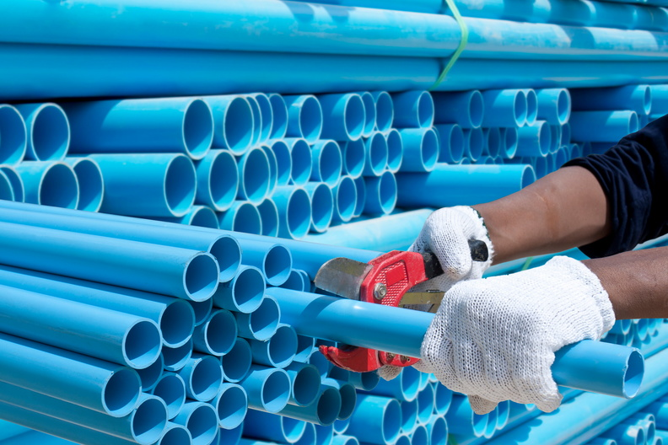
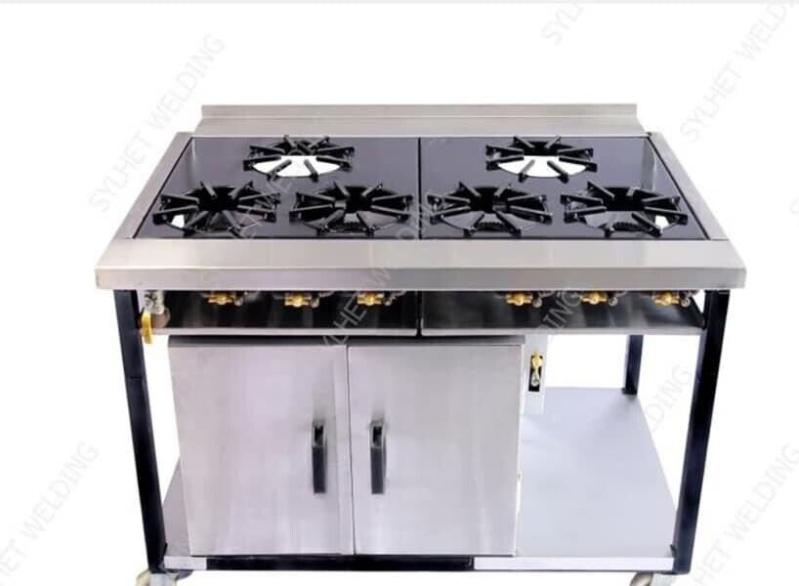
Design your own water management device
Task: Using the tools you have been given and nothing else, design a proposal for a device to manage water quality and access in a village in a LIC. The resources you have been given will be scaled up to an industrial equivalent during manufacturing.

Slide 9
Plenary
What would have made your water management device better? If you had any equipment you wanted, what would you have used and why?
Challenge: How do you think a device such as the one you just invented could be scaled up?

