Slide 1
Experiencing Geography
#Choosegeography
Head of Education and Outdoor Learning
Steve Brace
2022
www.rgs.org/schools @RGS_IBGSchools @stevebracegeog

Slide 2
Spoiler ….
A geography student might be …
Someone who is a (climate) activist, aware, caring, clever, open minded, environmentally & socially concerned, interested in the world, logical, outdoorsy and (possibly) vegan
But does archetype appeal to all?

Slide 3
The Royal Geographical Society (with IBG)
The learned and professional body for geography
Schools, higher education, with the professions and public
16,000 Fellows
A focus on the discipline and subject knowledge
“Advancing geography and geographical learning”

Slide 4
Stepping outside “our” experience
Most of us:
Did well at & enjoyed geography
Were inspired by a teacher and became one too
Knew other people who’d studied geography &/or been to uni
Are passionate and knowledgeable about our subject & want to celebrate it
Make connections between geography’s ‘intent’, the wider world & future careers
But this isn’t the experience of all young people &/or necessarily how young people view geography

Slide 5
External research
RGS commissioned YouGov polls
Rapid Evidence Review: National Education Nature Park & Climate Leaders Award – green skills chapter
NB. An opportunity for departmental CPD

Slide 6
Scope of the various research
Who is and isn’t studying geography (2010-2020 England)
What do those who are, & aren’t, studying geography think about the subject. And how does geography (+ wider themes) fit into YPs’ plans for future study and careers (500 YP England
The experience of Black, Asian and minority ethnic geography trainees and ECT teachers
UK wide representative samples of public opinion

Slide 7
A changing subject – But only up to A Level
Increase mainly from groups previously less likely to study geography: Black, Asian & minority ethnic pupils, disadvantaged, lower prior attainment &/or studying in comp. schools
Since 2011, numbers of YP studying GCSE have risen from 180,000 in 2010 to 268,000 in 2021
But, this progress is not continued into A Level where, apart from white pupils, fewer pupils of all other ethnicities chose geography than expected.
Narrowing continues at university.
“Geography of Geography”

Slide 8
The changing nature of the GCSE intake
Since 2010 the proportion of young people taking geography has risen from 27% to 40%
A more representative uptake. White students 42%, Chinese students 52%, Black/Black British rose from 18% in 2010 to 37%
A good gender balance
Source: Geography of Geography

Slide 9
But: Transitions to A Level
Fewer disadvantaged pupils: 1.4% of cohort. 2.0% expected
By demography
+‘countryside living’ 7.7%. 6.8% expected
-‘multicultural living’ 2.6%. 3.5% expected
Apart from white pupils, fewer pupils of all (known) ethnicities entered than expected
Asian/Asian British 3.5%. 5.1% expected
Chinese 6.7%. 8.3% expected

Slide 10
The positive impact of studying geography: Institute for Fiscal Studies
Study: Geog. students are more likely to complete their degree, have the 3rd lowest drop out rate of all subjects & have some of the highest National Student Satisfaction scores.
Employment: Five years after graduation, geography graduates have an above average likelihood of gaining employment.
Earnings: Geography graduate earnings outperform many other subjects & geographers are in the Top 10 for graduate salaries

Slide 11
This is not understood by YP
What salary do you think someone might earn after studying geography?’
Above average 14%
Average 54%
Below average 14%
Not sure 18%
After graduation how more or less likely do you think people who have studied geography are to be in employment compared to (other) graduates.
Much more or slightly more likely 33%
Neither more nor less likely 49%
Much less or slightly less likely 18%
Source: Young peoples views on subject choices, further study and careers

Slide 12
Young people subject choices, further study & careers
RGS commissioned external research by Censuswise
Focused on
importance of careers and job prospects in decision making
the issues young people care about & how they view the relative importance of these in subject-choices and future careers
their views on geography
500 16–21-year-olds (England)
Included a minimum of 250 BAME, 100 white, 100 lower socio-economic respondents
268 were studying geography during the research period
Source: Young peoples views on subject choices, further study and careers

Slide 13
Young Peoples’ views
There is a geography student ‘archetype’: someone who is a (climate) activist, caring, clever, open minded, environmentally & socially concerned, interested in the world, logical, outdoorsy and (probably) vegan
Young peoples’ views on their understanding of geography draw strongly on environmental, social & global themes & reflect their interest (or not) in the subject

Slide 14
A Level choices
Most YP choose their A Levels based on ideas about their future careers
When asked, have you chosen/did you choose your A Levels based on what career you want to get into:
Yes 67%
No 25%
Groups with a higher positive response rate include:
Males (73%)
Greater London (76%)
Some Asian ethnic groups (Bangladeshi, 76%, Indian, 77%; Pakistani, 86%)
Those from higher socio-economic status backgrounds (higher managerial, 74%)

Slide 15
Why not geography?
For those not studying geography they prefer other subjects, feel another subject would be better for their future/career or do not know what career geography could lead onto
Reasons given by those currently not studying geography, or not planning on studying geography at university, in rank order were:
I prefer a different subject
I think a different subject will be better for my future/career
I'm not sure what career path I could take with geography
There were no significant differences across sub-groups to this question.

Slide 16
What matters most?
When asked about their concerns for when they leave education young people the top three issues were:
Earning a good salary
Getting the ‘right’ job
Getting a job in general
Doing ‘good’ through their job, using their subject in their job or finding a career where they could help the environment or address social concerns were of lower priority.

Slide 17
Career concerns: rank order
In rank order:
Earning a good salary 51%
Finding the right job for me 44%
Finding a job in general 37%
Starting my career in the right subject 23%
Doing 'good' through my job 19%
Using my subject in my future workplace 16%
Finding a career to help the env./address social concerns 14%
Some variations by group:
Earning a good salary: highest response Black and Black British 60%
Finding a career where I can help the environment/address social concerns: White 19%, Asian 12%, Black and Black British 9%

Slide 18
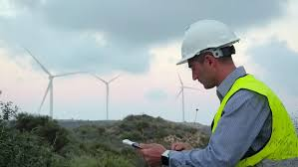
Green jobs
UK’s low carbon economy worth £200B (4X manu) & employs 1.2M
But, little public knowledge of this
CBI: lack of awareness of the green economy & a ‘huge task’ be required to educate public about path to net-zero
RGS/YouGov Poll (2021) what’s value of the UK’s ‘low carbon, environmental goods and services’
49% no answer
Only 6% selected an answer which was +/- £50B of the correct answer

Slide 19
Green Jobs ‘a bit of a punt’
Green jobs seemed ‘a bit of a punt’; and (particularly for working class audiences) jobs which provided security and positive working conditions mattered more than green jobs
Source: Public First
currently no clear vocational pathways into the green economy
or well-understood professions associated with it
Many young people were effectively making long-term plans before university … it would be too much to suggest that these graduates are “lost” to the green economy, (but) there aren’t yet early “vocational” paths into the green economy,

Slide 20
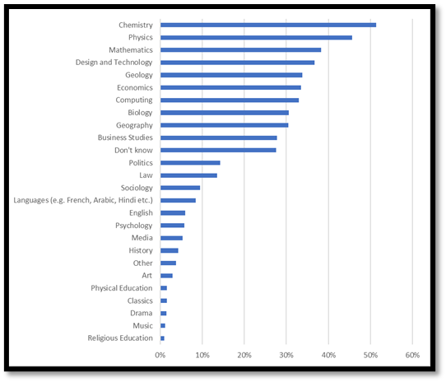
Which subjects help YP get future role in green sector?
Source RGS/ YouGov 2021

Slide 21
‘Geography Careers’
Which jobs would be available to you if you studied geography:
1. Geography teaching 46 mentions
2=. Built env, planning, survey 24 mentions
2=. Travel and tourism 24 mentions
3. Environment 23 mentions
4. Weather/meteorology 15 mentions

Slide 22
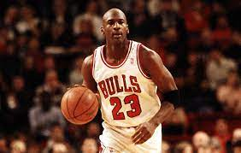
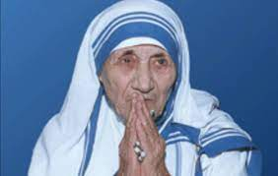
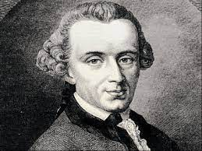
Who studied geography …
None of these careers are really available to current students …

Slide 23
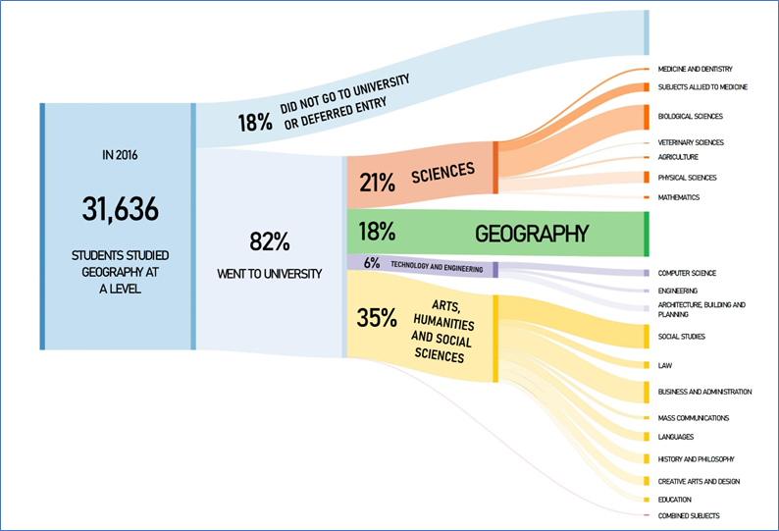
What do A Level geographer study?

Slide 24
Views on geography 172 responses
Study of/a subject about (variously) climate change, coasts, countries, earth, economy, environment, geology, human and physical topics, humans, impacts, issues, landscapes, maps, natural and human influences, rocks, weather and climate, wildlife, or the world | 55
Interesting, fun | 34
Boring | 15

Slide 25
Some individual responses
“A caring subject that will make a difference to the world”
“A key subject for life”
“A way to learn about the environment and how you can save it”
“An interesting, globalised subject that brings many travel and social opportunities”
“Becoming one with nature”
“Difficult but sometimes interesting”
“Globally eye-opening”
“Not helpful to my career path & has too much content at GCSE that put me off”
“What’s happening in the world around us and why”
“Where you can make a living and make the world a better place”

Slide 26
Who does geography appeal to …
73% of respondents reported that they “do not think geography appeals most to any sort of students”.
27% of the respondents provided 125 responses through open text answers
The top three most common responses, clustered by broad themes, were people:
(Who want to) change the world, (are) environmental/socially concerned, ethical, interested in the future of the earth and nature, and socially minded | 56
(Are) analytical, intelligent, open minded, smart | 20
Enjoy it, like it, are interested in geography | 12

Slide 27
What words would you most associate with a person who studies/studied geography?
Respondent could provide up to 3 words in response to this question and 362 responses were given. The top four groups of answers, clustered by theme, reveal views about:
The mindset and outlook of geographers | Aware, caring, committed, concerned, interested, perceptive | 78
Their academic abilities | Academic, articulate, clever, intelligent, smart | 71
Their interests | Climate change, eco, environment, green, world issues | 57
Their broader characteristics | Active, adventurous, ambitious, enthusiastic, fun, friendly, hard-working, helpful, outdoorsy, keen, kind, passionate | 41

Slide 28
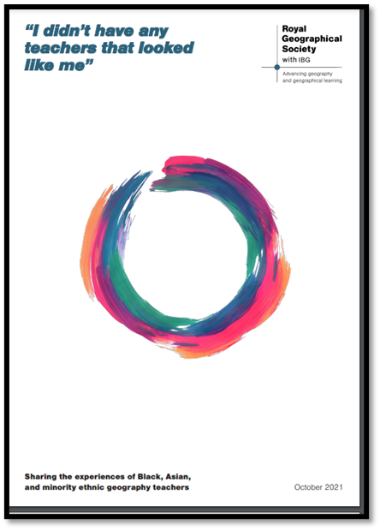
I didn’t have any teachers who looked like me
* They had experienced racism, from pupils
& colleagues
* There is ongoing underrepresentation of Black, Asian & and minority ethnic perspectives & people (and) this excludes people & impacts negatively on the reality of who geography is for
* There have been positive actions, eg Black Geographers, but more is needed
* There can be expectation from white
colleagues that such issues are for Black, Asian & minority ethnic colleagues to address
* The teachers are often the only non-white member of their dept
Source: I didn’t have any teachers that looked like me

Slide 29
Recommendations
Recognise that geography emerged from the structures of imperialism and colonialism and address this legacy
Consider EDI as subject-wide issues
Empower and support Black, Asian & minority ethnic voices and initiative within geography teaching
Review resources & practice to address EDI
Address EDI in reviews of National Curriculum & Exams
Undertake more work with underrepresented YP, to better understand their perspectives on geography
Develop more inclusive careers materials
Recruit, support & retain more Black, Asian & minority ethnic teachers

Slide 30
Recap #1
Geography has made substantial progress … “at GCSE”
(In many respects) there are positive views held about geography and geographers
Overall, most young people see a connection between their subject choices and future careers & this is important to them
For those not studying geography they prefer another subject/s, believe another subject/s will be better for their future, do not like geography or are unclear about the career path that geography could provide

Slide 31
Recap #2
“Wider considerations” - such as doing good through my job or addressing environment/social concerns in my career are a lower priority for most young people
The generic ‘transactional’ benefits (£, employabiltity) of studying geography are poorly understood
Geography’s career destinations are focused on a narrow range of options (teaching)
The ‘green economy’, espc for some groups is poorly understood

Slide 32
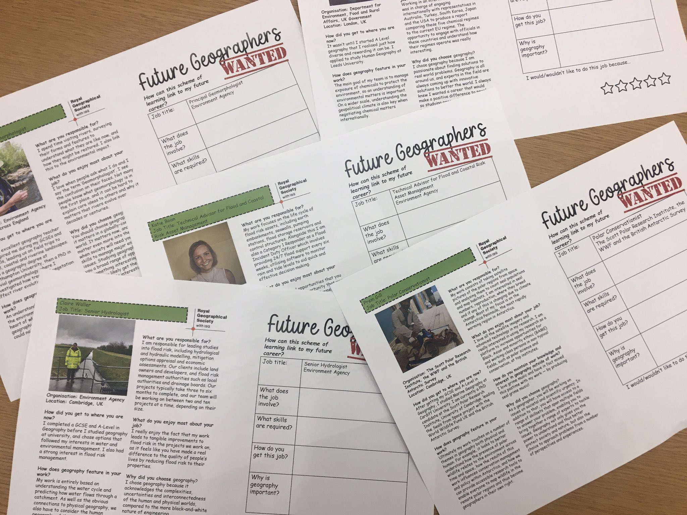
I am a (actual) geographer
www.rgs.org/iamageographer
Also see ‘future geographers wanted’ from @miss_m_pickett

Slide 33
@geoteachrach Inspirational geographers

Slide 34
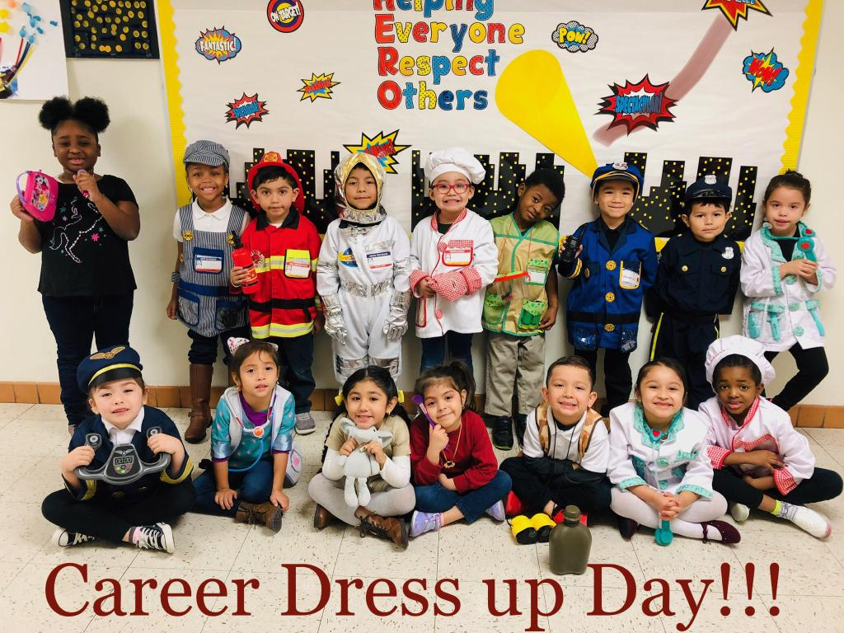
What might geography be?
Notes:
https://twitter.com/TGTerryES

Slide 35
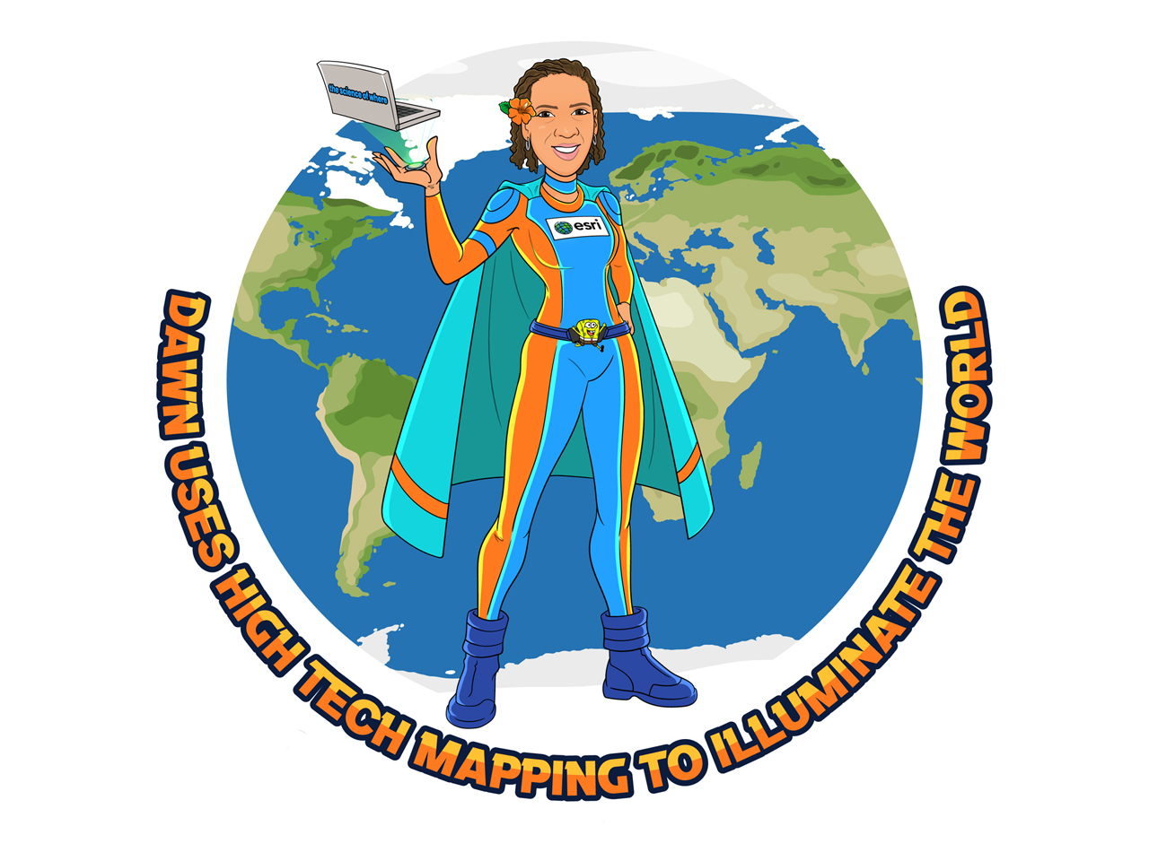
RGS Geography Superheroes

Slide 36
Geography for All 2022 - 2023
Support network & programme for ITT & ECT teachers
Event 16th June
Interventions with target schools to evaluate & share
Partnerships with & profiling work of others
History and geography curricula at GCSE and A Level: embedding equality, diversity and inclusion

Slide 37
Couple of other things
Using data & geography
www.rgs.org/geomaths
Subject Knowledge Programme
www.rgs.org/skp

Slide 38
Questions …
@RGS_IBGschools @stevebracegeog
www.rgs.org/schools
S.brace@rgs.org

