Slide 1
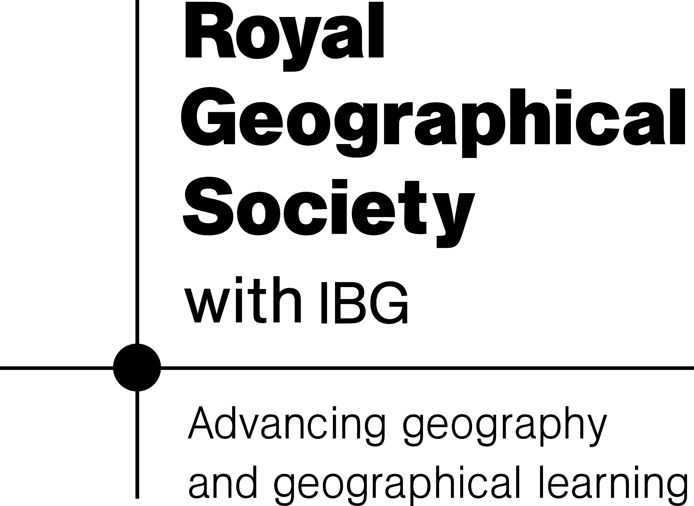
Sketch map of the Wādī Darbāt

Slide 2
Source – the start of the river. Usually in higher ground such as mountains and hills.
Mouth – the end of a river which flows out to the sea or a lake.
Confluence – the place where two rivers meet.
Meander – a bend (or several bends) in a river.
Valley – slopes on either side of a river.

