Slide 1
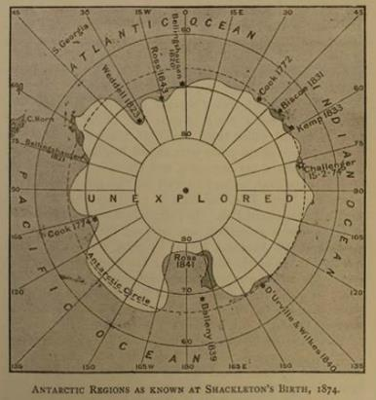

What is an ‘Explorer’?

Slide 2
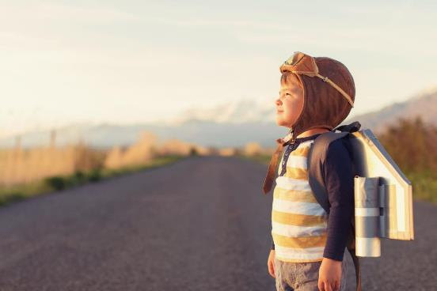
Can you name any ‘Explorers’
What does an ‘Explorer’ look like?

Slide 3
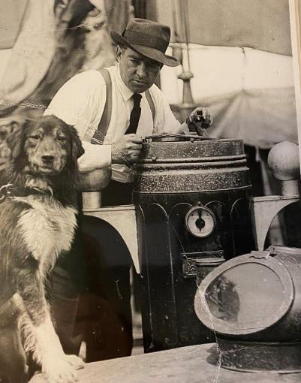
Sir Ernest Shackleton
Sir Ernest Shackleton was a famous polar explorer who led the 1914–17 Endurance Expedition to attempt to cross Antarctica from one side to the other.
Royal Geographical Society - Geography resources for teachers (rgs.org)

Slide 4
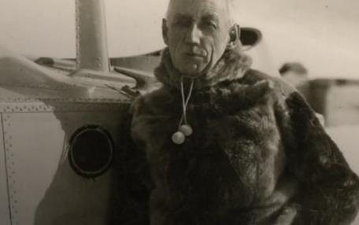
Roald Amundsen is one of history’s most celebrated explorers, famous for navigating the North-West Passage and being the first to reach the South Pole.
Roald Amundsen | Royal Museums Greenwich (rmg.co.uk)

Slide 5
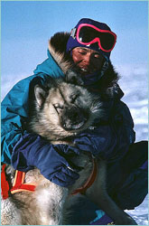
Keizo Funatsu is a great adventurer. He was an office worker for a Japanese business firm but quit in 1984. After he left his regular job, he started his life as an adventurer.
http://www.explorapoles.org/explorers/profile/funatsu_keizo

Slide 6
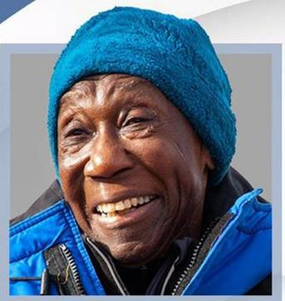
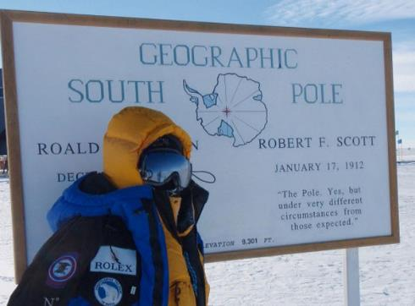
Barbara Hillary
Barbara Hillary was the first African American woman on record to reach both the North and South Poles. She reached the North Pole aged 75 and the South Pole aged 79.
https://barbarahillary.com/about

Slide 7
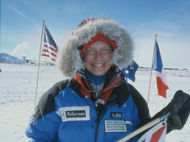
Fiona Thornewill
Fiona Thornewill together with her husband Mike, realised their dreams of being the first married couple to walk to both the South and North Poles.
http://www.explorapoles.org/explorers/profile/thornewill_fiona/

Slide 8

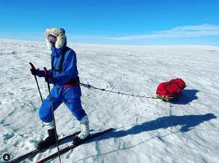
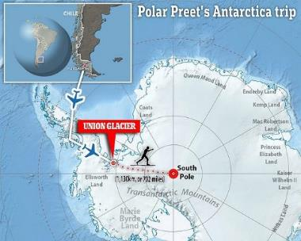
"That's part of the reason why I wanted to do this - for people who don't fit a certain image," she said.
Preet Chandi is thought to have become the first woman of colour to complete a solo expedition across Antarctica.
Army officer completes remarkable solo South Pole trek - BBC News

Slide 9
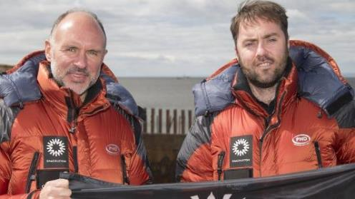
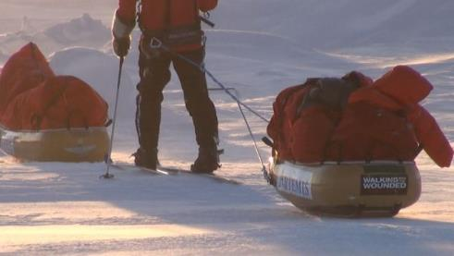
Martin Hewitt
Martin Hewitt, lost the use of his right arm after being shot in Afghanistan. As a disabled military veteran, he reached the South Pole with another polar explorer after skiing more than 400 miles (644km) in 50 days
Disabled military veteran reaches South Pole - BBC News

Slide 10
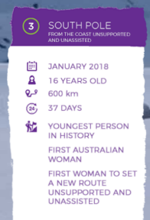
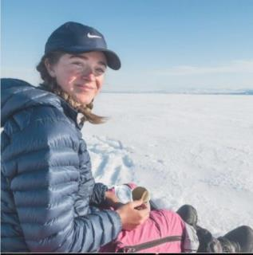
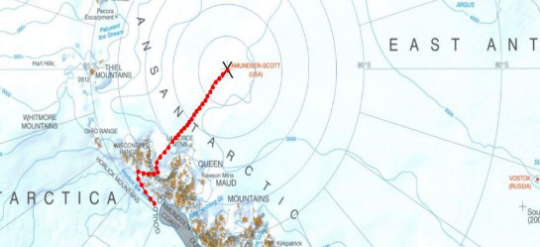
Jade Hameister
Jade Hameister (aged 16), arrived at the South Pole after an epic 37 day journey via a new route through the Kansas Glacier, from the Amundsen Coast of Antarctica.

Slide 11

Explorer: a person who explores an unfamiliar area
Familiar places
Places I haven’t been to yet
Unknown places
Places I already know
Places I don’t know very well

Slide 12
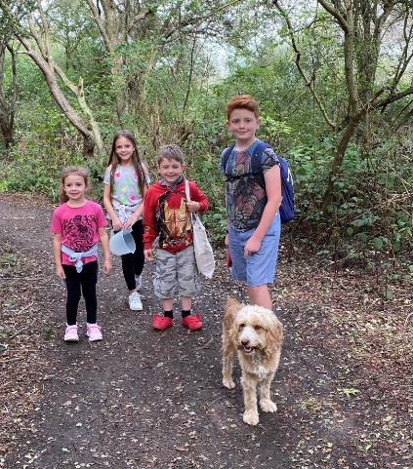
Anyone can be an explorer.
Be curious
Be passionate
Be determined
Be aware
Be mindful
Be safe
Be part of a team
Make a new discovery every day.

