Slide 1
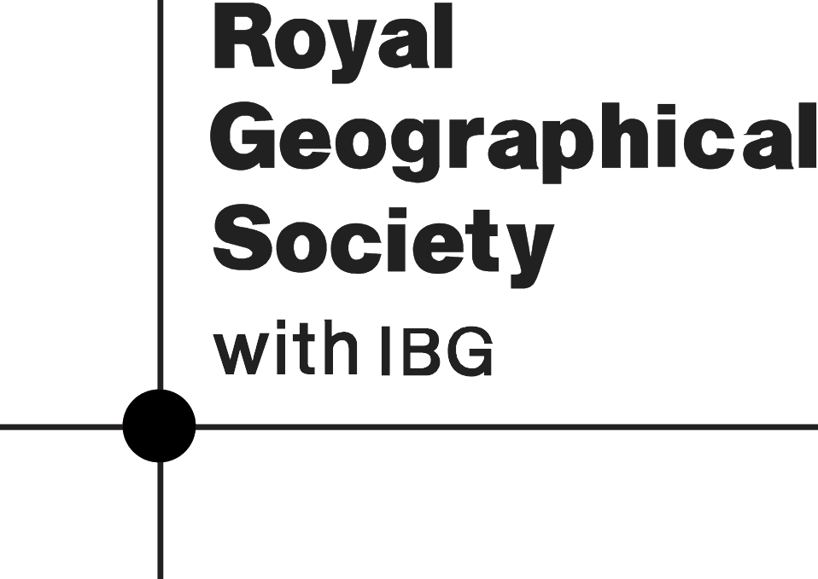





Geographical careers in the conservation sector
What is conservation? Conservation refers to the protect of plants, animals and habitats. It is about the management of land and access to natural resources. As species around the world are declining and habitats are being destroyed, conservation is more important now than ever. Working in the conservation sector means making a real-world impact to improving biodiversity and protect habitats.
Examples of conservation organisations that hire geographers include
Natural Resources Wales manages and protect the natural environment in Wales. Including its natural environment, including woodlands, rivers, wildlife and coastline.
National Trust cares for historic buildings, countryside and coastlines so they can be enjoyed by everyone now and in the future.
Wildlife Trust works to protect and restore wildlife and natural habitats across the UK.
RSPB focuses on protecting birds and the habitats they depend on.
Butterfly Conservation works to save butterflies, moths and the habitats they need to survive.
Bat Conservation Trust helps protect bats and improve the places where they live.
City of Trees plants and cares for trees in urban areas to create greener areas and healthier communities.
Woodland Trust protects ancient woodland and plants new trees to create more woods for people and wildlife.
Geographical Knowledge used in conservation
Understanding of UK landscapes and ecosystems, such as deciduous woodlands.
Understanding different species and adaptations of plants and animals that live in these ecosystems; how threats to ecosystems and how they are impacted by human activity; understanding how ecosystems can be managed to support habitats and biodiversity.
Understanding different types of habitats found in the UK such as wetlands, grasslands, saltmarsh, heathlands and lowlands.
Understanding of river and/or coastal landscapes and the impact that human activity has on these environments and how these landscapes can be managed sustainability
Geographical skills used in conservation
Fieldwork skills, including recording and collecting data in the field
Teamwork
Communication
Problem solving

Slide 2




Geographical careers in the conservation sector
Job Roles
Digital Communications Officer
Education Officer
Area Ranger
Expert Advisor
A Digital Communications Officer develops and manages the online presence of an organisation. This role involves being the voice of an organisation across digital platforms, creating engaging content for the website and social media (including Instagram, Youtube, LinkedIn and TikTok). A communications Officer helps raise awareness of conservation efforts to engage supporters and strengthen the organisation’s public image.
An Education Officer plays a key role in developing, managing, and delivering an organisation’s education work with children and young people. This includes designing and delivering educational programs, workshops, and outreach activities to schools and visitors. It involves creating learning materials that promote environmental awareness and conservation efforts to help the public understand the importance of biodiversity and habitat protection.
An Area Ranger is responsible for managing and improving habitats in a specified ecosystem, such as a woodland, sand dune or wetland. This may include planting trees, restoring micro-ecosystems like ponds or meadows and controlling invasive species populations. This may include monitoring the population of different species. It also includes ensuring an area is accessible to visitors so they can enjoy nature in a sustainable way.
An Expert Advisor provides expertise on how developments, such as offshore wind farms and coastal infrastructure, may affect different plants and animal species, and their habitats. It involves providing specialist scientific and geographical knowledge, and technical guidance which is used to plan projects and carry out research that will help protect habitats and increase biodiversity.
Salary: 20k to 33k per year
Salary 30 to 40k per year
Salary 26 to 30k per year
Salary 41 to 45k per year

Slide 3

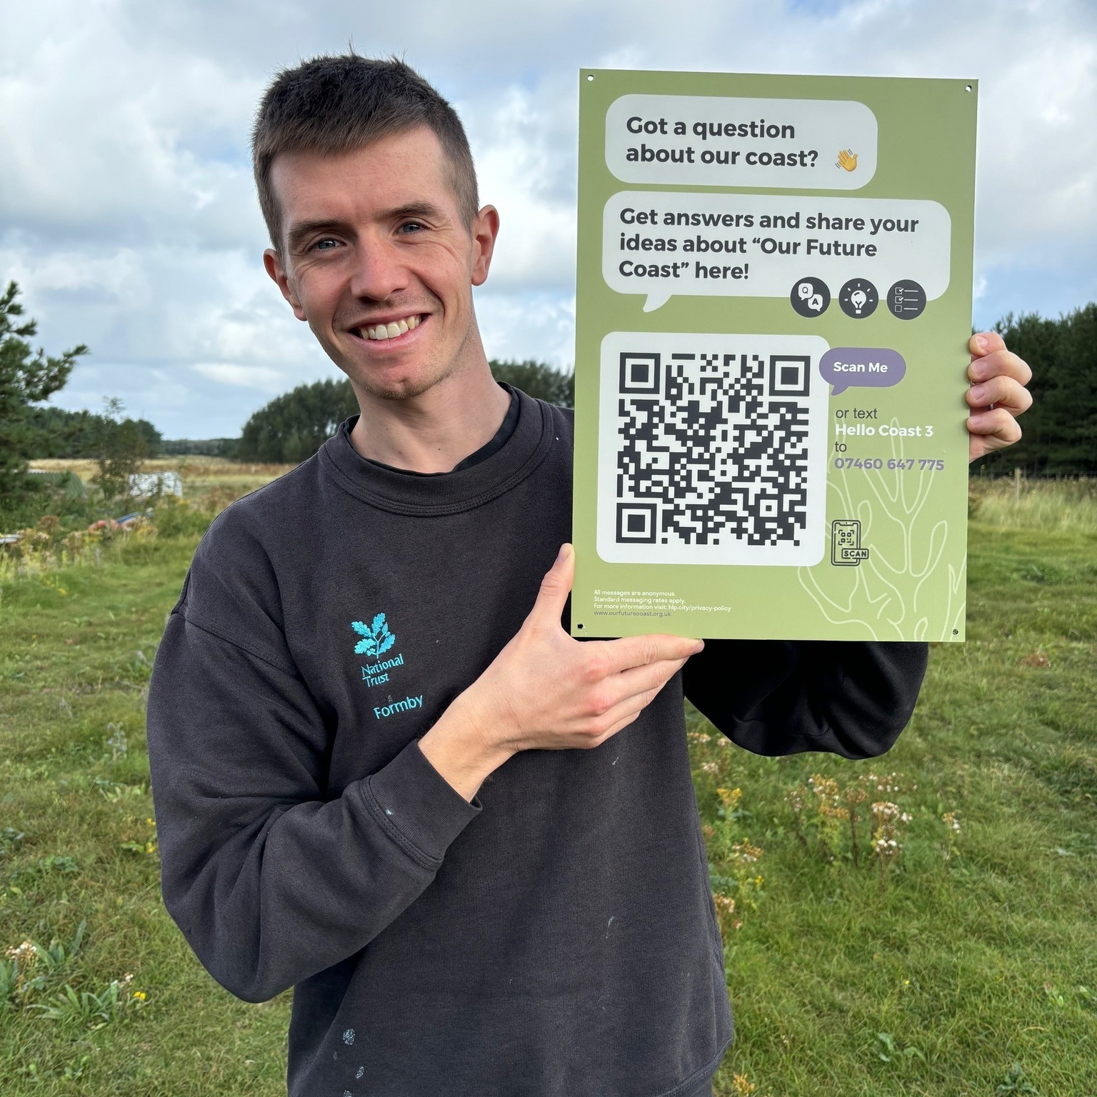
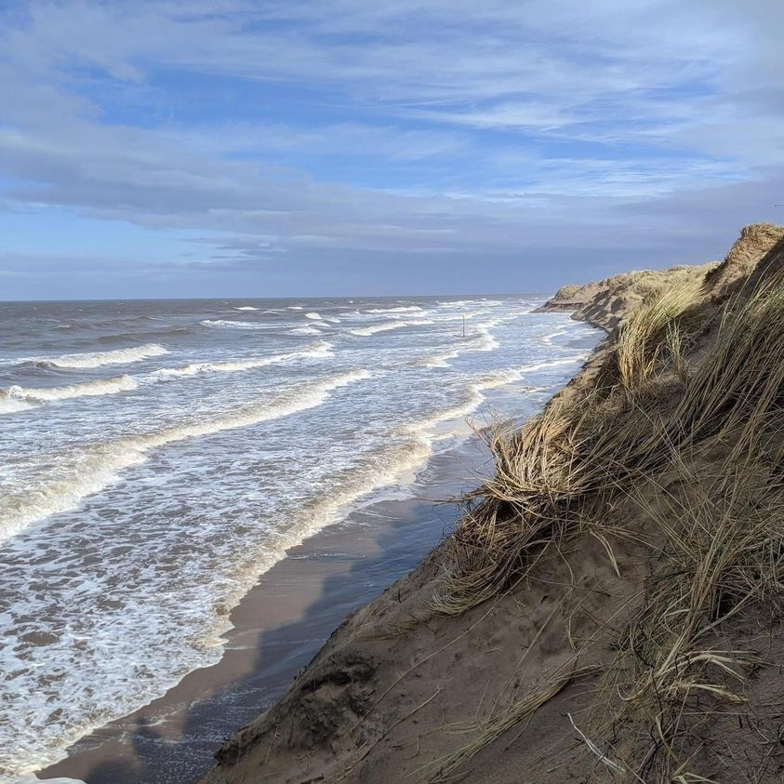
Geographical careers in the conservation sector
Meet the Geographer
Meet Chris
Chris is an Area Ranger for the National Trust Formby.
What is an Area Ranger?
I'm responsible for managing the ranger team, of which there's around five of us, and we are the people on the ground who deliver habitat conservation work and access improvements across the site. Our goal is to protect and conserve the habitats we have at Formby, ensuring not only that our rare species thrive, but that we enhance the whole site's biodiversity. Our focus is the sand dune habitat, as this is the most threatened and therefore of greatest priority. The majority of Formby, and the Sefton Coast, is a SSSI, which stands for Site of Special Scientific Interest, meaning it's protected by law in England. Our job is to preserve these habitats, ensuring the species they support are doing well, and at the same time aligning this with the impact of our visitors, allowing people to engage with nature on site and enjoy the benefits of being in green and blue space. My job is entirely focused at Formby because of its size, complexity, visitor numbers, and national and international habitat designations, but some rangers work across a number of different sites
What does a day-in-the life look like for you?
It's a mixture of office work and on-site work, and it's very seasonal. In the spring, we're doing a lot of access work and beginning our species monitoring, particularly with rare amphibians and reptiles that we have on site. We start this around April when they begin to emerge. More monitoring and surveying in the summer months, as well as grassland management, invasive species removal, and visitor engagement work. Then in the autumn and winter period we focus on woodland management, as this is outside of bird nesting season.
Why did you Choose Geography?
I loved geography at school and really enjoyed just learning about nature and the environment, so I went on to study A level geography after doing GCSE geography. It was never my best subject, but it was always something I loved learning about. I loved the field trips, the opportunity to be outdoors in beautiful spaces, and then I decided to pursue this interest at university, doing a BSc geography degree at the University of Leeds.

Slide 4
Geographical careers in the conservation sector Student Activity, page 1
Starter Activity
Using the careers information on the previous page, complete the following tasks
1. Circle the correct definition of conservation
a. Conservation involves isolating natural habitats from human activity b. Conservation involves protecting natural habitats and species c. Conservation involves clearing natural habitats for industrial development and economic growth
2. What is the difference between the National Trust and the Wildlife Trust
3. Circle the odd one out i. a) City for Trees b) Woodland Trust c) RSPB Explain
……………………………………………………………………………………………………………………………………………………………………………………………………………………………………………………………………………………
ii. a) Natural Resources Wales b) Butterfly Conservation c) Woodland Trust
Explain
…………………………………………………………………………………………………………………………………………………………………………………………………………………………………………………………………………………….
Comprehension Activity
Read Chris’s profile and answer the questions
What is the main habitat Chris works to help conserve a. beach b. salt marsh c. sand dune
If a habitat is labelled a triple SI, what does this mean? …………………………………………………………………………………………………………………………………………………………………………………………………………………………………………………………
Chris’s work is a mixture of office and site work True False
Describe how Chris’s work differs between the summer and winter season
Why did Chris Choose Geography? ……………………………………………………………………………………………………………………………………………………………………………………………………………………………………………………………………………………………………………………………………………………………………………………………………………………………………………………………………………………………………………………
5. Why did Chris Choose Geography?
……………………………………………………………………………………………………………………………………………………………………………………………………………………………………………………………………………………………………………………………………………………………………………………………………………………………………………………………………………………………………………………

Slide 5
Geographical careers in the conservation sector
Student Activity, page 2
Think like a Geographer Scenario – You are working on a project to restore an area of ancient deciduous woodland in Scotland. The woodland has a high population of deer and invasive grey squirrels; increasing the population of native red squirrels is a priority. Historically, the woodland has been threatened by deforestation for timber and demand for farmland. The woodland has a high number of visitors every year, and as a result a lot of the footpaths have been eroded and litter is an issue. What would your role be as a Communications Officer, Education Officer, Area Ranger and Expert Advisor in the restoration of the woodland? What geographical knowledge or skills might you use in each role to help tackle some challenges and threats the woodland is facing?
Digital Communications Officer
Education Officer
Area Ranger
Expert Advisor

Slide 6

Geographical careers in the conservation sector
Student Activity, page 3
Plenary
Rank the job roles from 1 to 4 . 1 represents the role that most appeals to you, 4 represents the role that least appeals. Justify your order.
Top tips for securing a job in the conservation sector
Conservation is a competitive industry! This means that there are lots of people that want a job in conservation, but there are not enough jobs to meet this demand.
Securing work experience or engaging in volunteering is essential to securing a job in conservation as this not only helps you understand more about the types of jobs you can do, but also proves you’re dedicated and committed to working in this sector.
Organisations like the Wildlife Trust offer lots of opportunities for young people. For example, Wildlife Trust London run a Keeping it Wild programme. This includes paid traineeships, workshops and a Youth Board. Gloucestershire Wildlife Trust offers young people the opportunity to become a Youth Ranger and Northumberland Wildlife Trust run Youth-Led Projects such as Eco Influencers. It’s worth researching what volunteering opportunities are available for young people across different conservation organisations to kick-start your conservation career journey. Your curiosity and willingness to learn will go a long way!
Digital Communications Officer
Education Officer
Area Ranger
Expert Advisor
This role appeals to me most because …
………………………………………………………………………………………………………………………………………………………………………………………………………………………………………………………………………………………………………………………………………………………………………………………………………………………………………………………
This role appeals to me least because …
………………………………………………………………………………………………………………………………………………………………………………………………………………………………………………………………………………………………………………………………………………………………………………………………………………………………………………………

