Slide 1
Don’t Panic: The Truth About Population
Learning Objective: To describe the changes to the population over time and explain the problems associated with this.
Starter: Answer the following questions in the back of your book using your own knowledge. Don’t worry if you are not sure - try to estimate.
What is the current population of the world?
How is the population of the world distributed?
Is the population of the world going to grow or shrink? Why?
Are there any problems associated with the size of the world’s population?
Challenge: How might these problems link to the SDGs?

Slide 2
Key terms
Birth rate: The number of births per year per 1000 people.
Death rate: The number of deaths per year per 1000 people.
Infant mortality rate: The number of children per year out of every 1000 born alive that die before they reach the age of one.
Life expectancy: The average number of years a person can expect to live.
Adult literacy rate: Number of adults who can read and write in every 1000 people.

Slide 3
Hans Rosling - Don’t Panic: The Truth About Population
Task: Complete the questions on your sheet as we watch a talk given by statistician Hans Rosling about the world’s population.
https://www.youtube.com/watch?v=FACK2knC08E
Notes:
The documentary is an hour long - it should take 2 single lessons
Link to questions: Hans Rosling - Don't Panic: The Truth About Population Questions

Slide 4
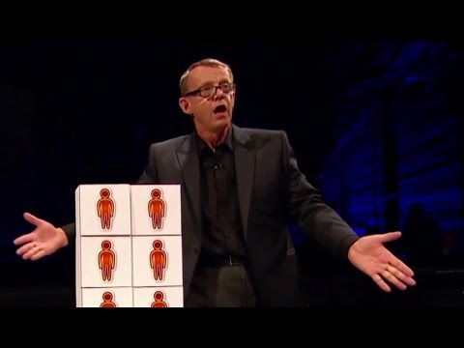

Slide 5
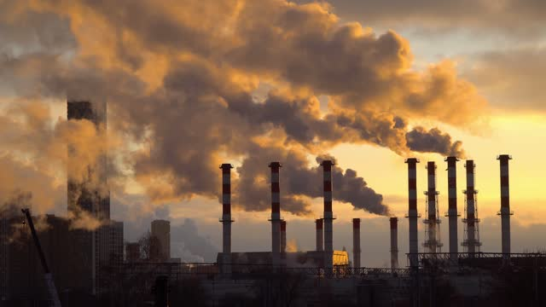
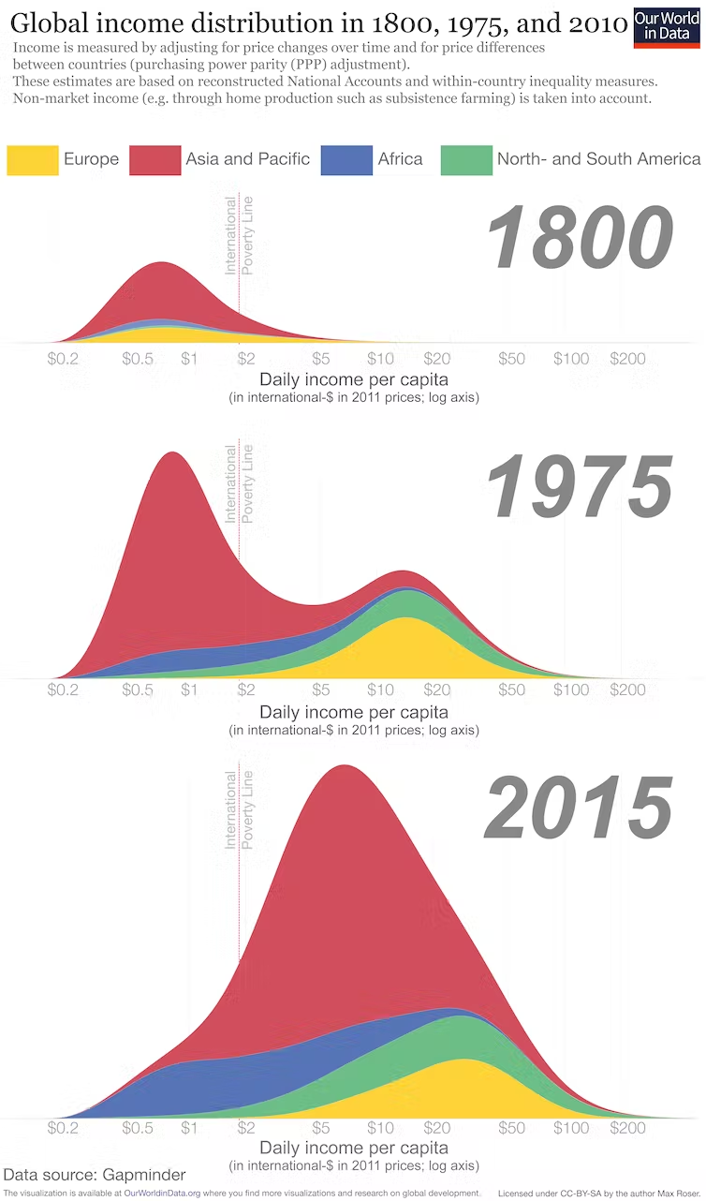
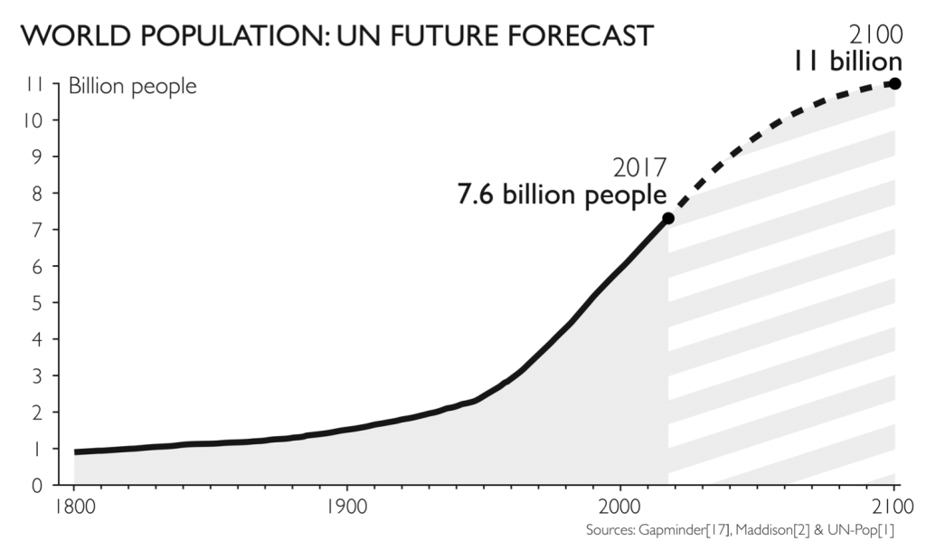
Do you agree with Hans Rosling’s positive outlook on the future of the world’s population? Why or why not?

Slide 6
Plenary
Return to your mind map of the global issues facing the world that you made last lesson. Draw lines between issues to exemplify the interdependence of them and explain how the issues link to one another.

