Slide 1
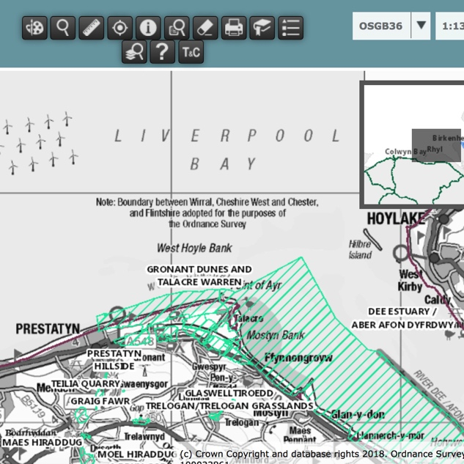
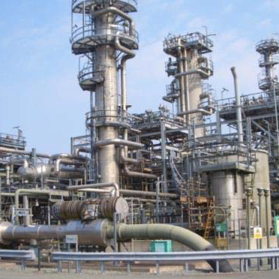
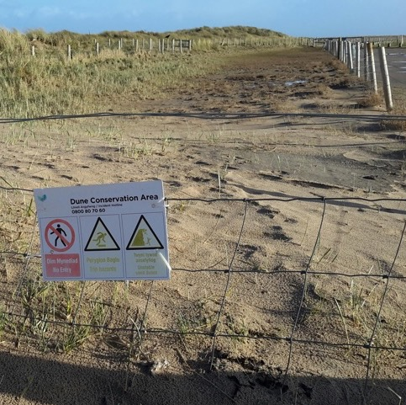
Integrating Professional River Study Techniques into School Fieldwork
Project 3:
Competing Human Interests in Coastal Areas
Notes:
Images:
(left) Screen grab of UK Magic Map showing SSSIs around Point of Ayr (www.natureonthemap.naturalengland.org.uk/magicmap.aspx)
(centre) Point of Ayr Gas Terminal. Image courtesy of Environmental Resource Management (ERM)
(right) Dune management. Image courtesy of RGS-IBG. Image licence: CC-BY-SA 4.0

Slide 2
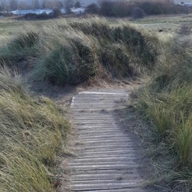
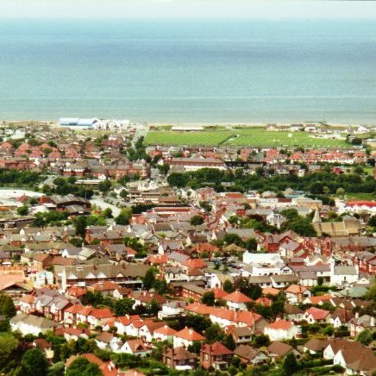
Background & Introduction
Coastal areas are often under intense pressure from varying human interests
Environmental protection
Industry (heavy & light; local, national, & multinational)
Business (small & large; local, national & multinational)
Local communities & associated services
Tourism
Managing competing interests is difficult, and highly dependent on the social, economic, and political climate at local, regional, and national levels
Human and coastal pressures change over time
Mitigation measures can be put in place to alleviate issues
Climate change has potential future implications (e.g., flooding, rising sea level, extreme weather)
Notes:
Images:
(left) Prestatyn, Image by Graham Horn (http://www.geograph.org.uk/photo/724208). Image licence: CC-BY 2.0
(top right) Dune management at the popular tourist and leisure site of Gronant and Talacre Dunes. Images courtesy of RGS-IBG. Image licence: CC-BY-SA 4.0
(bottom right) Point of Ayr Gas Terminal. Image courtesy of Environmental Resource Management (ERM)

Slide 3
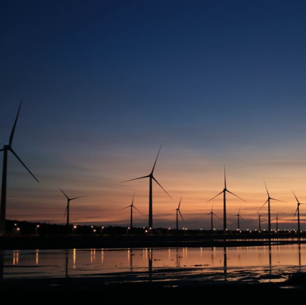
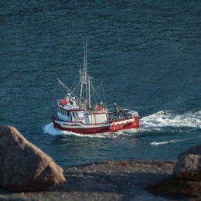
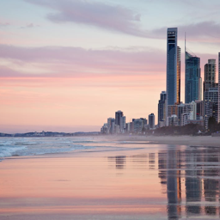
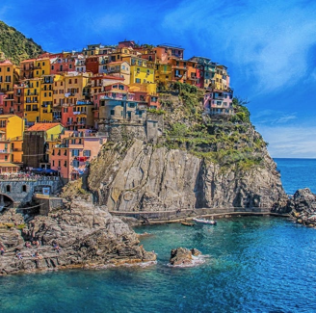
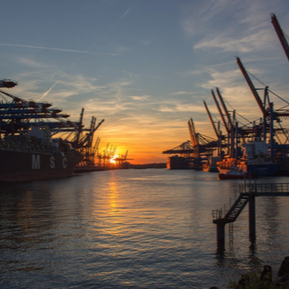
‘Real-world’ Examples
Coastal conflicts arising from competing interests and pressures are evident at different scales along most populated coastlines
On-going legal battles in California, where public access to beaches is enshrined in law, but access routes to the coastline often cross private property
Coastal development in areas with high population densities and high tourist numbers. For example, along the Gulf of Maine, where issues around population change, property values, and natural coastal processes involve a variety of management options (e.g., integrated management, land-use planning, conservation)
Notes:
Images:
- Pexels.com (stock photography with a CC0 licence)
Links to examples:
https://www.theguardian.com/environment/2018/feb/23/martins-beach-california-vinod-khosla
http://www.gulfofmaine.org/2/wp-content/uploads/2014/03/coastal-land-use-theme-paper.pdf

Slide 4
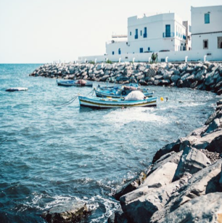
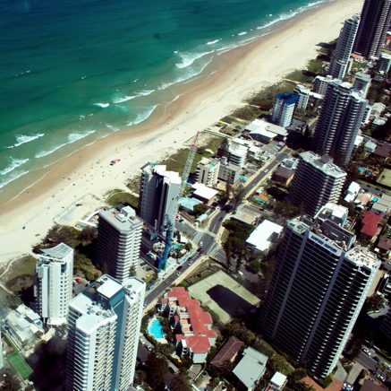
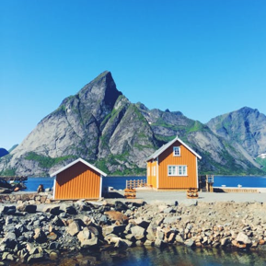
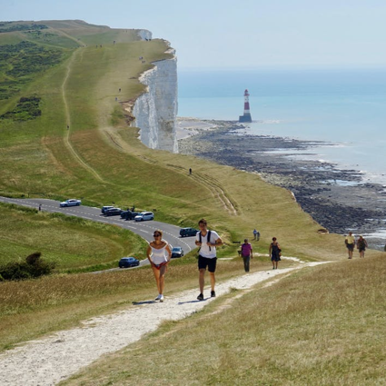
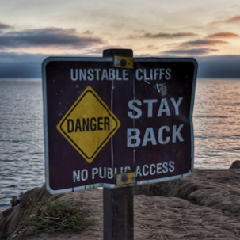
Pre-Fieldwork Activities
Research Questions & Hypotheses
Research should be framed around scientific questions & hypotheses
For example:
Number of competing coastal pressures as a function of population density
Differences in coastal management approaches from different stakeholders (e.g., big industry vs. local residents vs. local government).
Notes:
Images:
(all) Pexels.com (stock photography with a CC0 licence)

Slide 5
Pre-Fieldwork Activities
Site Selection
Coastal areas hosting competing human interests
For example, sites containing two or more of the following:
Residential areas
Commercial areas
Tourist attractions & facilities
Industrial sites
Protected areas (e.g., SSSIs, historical sites, cultural sites)

Slide 6
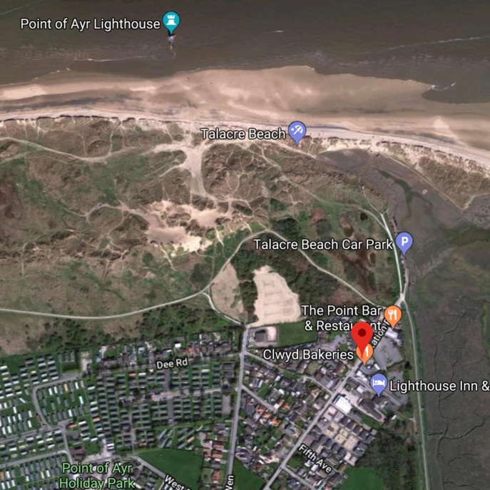
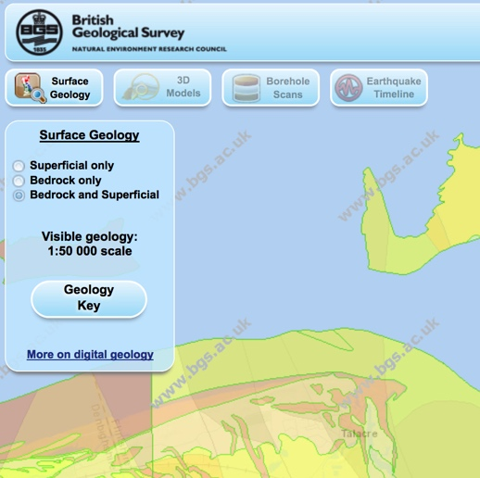
Pre-Fieldwork Activities
Metadata: Cartography
Use maps to identify:
Local and regional scale coastal morphology
Geological setting and impacts on coastal evolution
Proximal natural features/processes
Types of land use and human infrastructure
Land use change over time
For example:
Location on global and UK scale maps (political and topographical)
Current and past Ordnance Survey maps
Geological map of the study area
Current and past aerial /satellite images
Maps of designated (i.e., protected) areas in and around the field area
Environment Agency coastal erosion maps of target areas
Notes:
Images:
(top) Google Maps screen grab (Talacre & Point of Ayr)
(bottom) Screen grab from British Geological Survey (BGS) Geology of Britain geological map (http://mapapps.bgs.ac.uk/geologyofbritain3d/index.html)

Slide 7
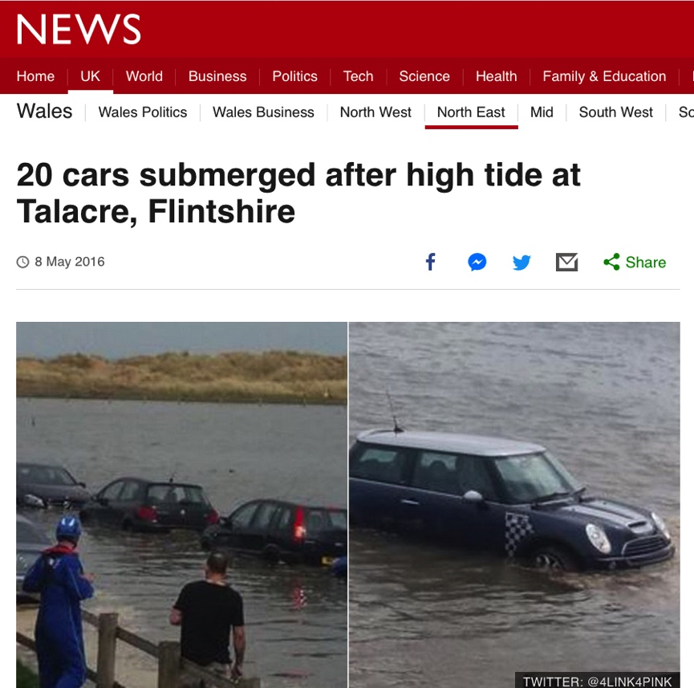
Pre-Fieldwork Activities
Metadata: Other Secondary Data Sources
Environment Agency records and information
Tidal records
Flood risk maps
Media reports
Planning applications
Local guides and publications
e.g., Press coverage of local coastal flooding
Notes:
Images:
- Screen grab of 2016 BBC report on a tidal flooding event at Talacre (http://www.bbc.co.uk/news/uk-wales-north-east-wales-36243086)

Slide 8
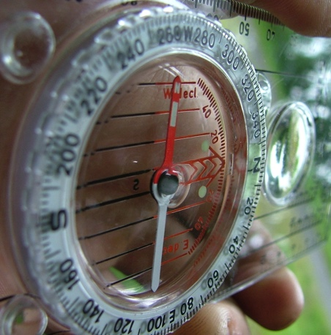
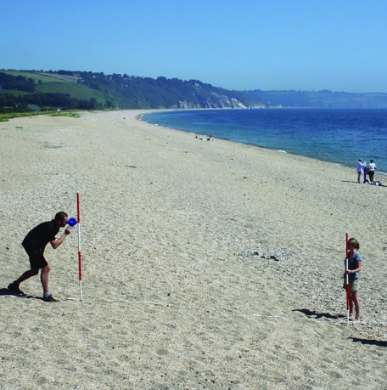
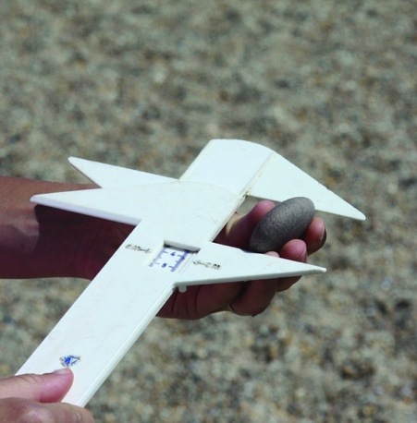
Pre-Fieldwork Activities
Research Techniques
No ‘one size fits all’
Dependent on field area/ field sites
Dependent on features & processes to measure
Dependent on research questions and hypotheses
Dependent on spatial and temporal scales of study
Dependent on available resources (i.e., time, money, expertise)
https://www.rgs.org/schools/teaching-resources/sampling-techniques/
Notes:
Images:
(left) (left) Silva Expedition 4 compass-clinometer (https://en.wikipedia.org/wiki/Silva_compass#/media/File:Silva_compass,_Expedition_4.jpg). Image licence: CC-BY-SA 3.0
(centre) Measuring gradient by the Field Studies Council (https://www.geography-fieldwork.org/a-level/coasts/coastal-management/method/). Image licence: CC_BY
(right) Using callipers to measure the a, b and c axes of a pebble by the Field Studies Council (https://www.geography-fieldwork.org/a-level/coasts/coastal-management/method/). Image licence: CC_BY

Slide 9
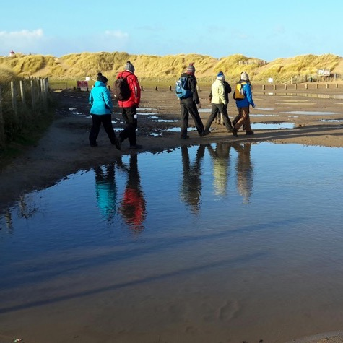
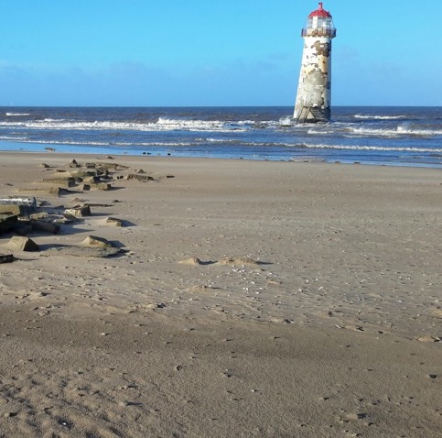
Pre-Fieldwork Activities
Logistical Planning
Field Plan
Dependent on time available
Dependent on number of sites & transit times
Dependent on number of team members
Dependent on data collection techniques
Mitigate impacts of activities on the local environment and habitats, particularly in protected areas (e.g., SSSIs); for example, keep to established paths
Notes:
Images:
(left) Pexels.com (stock photography with a CC0 licence)
(centre) Talacre Beach Lighthouse. Image courtesy of Tornillo Scientific. Image licence: CC-BY-SA 4.0
(right) Group cross flooded car park at Gronant and Talacre Dunes. Images courtesy of RGS-IBG. Image licence: CC-BY-SA 4.0

Slide 10
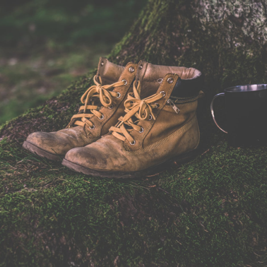
Pre-Fieldwork Activities
Logistical Planning
Field Kit (Universal)
Clothing (long trousers, long sleeves, wet weather gear, boots)
Field note book
Charged mobile phone
GPS device
Camera
Sharpened pencils
First aid kit
Field Kit (Fieldwork Specific)
Research equipment (e.g., metre ruler, callipers, etc.)
Notes:
Images:
(all) Pexels.com (stock photography with a CC0 licence)

Slide 11
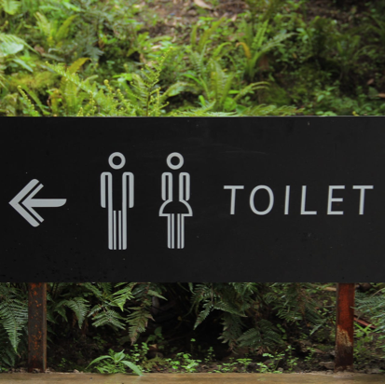
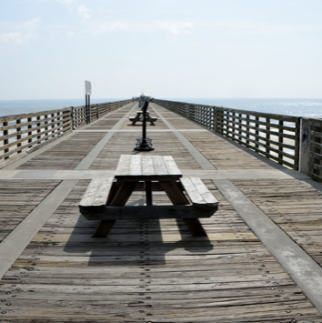
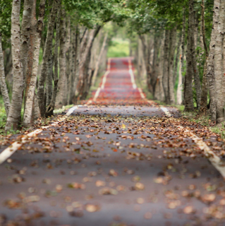
Pre-Fieldwork Activities
Logistical Planning
Site Practicalities
Parking (incl. bus parking)
Toilets
Picnic sites
Shops & cafes
Field centres & visitor centres
Accessibility (roads, foot paths, etc.)
Nearest A&E Department
Notes:
Images:
(all) Pexels.com (stock photography with a CC0 licence)

Slide 12
Comparative Study of River Regimes Pre-Fieldwork Activities
Products of an evolving planet
Pre-Fieldwork Activities
Logistical Planning
Risk Assessment
Hazard Control Measures Residual Risk
Working near tidal water
Uneven / unstable ground
Biological hazards (dogs, etc.).
Coastal waters will not be entered. Tide schedules consulted before visit. Maintain vigilance. Carry charged mobile phone.
Keep to flat areas; walk with care; ……. etc.
Coastal areas popular with dog walkers. Take precautions around unknown animals (i.e., don't pet dogs without owners’ permission).
MEDIUM
LOW
LOW
https://www.rgs.org/in-the-field/fieldwork-in-schools/fieldwork-safety-and-planning/risk-assessments/
Notes:
Example of factors to consider (NOT exhaustive)

Slide 13
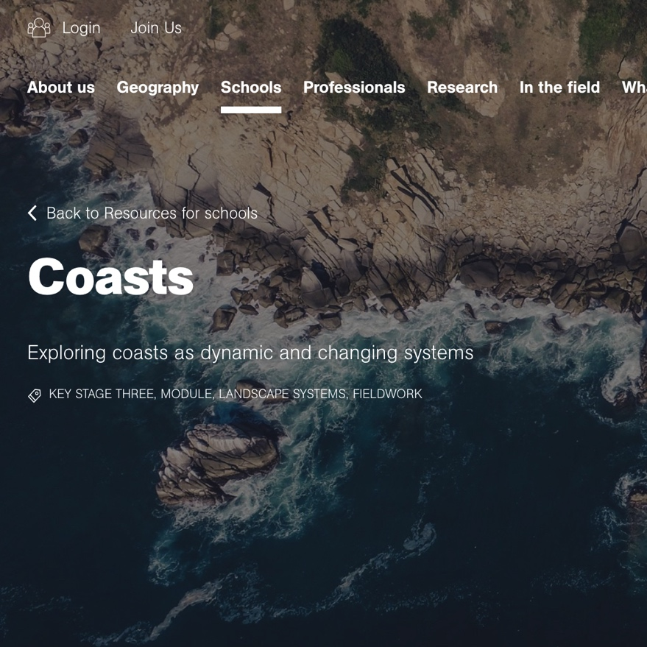
Pre-Fieldwork Activities
Logistical Planning
Other Resources
https://www.rgs.org/schools/teaching-resources/a-student-guide-to-the-a-level-independent-investi/
https://www.rgs.org/schools/teaching-resources/coasts/
https://www.rgs.org/schools/teaching-resources/coastal-processes-and-management/
https://www.rgs.org/schools/teaching-resources/coasts/planning-coastal-fieldwork/
https://www.geography-fieldwork.org/a-level/coasts/coastal-management/method/
Notes:
Image:
- Screen grab from RGS-IBG website (https://www.rgs.org/schools/teaching-resources/coasts/)

Slide 14
Comparative Study of River Regimes Data Collection Technique
Products of an evolving planet
Data Collection Technique
Field Notebook
Critical fieldwork aspect
Record of sites, activities, & data
For professionals, field notebook can be a legal document
Date, time, weather conditions, investigator mood
Name of field site, GPS waypoint name, co-ordinates
Brief site description (e.g., land use, human infrastructure, natural features & processes, vegetation, areas of vulnerability [e.g., erosion, pollution], areas of competing interest, other relevant observations)
Site sketch
Record of methods & collected data

Slide 15
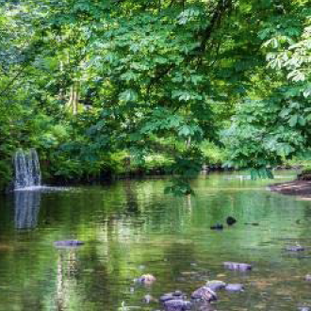
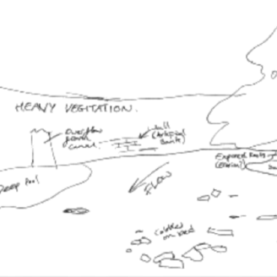
Comparative Study of River Regimes Data Collection Technique
Products of an evolving planet
Data Collection Technique
Field Notebook
Site Sketch Good Practice
Include major features
Sense of scale and spatial distribution of features
Notes:
Images:
- (both) Images courtesy of Environmental Resource Management (ERM)

Slide 16
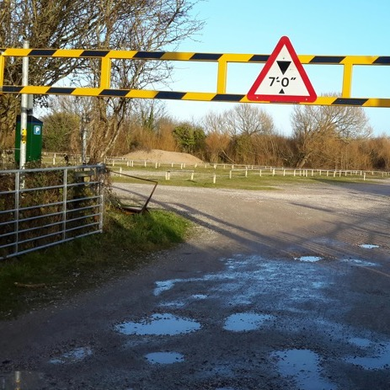
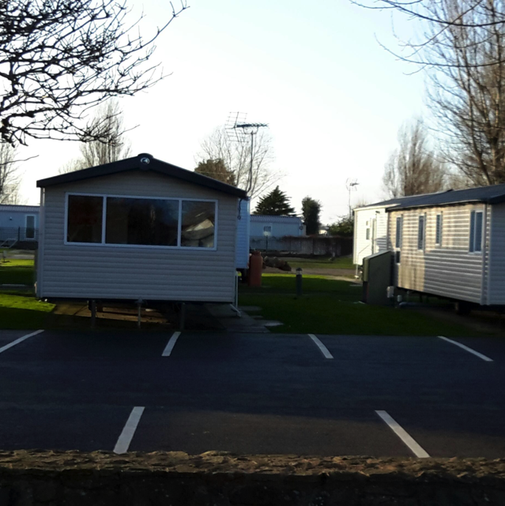
Data Collection Technique
Qualitative Observations
What is Measured?
Visual observations of the main stakeholders, processes, and competing pressures
Notes:
Images:
(top left) Point of Ayr Gas Terminal. Image courtesy of Environmental Resource Management (ERM)
(bottom left) ) Dune management at Gronant and Talacre Dunes. Images courtesy of RGS-IBG. Image licence: CC-BY-SA 4.0
(top right) New Talacre Dunes car park. Images courtesy of RGS-IBG. Image licence: CC-BY-SA 4.0
(bottom right) Talacre holiday park. Images courtesy of RGS-IBG. Image licence: CC-BY-SA 4.0
(far right) Prestatyn, Image by Graham Horn (http://www.geograph.org.uk/photo/724208). Image licence: CC-BY 2.0

Slide 17
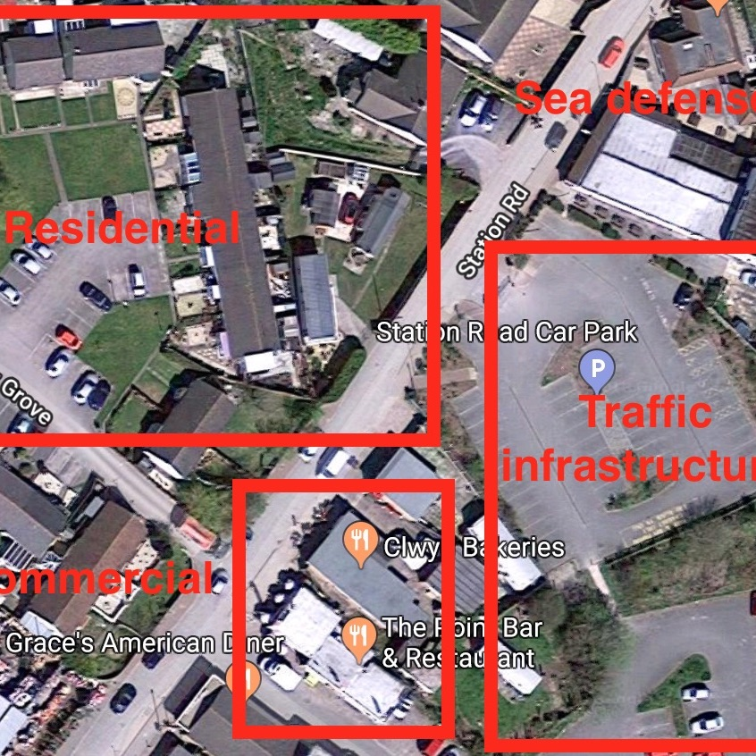
Data Collection Technique
Land Use Mapping
What is Measured?
Residential infrastructure (e.g., houses, apartments)
Community facilities (e.g., hospitals, police, post office, doctors, water treatment plants, etc.)
Commercial infrastructure (e.g., shops & businesses)
Agricultural land & other green spaces
Industrial sites
Transport infrastructure (e.g., motorways, A and B roads, railways)
Coastal features (natural features, defence infrastructure, etc.)
Protected land (e.g., designated sites of scientific, ecological, cultural, or historical importance)
Data collection from fieldwork only, or from aerial/satellite images supported by field-based ground-truthing
Report data in terms of total area (m²) or total number of units (e.g., number of houses)
Notes:
Images:
- Annotated Google Maps screen grab of Talacre

Slide 18
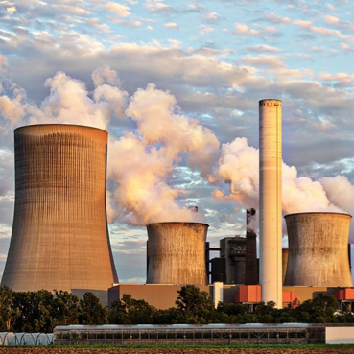
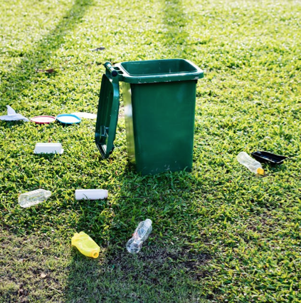
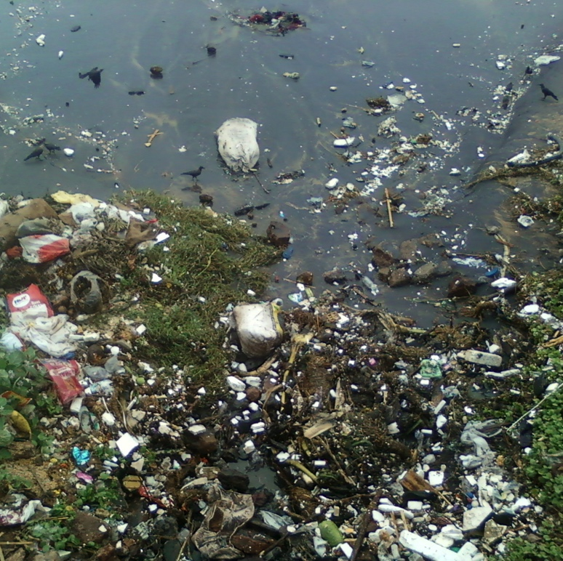
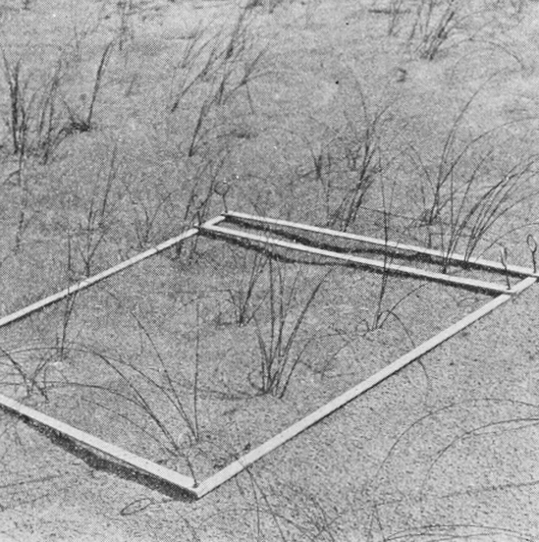
Data Collection Technique
Litter & Pollution Survey
What is Measured?
Amount of litter (or other pollution type) per a chosen unit area (e.g., quadrat)
Record of pollution hot spots (e.g., noise pollution, atmospheric pollution, water pollution; where possible, measure or estimate area of impact
Notes:
Images:
(top) Pexels.com (stock photography with a CC0 licence)
(bottom right) Quadrat from Popular Science Monthly Volume 80 1921 (Public domain, via Wikimedia Commons
(bottom left) Water pollution by Adityamadhav83. Image licence: CC BY-SA, from Wikimedia Commons

Slide 19
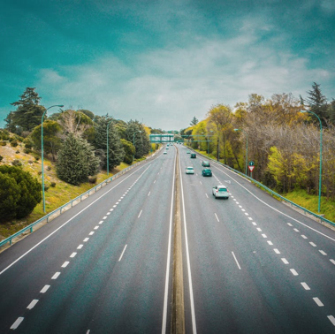
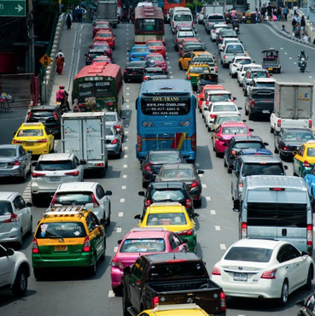
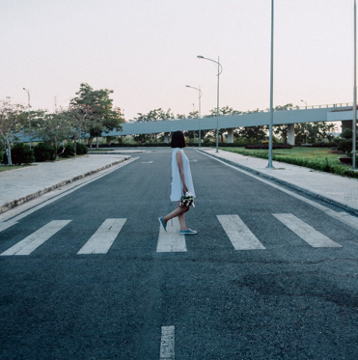
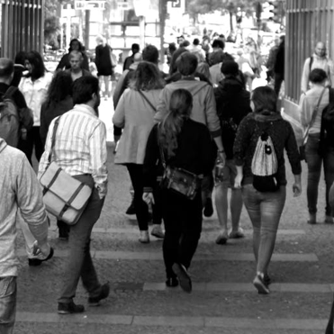
Data Collection Technique
Traffic & Pedestrian Surveys
What is Measured?
Number of pedestrians passing a given point in a given timespan
Number of vehicles passing a given point in a given timespan
Make careful note of time-of-day and weather conditions
Notes:
Images:
(all) Pexels.com (stock photography with a CC0 licence)

Slide 20
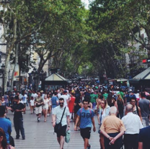
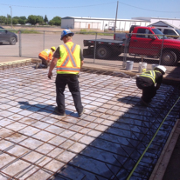
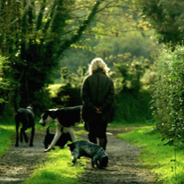
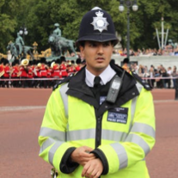
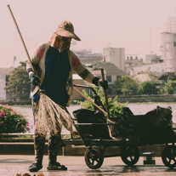
Data Collection Technique
Questionnaires
What is Measured?
Viewpoints of different stakeholders (e.g., residents, businesses, tourists, etc.) with regards to competing interests in coastal areas
Possible focus could include: population pressures, infrastructure, transport issues, pollution, economic situation, future hopes, etc.
Before performing questionnaires, carefully consider the ethical responsibilities of social science research
Notes:
Images:
- Pixabey.com & Pexels.com (stock photography with a CC0 licence)

Slide 21
Data Collection Technique
Competing Human Interests
Site Requirements
Coastal locations with different stakeholders or processes providing competing pressures
Equipment & Costs
Tape measure (low cost) or GPS-enabled device (high cost) for land use mapping
Stopwatch (low cost) for traffic & pedestrian surveys
Quadrat (litter surveys; low cost)
Notebook & pencil
Notes:
Images:
(all) Pexels.com (stock photography with a CC0 licence)

Slide 22
Data Collection Technique
Competing Human Interests
Data Resolution Needs
Land use inventories: for small sites all features should be recorded (e.g., total number of houses [or area covered by residential buildings])
Traffic & pedestrian surveys: at least 5–10 minutes, repeated at different times of the day (at the very least, consideration of time-of-day should be made clear when presenting results)
For suitable variables, repeat measurements should be taken so that average (either mean or median) and indicators of data spread (e.g., standard deviation) can be calculated
Professional Measurement Techniques
Similar data to those collected here
Basic field site observations
Secondary data to identify key features (e.g., maps, management reports, etc.)

Slide 23
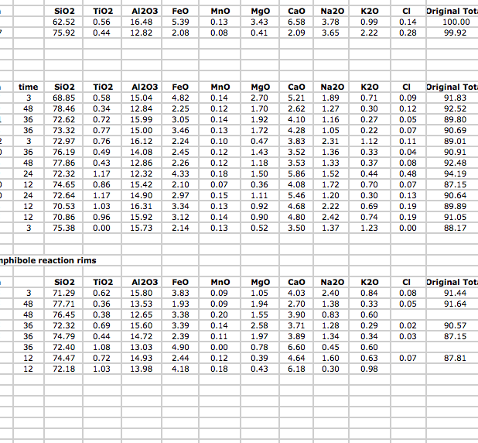
Post-Fieldwork Activities
Data Organisation & Input
For professionals, fieldwork is only the start
Post-fieldwork activities are the longest part of any project
The first step is data organisation and management
Transfer field data to computer or tablet
Consider storage options (e.g., Microsoft Excel, ArcGIS, Google Earth)
For groups, develop data management plan & sharing facilities (e.g., Google Drive, Dropbox)
Notes:
Images:
(left) Microsoft excel screen grab
(right) Screen grab of Dropbox homepage (https://www.dropbox.com/?landing=dbv2)

Slide 24
Post-Fieldwork Activities
Data Analysis & Interpretation
Appropriate use of:
Statistical techniques (e.g., data averaging, data spread, etc.)
Chart types and tables
Spatial analysis (e.g., ArcGIS, which is freely available to UK schools)
Interpretation and analysis should:
Reflect and be supported by the data
Compare and contrast different sites
Consider the results of similar studies & compare data with available secondary data sources
Return to original scientific questions and hypotheses
Consider how results would change under different conditions (e.g., changing seasons, after a storm event)
Consider how results may change in the future (e.g., impacts of climate change)
Data limitations should be considered and clearly presented

Slide 25
Post-Fieldwork Activities
Data Analysis & Interpretation
Using data collected in the field and additional metadata:
Create a network showing the interconnections between stakeholders, pressures, and processes
Consider how coastal pressures have changed with time
Consider how coastal pressures may change in the future (e.g., with climate change, rising sea level, population change, coastal development, etc.)

Slide 26
Comparative Study of River Regimes Post-Fieldwork Activities
Products of an evolving planet
Post-Fieldwork Activities
Data Reporting & Sharing
Data sharing and open access is required for some professionals
For others, data sharing is restricted to paid clients
Data sharing & reporting must consider the needs of the audience
Can include written reports, oral presentations, graphical representations
Present at ‘conferences’, where different teams present concurrently using posters or talks
To reach a broader audience:
Webpage creation
Social media & blogging
Citizen science platforms
Notes:
Images:
(all) Pexels.com (stock photography with a CC0 licence)

Slide 27
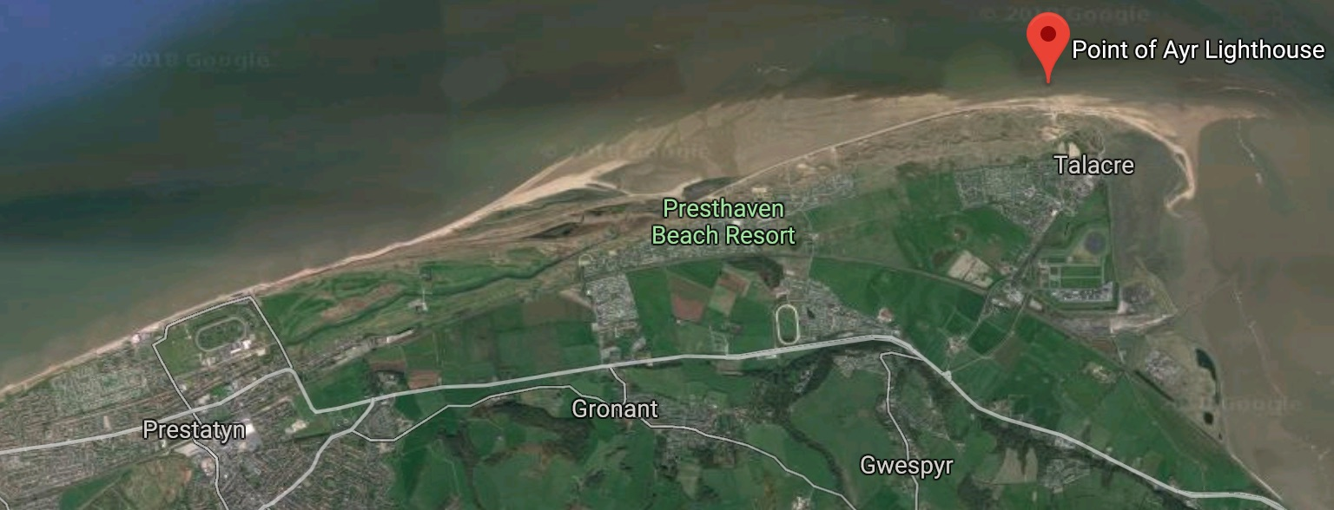
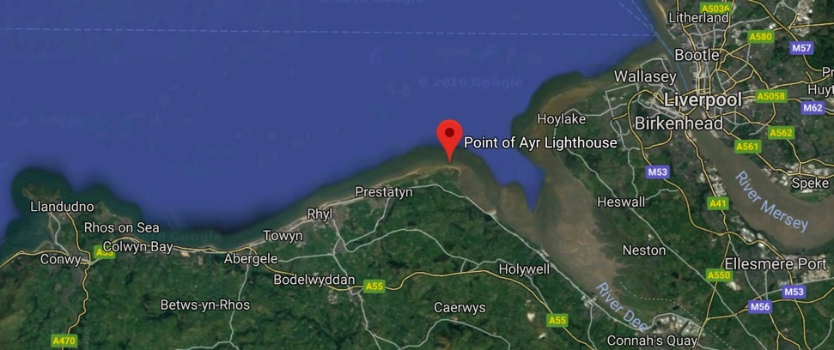
Case Study
Point of Ayr, North Wales
North-easterly most point of Wales
High-energy sandy coastline meets the low energy Dee Estuary
Notes:
Image:
- (all) Google Maps screen grabs (Northeast Wales & Point of Ayr)

Slide 28
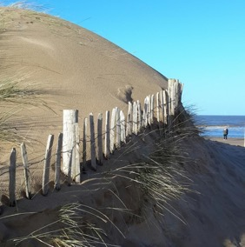
Case Study
Point of Ayr, North Wales
Multiple competing interests
Environment
(Wildlife, dunes & SSSIs)
Industry
(ENI Point of Ayr Gas Terminal)
Notes:
Images:
(top left) Dune management. Image courtesy of RGS-IBG. Image licence: CC-BY-SA 4.0
(bottom left) Natterjack toad. Image by Bernard Dupont (https://www.flickr.com/photos/berniedup/40768303714). Image licence: CC-BY-SA 2.0
(Centre) Screen grab of UK Magic Map showing SSSIs around Point of Ayr (www.natureonthemap.naturalengland.org.uk/magicmap.aspx)
(right) Point of Ayr Gas Terminal. Image courtesy of Environmental Resource Management (ERM)

Slide 29
Case Study
Point of Ayr, North Wales
Multiple competing interests
Local residents
(Talacre village/ Prestatyn town)
Tourists
(Talacre holiday park)
Notes:
Images:
(left) Prestatyn, Image by Graham Horn (http://www.geograph.org.uk/photo/724208). Image licence: CC-BY 2.0
(centre & right) Talacre holiday park. Images courtesy of RGS-IBG. Image licence: CC-BY-SA 4.0

Slide 30
Case Study
Point of Ayr, North Wales
Gronant and Talacre Dunes (53°21'18.5"N 3°19'02.7"W)
Coastal dune and salt marsh with important coastal protection function
Almost only natural coastline between Dee Estuary and Great Orme
Above gas pipeline from offshore fields to Point of Ayr Gas Terminal
Historical (foundations of chalets to house WW2 evacuees still visible)
SSSI designated for dune system habitats
Popular holiday and leisure location
Notes:
Images:
(left) Gronant & Talacre Dunes. Image courtesy of RGS-IBG. Image licence: CC-BY-SA 4.0
(centre and right) Google Maps screen grabs (Gronant and Talacre Dunes at 53°21'18.5"N 3°19'02.7"W)

Slide 31
Case Study
Point of Ayr, North Wales
Gronant and Talacre Dunes (53°21'18.5"N 3°19'02.7"W)
Under active management to:
Species re-introduction
(e.g., natterjack toad)
Encourage sand accretion
Control visitor pressure
Pathways to focus human traffic
Gradual reduction of dune-based parking lot
Novel dune stabilization methods (e.g., old Christmas trees)
Notes:
Images:
(right-side cluster) Active management (pathways, flooded car park, car park blocked off for regeneration). Images courtesy of RGS-IBG. Image licence: CC-BY-SA 4.0
(centre) Natterjack toad. Image by Bernard Dupont (https://www.flickr.com/photos/berniedup/40768303714). Image licence: CC-BY-SA 2.0
(left) Dune stabilisation for sand accretion. Images courtesy of RGS-IBG. Image licence: CC-BY-SA 4.0

Slide 32
Case Study
Point of Ayr, North Wales
Talacre Holiday Park and Village (53°21'02.2"N 3°19'19.6”W)
Holiday caravan park with a variety of services
Adjacent village providing additional services to tourists
Residential areas for long-term residents
Direct access to Gronant and Talacre Dunes and the beach
Active management to relieve pressure (e.g., dune regeneration of current car park, development of new parking facilities
Close proximity to Point of Ayr Gas Terminal
Notes:
Images:
(left & second left) Facilities at Talacre Beach Holiday Village. Images courtesy of RGS-IBG. Image licence: CC-BY-SA 4.0
(centre left and centre right) Google Maps screen grabs (Talacre Holiday Park and Village at 53°21'02.2"N 3°19'19.6”W)
(top right) Old car park gradually blocked off for dune regeneration. Image courtesy of RGS-IBG. Image licence: CC-BY-SA 4.0
(bottom right) New Talacre Dunes car park. Image courtesy of RGS-IBG. Image licence: CC-BY-SA 4.0

Slide 33
Case Study
Point of Ayr, North Wales
Prestatyn Town (53°20'30.3"N 3°24'54.5"W)
Denbighshire coastal town between Talacre and Rhyl
Significant commercial, residential, and tourism infrastructure
Heavily engineered coastline (e.g., groynes, sea walls, rock armour, flood gates, introduction of new beach material)
History of pluvial flooding from heavy rain / surface runoff
With changing climate, risk of flooding is increasing
Notes:
Images:
(left & second to left) Google Maps screen grabs (Prestatyn Sea Defences at 53°20'30.3"N 3°24'54.5"W)
(top right) Sea wall at Prestatyn. Image courtesy of RGS-IBG. Image licence: CC-BY-SA 4.0
(bottom right) Rock armour at Prestatyn. Image courtesy of RGS-IBG. Image licence: CC-BY-SA 4.0

Slide 34
Case Study
Point of Ayr, North Wales
Gas Colliery Quay Wall and Revetment (53°20'40.0"N 3°18'37.6"W)
South (quay wall) and east (revetment) of former colliery site
Quay wall: ~220 m long / Revetment: 10-m wide rock armour
Hard coastal engineering protects industrial & residential areas
Surrounded by protected habitats (SSSIs) and used for leisure
Actively managed by Point of Ayr Gas Terminal
Notes:
Images:
(left & second to left) Google Maps screen grabs (Gas Colliery Quay Wall and Revetment at 53°20'40.0"N 3°18'37.6"W)
(second to right) Pathway used for leisure by tourists and local residents. Image courtesy of RGS-IBG. Image licence: CC-BY-SA 4.0
(top right) Property protected by raised coastal defence. Image courtesy of RGS-IBG. Image licence: CC-BY-SA 4.0
(bottom right) Pumping station to manage flood water. Image courtesy of RGS-IBG. Image licence: CC-BY-SA 4.0

