Slide 1
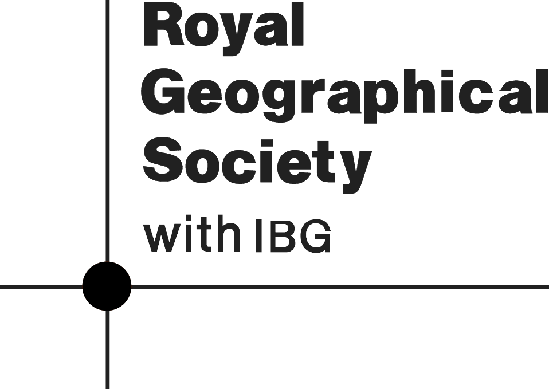
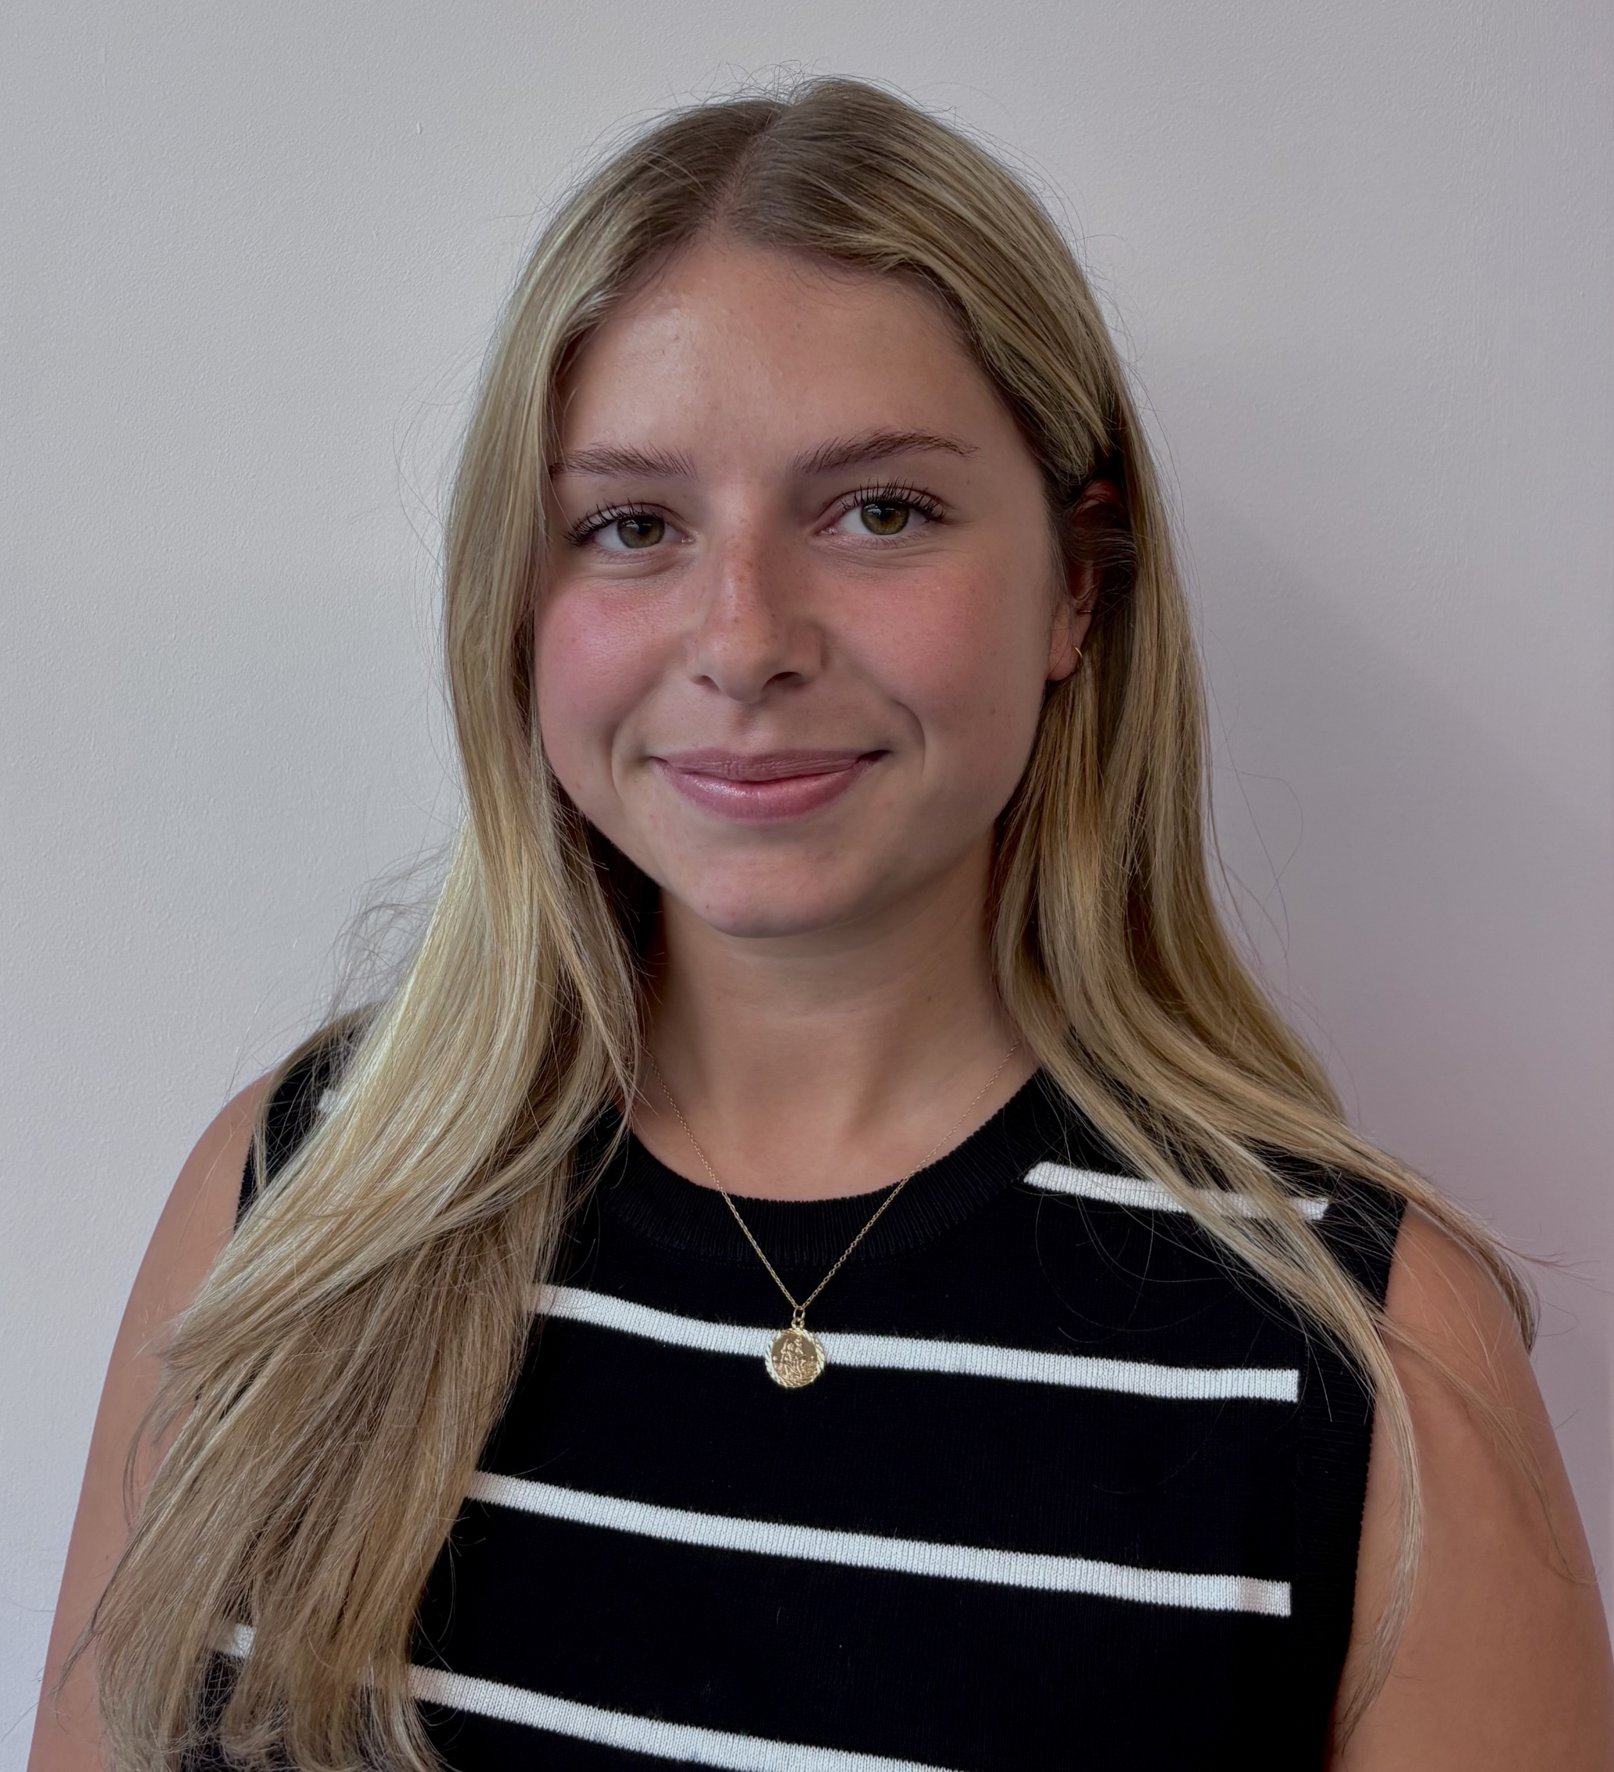
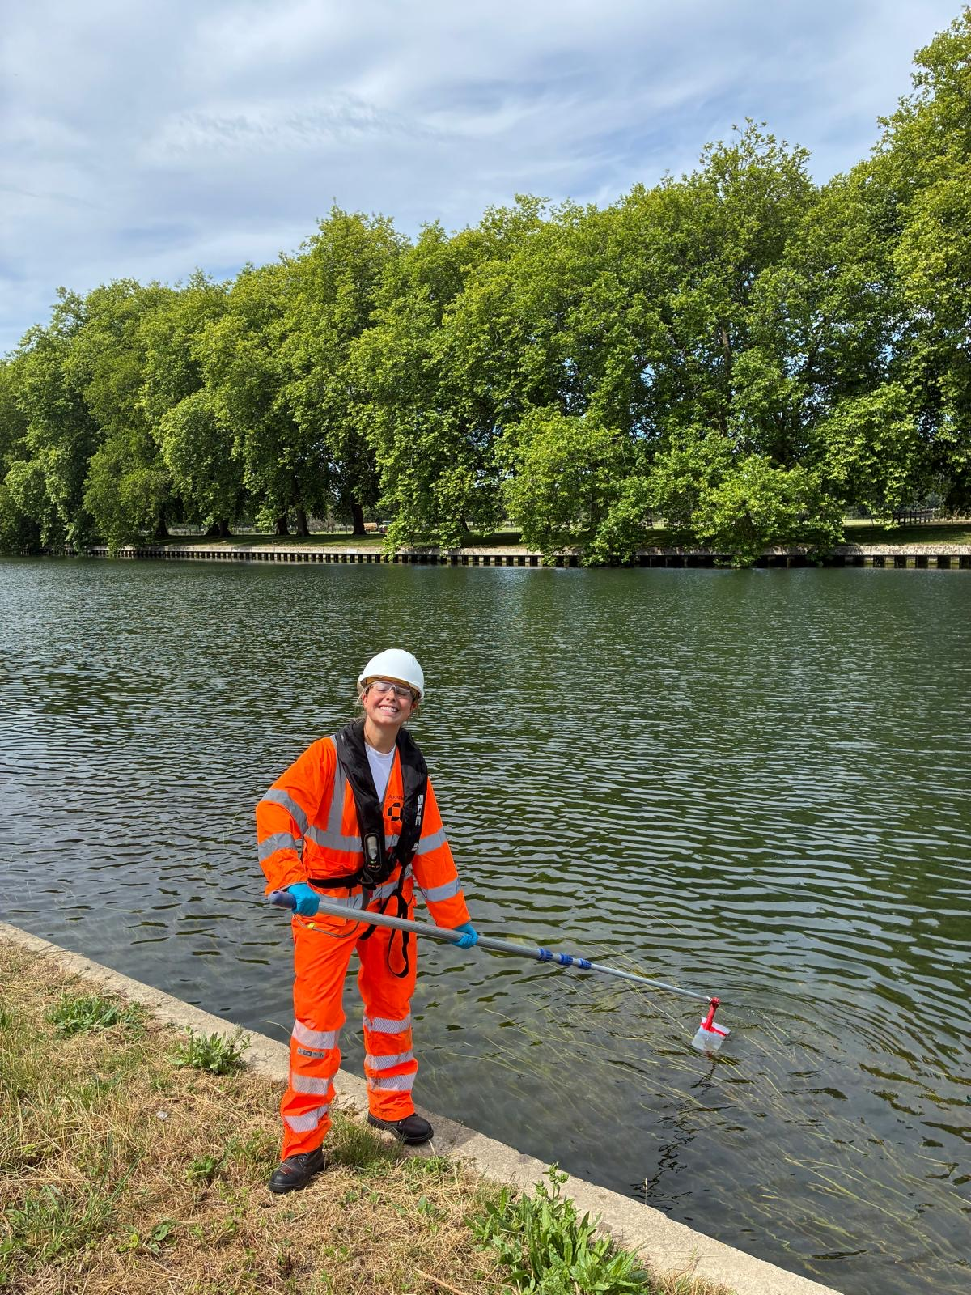
Geographical careers in river landscapes
Meet the Geographer
Meet Frankie, Environmental Consultant at Atkins Réalis
Credit, Frankie Brown
What do you do?
I am a Graduate Environmental Consultant at Atkins Réalis . Atkins Réalis is a global engineering and design company that delivers transport, water, energy, building and environmental projects. It works with governments and local authorities to create safe and sustainable infrastructure. I did a placement year with Atkins Réalis whilst I was studying BSc Environmental Geography at Cardiff University. As an environmental consultant I help people and companies (clients) to protect the environment. I will collect and analyse data, to help solve environmental problems and provide advice to clients to make sure that projects are carried out responsibly and sustainably.
Why did you choose geography?
I studied geography at GCSE and A Level. I enjoyed studying the rivers and coastal modules at GCSE in particularly, which led me to pursue it at A Level. I was interested in climate change and sustainability. and I had a love for the outdoors and nature. When it came to choosing my degree, I considered career paths and knew that a career in environmental science would have a positive impact on the world.
Advice to students
If you’re interested in geography, stay curious! Keep up to date with the news, get involved in activities like volunteering and don’t be afraid to try different things and explore your interests. If you’re considering university, consider courses that offer a placement year as this will help you develop skills that will support your career. A career is something you’ll spend a large part of your life doing so choose something you enjoy and find meaningful.
What does your day-to-day look like?
My days are a mix of desk-based work in the office and site work. Its project based and my day to day involves lots of meetings, tasks like analysing data, writing reports and creating maps. I’m always learning new things and everyday in the office is quite different. I also go on site visits. For example, I recently went to a site near Heathrow Airport to take water quality samples from a river. These samples get sent to the lab to test the water for things like for algae and contaminants. I use a water quality probe to measure the conditions of the water, such as measuring temperature, pH and dissolved oxygen. I get to travel around the South of England fairly often to visit sites and collect data and its one of the best parts of my job.
Credit, Frankie Brown

Slide 2
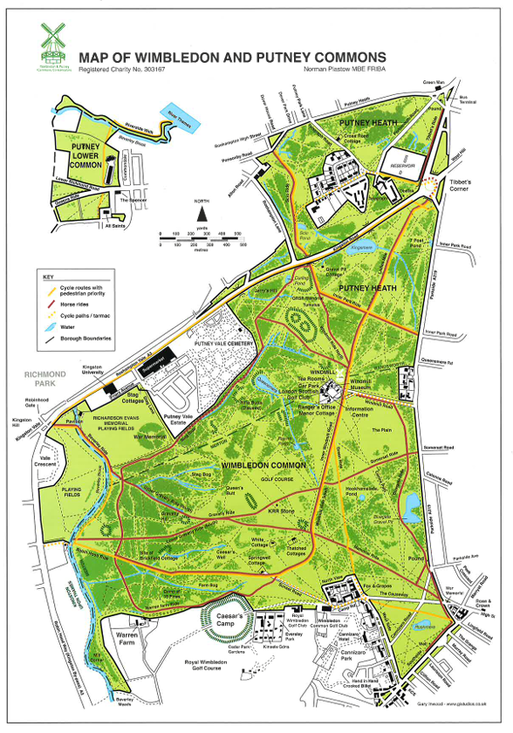
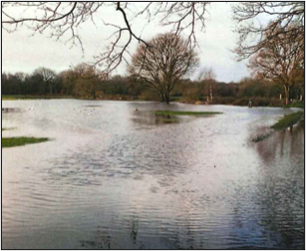
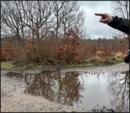
Geographical careers in coastal landscapes
Wimbledon & Putney Common case study
The challenge
Due to surface water flooding and river flooding, paths become flooded and inaccessible after period of heavy rainfall. The Common is located in a highly urbanised area of London. There are areas of woodland, heathland, grassland and wetland that need protecting as well as ensuring that visitors can access the Common.
Key definitions
Surface water flooding
When rainfall cannot soak into the ground quickly, causing water to flow over the surface and collect in low-lying areas
Nature-based solutions
Also known as soft engineering. Solutions involve working with nature to reduce flooding by slowing, storing and absorbing water in a natural way. Examples include creating ponds, wetlands and planting trees.
Geographical Information Systems (GIS)
A digital mapping software that is used to collect, analyse and display geographical data on a map. Helps geographers identify patterns
Project aims
To locate flooding ‘hotspot’ areas across the commons
Find out why these areas are flooding
Suggest specific nature-based solutions to reduce flooding
Use GIS to show where these solutions could be installed
Improve access for visitors while increasing benefits for nature
Geographical knowledge and skills used
GIS mapping and analysis
Understanding drainage basins and runoff
Interpreting geology and soil maps
Fieldwork and data collection
Flood risk assessment
Environmental problem solving

Slide 3
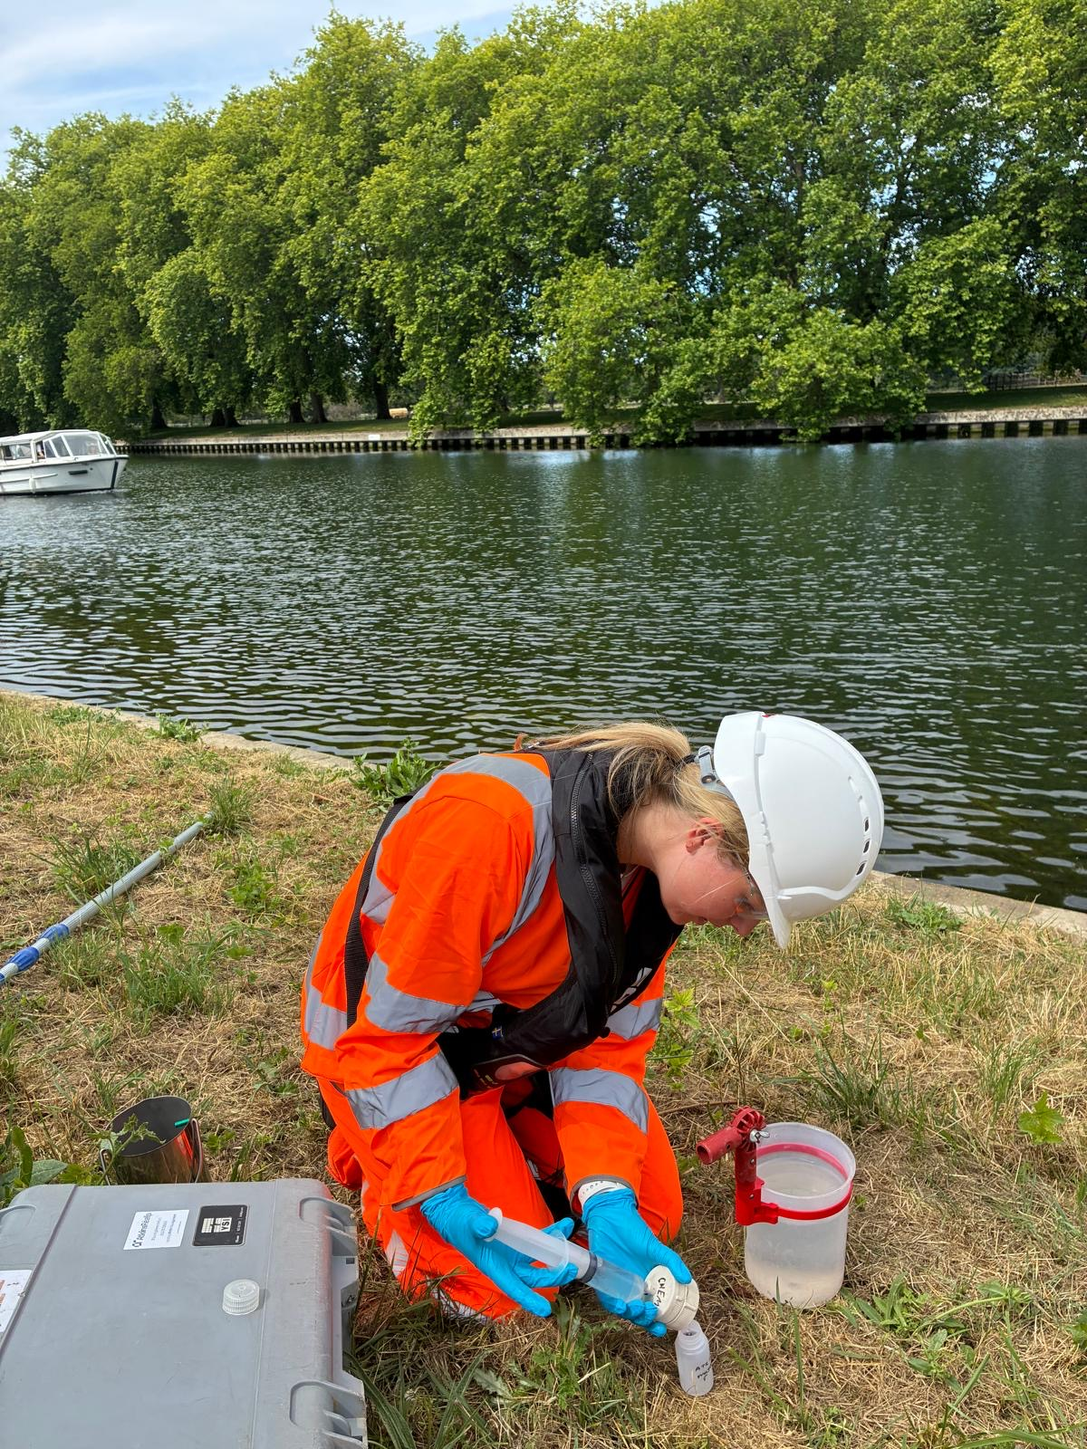
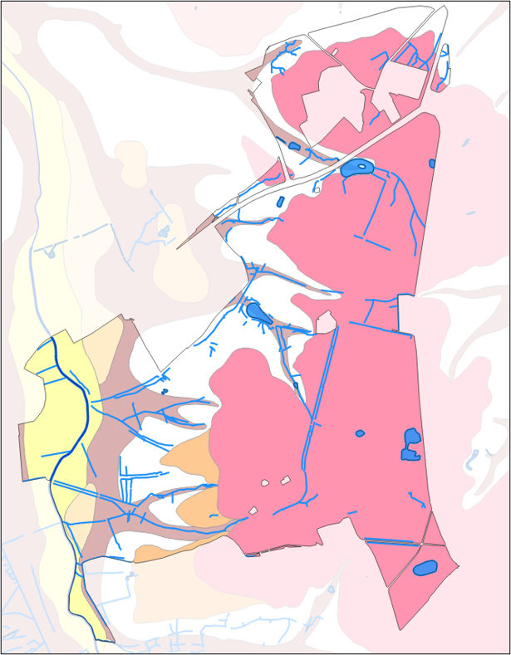
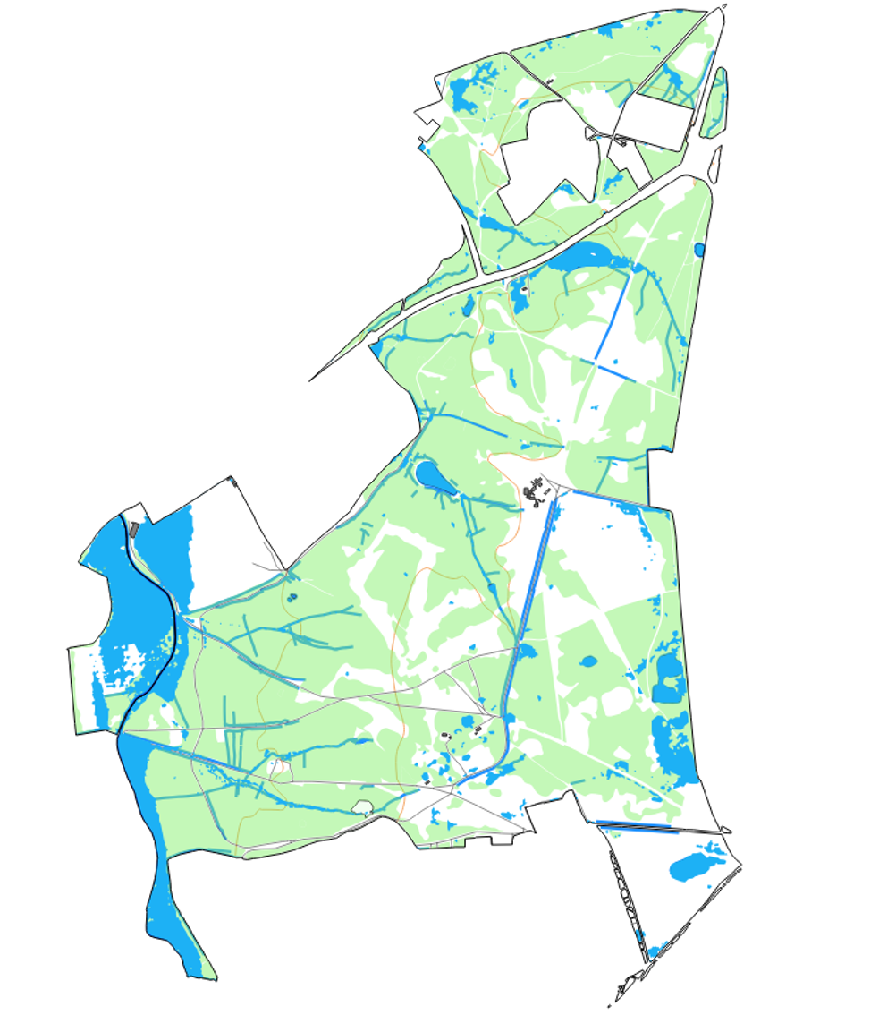
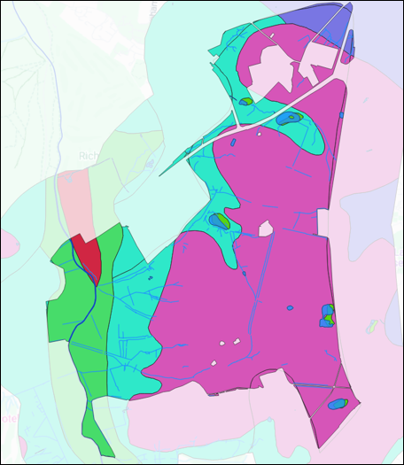
Geographical careers in coastal landscapes
Wimbledon & Putney Common case study
Methodology
How did Frankie and her team carry out the project?
Stage 1: Desk-based GIS Analysis
They used GIS to review maps, geology and soil data. They analysed water flow and drainage patterns and identified any potential flood hotspot areas.
Stage 2: They visited the Commons to observe flooding and drainage issues after period of heavy rainfall. They took lots of photographs and field observations
Step 3: They combined field observations with GIS data to map flood hotspots and identify opportunities for nature-based solutions. They collated this data to create detailed area plans
Key definitions
Surface water flooding
When rainfall cannot soak into the ground quickly, causing water to flow over the surface and collect in low-lying areas
Nature-based solutions
Also known as soft engineering. Solutions involve working with nature to reduce flooding by slowing, storing and absorbing water in a natural way. Examples include creating ponds, wetlands and planting trees.
Geographical Information Systems (GIS)
A digital mapping software that is used to collect, analyse and display geographical data on a map. Helps geographers identify patterns
Credit, Frankie Brown
Maps of Wimbledon Common created using GIS
Geology map
Surface water flood risk map
Soil map
Maps credit, Frankie Brown

Slide 4
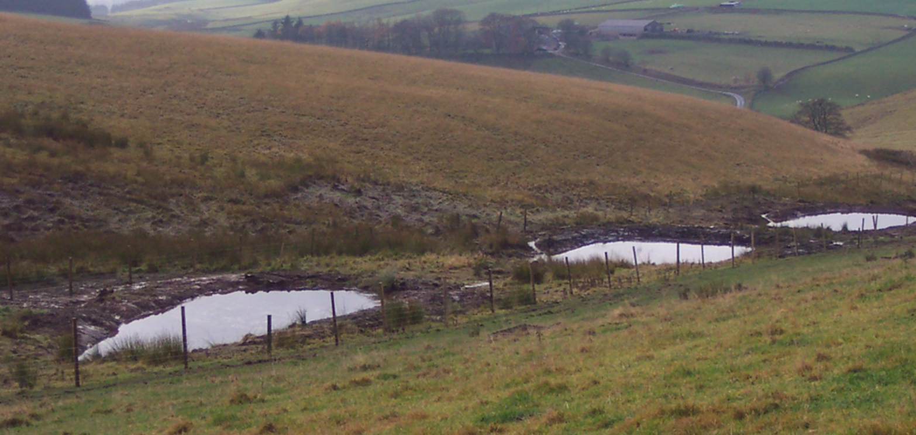
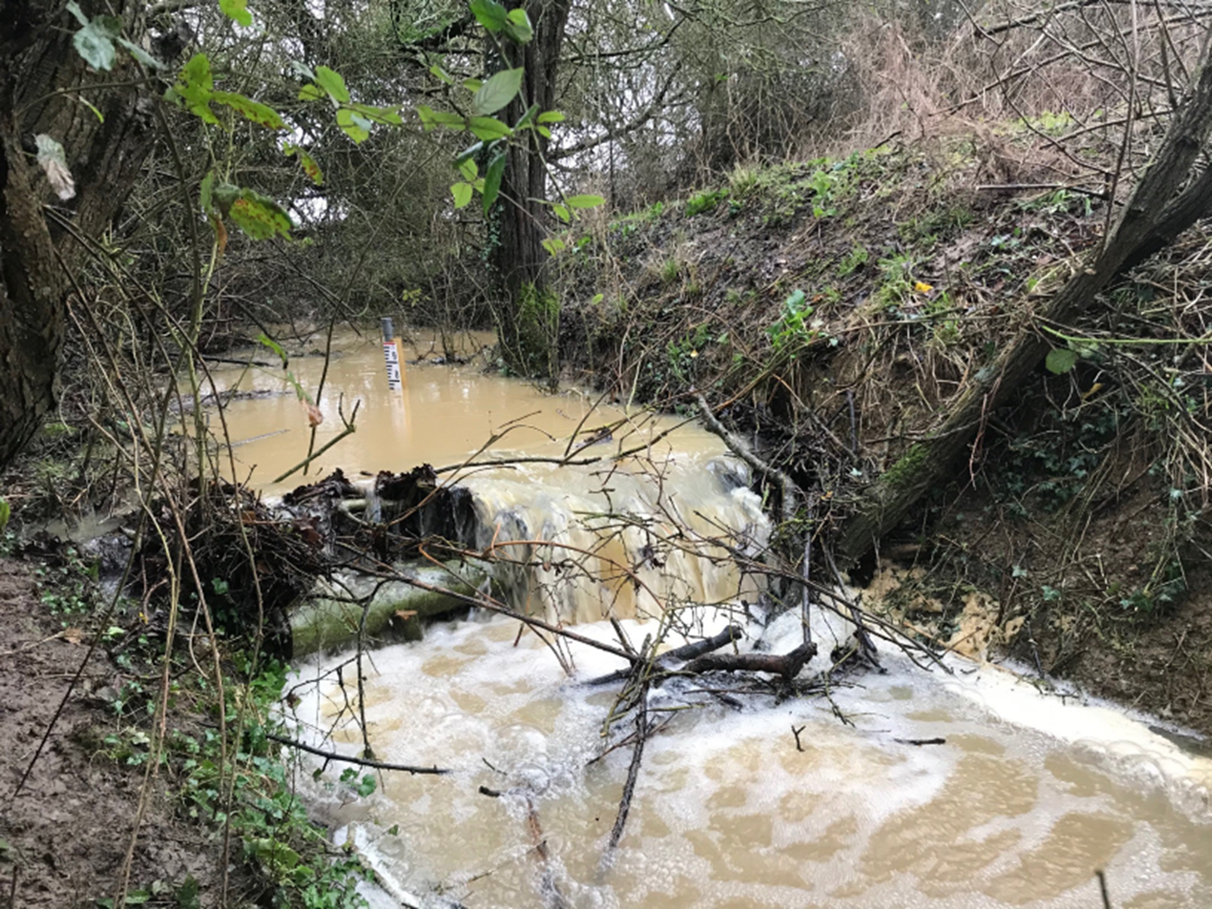
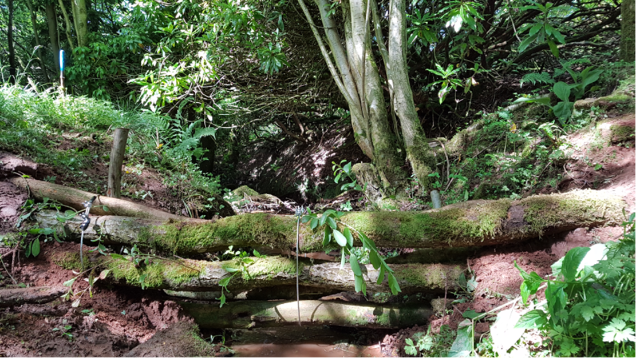
Geographical careers in coastal landscapes
Wimbledon & Putney Common case study
Proposed solutions
Suggested nature-based solutions include:
Water storage ponds
These create temporary storage for rainfall and hold water during heavy rain. They can provide new habitats for wildlife
Restoring drains
Old ditches that have been blocked or overgrown can be restored and reused to help management the movement of water across the Commons and carry it away from ‘hotspots’. This will also reduce the amount of water collected on paths
In Channel Leaky barriers
These are small wooden structures that are placed across streams that act like a natural dam. They help to slow the flow of water during heavy rainfall, temporarily storing water upstream to reduce flood risk downstream
Evaluation
Benefits of completing the project include:
Create a safer green space for visitors by reducing flooding on paths and trails
Manage rainwater more naturally
Ensure the commons are more resilient to climate change
Demonstrate sustainable flood management in an urban environment
Support wildlife and biodiversity
Challenges of delivering the project include:
Flooded paths will reduce visitor access and this means that walking routes need to be safe and useable.
Climate change means that there is increased rainfall
Local community needs to be happy and as the Commons relay on public funding, stakeholders must approve the plans
Challenge to balance recreation with conservation (e.g. rugby pitches flood). Challenging to avoid damage to sensitive natural environments like heathland and wetland X

Slide 5
Geographical careers in river landscapes
Student Activity, page 1
Starter Activity
Sort into hard engineering and soft engineering (nature-based) solutions to river flooding
Building a dam
Planting trees
Floodplain zoning
Concrete embankments
Dredging
Flood walls
Activity 1 – Read the meet the geographer page
1a. What does an environmental consultant do? Choose the correct description
i. An environmental consultant collects and analyses environmental data to help clients solve environmental problems and ensure projects are sustainable and responsible
ii. An environmental consultant helps design buildings and manages construction projects to ensure they are built quickly and at low cost
iii. An environmental consultant sells environmentally friendly products to businesses and advises them on how they can increase their profits
1b. Suggest one reason why Frankie choose to study geography
------------------------------------------------------------------------------------------------------------------------------------------------------------------------------------------------------------------------------------------------------------------------------------------------------------------------------------------------------------------------------------------------------------------------------------------------------------------------------------
1c. What key geographical skills does Frankie use in her day-today as an Environmental Consultant? Tick all that apply
Collecting and recording data in the field
Writing reports
Problem solving
Communicating ideas
Hard engineering | Natured-based solutions
Using GIS
Drawing field sketches
Writing an extended argument
Coding

Slide 6
Geographical careers in river landscapes
Student Activity, page 2
Activity 2
2a. Sort into advantages and disadvantages of in-channel leaky barriers
Suggest a social, economic and environmental benefit of the project
Socially, managing flooding on the Wimbledon & Putney Common will …
---------------------------------------------------------------------------------------------------------------------------------------------------------------------------------------------------------------------------------------------------------------------------------------------------------------------------------------------------------------------------------------------------------------------
Economically …
--------------------------------------------------------------------------------------------------------------------------------------------------------------------------------------------------------------------------------------------------------------------------------------------------------------------------------------------------------------------------------------------------------------------
Environmentally …
--------------------------------------------------------------------------------------------------------------------------------------------------------------------------------------------------------------------------------------------------------------------------------------------------------------------------------------------------------------------------------------------------------------------
Require maintenance particularly in areas where there isn’t any natural wood supply | They work immediately
Can collapse in very fast flowing streams | Can improve water quality
Help to reduce peak flow, reducing flood risk | Provide a habitat
2b. Suggest one way water storage ponds will reduce flooding
-------------------------------------------------------------------------------------------------------------------------------------------------------------------------------------------------------------------------------------------------------------------------------------------------------------------------------------------------------------------------------------------------------------------------------------------------------------

