Slide 1
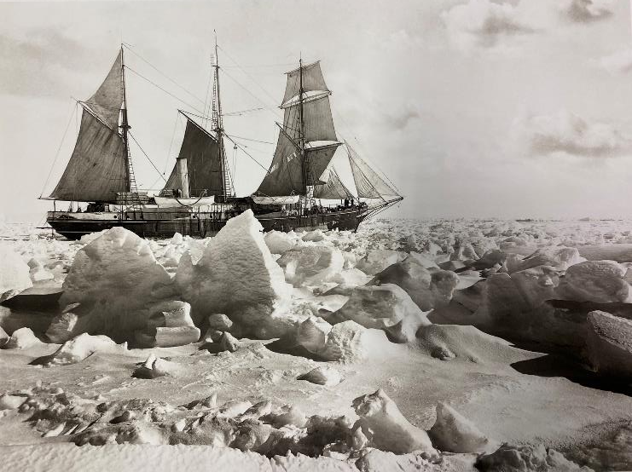
Listening to Others
Endurance in full sail in the ice, 25th January 1915. Photograph Frank Hurley

Slide 2
Shackleton had an important decision to make
Ernest Shackleton was a Polar Explorer who had planned for a long time to be the first to cross the continent of Antarctica. He had to overcome lots of obstacles to set out to do this .
He was finally within striking distance of his goal, but as he was about to leave the island of South Georgia, on his ship the Endurance, he was warned by other sailors that the sea ice was worse than expected. There was a risk he might get trapped in the ice.
But he didn’t listen. He thought he knew best.
As he sailed south, he saw the sea was alive with seals who were swimming away to find warmer waters. Animals often have good instincts and know which way to go to stay safe. Shackleton could have followed them, he could have turned around and listened to their message.
But he didn’t. he thought he knew best.
And the ice came. And his ship was trapped in the ice. Miles from anywhere. In those days there was no satellite telephone to call for help. After his ship sank, Shackleton was brave and determined to keep his crew alive and they lived on the ice until he could reach help and they were rescued.
But why didn’t he listen to others?

Slide 3
Assembly Notes
Introduce the image of the Endurance stuck in the ice and explain that you are going to tell the story of Shackleton’s failed expedition and the near loss of his entire crew as well as his ship. Only his bravery and determination saved them. But there is another side to the story. He may not have got into that trouble if he had been willing to listen to others.
The second slide has some suggested words but this story can be told in your own words. You could also act it out, taking the part of the focused and keen Shackleton yourself but select the following characters:
2 children to be ‘whalers’ offering advice about the amount of ice around in the ocean for the time of year.
3 – 4 children to be ‘seals’ swimming past.
2 children to be crew members noticing the seals. They are trying to warn you that if the seals are swimming in the opposite direction looking for warmer water and more crabs to eat, then the ocean must be especially cold and icy where they have come from.
Ask the audience why they think Shackleton didn’t want to listen to advice.
Ask the audience if they have ever offered some good advice or a warning to a friend who didn’t listen to them.
Ask if anyone can remember a poor decision they made, perhaps something silly they did after being warned it was a bad idea.
Finish by saying that although we can’t always guarantee what will happen in the future, we can learn to be humble and value what others have to say. We can also notice what others are doing and think about whether we need to change our own actions as a result, especially if it might keep us and others safe.

