Slide 1
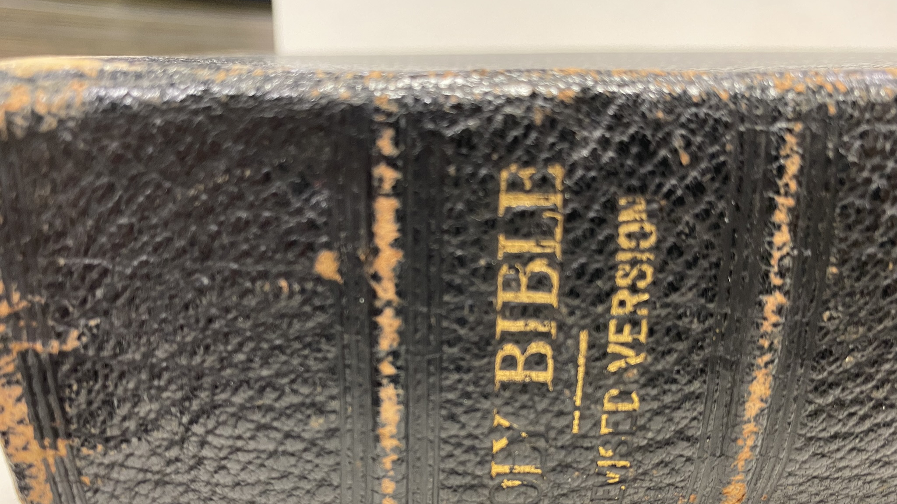
Shackleton’s Bible

Slide 2
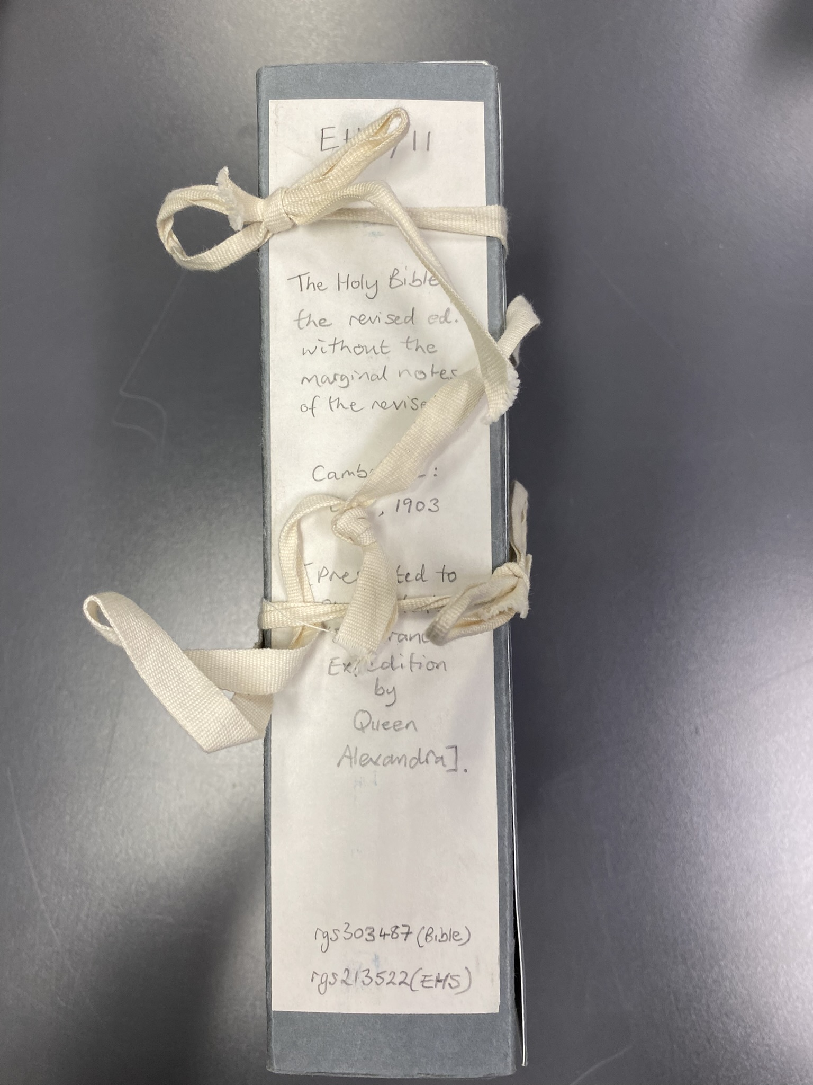
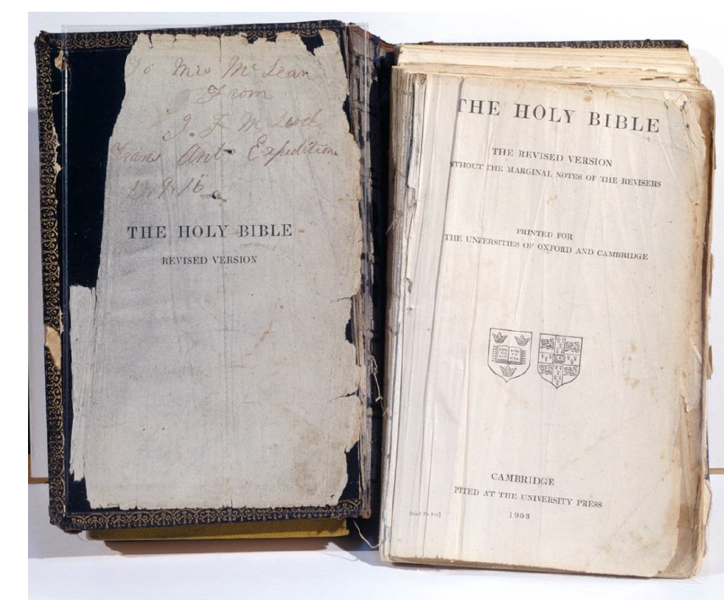
Wrapped up inside a box, carefully tied and tucked away in the library of the Royal Geographical Society, lies a tattered bible that belonged to the explorer Ernest Shackleton. And there is a story of friendship and love to tell.

Slide 3
The explorer Shackleton was a man of Christian beliefs and he treasured a bible given to him by Queen Alexandra. He treasured it so much that he took it to Antarctica with him when he went on his Trans-Antarctic Expedition.
After their ship Endurance was crushed by polar ice and the crew forced to abandon ship, Shackleton ordered everyone to leave their non-essentials behind and travel light. To show a good example, he threw his beloved bible away in the snow and ice.
One of Shackleton’s men knew what a sacrifice this was for his leader and quietly picked the book up. The man was called Macleod and he secretly carried the book all the way to safety in South America. This book weighed about 1.5 kilograms, the same as a large bag of sugar. Imagine walking for miles across freezing ice, with barely nothing to eat, no energy and cold to the bone yet having to carry something that weighs as much as a bag of sugar around all day long.
Why do you think Macleod wanted to save Shackleton’s treasured bible for him?
Why do you think Macleod admired and respected Shackleton?
What would you do, or have you done, to help a friend out?

Slide 4
Other religions also have holy books and texts. For example, the holy book of Islam is called the Quran and the holy book of Judaism is the Torah.
Why do some things, such as religious books or personal mementoes, give us such comfort?
Do you have something that is not worth lots of money but is worth the world to you? What is your ‘treasure’?

Slide 5
Assembly Notes
Use this presentation to illustrate the talk. You could also have a large bible to hand, about the same weight as the one described here or even a bag of sugar. At the beginning of the assembly, invite a child up on stage and give them the bible or bag of sugar to hold while you are talking. Check on them and ask if their arms are aching during the assembly to emphasise what it might feel like to carry around a heavy bible all day long.
Discuss the reasons that a crew member would do this for Shackleton and suggest he was a leader who was loved by his team because he took care of them and only asked them to do what he would do himself.

