Slide 1
Lesson 3 – Impacts of Hazards in The Gobi Desert.

Slide 2
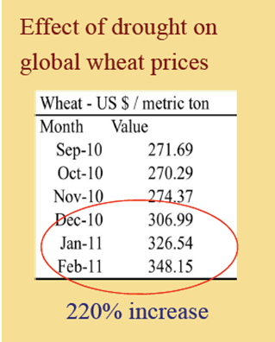
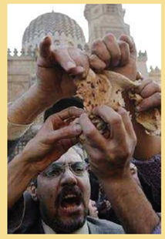
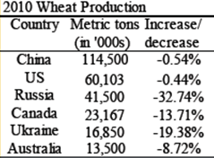
Starter – The Butterfly effect – how are the following linked?
STEP 1 - Hazards in the Gobi desert and beyond results in a decrease in wheat production in both 2010 and 2011:
STEP 2 – in 2011 there is a 220% increase in global wheat prices.
STEP 3 – Extreme food insecurity globally e.g. The Sahel, the Maghreb. Leading to famine and also protests e.g. Protests over bread prices are part of the start of the Arab Spring protests in Tunisia & Egypt.

