Slide 1
Lesson Three: Mapping the River Thames

Slide 2
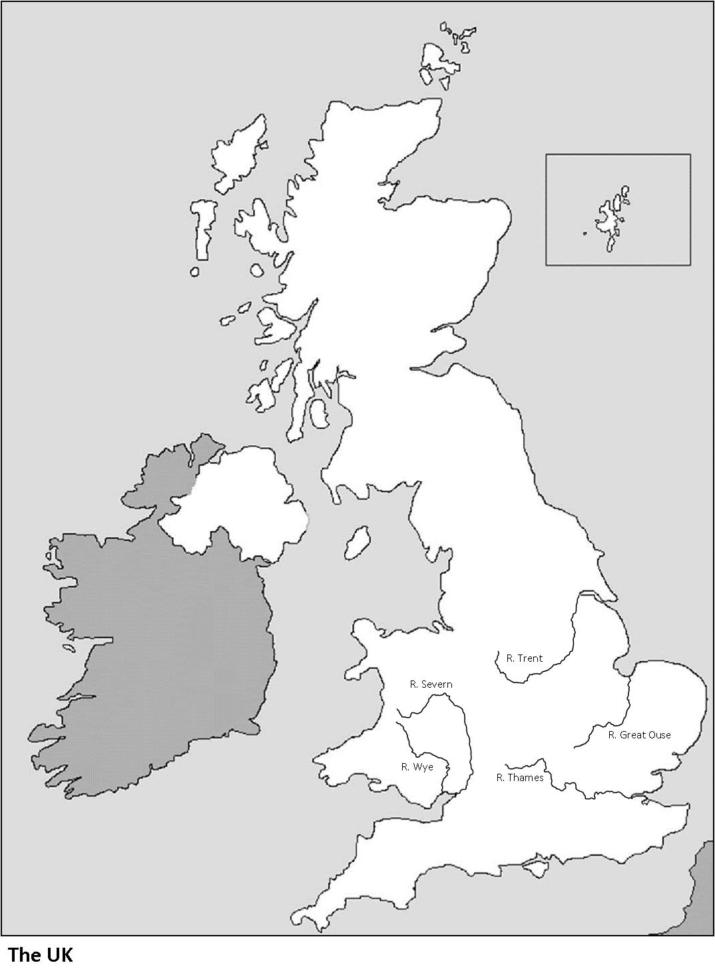
The U.K.’s Longest Rivers
River Trent
297km
River Severn
354km
River Great Ouse
230km
River Wye 215km
River Thames
346km

Slide 3
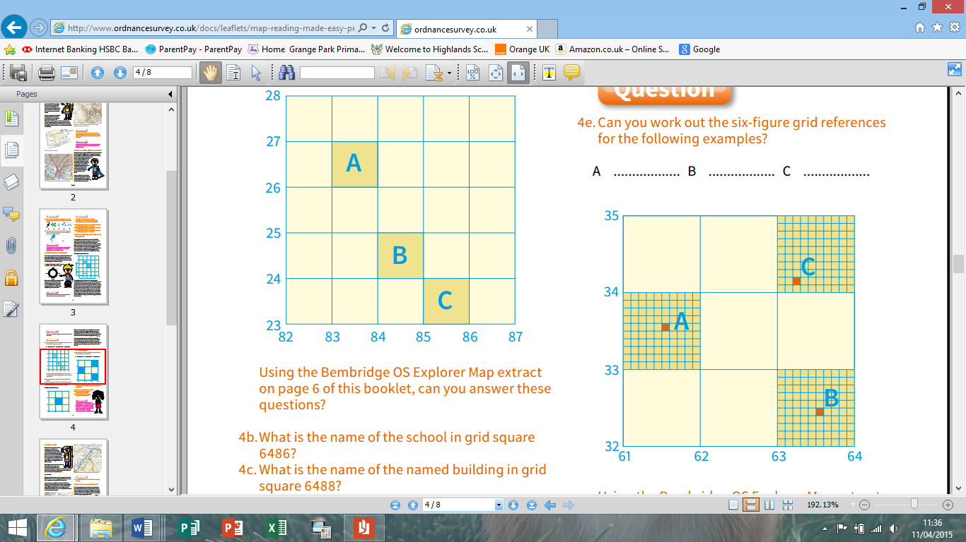
Grid Squares
A is located in grid square 8326.
Can you locate B and C?
© Ordnance Survey

Slide 4
6 Figure Grid References
C is located at grid reference 632341
Can you locate A and?
(C) Ordnance Survey

Slide 5
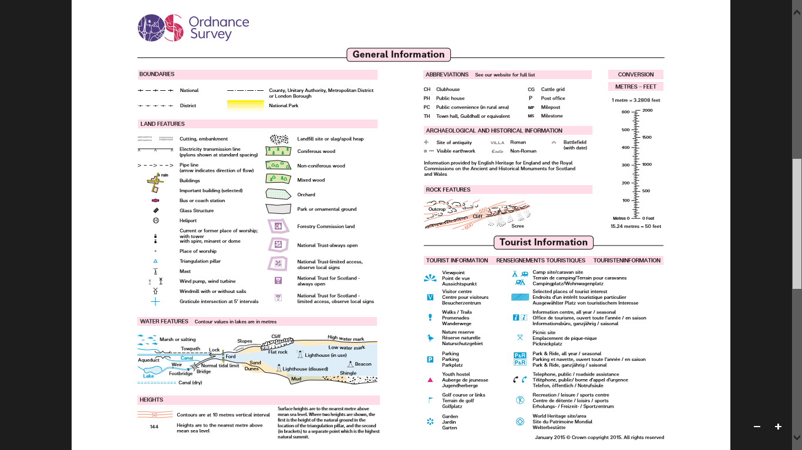
The Key

Slide 6
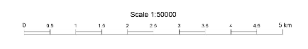
The Scale

Slide 7
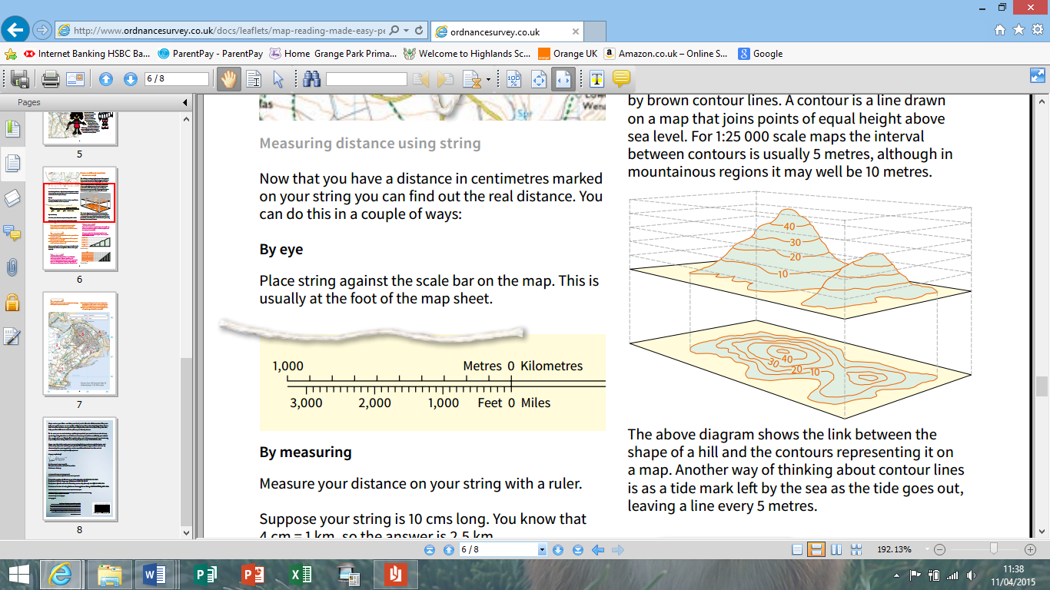
Contour Lines
© Ordnance Survey

Slide 8
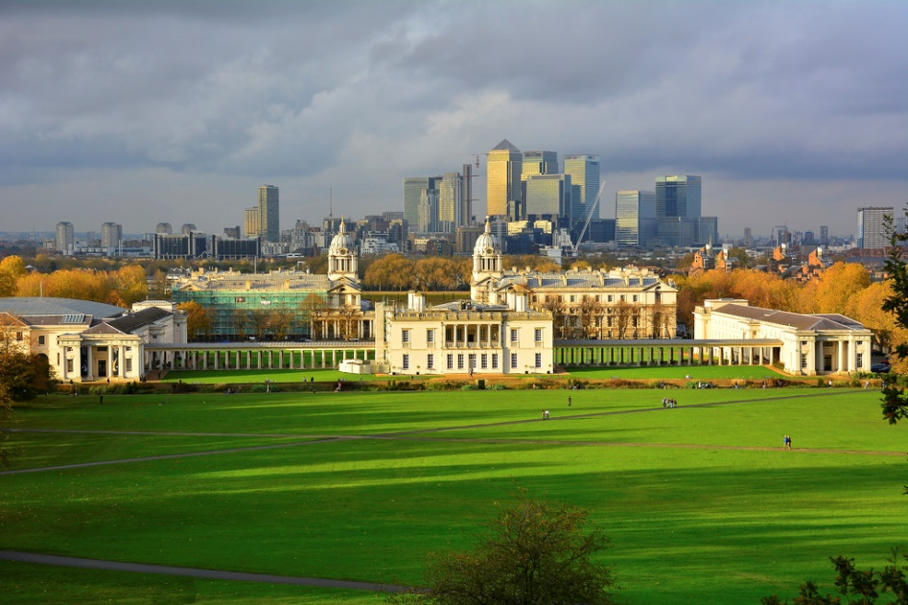
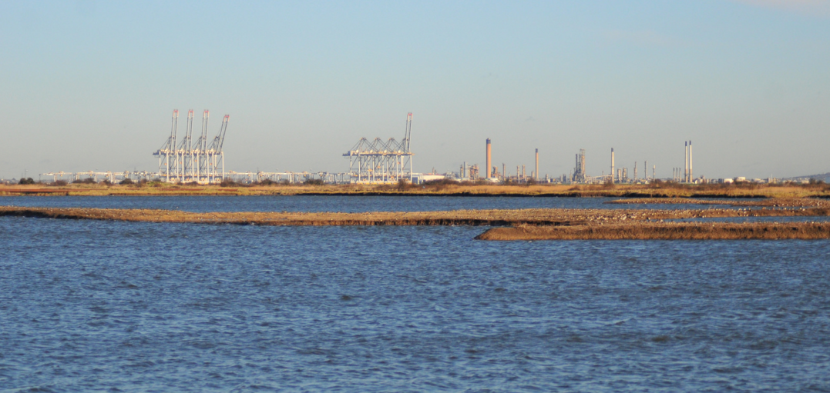
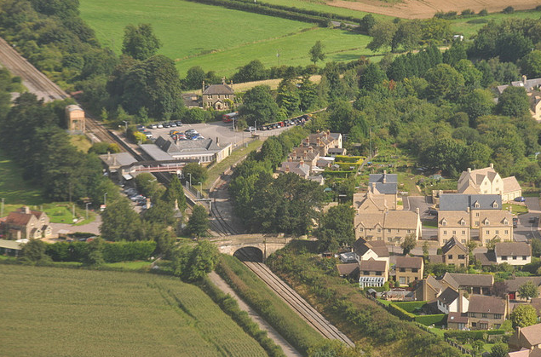
Spot the Location
A
B
London, Greenwich Park © Martin Pettitt, Flickr
C
DSC_6185 © Thomas Cogley, Flickr
Kemble Railway Station from the Air © Zen Whisk, Flickr

