Slide 1
4 Assembly
Shackleton 100
Endurance 100
Geography History

Slide 2
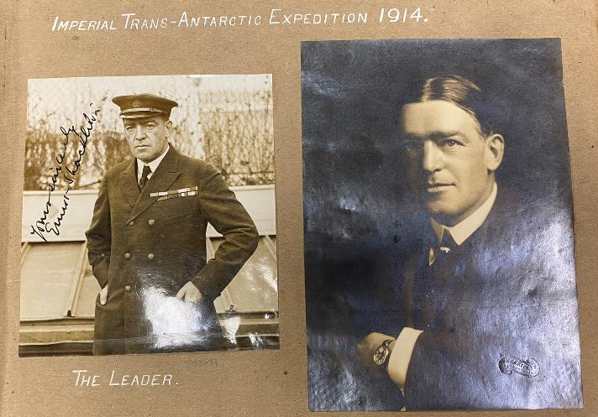
Failure and Hero
Sir Ernest Shackleton

Slide 3
Assembly Notes
Ask children what it means ‘to fail’ – establish it’s when you set out to do something but don’t manage to do it. Ask for some examples (prime some adults to volunteer an example, including yourself) and encourage children to contribute. Or you could describe some examples and ask if anyone has experienced them. Perhaps it was a tricky move in PE, or riding a bike, or baking a cake?
Ask how it makes you feel if you’ve failed at something and explore briefly, feelings of sadness and unhappiness that come with it. Then introduce Shackleton. Here is a man who is considered to be one of the most famous and heroic explorers the world has known, yet he was a big failure.
After planning for years, raising and borrowing money and getting a ship and a crew together, he tried to cross Antarctica only to be beaten by bad weather. He lost his chance of fame – he wanted to be the first to do it. He lost his ship – it broke up in the ice. But before it broke up he was stuck in the ice for nearly nine months! He thought he would turn his luck around and sail free of the ice when the warmer weather came. Instead it crushed his ship.
Why is he a hero then? Because he never worried about himself but focused on how he would get his team members all home safely. He never gave up. He was always full of hope and helped everyone to feel that things would be OK. After years of adventures, he managed to get everyone home safely. Ask what the difference is then between a ‘failure’ and a hero’. A ‘hero’ doesn’t give up or worry about failure, neither do they blame anyone. They just get on with it. You could take further positive examples at this point.

