Slide 1


Location and characteristics of the Sharqiya Sands
Learning Goals
Describe the location of the Sharqiya Sands.
Identify the characteristics of the Sharqiya Sands.
Understand how the Sharqiya Sands fits within the desert ecosystem model.
Write down all the words you associate with ‘desert’.

Slide 2
Sharqiya Sands
Number yourselves 1-4.
Number 4s will be the main drawers and will see the image last.
You will take it in turns to look at an image then report what you see to the rest of your group. Come up when your number is called.
When you are reporting to your group, you are not to draw anything – your role is to describe what you see.
Other members of your group can add on or change things once they have seen the image.
When number 4s are up, the rest of the group can contribute to the drawing.
It’s down to you to work as a team to get the most accurate representation as possible.
Use what you have drawn as a group to create a sketch map of the Sharqiya Sands in your case study sheet and describe its location.

Slide 3
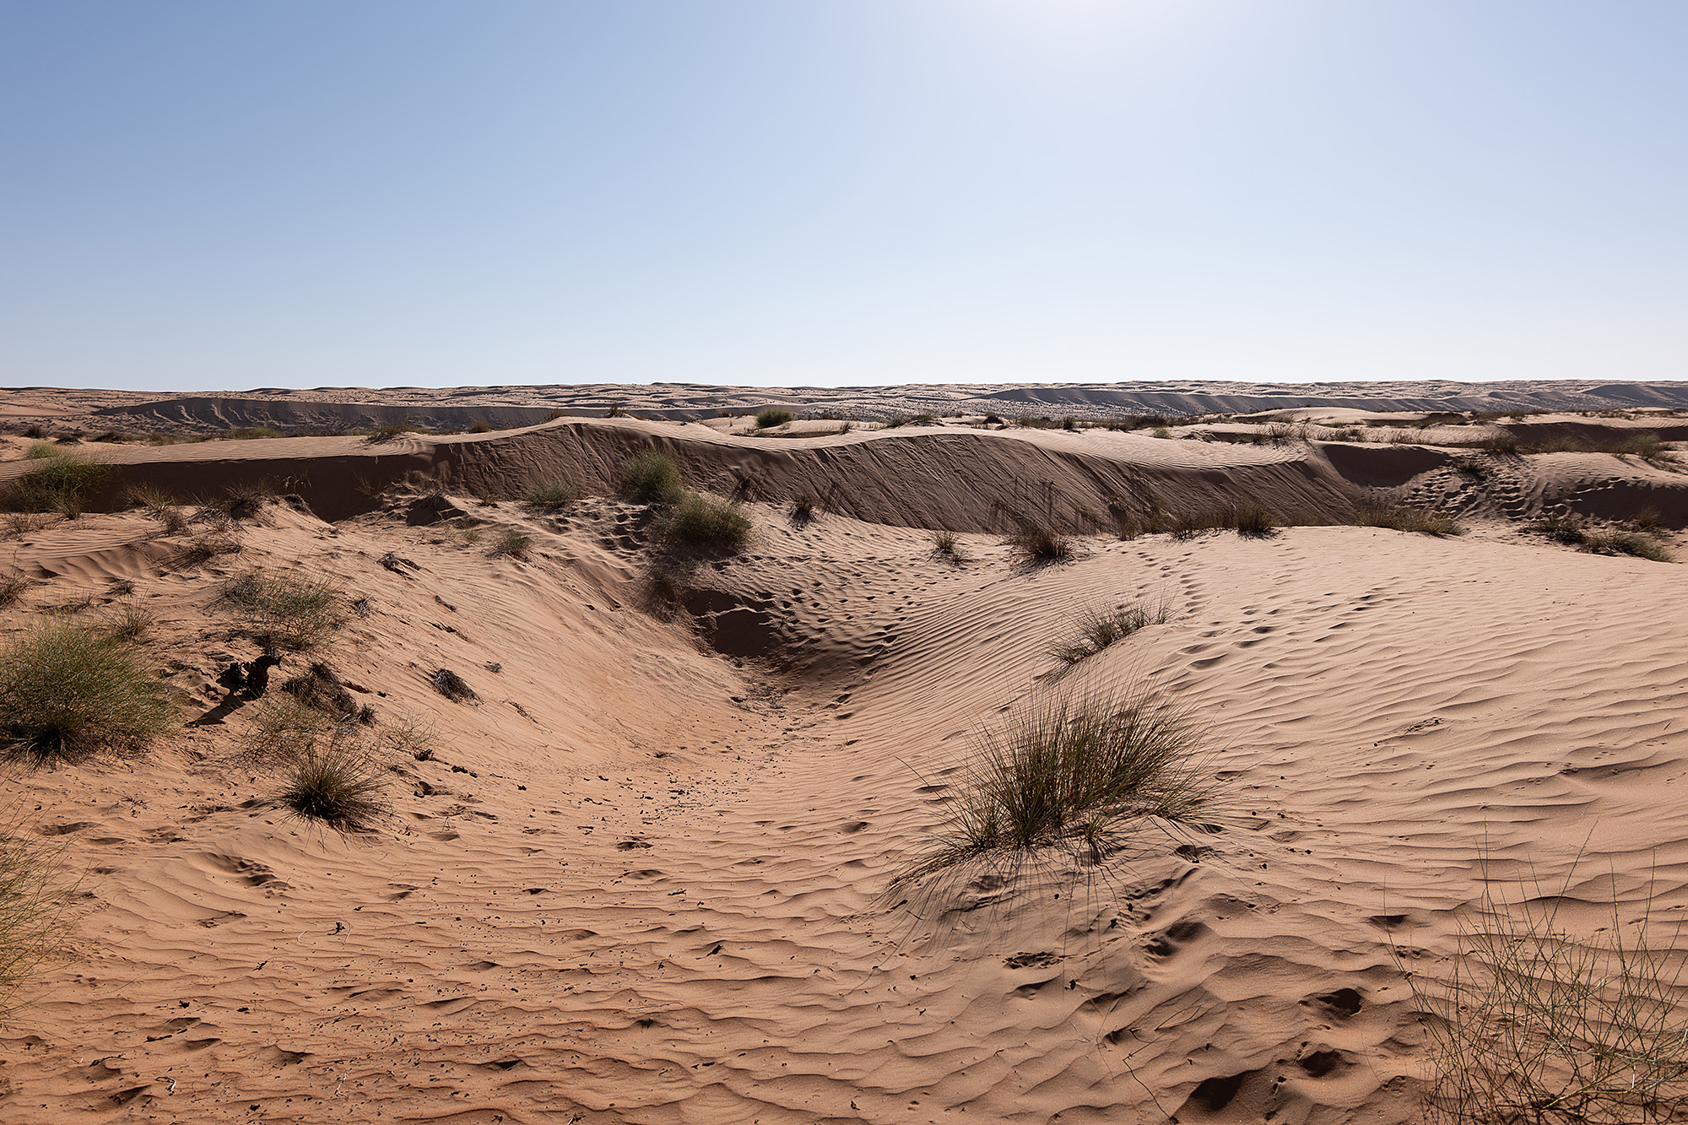
Sharqiya Sands
The Sharqiya Sands (also known as the Wahiba Sands) is a sand sea ecosystem in the Eastern region of Oman within the Arabian Peninsula.
It is approximately 1500 km² in size and is identified as an isolated sand sea.
It is flanked by the Wadi Batha and Al Hajah Mountains to the North, the Arabian Sea to the Southwest and Wadis Andam and Matam to the West.
Image credit: Ana-Maria Pavalache

Slide 4
Sharqiya Sands climate
Complete the climate graph in your case study sheet using the data opposite.
Analyse the results of your graph.
 | Rainfall (in mm) | Temperature in °C
J | 45 | 20
F | 20 | 21
M | 17 | 25
A | 1 | 32
M | 31 | 33
J | 1 | 37
J | 43 | 36
A | 11 | 35
S | 6 | 32
O | 0 | 29
N | 0 | 23
D | 0 | 23
You could use the following sentence starters to help:
  Overall, the temperature/rainfall (increases/decreases/fluctuates)
  The most/least amount of rainfall/temperature was… at…mm/ºC.
  The range of rainfall is…
  There is/isn’t a correlation between temperature and rainfall. For example…
Data Source: www.worldweatheronline.com

Slide 5
Sharqiya climate graph

Slide 6
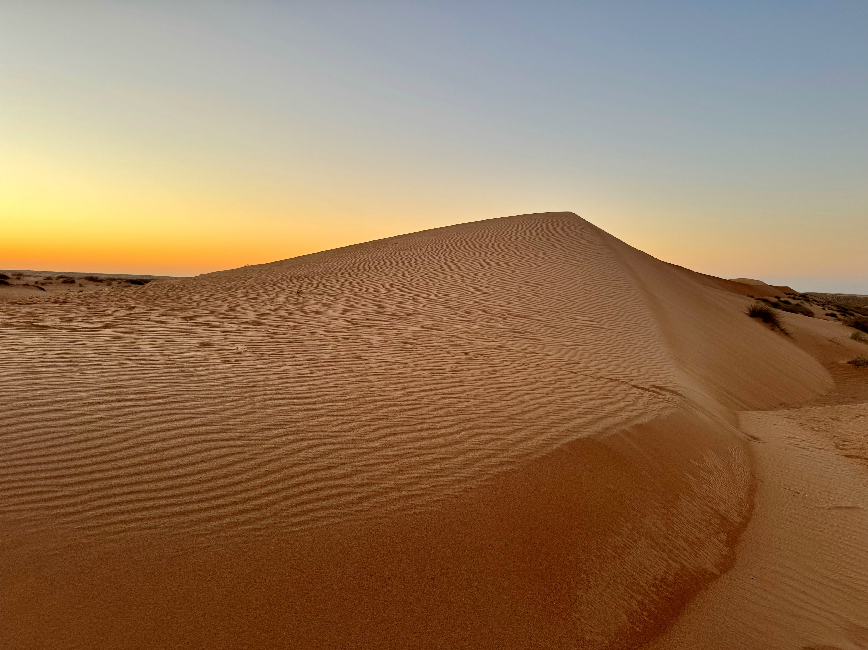
Soil in the Sharqiya Sands
As with many desert ecosystems, the soils in the Sharqiya Sands is mainly sandy.
The Sands are constantly shifting as they are blown by the wind which affects the stability of the soil.
The soil does not hold much water as it is highly permeable.
Image credit: Ana-Maria Pavalache

Slide 7
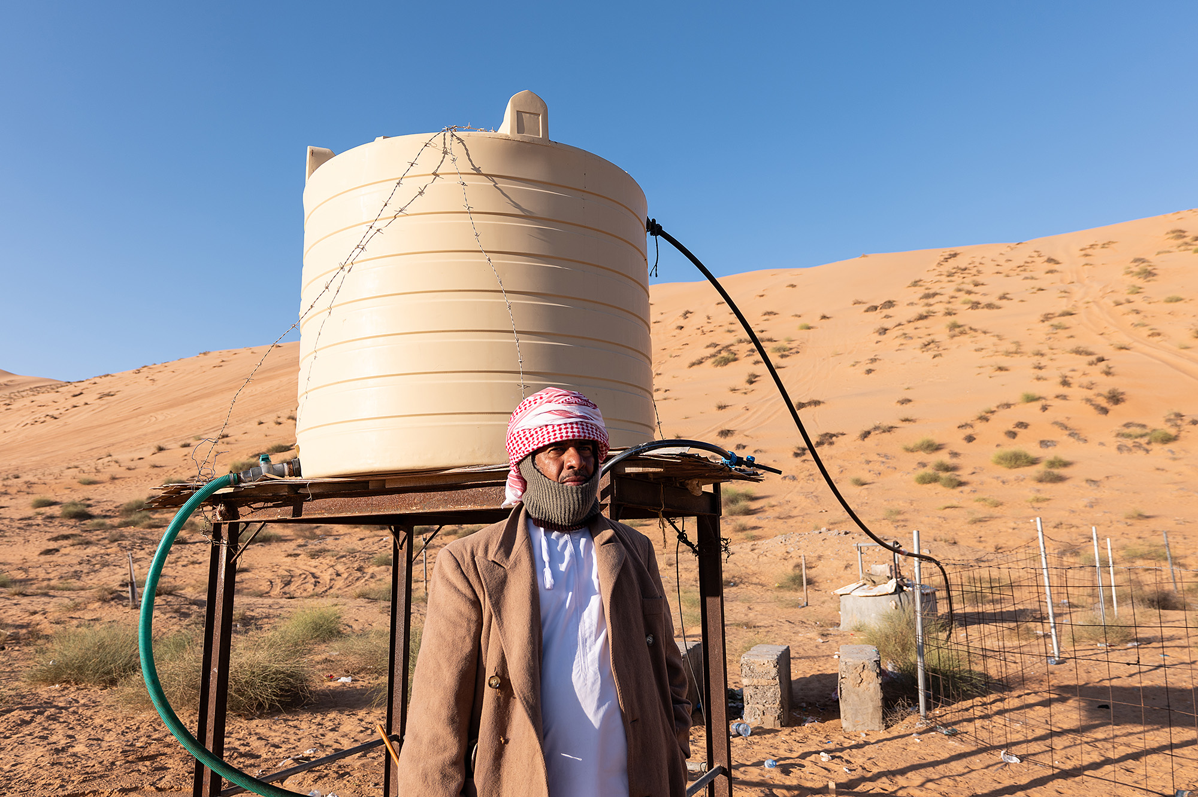
Sharqiya Sands: water
Image credit: Ana-Maria Pavalache
Due to the sandy nature of the sol, water is scarce within the Sharqiya Sands.
There are, however, underground sources which are fed by rain falling in the Al Hajah Mountains which feeds underground wells and oases.
During times where these is high rainfall, water collects in low lying areas in temporary pools.
People living in the Sharqiya Sands collect water from wells and store it in containers.

Slide 8
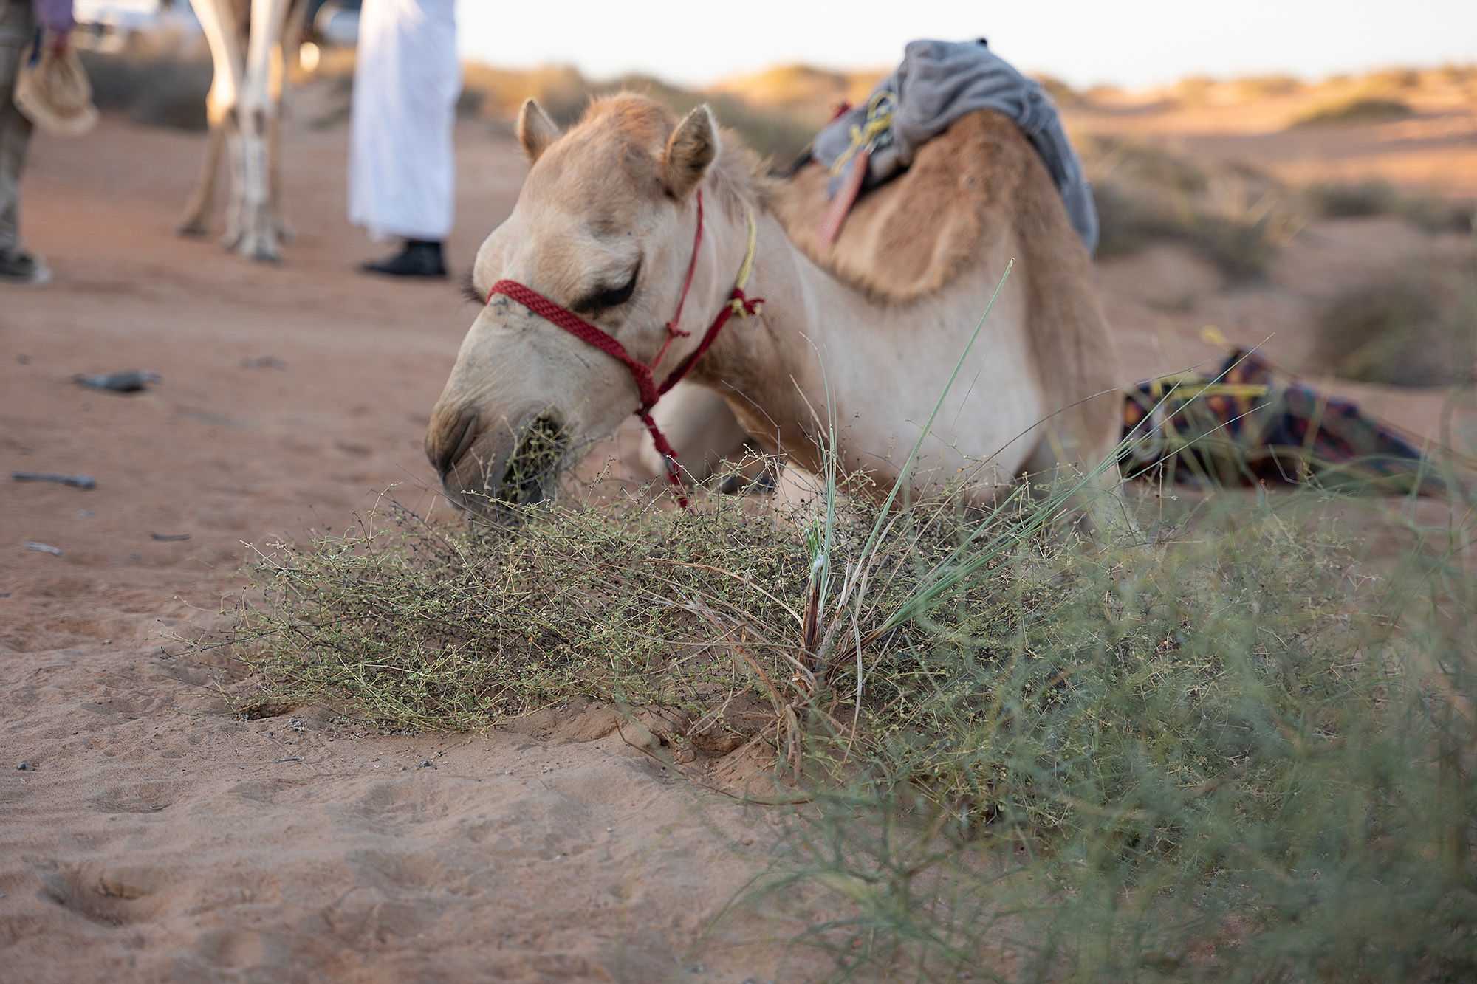
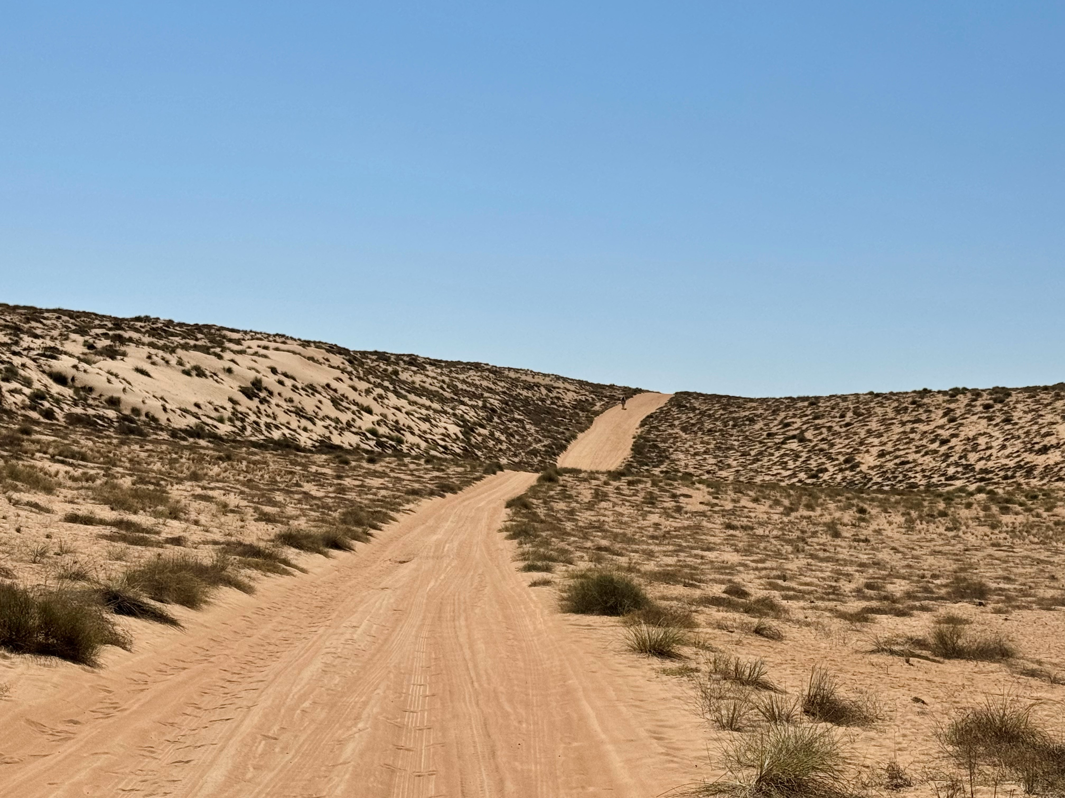
Sharqiya Sands: vegetation
The Sharqiya Sands has 150 species of plant.
Much of the vegetation grows in low lying areas and around oases and wadis where they can access water.
Image credit: Ana-Maria Pavalache
Image credit: Ana-Maria Pavalache
The Stipagrostis grass grows quickly after rainfall and has deep roots.
It provides food for camels.

Slide 9
Ecosystem model
Soil
Vegetation
Climate
Water
On your own copy of this ecosystem model add information along the lines as to how the different characteristics are interdependent on one another.

Slide 10
Just a minute…
EXIT CARD
What was the key thing you learnt this lesson?

