Slide 1
Definition
To describe different mitigation strategies
Climate change mitigation means avoiding and reducing emissions of heat-trapping greenhouse gases into the atmosphere to prevent the planet from warming
Activity 1
What do we know already?
1
2
3
4
5

Slide 2
To describe different mitigation strategies
Mixed-Up Key Term | Description
Renewable Energy | Planting trees on a large scale to absorb carbon dioxide
Green Building Design | Use of sustainable sources like solar, wind, and hydropower
Public Transportation | Encouraging the use of public transportation to reduce individual carbon footprints
Carbon Capture and Storage (CCS) | Constructing buildings using eco-friendly materials and energy-efficient technologies
Afforestation | Capturing carbon dioxide emissions from industrial processes and power plants, then storing them underground
International Cooperation | Improving the efficiency of energy use in buildings, transportation, and industries
Energy Efficiency | Collaborating with other countries to address
Activity 2
Matching task
On your sheet, match the correct terms together.

Slide 3
To describe different mitigation strategies
Mitigation Strategy | Description
Afforestation | Planting trees on a large scale to absorb carbon dioxide
Renewable Energy | Use of sustainable sources like solar, wind, and hydropower.
Energy Efficiency | Improving the efficiency of energy use in buildings, transportation, and industries.
Carbon Capture and Storage (CCS) | Capturing carbon dioxide emissions from industrial processes and power plants, then storing them underground.
Green Building Design | Constructing buildings using eco-friendly materials and energy-efficient technologies.
Public Transportation | Encouraging the use of public transportation to reduce individual carbon footprints.
International Cooperation | Collaborating with other countries to address global climate change.

Slide 4
To describe different mitigation strategies
In your opinion, what is more effective at tackling climate change, mitigation or adaptation?
Introduction
Point: Mitigation is about (definition), and adaptation is about (definition).
Explanation: This means that (explanation).
Link: To address climate change effectively, both approaches are needed.
Paragraph 1 Mitigation helps reduce climate change. Examples include:
Afforestation Renewable Energy , Energy Efficiency
Sentence starters:
Point: One example of a mitigation strategy is (strategy).
Explanation: This reduces the impact of climate change because (explanation).
Link: Overall, mitigation strategies are crucial for (reason).
Paragraph 2 Adaptation helps us adjust to climate change. Examples include:
Green Building Design
Public Transportation
Sentence starters:
Point: One example of an adaptation strategy is (strategy).
Explanation: This is important because (explanation).
Link: Adaptation is essential because (reason).
Conclusion
Point: Both strategies are needed to tackle climate change.
Evidence: (supporting evidence).
Explanation: By using both mitigation and adaptation, we can (explanation).
Link Therefore, it’s important to focus on both approaches
Activity 3 - response
Success criteria
I clearly explained what mitigation and adaptation are.
I gave at least one example of each strategy and explained how it works.
I included my thoughts on which strategy is most important.

Slide 5
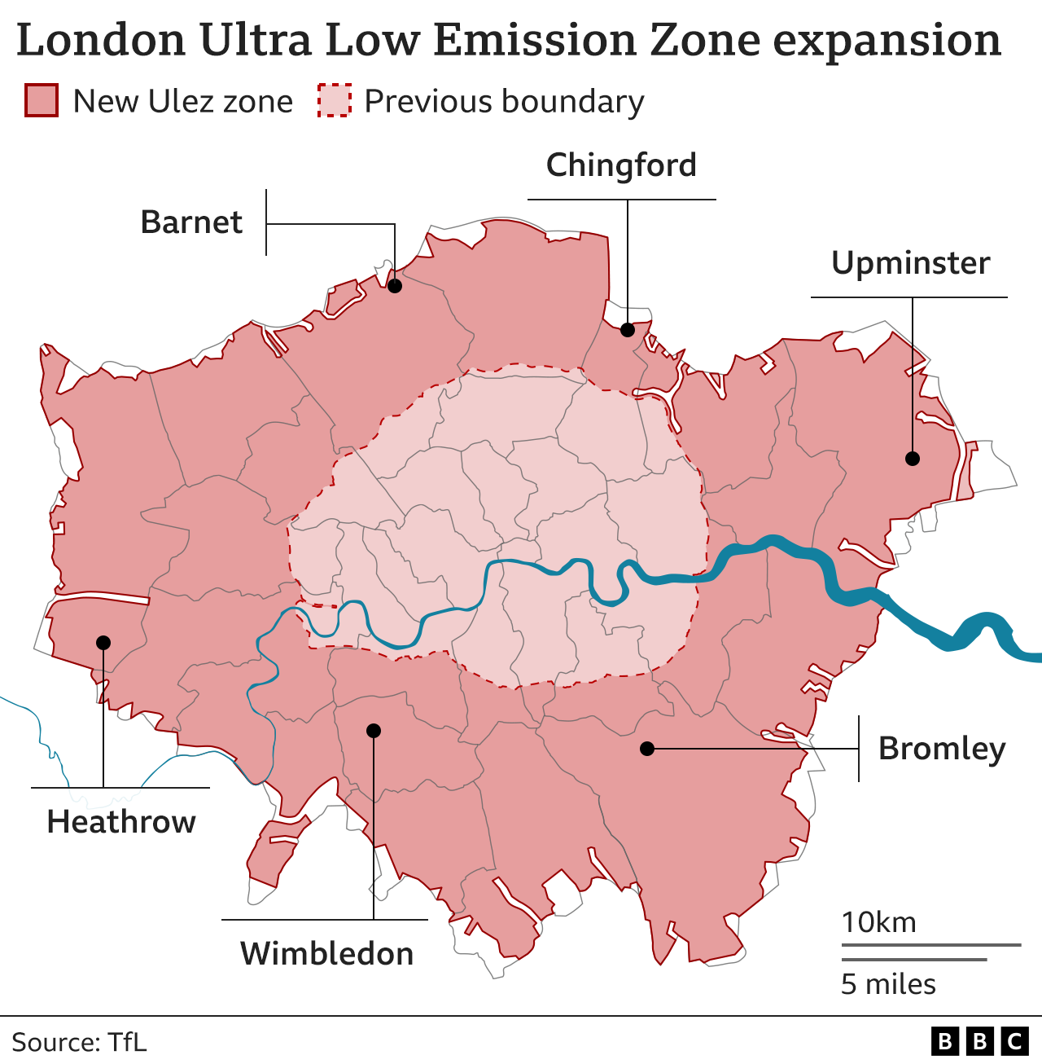
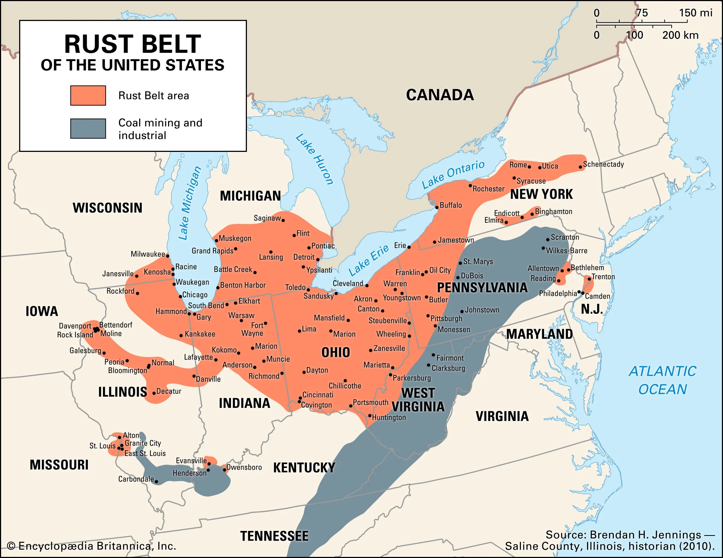
To describe different mitigation strategies
A 'just transition' means moving to a more sustainable economy in a way that's fair to everyone – including people working in polluting industries
https://www.britannica.com/place/Rust-Belt
https://www.bbc.co.uk/news/uk-england-london-66592199
Notes:
https://www.britannica.com/place/Rust-Belt

Slide 6
Reading exercise:
To describe different mitigation strategies
A just transition refers to a process of economic and social change that aims to address the challenges and inequalities associated with transitions to more sustainable and equitable economies. This concept is often applied in the context of transitioning from a fossil fuel-based economy to one that is more environmentally sustainable. The idea is to ensure that the shift to cleaner and more sustainable practices doesn't disproportionately harm certain communities, workers, or social groups.
Key principles of a just transition include:
Equity and Social Justice: Ensuring that the benefits and burdens of the transition are distributed fairly among different groups within society. This includes considering the impact on workers, vulnerable communities, and other affected stakeholders.
Worker Rights and Support: Protecting the rights of workers affected by the transition, including providing support for retraining, reskilling, and assistance in finding new employment opportunities.
Community Engagement: Involving local communities and stakeholders in the decision-making processes related to the transition to ensure their perspectives, needs, and concerns are taken into account.
Environmental Justice: Addressing and rectifying existing environmental injustices, particularly those disproportionately affecting marginalised communities.
Diversity and Inclusion: Promoting diversity and inclusion in the new, sustainable economy to prevent the perpetuation of existing social and economic disparities.
The concept of a just transition recognizes that moving toward sustainability and addressing environmental challenges is necessary but must be done in a way that doesn't exacerbate existing social and economic inequalities. It's an inclusive and holistic approach that considers the broader societal impacts of transitions to a more sustainable future. The term has been used in various contexts, including discussions on climate change, energy transition, and sustainable development.
Notes:
Adapted -https://ec.europa.eu/regional_policy/sources/funding/just-transition-fund/guidelines-engage-people-vulnerable-situations.pdf

Slide 7
Activity 4 - Scenario
To describe different mitigation strategies
Success criteria
How you might you support workers who may lose their jobs in the coal industry?
How you will ensure communities who have been affected by coal mining receive support?
How will your transition plan ensure that both mitigation and adaptation efforts continue over time, creating a long-lasting, sustainable future for all groups?
.
Imagine you are a policymaker in a country that is moving from coal to renewable energy sources like wind or solar.
As part of this transition, you must ensure that the process is fair and just for all people.
effectively contributes to climate change mitigation (reducing greenhouse gas emissions) and adaptation (helping people adjust to climate impacts).

