Slide 1
Stay Home
Lesson 5
Future Places
Paula Owens

Slide 2
Noticing the world
What do we like about our place?
What would we change?
Who else lives in this place?
What makes a healthy environment - for humans and other living things?

Slide 3
What makes a place special?
Good for people to live well together?
Good for jobs and the economy?
Good for the environment and other living things?

Slide 4
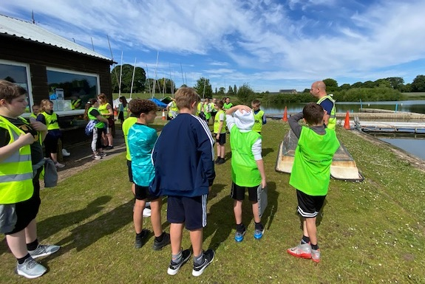
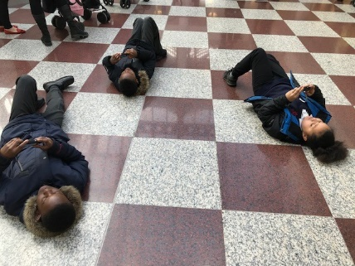
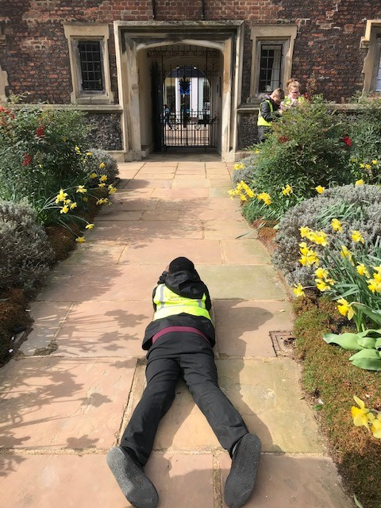
Noticing the everyday wonders
What’s special where we live?
Which places or features are the most important and why?
Pupils explore their town centre, Croydon by looking carefully, and in new ways.
Gresford Primary pupils explore what’s on their doorstep.

Slide 5
I Wonder …
Wonder:
a) rapt attention or astonishment at something awesomely mysterious or new to one's experience.
b) feeling of doubt or uncertainty
How would you describe this word? What other definitions can you find?
What new wonders have you discovered?
What do you wonder about them?

Slide 6
I Wonder ….
 | where | how | what | when | if
I wonder
Why is your ‘wonder’ special?
Which questions will you ask?
Can you put the answers on a map using text boxes or call outs?
What other information could you add?

Slide 7
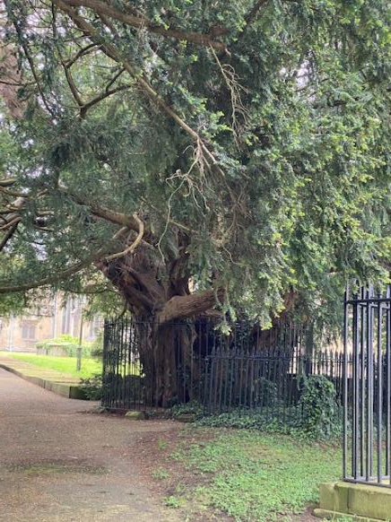
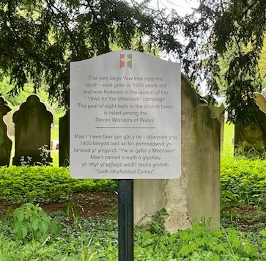
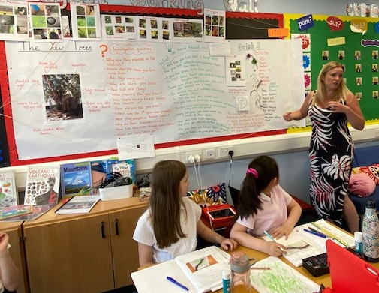
The Wonder of Trees
On the doorstep of Gresford School, children discovered the Gresford Yews, already thought to be a wonder of Wales.
Where were they? How old were they? Why were they there? What were they like?

Slide 8
Investigating local wonders through fieldwork
Are you prepared?
What do you want to find out?
How will you do it?
Which techniques are best and why?
Locating | Questioning | Measuring | Photographing | Feeling
Mapping | Surveying | Counting | Sketching | Describing
Here are some techniques you might think about developing further.

Slide 9
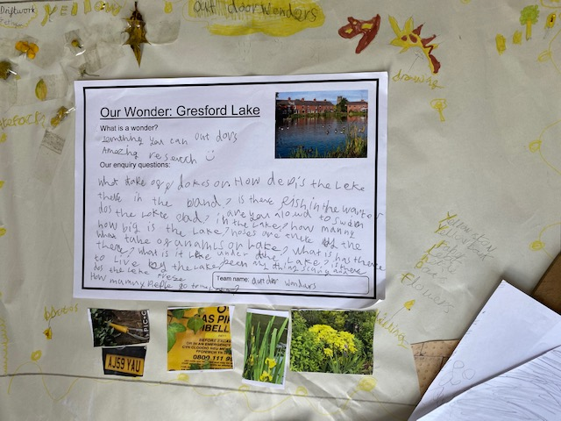
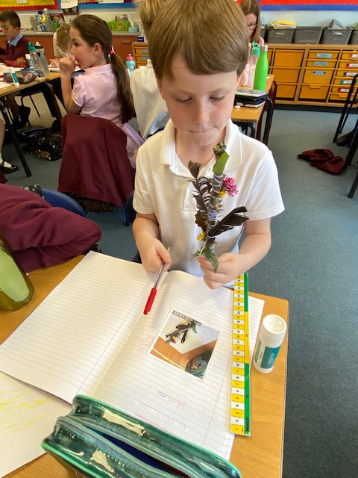
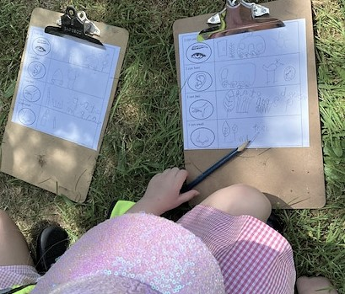
Data Collection
Questioning and ‘Drifts’
Journey Sticks
Recording sensory data

Slide 10
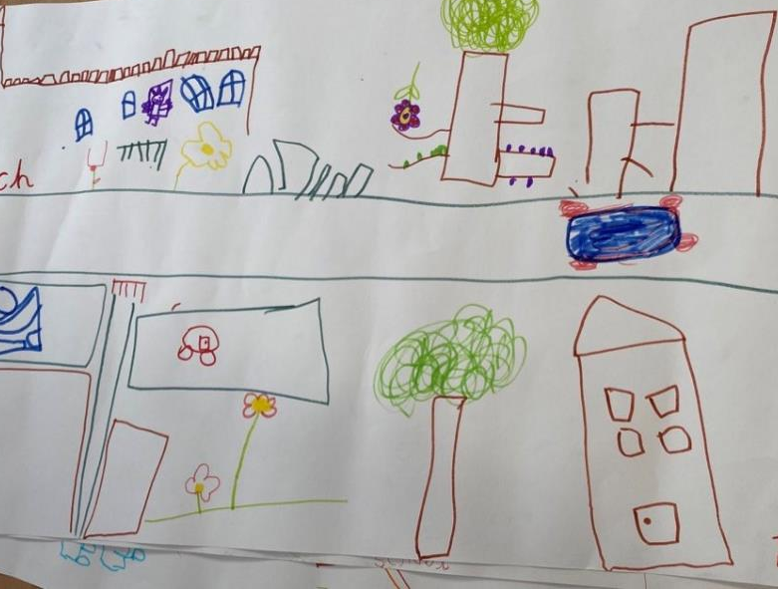
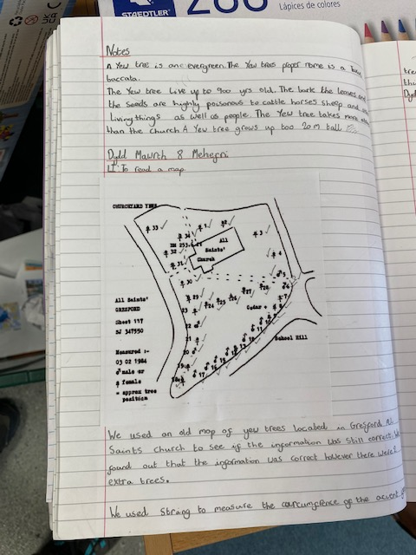
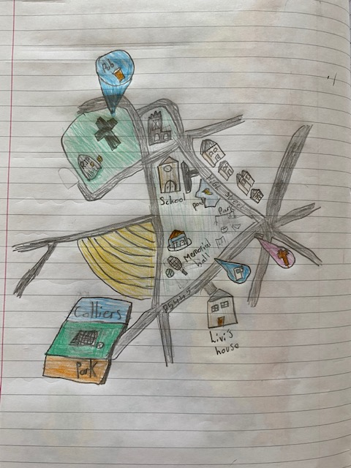
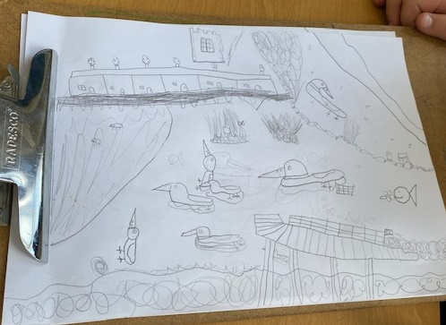
Data Collection
Using and making maps are an essential part of geography data collection
Field sketching’

Slide 11
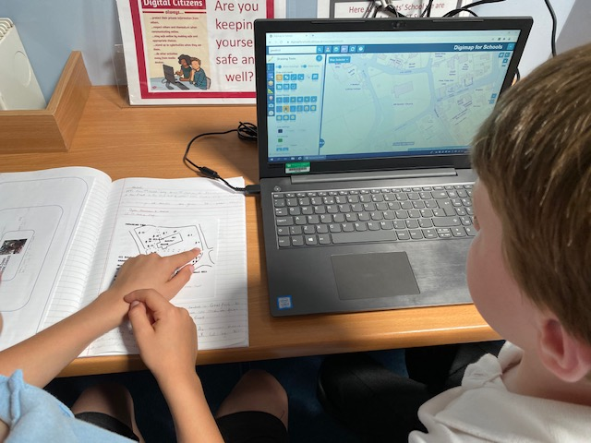
Data Analysis
Children at Gresford Primary compared their own ‘Gresford Yews’ observations in the field with a historical map showing their location and number.
They found their data was different and created updated maps.

Slide 12
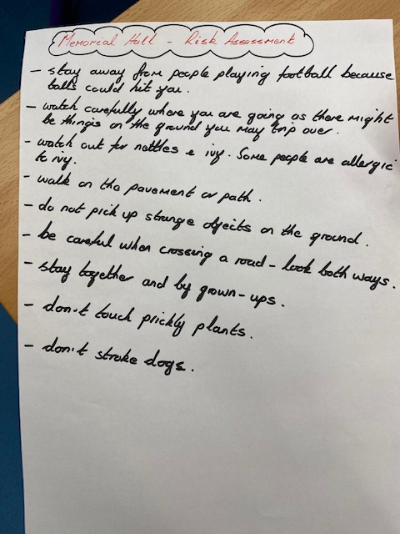
Risk Assessment
Pupils used maps and websites to carry out their own risk assessment before going out.
All Saints Primary in Gresford

Slide 13
True or False?
Places are always changing.
We can’t change the past.
We can choose to act differently
We can shape the future
We are part of the natural world
There are things we can do to make the planet a healthier place to live.

Slide 14
Thinking about futures
From Dave Hicks (2014)
Preferred Futures
Possible Futures
Probable Futures
Why do we say there is more than one future? Which one would you choose and why?

Slide 15
What do you your place to be like?
What would you change and why?
Look at how changes in this city in Colombia, S America, helped people and environment.
https://ashden.org/winners/alcaldia-de-medellin/

Slide 16
Resources
Hicks, D. (2014) Educating for Hope in Troubled Times London:IOEPress
Children’s views of the future Diapositivo 1 (uac.pt)
Digimap for schools www.digimapforschools.edina.ac.uk
Google Maps www.maps.google.co.uk
The world in 2050 https://www.wired.co.uk/article/earth-2050-kaspersky-map
Trip geo www.tripgeo.com
Ashden www.ashden.org

Slide 17
Submit your maps
Please submit your Stay Home maps through www.rgs.org/stayhome –
we are really interested to see what you have created!

