Slide 1

Carbon capture in Oman
Learning Goals
Know what carbon capture is and why is it important in the fight against climate change.
Understand the chemistry of mineralisation.
Use the case study of 44.01 as an example of effective climate action in Oman.

Slide 2
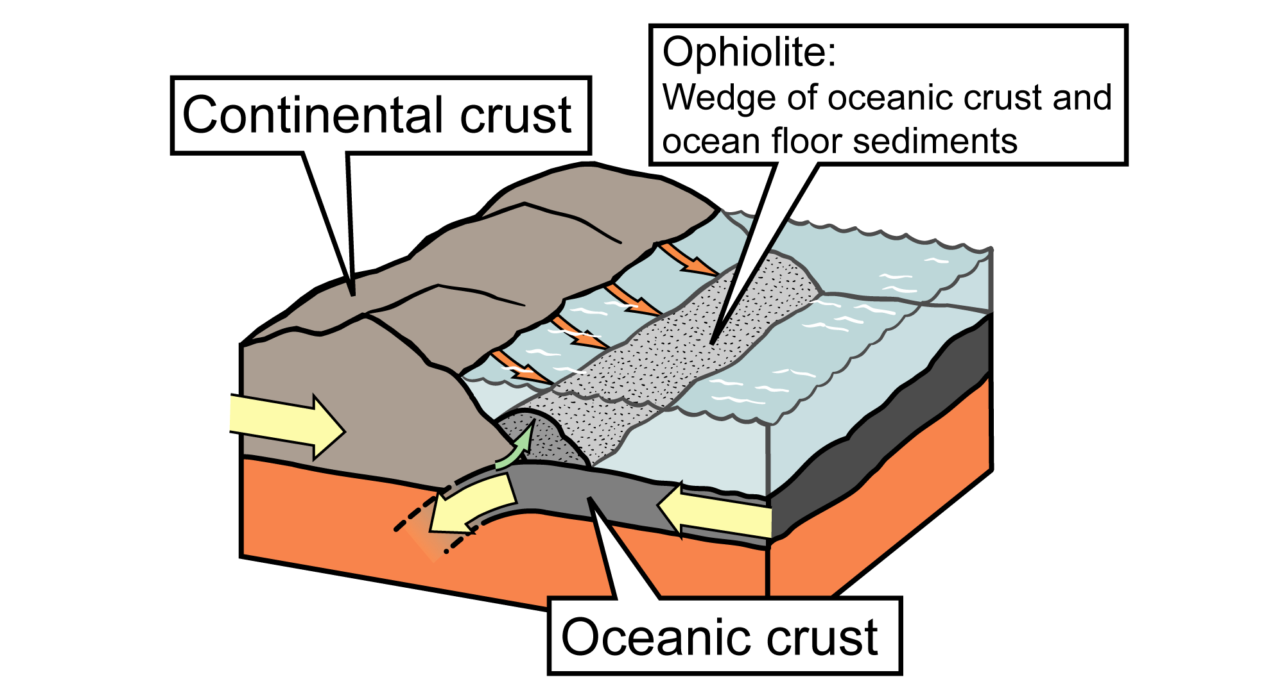
Ophiolite
What is Ophiolite?
Ophiolite is a rock formation, or suite of rocks that often includes rocks such as limestone, basalt, gabbro, and peridotite.
The ophiolite rock formations represent a section of Earth's oceanic crust that has been uplifted above sea level through tectonic processes, such as subduction or continental collision.
Image Source: J. Houghton © modified by the Earth@Home project

Slide 3
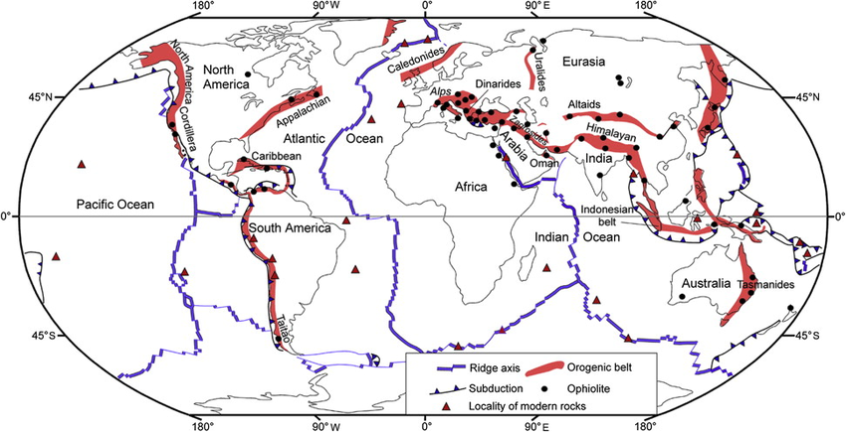
Locating ophiolite
The map shows the global distribution of ophiolite belts. These linear regions of uplifted and exposed rock reveal multiple layers of rock, one of which is peridotite.
Using the map, describe the distribution of ophiolite.
Image source: Global distribution of ophiolitic belts © ResearchGate

Slide 4
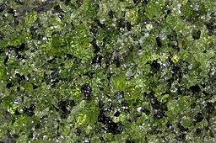
Using peridotite for carbon capture
The Oman Ophiolite Belt is one of the best-preserved and studied ophiolite regions in the world. It is one of the largest and most complete sequences in the world.
In Oman, a company called 44.01 has developed a technology to capture carbon and bury it underground using peridotite. This technology is both effective and scalable, meaning it has the potential to achieve negative emissions in the future, making it a promising form of negative emissions technology.
Peridotite@James St. John, CC BY 2.0 httpscreativecommons.orglicensesby2.0, via Wikimedia Commons

Slide 5

What is carbon capture?
Watch the following video and answer the questions on carbon capture on your sheet.

Slide 6

Who are 44.01?
From the video, summarise who 44.01 are and what they do on your sheets.

Slide 7
The rock candy experiment
Task
We are going to start an activity today that illustrates the process of crystallisation, called the rock candy experiment.
On your desks, check that you have the following supplies:
A clean glass jar
String or wooden skewers
A pencil or chopstick
Sugar
Water
Food colouring (optional)
Paper clips (if using string)
Safety goggles
Protective gloves

Slide 8
The rock candy experiment
Step 1
Heat some water in a pot and gradually dissolve sugar into it, stirring constantly. Continue adding sugar until no more can dissolve, creating a ‘supersaturated solution’.
Step 2
Tie a string to a pencil or chopstick and rest it across the top of the jar, with the string hanging into the sugar solution. Attach a paper clip to the bottom of the string to weigh it down (you can use a wooden skewer instead of a string).
Step 3
Add your food colouring.
Step 4
Place the jar in a safe spot and cover it loosely with a lid or plastic wrap. Leave it undisturbed for several days. As the water evaporates, sugar molecules will crystallise on the string/skewer.

Slide 9
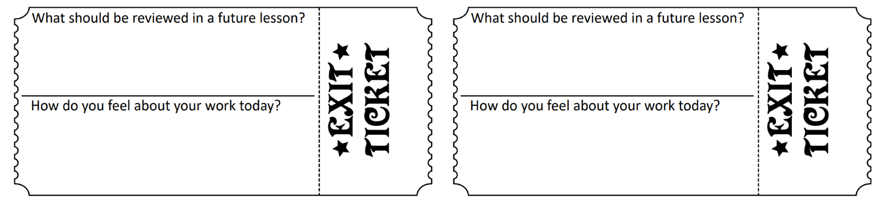
Exit ticket
Using your exit ticket, write a question on something to do with today’s lesson. Swap the ticket with your partner. To exit the classroom, you must answer the question correctly.

