Slide 1
Recap Task
Climate justice, who is responsible
1.Name the main greenhouse gas
2.What is meant by climate mobility?
3.How is climate change and race linked?
4.Describe two local impacts of climate?
5.Describe two global impacts of climate change?

Slide 2
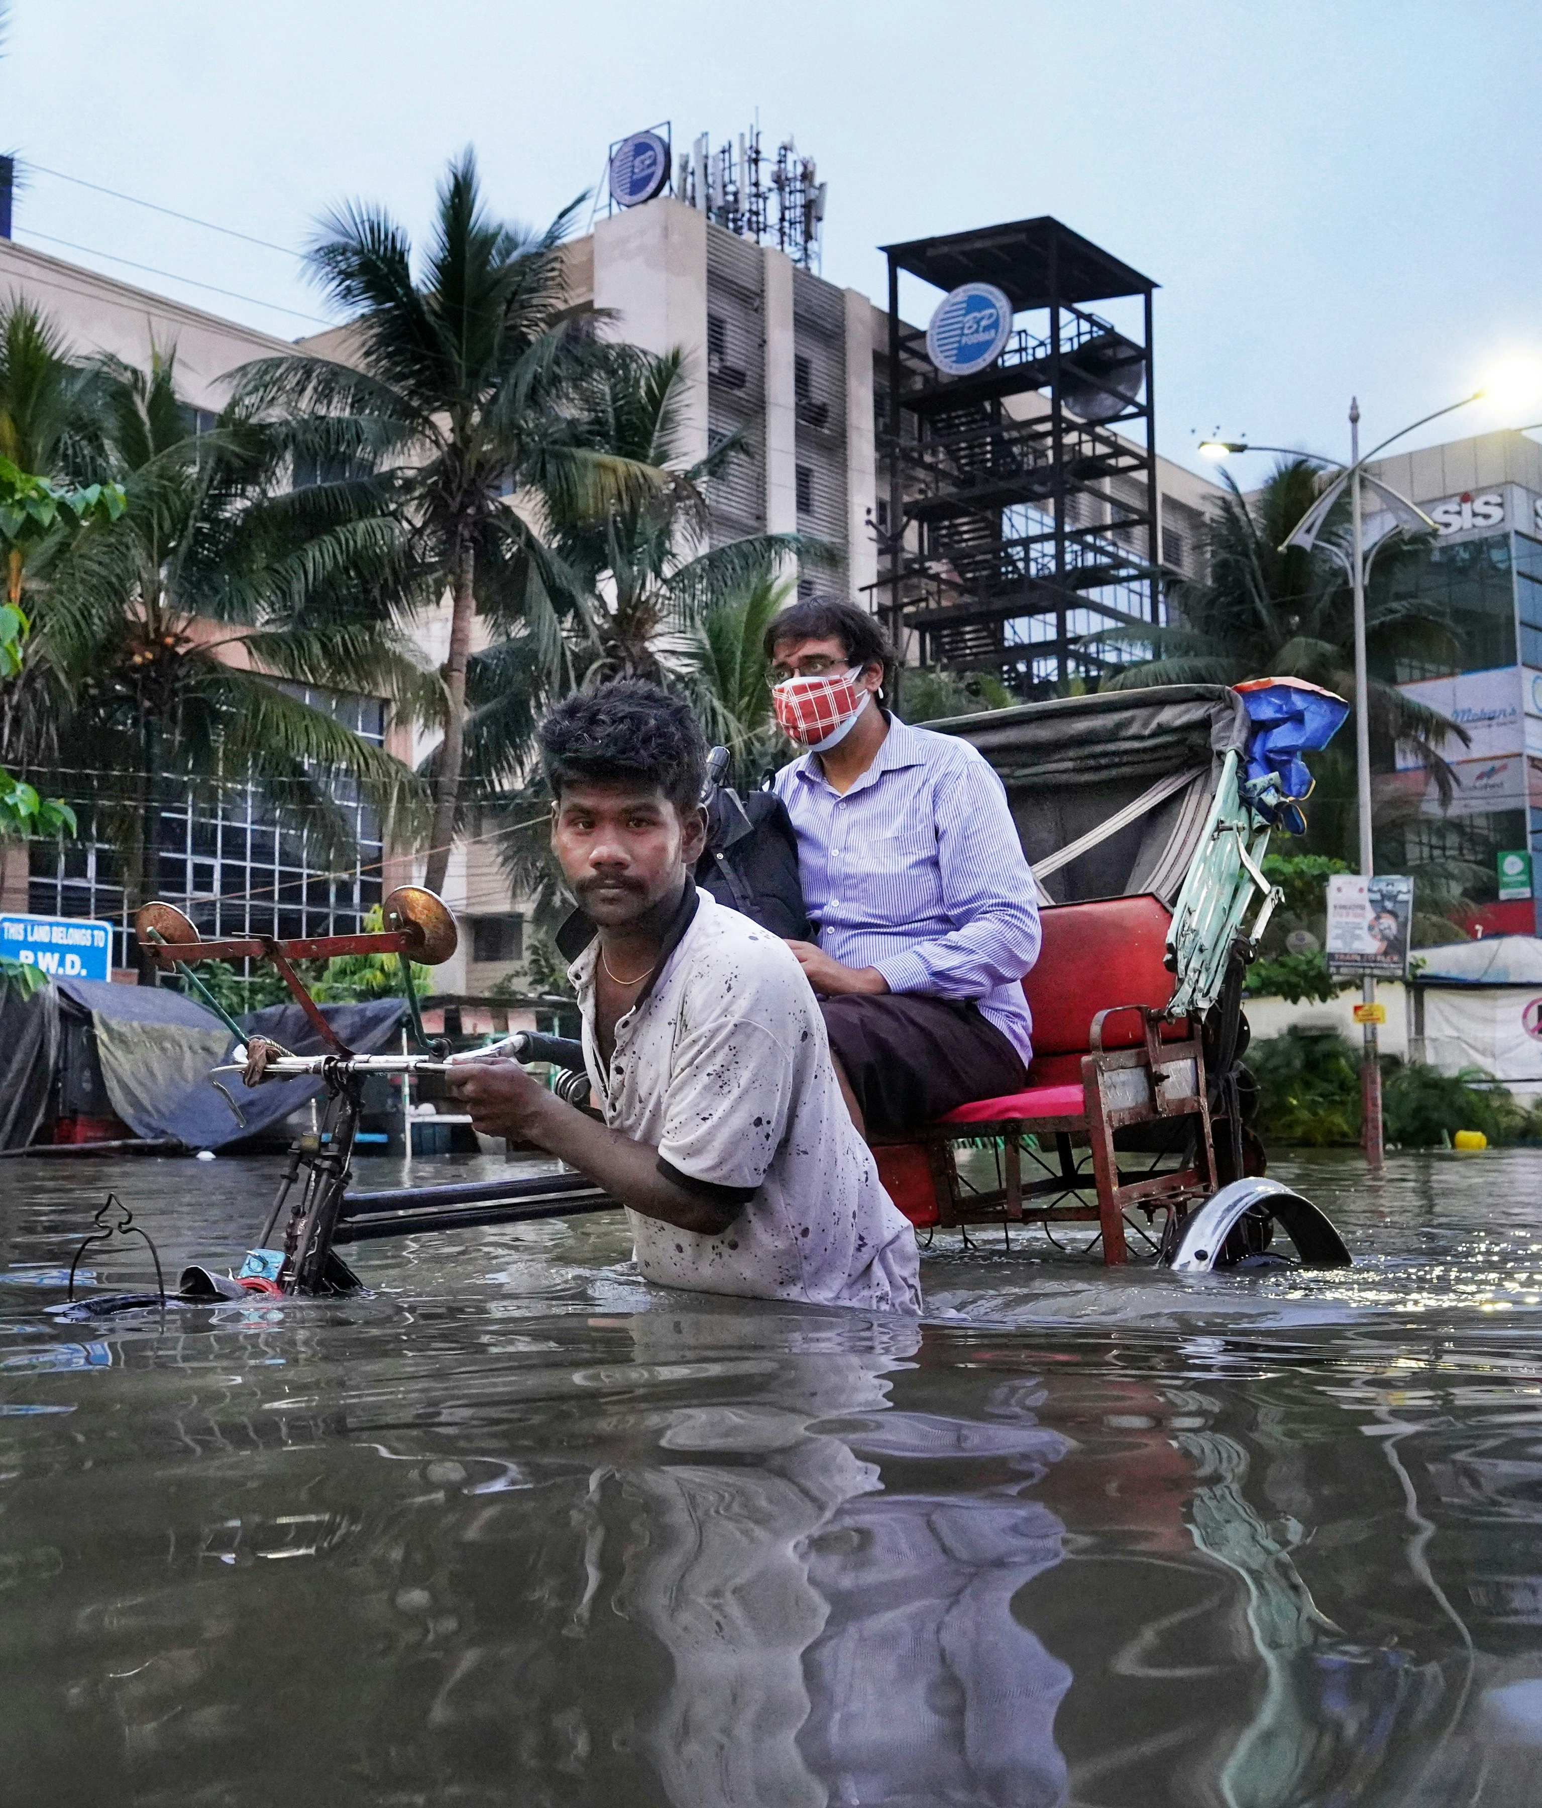
Recap Task
Climate justice, who is responsible
Name the main greenhouse gas: The main greenhouse gas is carbon dioxide (CO2).
What is meant by climate mobility?: Climate mobility refers to people moving from one place to another because of changes in climate.
How is climate change and race linked?: Climate change can affect everyone, but it often impacts communities of colour more severely due to factors like unequal access to resources
Describe two local impacts of climate: frequent heatwaves and droughts, as well as increased flooding during heavy rainstorms.
Describe two global impacts of climate change: rising temperatures, melting glaciers and ice caps, as well as more intense hurricanes and wildfires around the world
Dibakar Roy/Unsplash

Slide 3
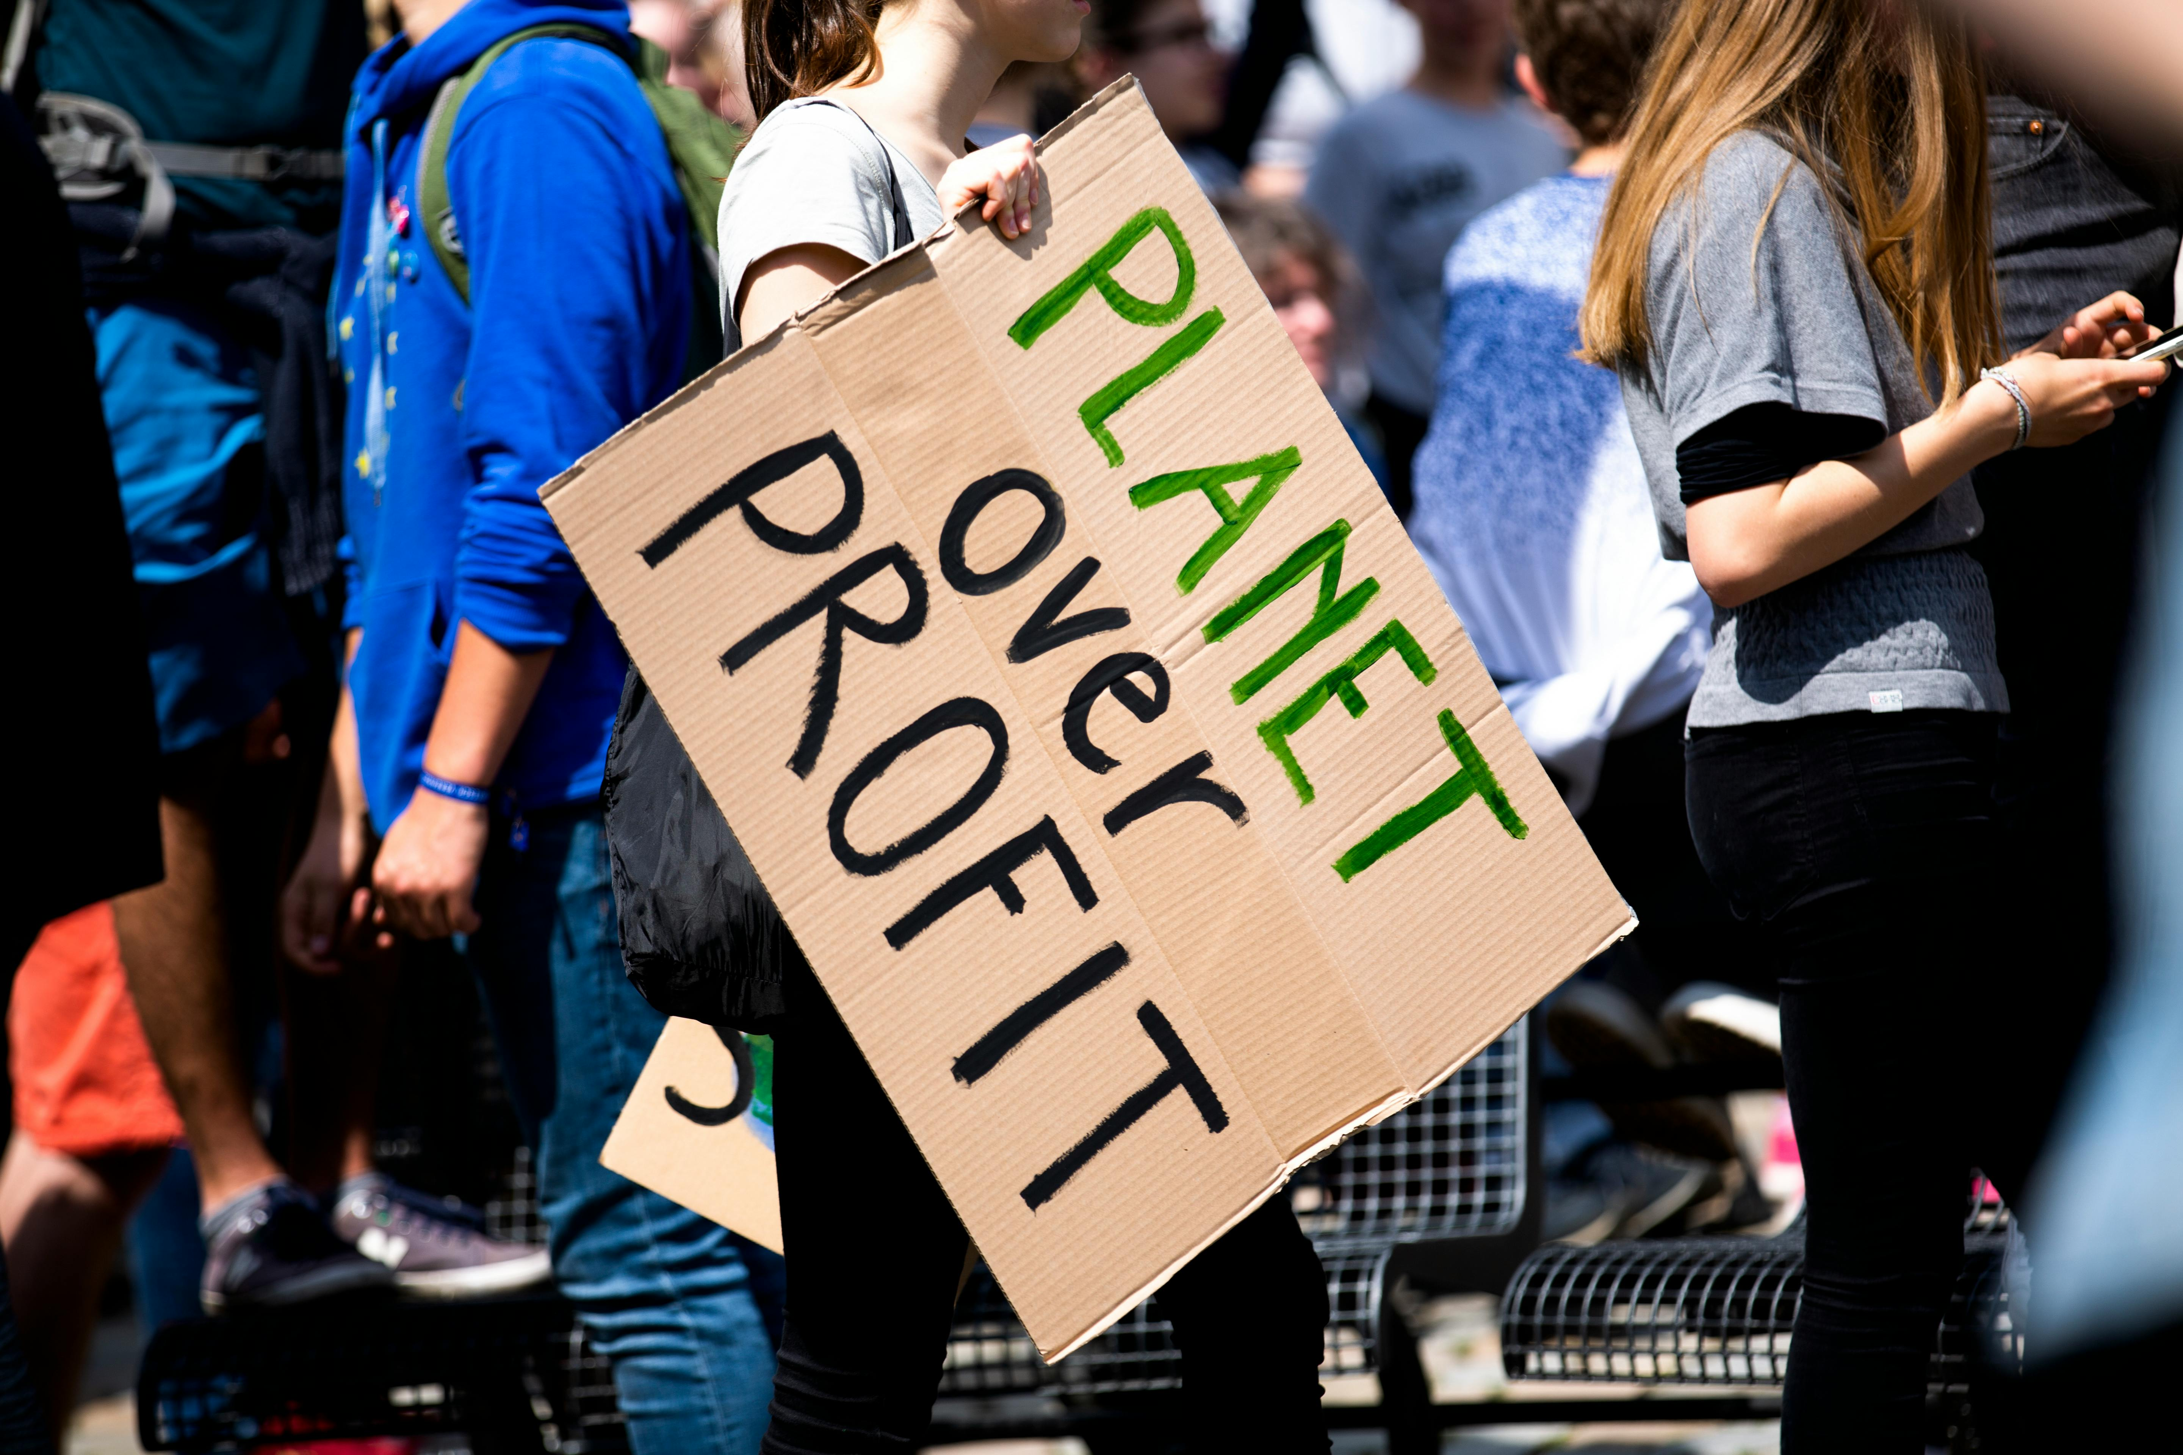
Is Greta correct?
Climate justice, who is responsible
Read
Greta Thunberg’s speech
Markus Spiske/Pexels

Slide 4
Who is responsible
Climate justice, who is responsible
This is all wrong. I shouldn’t be standing here. I should be back in school on the other side of the ocean. Yet you all come to me for hope? How dare you! You have stolen my dreams and my childhood with your empty words. And yet I’m one of the lucky ones. People are suffering. People are dying. Entire ecosystems are collapsing. We are in the beginning of a mass extinction. And all you can talk about is money and fairytales of eternal economic growth. How dare you!
For more than 30 years the science has been crystal clear. How dare you continue to look away, and come here saying that you are doing enough, when the politics and solutions needed are still nowhere in sight.
With today’s emissions levels, our remaining CO2 budget will be gone in less than 8.5 years
You say you “hear” us and that you understand the urgency. But no matter how sad and angry I am, I don’t want to believe that. Because if you fully understood the situation and still kept on failing to act, then you would be evil. And I refuse to believe that.
The popular idea of cutting our emissions in half in 10 years only gives us a 50% chance of staying below 1.5C degrees, and the risk of setting off irreversible chain reactions beyond human control.
Maybe 50% is acceptable to you. But those numbers don’t include tipping points, most feedback loops, additional warming hidden by toxic air pollution or the aspects of justice and equity. They also rely on my and my children’s generation sucking hundreds of billions of tonnes of your CO2 out of the air with technologies that barely exist. So a 50% risk is simply not acceptable to us – we who have to live with the consequences.
To have a 67% chance of staying below a 1.5C global temperature rise – the best odds given by the Intergovernmental Panel on Climate Change – the world had 420 gigatonnes of carbon dioxide left to emit back on 1 January 2018. Today that figure is already down to less than 350 gigatonnes. How dare you pretend that this can be solved with business-as-usual and some technical solutions. With today’s emissions levels, that remaining CO2 budget will be entirely gone in less than eight and a half years.
There will not be any solutions or plans presented in line with these figures today. Because these numbers are too uncomfortable. And you are still not mature enough to tell it like it is.
You are failing us. But the young people are starting to understand your betrayal. The eyes of all future generations are upon you. And if you choose to fail us I say we will never forgive you. We will not let you get away with this. Right here, right now is where we draw the line. The world is waking up. And change is coming, whether you like it or not.
Read
Greta Thunberg speech
Notes:
Video/Transcript

Slide 5

Climate justice, who is responsible
Justice
What does justice mean to you?
Try write your own definition
How could we link this to climate change?

Slide 6
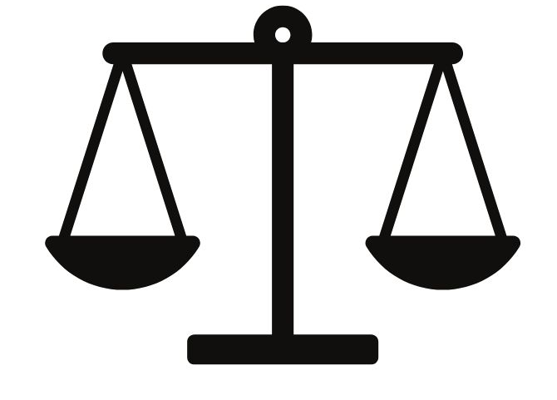
Climate justice, who is responsible
Climate justice
A political idea that all people and communities have a right to safe, clean, and healthy environments.
In the UK, climate justice relates to concerns about the inequitable outcomes for different people and places associated with vulnerability to climate impacts and the fairness of policy and practice responses to address climate change and its consequences.
Or ensuring that collectively and individually we have the ability to prepare for, respond to and recover from climate change impacts – and the policies to mitigate or adapt to them – by considering existing vulnerabilities, resources and capabilities.
Notes:
https://www.climatejust.org.uk/what-climate-justice

Slide 7
Who is responsible for climate change?
Climate justice, who is responsible
Who is responsible? Justify your decision

Slide 8

Individuals
Climate justice, who is responsible
Did you know?
The Premier League football club responsible for the highest carbon emissions is Chelsea FC. They are responsible for 6,621 tonnes of CO2
Simon Reza/Pexels
Notes:
https://www.statista.com/statistics/1497016/premier-league-carbon-footprint/

Slide 9
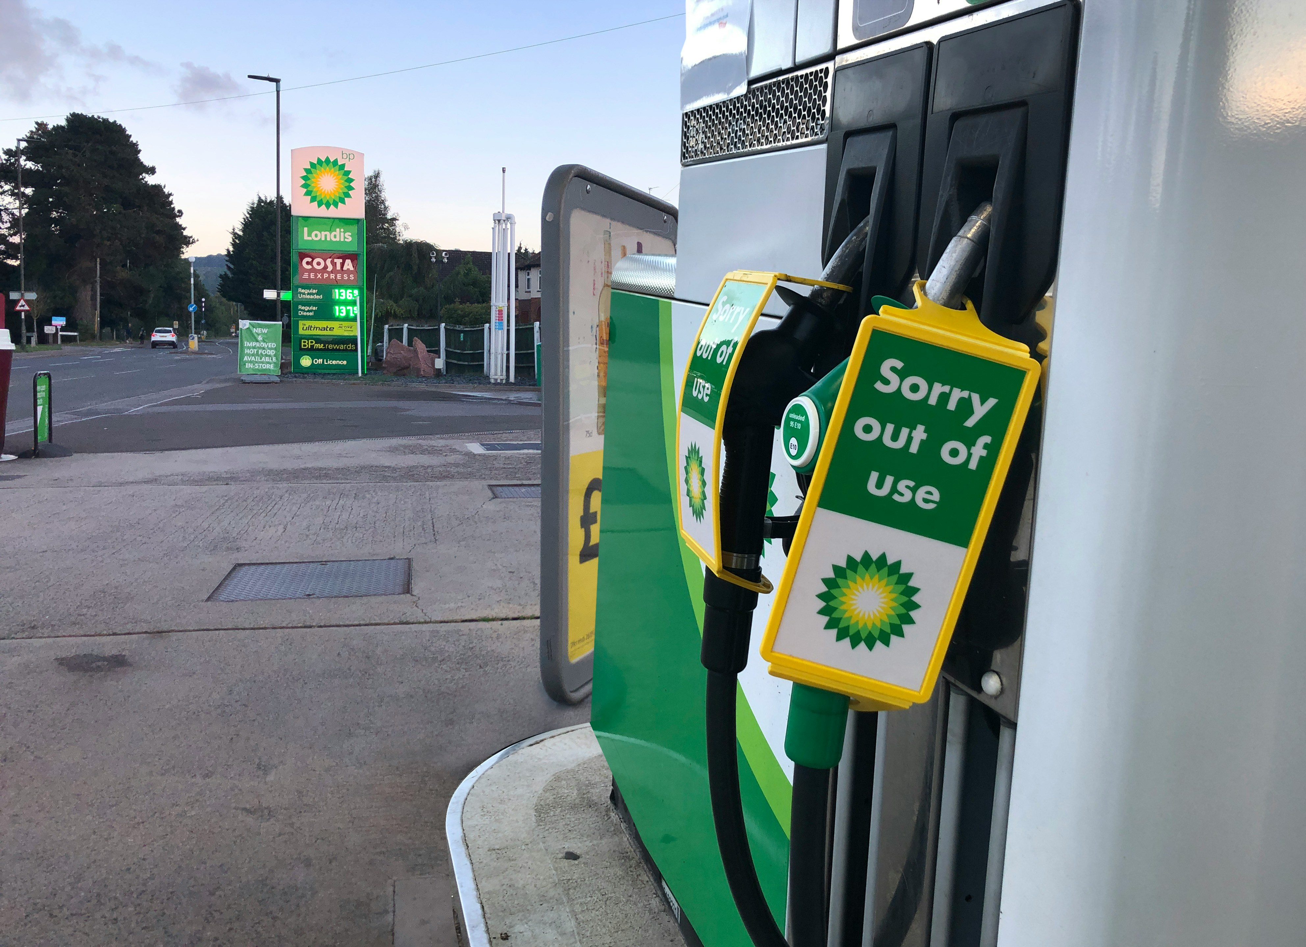
Companies…
Climate justice, who is responsible
Just 57 companies are linked to 80% of greenhouse gas emissions since 2016
Red Dot/Unsplash
Notes:
Image- https://www.bp.com/
https://www.theguardian.com/environment/2024/apr/04/just-57-companies-linked-to-80-of-greenhouse-gas-emissions-since-2016

Slide 10
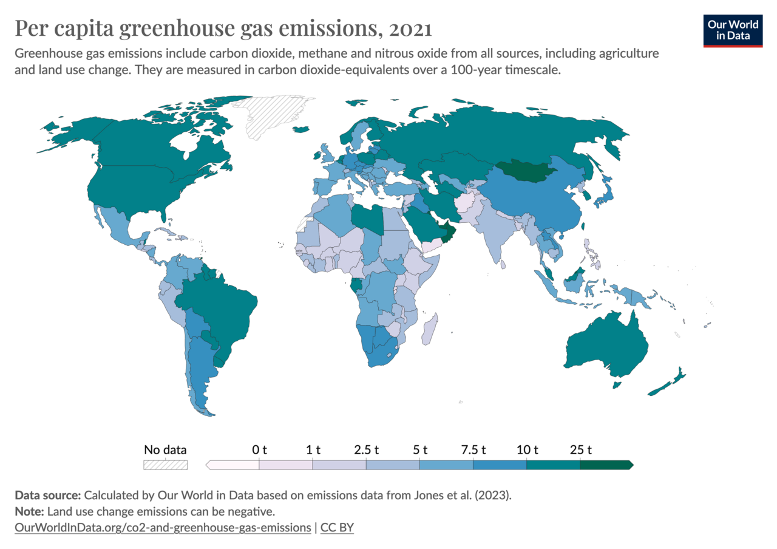
Countries
Climate justice, who is responsible
Notes:
https://ourworldindata.org/grapher/per-capita-ghg-emissions

Slide 11
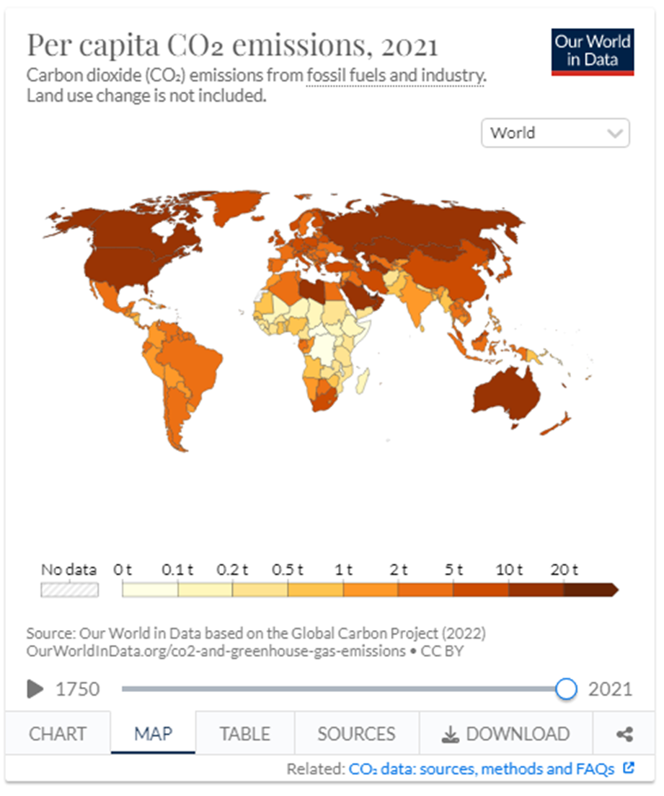
Discuss
Climate justice, who is responsible
What areas of the world have the most CO₂ emissions per capita?
What continent has the lowest CO₂ emissions?
From previous learning, what areas of the world are most affected?
What does this tell us?
Notes:
https://ourworldindata.org/grapher/per-capita-ghg-emissions

Slide 12
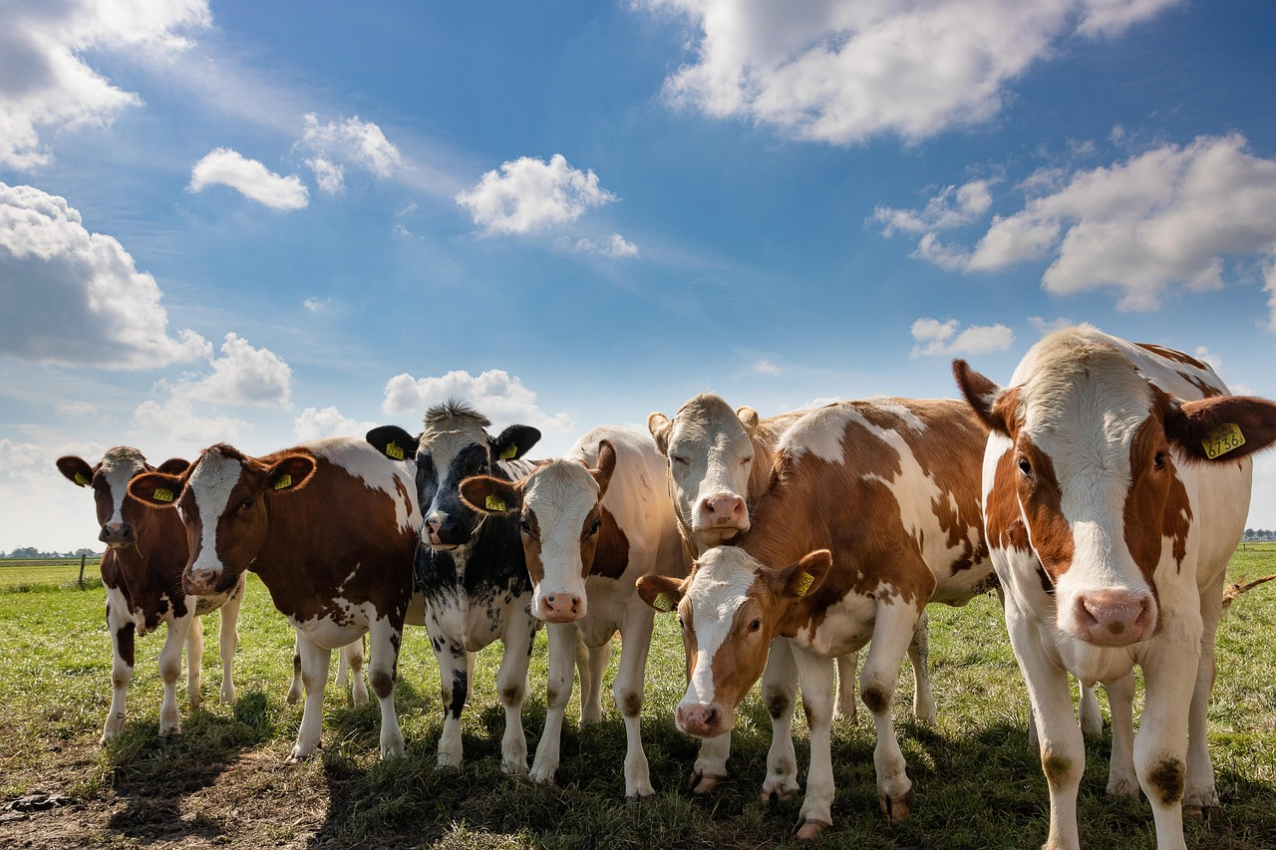
Consumers?
Climate justice, who is responsible
Products including clothing, processed foods and electronics imported into the UK are counted as the manufacturing country’s emissions, not the UK’s - although they would not have been produced were it not for UK demand. This accounts for 46% of the UK’s emissions yet are not currently covered by national reporting or included in the UK’s net zero target. Nearly half UK carbon footprint is from overseas emissions | University of Leeds
Meat accounts for nearly 60% of all greenhouse gases from food production Meat accounts for nearly 60% of all greenhouse gases from food production, study finds | Meat industry | The Guardian
The richest 1% of the global population emit twice as much as the poorest 50% How Buying Stuff Drives Climate Change (columbia.edu)
ReneH12/Pixabay

Slide 13
Climate justice, who is responsible
Excessive mansion energy use owning and operating large mansions with high energy consumption for heating, cooling, and lighting | Shell's operations emitted around 73 million metric tons of CO2 equivalent in 2020. | A single private jet flight can produce as much CO2 as the average person does in a year. | Brazil lost over 10,000 square kilometres of forest cover in the Amazon in 2020, an increase from previous years.
Promoting and indulging in luxury fashion consumption, contributing to overproduction and waste in the fashion industry. The fashion industry is responsible for approximately 10% of global carbon emissions. | Owning exotic pets, leading to illegal wildlife trafficking, habitat destruction, and biodiversity loss. Justin Bieber reported owns two savannah cats | ExxonMobil is responsible for approximately 4.7% of global industrial greenhouse gas emissions. | Russia's energy sector accounted for 68% of its total greenhouse gas emissions in 2020.
China is the world's largest emitter of CO2, accounting for approximately 27% of global emissions. | BP aims to reduce its oil and gas production by 40% and increase renewable energy capacity to 50 GW by 2030. | Alberta's oil sands industry is a significant contributor to Canada's overall greenhouse gas emissions. | The United States emitted approximately 5.1 billion metric tons of CO2 equivalent in 2020. They also withdrew from the Paris agreement
The yacht owned by Roman Abramovich, the billionaire who built a fortune off of trading gas and oil, for example, was responsible for 22,440 metric tons of carbon emissions that year—the same as the emissions released by over 4,800 gasoline cars driving for a year in the U.S. | 100 companies have been responsible for 71% of global greenhouse gas emissions | Exxon, a multinational gas and oil company, which was revealed to have been aware of climate change for decades. Rather than acting early on to tackle this threat, they instead led efforts to block measures that would cut emissions | The huge volume of planet-heating gases pumped out by the US, the largest historical emitter, has caused such harm to other, mostly poor, countries through heatwaves, crop failures and other consequences that the US is responsible for $1.91tn in lost global income since 1990
Consumer
Individual
Company
State

Slide 14
Climate justice, who is responsible
Who is responsible for climate justice
Time for task:
15 mins
Help box:
Write a journal article. Image you are writing to yourself in 20 years, the climate maybe very different, explain to your future self
“Who is responsible for climate change?”
Success criteria
Have you used 3 PEEL?
Have you written an introduction ?
Have you written conclusions

Slide 15
Article by Chris Waugh
Climate justice, who is responsible
Climate change is one of the biggest threats to our world in the 21st century, with passionate activists advocating for change. Many of these changes involve increased sustainability, and encouraging consumers to buy ‘greener’ products, but this ignores the main culprit of fossil fuel emissions and climate change: corporations.
Since 1988, just 100 companies have been responsible for 71% of global greenhouse gas emissions.¹ In addition to this, only 25 corporations and state-owned organisations were found to be responsible for over 50% of the global industrial emissions² during the same time period. Due to these staggering numbers, you would think that the onus would be put on these corporations to change the way they operate. However, this has never been the case. Instead, the common solutions which aim to tackle climate change revolve around consumer choice, and changes individuals can make in their everyday lives. These include, buying green or sustainable products, using public transport or a bike, and becoming vegan or vegetarian, among many others. Whilst these changes are good to make, they do not consider those unable to make them. With green products costing almost 50% more than their ‘non-green’ alternatives³, buying them is simply out of the question for many working-class people. As well as this, many other individuals live in areas where public transport is unavailable, and travelling by bike is not possible. No one should feel pressured to make choices that are going to negatively impact their everyday lives. Assuming everyone is free to make these choices is a very privileged outlook, and one that is far too common among some environmental activists.
Corporations on the other hand can easily choose to make their products greener and more sustainable, by using alternative methods. However, the main issue here is many corporations could not care less about climate change and instead prioritise profits. They are completely ignorant about the effects their acts have on our planet. One of the many examples of this is Exxon, a multinational gas and oil company, which was revealed to have been aware of climate change for decades. Rather than acting early on to tackle this threat, they instead led efforts to block measures that would cut emissions.⁴ Many advertisements, or changes to the way products are made or packaged are more likely to be done due to pressure or because the company believes they can make more profit from it, rather than it being purely due to their own concern.
Notes:
Global Social Challenges | Corporations vs. Consumers: Who is really to blame for climate change? (manchester.ac.uk)

Slide 16
Resources: Additional resource if needed

Slide 17
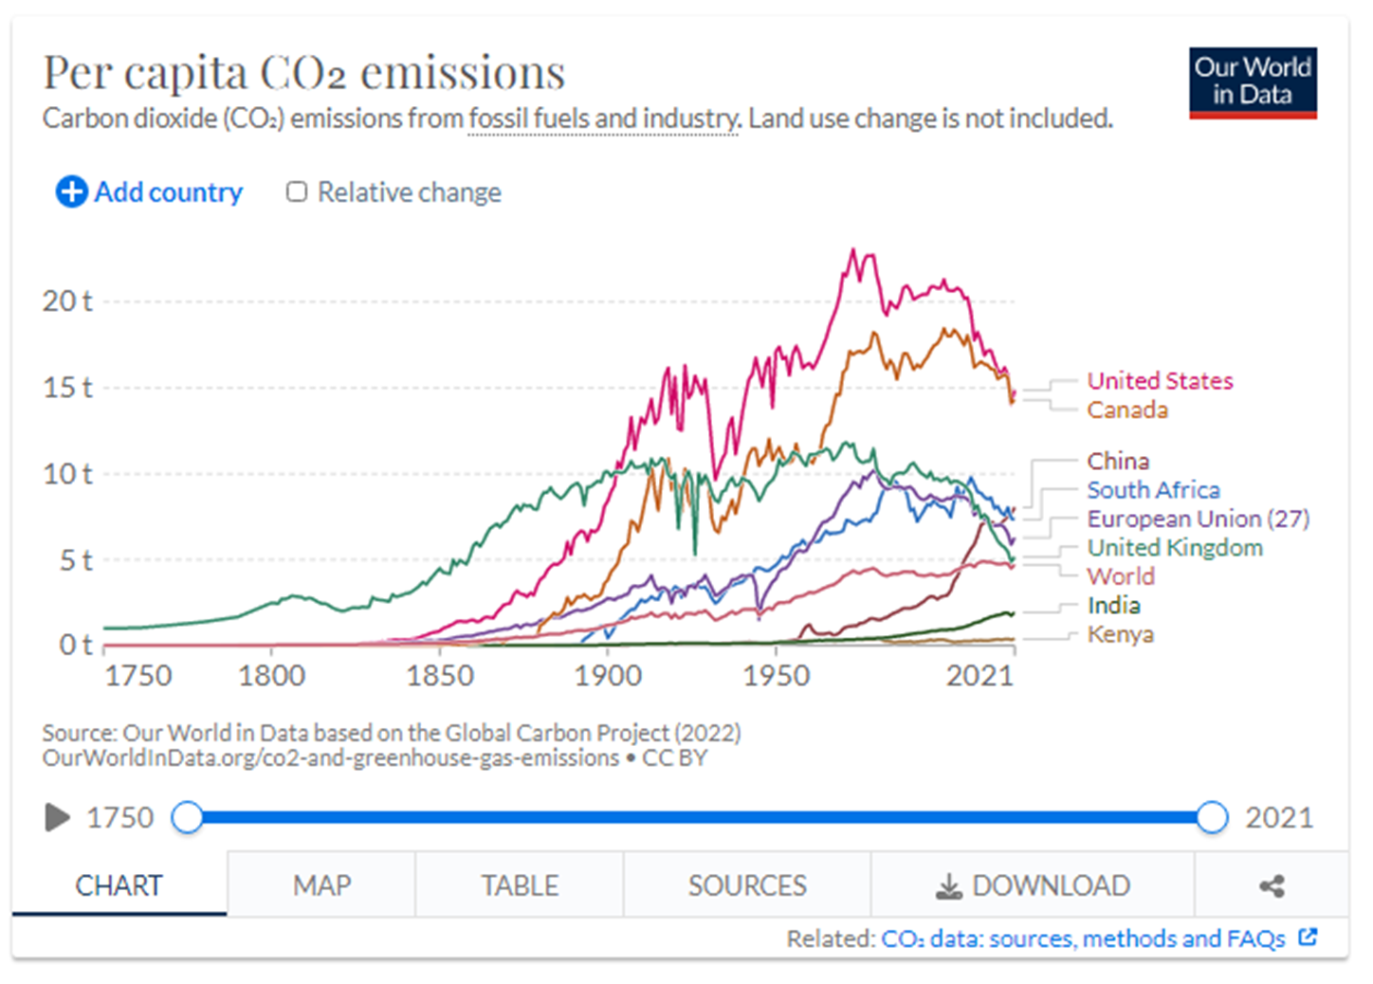
If you want to develop graph skills, you could use a resource such as this for a 10-minute activity
Notes:
https://ourworldindata.org/grapher/per-capita-ghg-emissions

Slide 18
Excessive Mansion Energy Use Owning and operating large mansions with high energy consumption for heating, cooling, and lighting | Shell's operations emitted around 73 million metric tons of CO2 equivalent in 2020. | A single private jet flight can produce as much CO2 as the average person does in a year. | Brazil lost over 10,000 square kilometers of forest cover in the Amazon in 2020, an increase from previous years.
Promoting and indulging in luxury fashion consumption, contributing to overproduction and waste in the fashion industry. The fashion industry is responsible for approximately 10% of global carbon emissions. | Owning exotic pets, leading to illegal wildlife trafficking, habitat destruction, and biodiversity loss. Justin Bieber reported owns two savannah cats | ExxonMobil is responsible for approximately 4.7% of global industrial greenhouse gas emissions. | Russia's energy sector accounted for 68% of its total greenhouse gas emissions in 2020.
China is the world's largest emitter of CO2, accounting for approximately 27% of global emissions. | BP aims to reduce its oil and gas production by 40% and increase renewable energy capacity to 50 GW by 2030. | Alberta's oil sands industry is a significant contributor to Canada's overall greenhouse gas emissions. | The United States emitted approximately 5.1 billion metric tons of CO2 equivalent in 2020. They also withdrew from the Paris agreement
The yacht owned by Roman Abramovich, the billionaire who built a fortune off of trading gas and oil, for example, was responsible for 22,440 metric tons of carbon emissions that year—the same as the emissions released by over 4,800 gasoline cars driving for a year in the U.S. | 100 companies have been responsible for 71% of global greenhouse gas emissions | Exxon, a multinational gas and oil company, which was revealed to have been aware of climate change for decades. Rather than acting early on to tackle this threat, they instead led efforts to block measures that would cut emissions | The huge volume of planet-heating gases pumped out by the US, the largest historical emitter, has caused such harm to other, mostly poor, countries through heatwaves, crop failures and other consequences that the US is responsible for $1.91tn in lost global income since 1990
Consumer
Individual
Company
State
Extension
1. What one of these factors is the worst?
Justify your answer?
2. How could we encourage

