Slide 1

Visualisers:
The possibilities are endless

Slide 2

Recommendations
https://www.amazon.co.uk/dp/B079DLTG9F/ref=cm_sw_r_cp_apa_i_podNFb48FCRAQ
https://www.amazon.co.uk/HUE-document-camera-Windows-Chrome-Blue/dp/B00U7LV402/ref=sr_1_1?crid=1IU6IGOK3NNVX&dchild=1&keywords=hue+pro+visualiser&qid=1604220769&s=electronics&sprefix=hue+pro%2Celectronics%2C185&sr=1-1
Notes:
7 mins

Slide 3
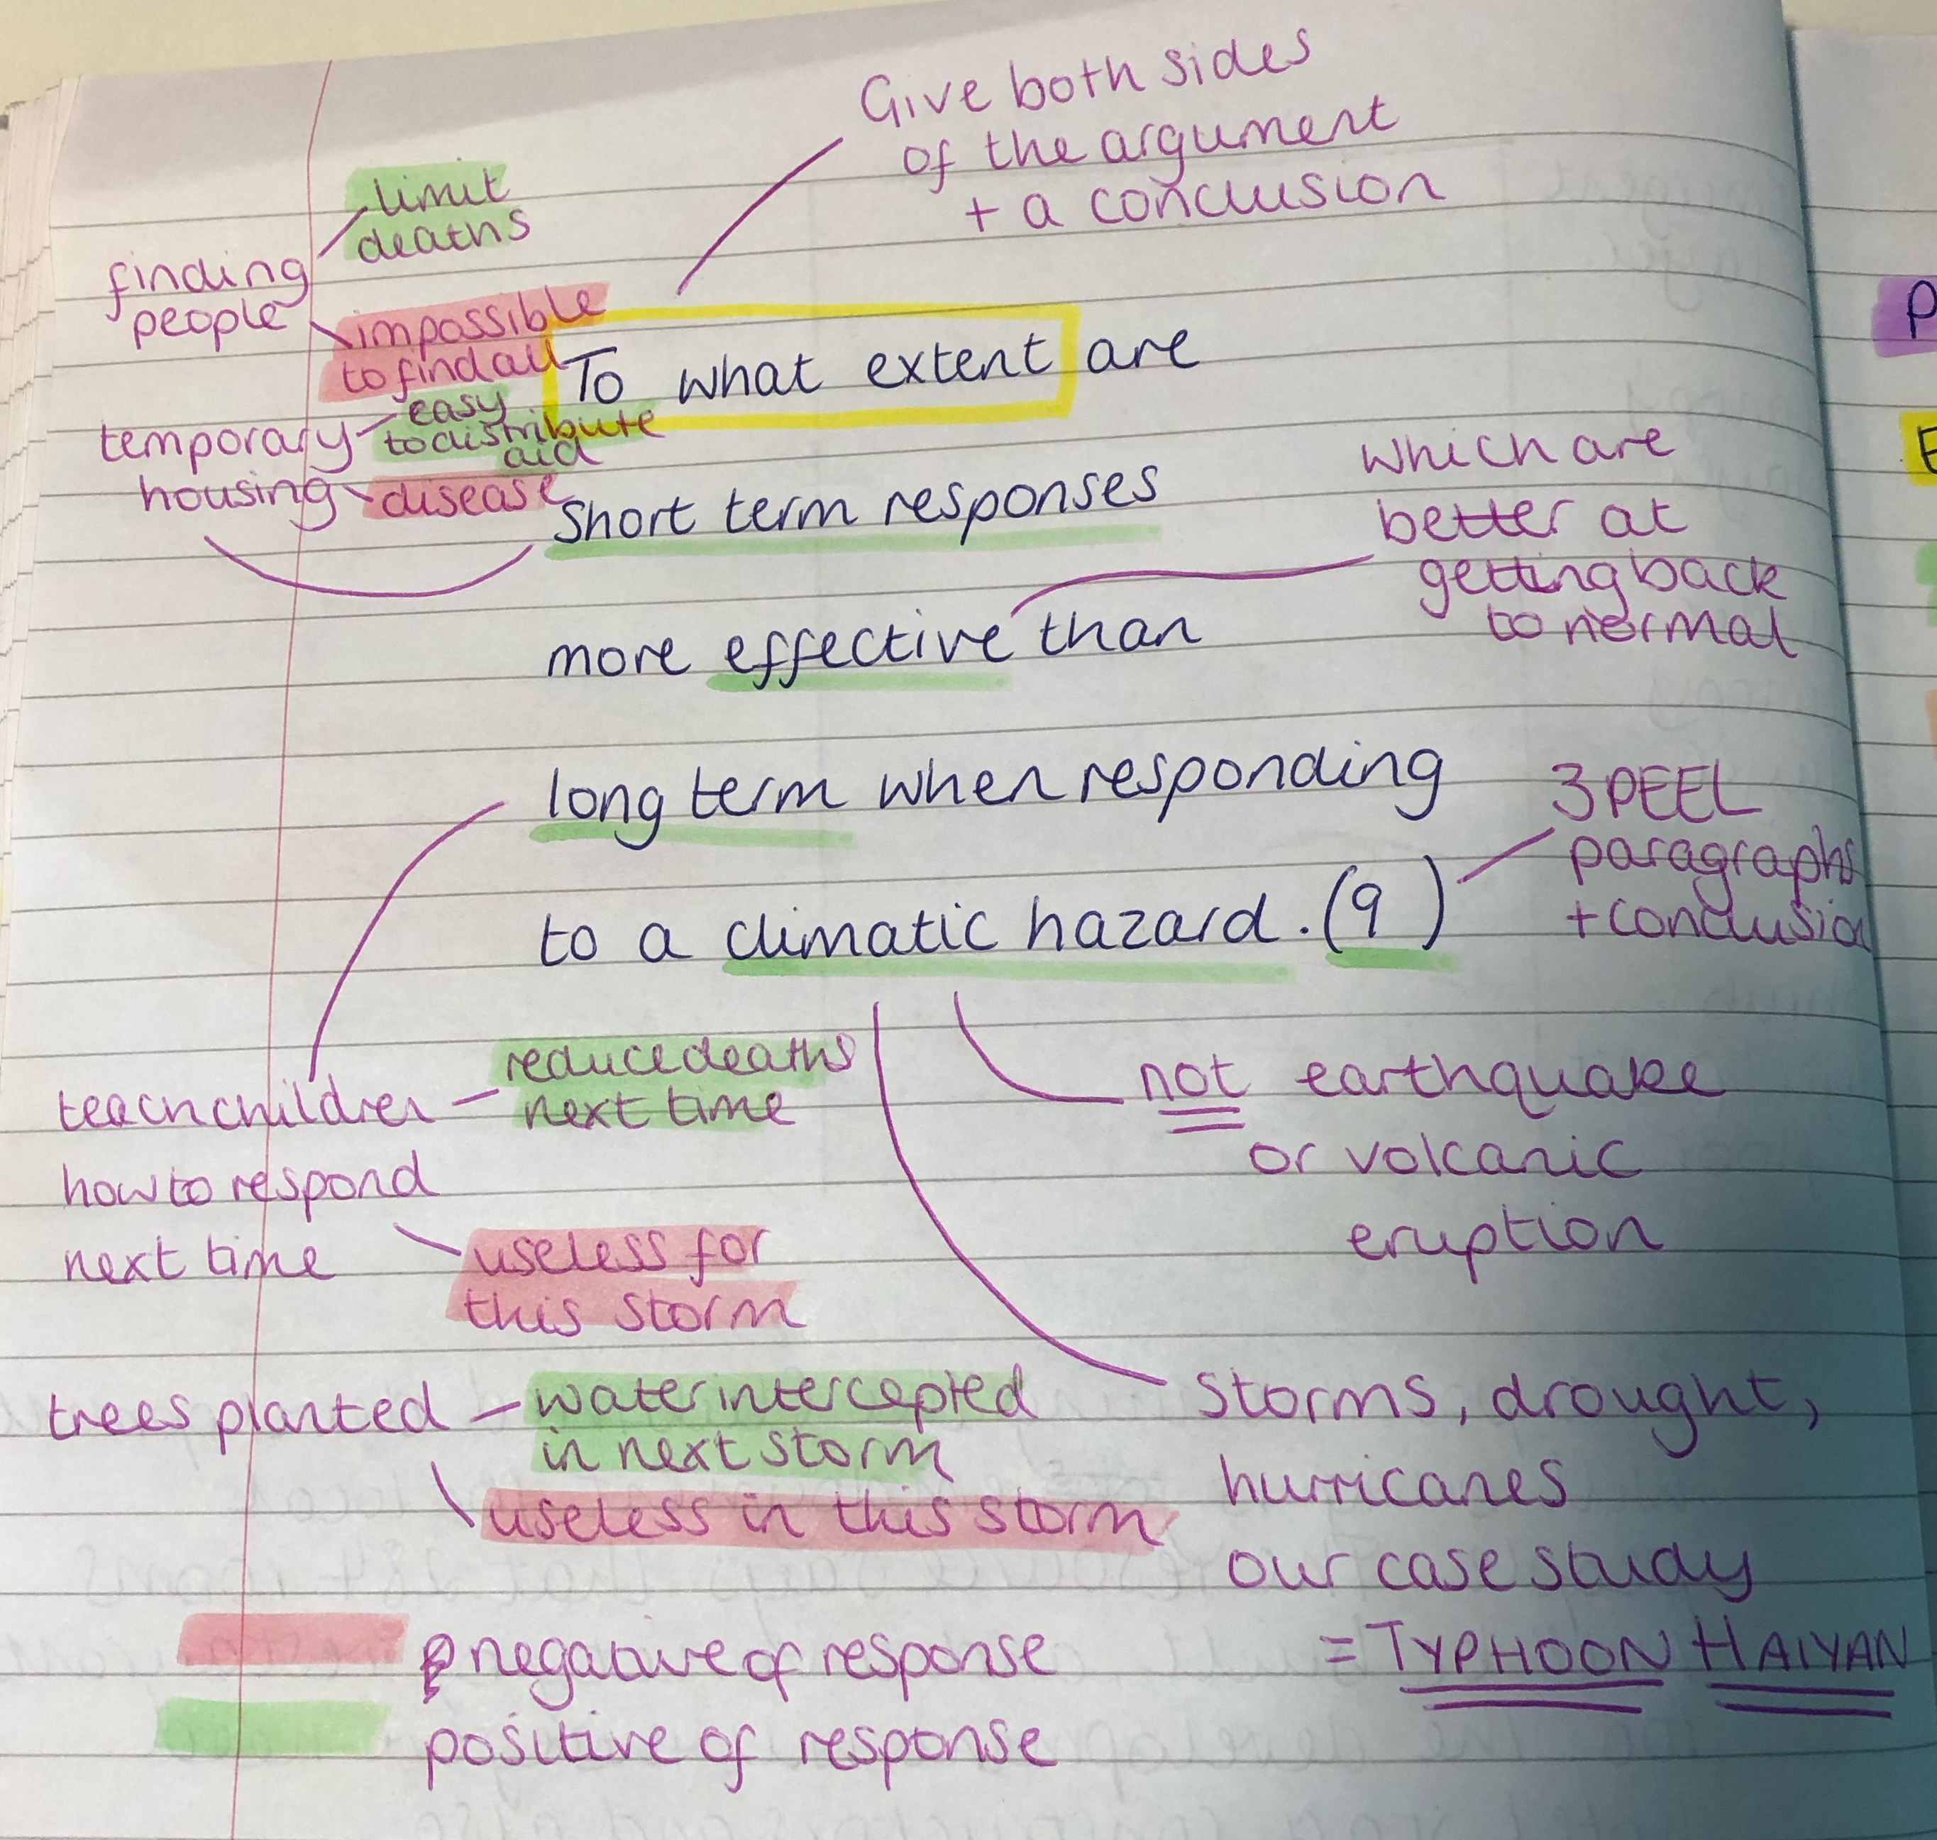
BUG-ing the question
Benefits
Language acquisition: Enables students to understand and simplify Tier 2 and 3 language
Challenge misconceptions: Address any misunderstandings for all students
Recall: Requires students to draw on previously learned content
Notes:
7 mins

Slide 4
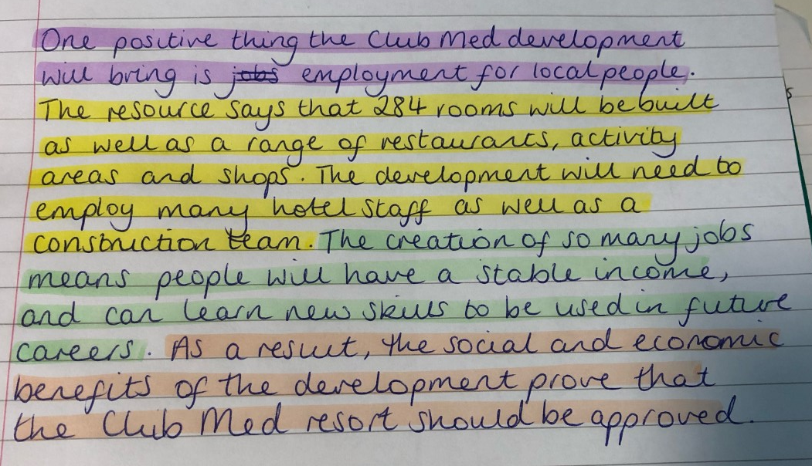
Teamwork writing
BUG question
Share ideas for each part of PEEL so all have a good plan.
Bounce around the room asking for full sentences.
Ask questions and address misconceptions- can we improve that? Does anyone want to swap any words?
Write the paragraph out and leave on visualiser. All students now have a PEEL plan and a ‘perfect paragraph’ that they have written.

Slide 5
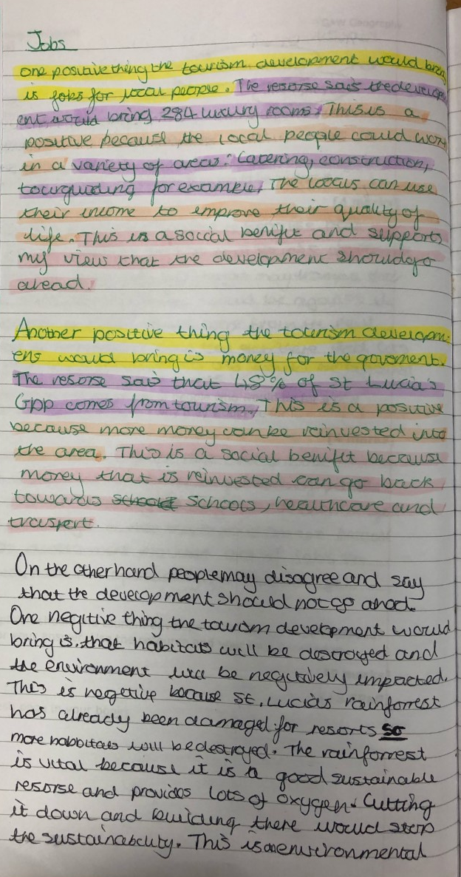
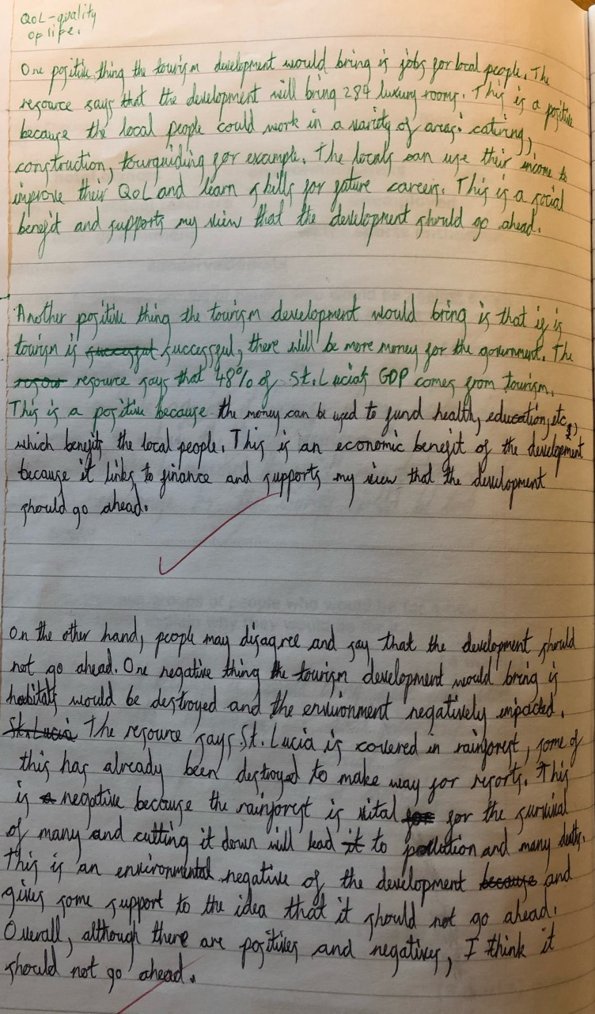
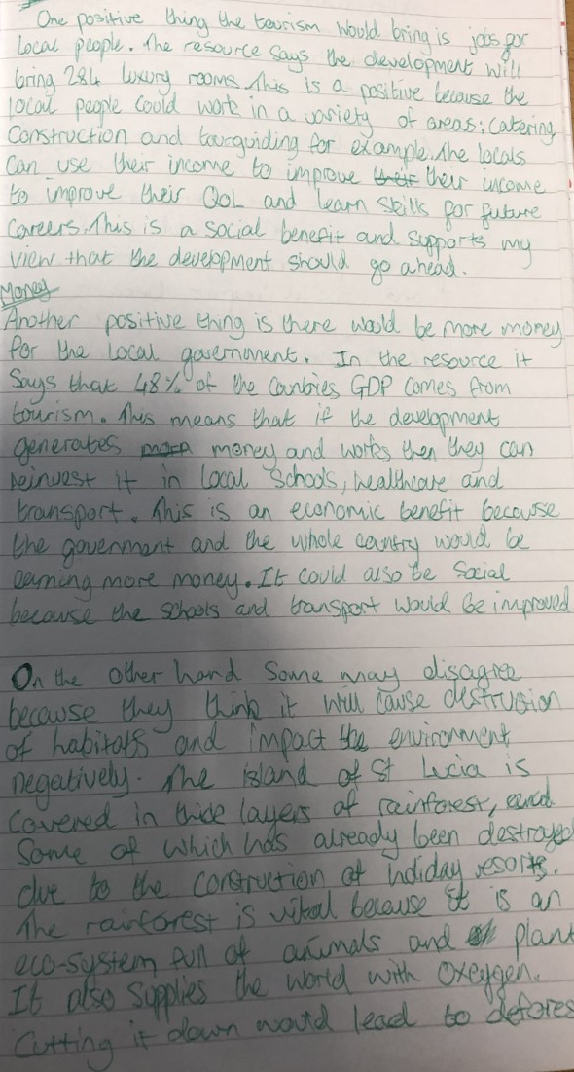
Teamwork writing

Slide 6
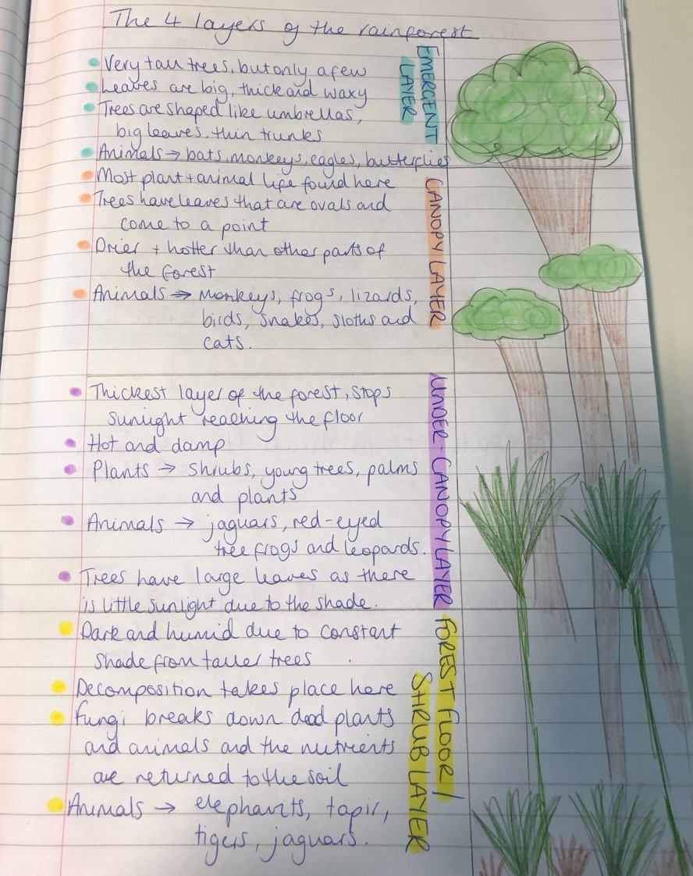
Other uses
Working alongside students to improve pace

Slide 7
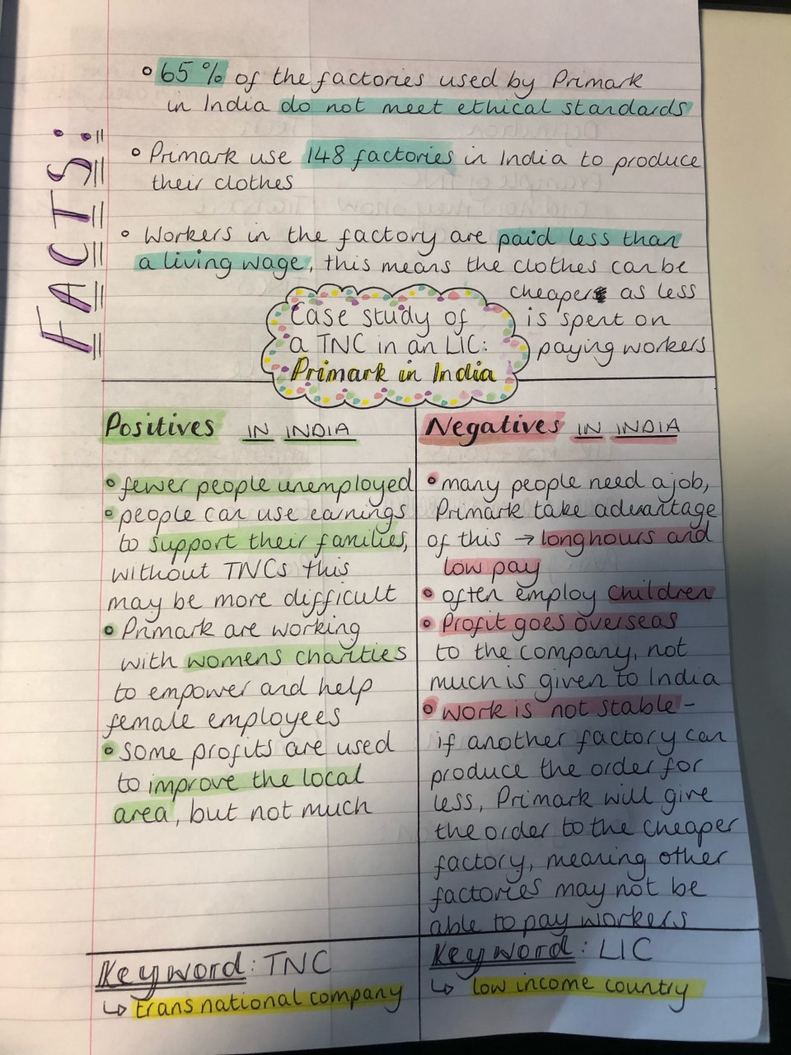
Other uses
Modelling revision techniques

