Slide 1
Opportunities and challenges of the Rub’ al-Khali
Learning Goals
Identify the opportunities and challenges faced in developing a desert environment.
Apply key information to support ideas.

Slide 2
Adaptions - recap
Command word: to ‘explain’ you should give reasons for. Using the PEE structure helps with this. You should make TWO different points.
Focus: this question is asking you to look at a plant OR an animal. You need to choose one and know something about them.
Explain how a plant or animal has adapted to the desert environment.
Point
Evidence
Explain
Evidence: this question is all about adaption, so you need to talk about how a named plant or animal has adapted.

Slide 3
Peer/self-marking
Use this check list to assess your/your partner’s answer. Use it also to write feedback.
Were there two separate points?
Were both points for a plant/animal?
Were the points named (i.e. the Arabian Fox)
Were the points developed to explain how they adapt to the desert environment?

Slide 4
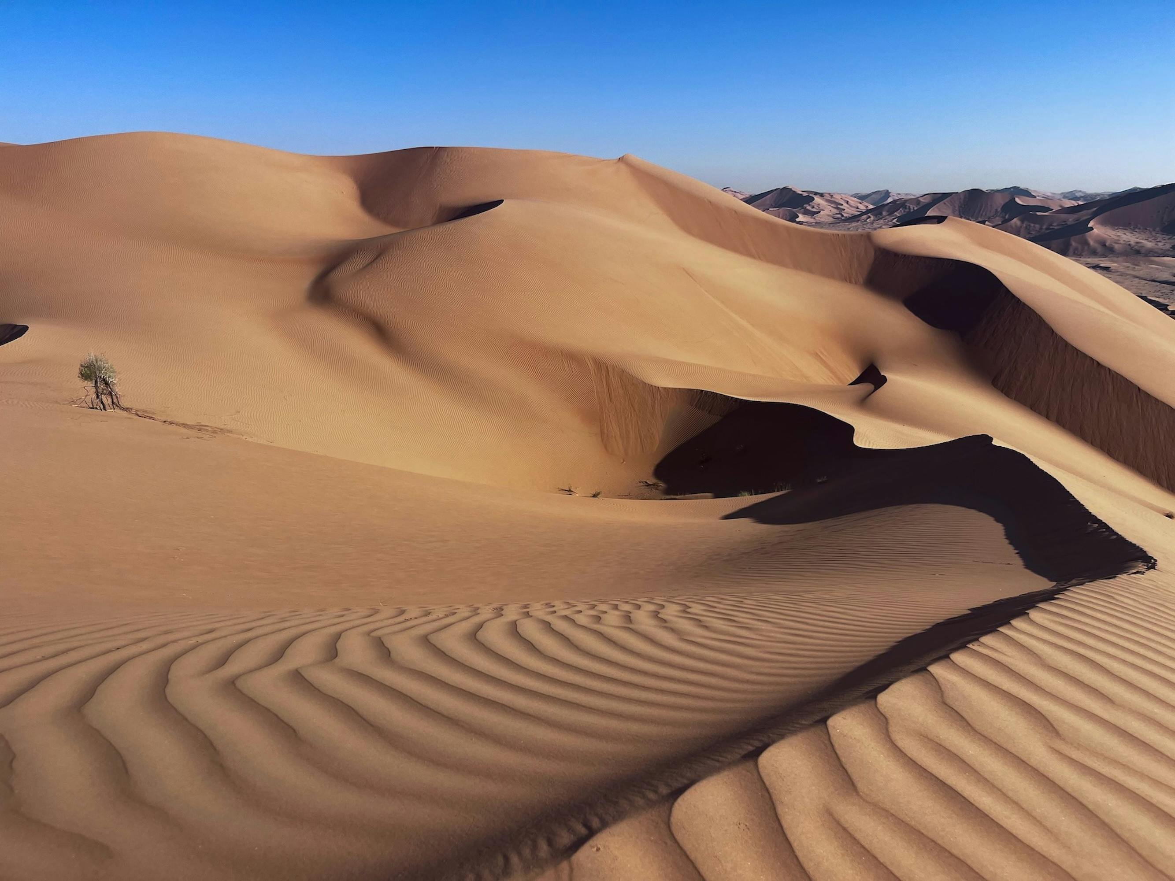
Rub’ al-Khali
The Rub’ al-Khali (or the Empty Quarter) is a vast desert biome in the southern Arabian Peninsular and can be found in all four of the Arabian countries in the region: Saudi Arabia, Oman, Yemen and the UAE.
It is approximately 650,000 km².
It is one of the driest regions in the world and is sparsely populated.
Two oil fields have been found in the Saudi Arabian part of the Rub’ al Khali.
Image Credit: Franck Lemozy, Pexels
What are the potential opportunities and challenges for this place?

Slide 5
Card sort
Look at the cards you have and separate them into opportunities and challenges.
Split them further into sub-categories covering social, economic and environmental.
Rank your cards from most to least important.
Choose your top two opportunities and challenges and summarise them in your notes.

Slide 6
Exam question
Evaluate the opportunities and challenges facing a named desert environment.
Introduction: 2 short sentences, 1 to define opportunities and challenges, 1 to introduce the place (Rub’ al Khali)
Opportunity (paragraph 1) Point Evidence Explain | Challenge (paragraph 2) Point Evidence Explain
Conclusion: are there more opportunities than challenges or via versa?
Connectives and sentence starters However, on the other hand, for example, this is because, one opportunity/challenge.

